Slide 1

How Children’s Learning is
Supported in the Primary School
Children and Young People’s Services
SEND Implementation Team

Slide 2

The role of parents
As a parent you know your child better than anyone else.
You hold key information about your child.
You contribute to the shared view of your child’s needs and the best way to help them with their learning both at home and in school.
Share with us what you think we need to
know.

Slide 3

Open and honest communication
We will always listen to your concerns.
If we can, we will offer you advice and
support or advise you where to go to get the help you
need.
We will always involve you in decisions to be made about your child’s needs in school.
We will ask your permission if we think advice is needed from outside the school to help your child.

Slide 4

The voice of the child
Young children depend on the adults around them to share important information about them that will allow their needs to be fully met.
Children also have a unique view of their needs and abilities and should be helped to express their opinions about things that affect them in school.
The school will ensure that your child will be listened to and that their views will be valued and responded to.

Slide 5
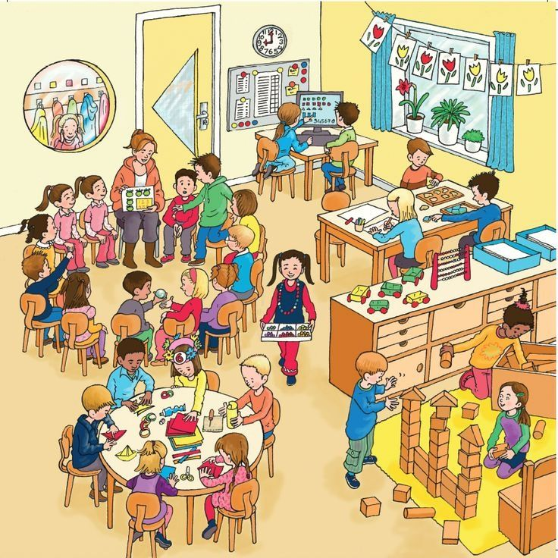
Meeting the needs of learners
Children have different skills, abilities and interests.
Children make progress at different rates.
Children learn best in different ways.
Please don’t compare your child with
others. Instead, praise them for trying
their best. This will build their
confidence.

Slide 6
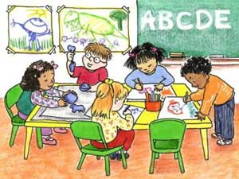
Supporting individual differences
Don’t worry if your child is provided with different work or activities from their classmates as this normal throughout schools.
Children learn differently and teachers are highly skilled professionals who will use a wide range of approaches to help the children learn best.
Teachers adapt lessons, the classroom,
materials and activities for the children.
In education this is called
differentiating the curriculum.

Slide 7
What to do if you are concerned about your child’s progress
As your child moves through school, their progress is monitored and their teachers will build up a picture of their interests,
skills and abilities.
Many children experience difficulties with aspects of
their learning from time to time but only a small number
may have Special Educational Needs.
Many factors can impact upon a child’s progress in school. For example, changed home circumstances, illness or friendship fall-outs.
Always let the school know if you are aware of anything that is
upsetting your child or if you are concerned about their progress.

Slide 8

What the school will do
The school will have clear procedures about who you should speak to if you have concerns about your child. Speak to the class teacher in the first instance who may refer you to Mrs Davidson, our Learning Support Co-ordinator.
The school will address any concerns you may have and will also advise you on how you can help your child at home.
Please be aware that home and school are very different environments and have different routines, structures and expectations. As a result, your child may present very differently at home and in school.
The school can only act upon their observations of how your child behaves, interacts or performs within the school environment.

Slide 9

What to expect if the school is concerned about your child’s progress
The school will take actions to address any difficulties children experience in school.
If school interventions are not working, and your child is not making expected progress, we will contact you to plan the best way forward.
The school will always tell you if they think
your child has Special Educational Needs
and should be on the school’s SEN Register.

Slide 10

The SEN register
Only the school can determine who should be
placed on the school’s SEN register.
Teachers have a professional responsibility to meet children’s needs in school.
They must act upon their observations of the child in school and on the results of any school assessments.
The school is unlikely to respond to recommendations in external reports if they do not match their professional judgement.

Slide 11

What is meant by Special Educational Needs (SEN)?
In the 1996 Education Order a child is described as having special educational needs (SEN) if they have significantly greater difficulty in learning or a disability that prevents access to school facilities.
Their SEN calls for special educational provision to be made that is additional to or otherwise different from what the other children of a similar age receive in an ordinary school.
If the school thinks that your child needs special educational provision they will be placed on the school’s SEN Register and Mrs Davidson Learning Support Co-ordinator (LSC) will arrange provision and monitor their progress on an individual education plan (IEP).

Slide 12

What’s important for learning
School is fun!
I can do some things for myself.
Everyone is different, it’s important I try my best.
Mistakes are learning opportunities.
Happy children learn best!

