Slide 1
2D Shapes
N
- MATHS TOPICS KS2 -

Slide 2

2D Shape
What is a 2D shape?
2D shapes have sides and angles (sometimes called corners) and are completely flat.
2D means ‘2 dimensional’.
This means these shapes only have 2 dimensions- height and width.
You can easily draw a 2D shape on a piece of paper.
height
width
Examples of 2D shapes include..
square circle triangle rhombus pentagon
2D Shape

Slide 3
2D Shape
3 straight sides.
3 angles.
What shape is this?
How many sides and angles does it have?
side
angle / corner
An angle is where two sides meet.
2D Shape

Slide 4
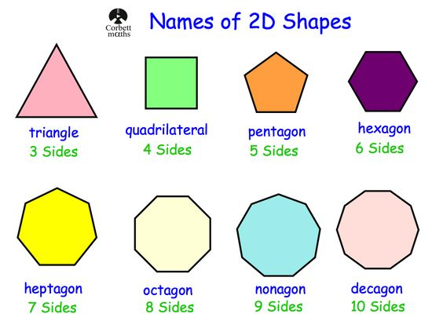
2D Shape
Common 2D shapes
Watch this video: https://youtu.be/7k1raqv-9yk
2D Shape

Slide 5
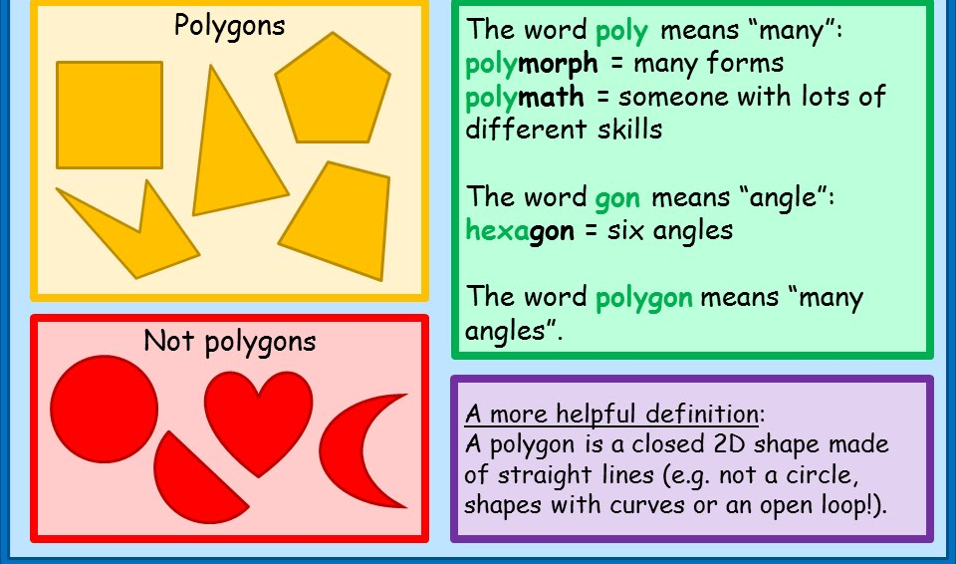
2D Shape
What is a polygon?
A polygon is a flat shape with 3 or more straight sides.
2D Shape

Slide 6
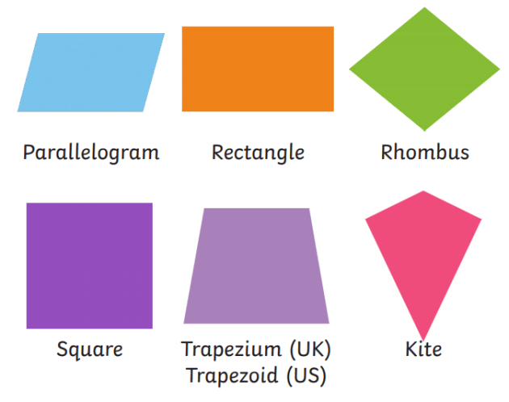
2D Shape
What is a quadrilateral?
A quadrilateral is a shape with 4 sides.
Here are some examples:
2D Shape

Slide 7
2D Shape
Properties of quadrilaterals
2D Shape

Slide 8
2D Shape
What is a right angle?
One straight horizontal line
MEETS a straight vertical line to make a corner.
The angle is 90°.
2D Shape

Slide 9
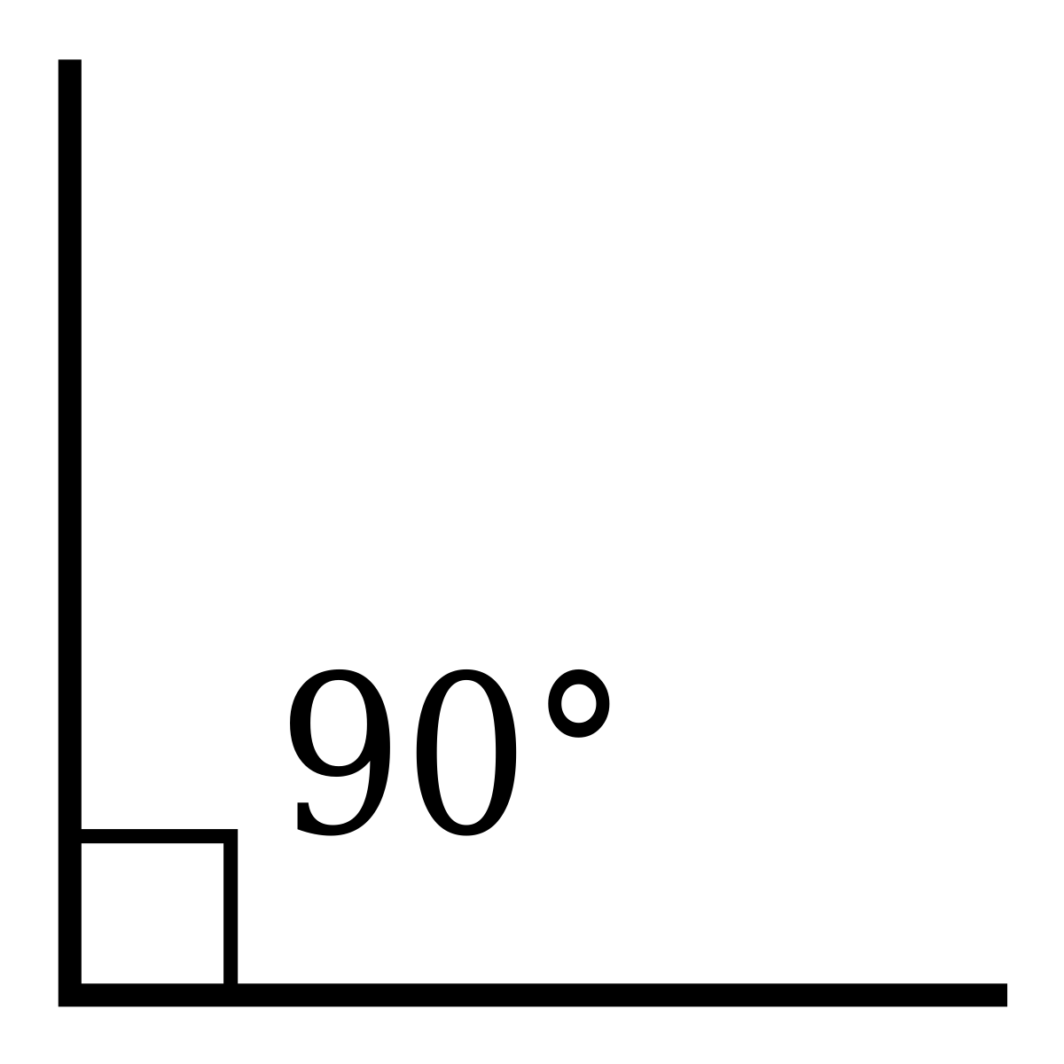
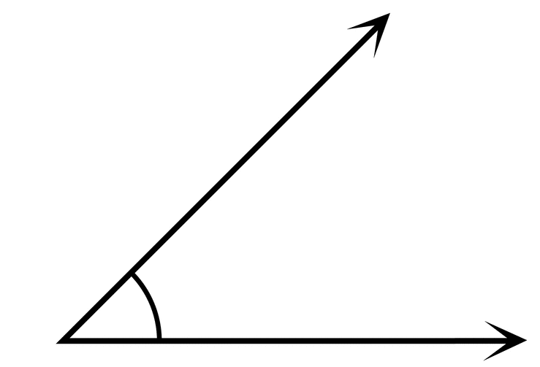
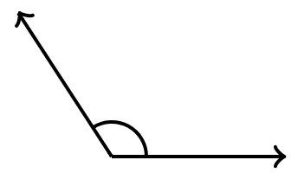
2D Shape
What is a right angle?
Right angle
This angle is less than a right angle.
This angle is more than a right angle.
2D Shape

Slide 10
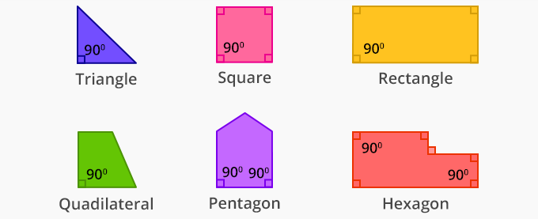
2D Shape
Right angles in shapes
2D Shape

