Slide 1

P2 Overview

Slide 2
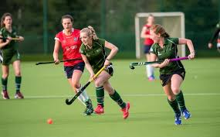


A bit about me..
Erin Carson
1st year at A.P.S.
Studied Sports Studies at University of Stirling then PGCE Primary at Ulster University
Particular interest in PE and Sport

Slide 3
P2
“Primary school Years 1 and 2 make up the Foundation Stage. Children build on the learning experiences that they bring to school from home and/or pre-school. They learn through well-planned, challenging play that develops their interests, curiosity and creativity.”

Slide 4
Key Areas of Learning
Literacy
Focus on developing language and literacy skills;
RWI phonics programme (yellow sounds book);
Guided Reading using Storyworld scheme.
Numeracy
Focus on developing understanding of numbers up to 20;
Addition & Subtraction within 10 and beyond;
2D and 3D shape;
Measures;
Handling Data.
The World Around Us
Me and My Senses;
Food, Glorious Food;
Pirates;
Houses & Homes;
The Outdoors.
Other Areas of Learning: RE, PDMU, The Arts, PE, ICT.

Slide 5
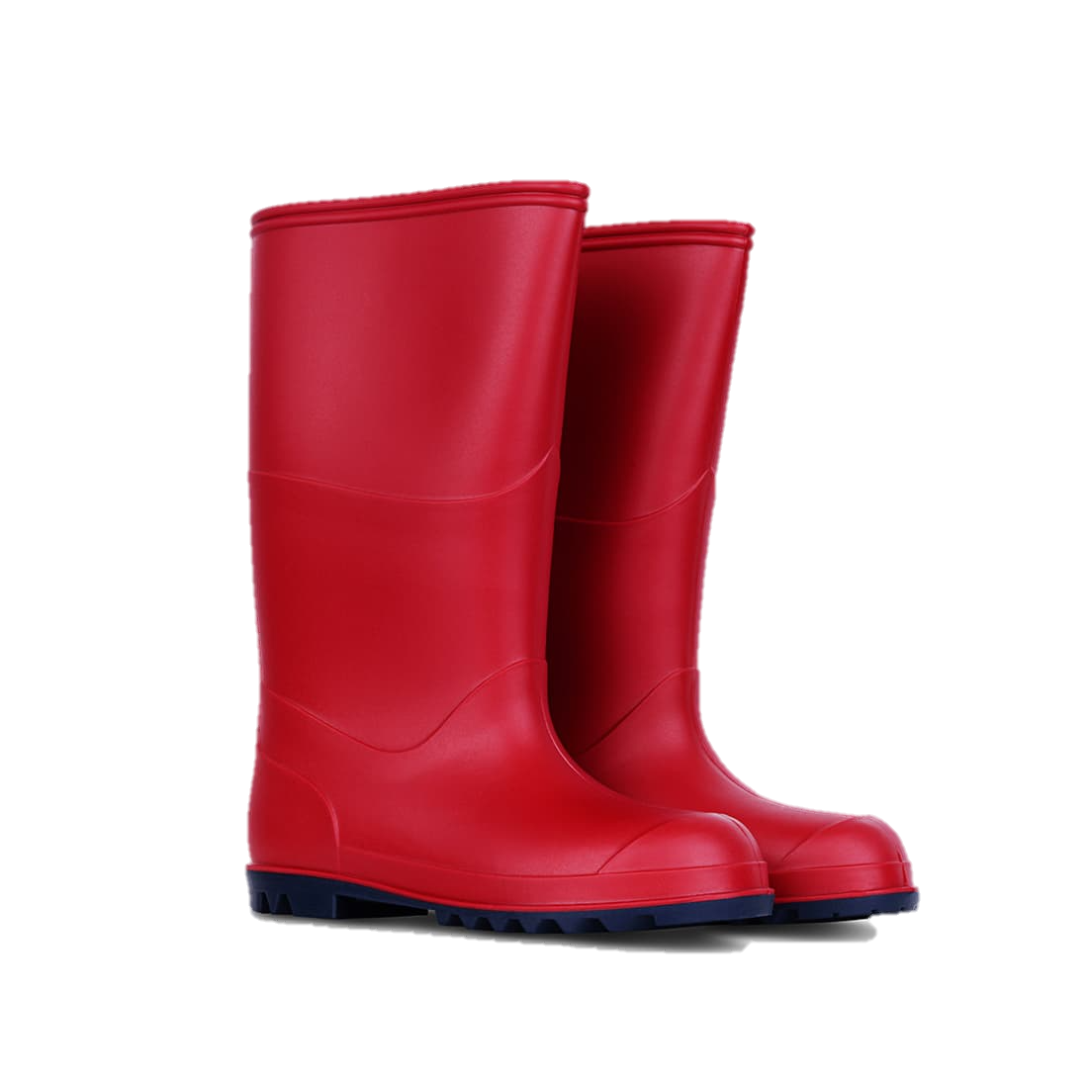


What your child will need..
To stay in school:
Stationery;
Water bottle (water only during day);
Wellies;
PE shoes / gutties
(don’t change for PE).
Important details:
Dinner money: School Money app – to be paid by Sunday for week ahead
Please ensure their folder is packed every day;
Consider packing break items that your child can open themselves (grapes);
Please ensure belongings are named!

Slide 6


Class Expectations
Listen to each other
Raise our hands to speak
Keep our hands and feet to ourselves
Be kind to others
Line up properly

Slide 7
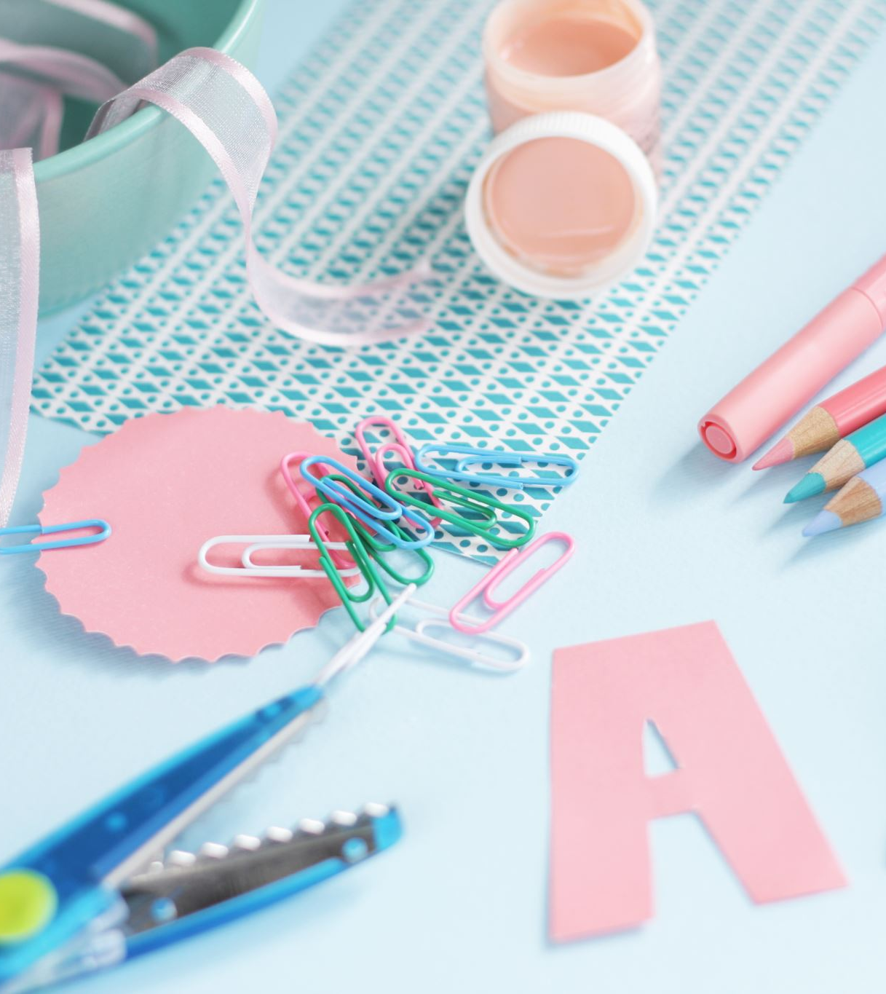
Class Routines
Morning routine
When I'm finished…
Play rotation
Class helpers etc
Table stationary
Rewards

Slide 8
Homework
Homework Policy on website;
1 written homework;
1 page of handwriting practice;
Spellings later in year (Jan-June);
Mental Maths Facts (Jan-June).
Reading homework 2 books per week, set on Mondays and Wednesdays.
Homework set on Monday and submitted by Friday.
Please sign written homework!

Slide 9
Weekly overview
 | Monday | Tuesday | Wednesday | Thursday | Friday
9.00– 9.45am | Carpet time Weekend News | Carpet time TWAU | Carpet time Numeracy | Carpet time TWAU | Assembly
9.45 – 10.25am | Guided Reading (MC) | RWI with MC | Guided Reading (MC) | RWI (RC) | RWI with RC
10.25-10.55am
11.00 – 11.45 am | PE (15 mins) Numeracy | PE (15 mins) Numeracy | Outdoor play (until 11.25am) Music | PE (15 mins) Numeracy | Numeracy
11.45am-12.25pm | Handwriting | ICT (from 12pm) | RE | ICT (from 12pm) | Garden PBL (11.30-12pm)
12.25-1.10 pm
1.10 – 2.00 pm | Play BL Story | Circle time (library) | TWAU Story | Play BL Story | PDMU Story

Slide 10
Staying in touch
Class teacher should be first point of contact for all matters, excluding child protection issues.
Send a note;
Email or telephone Mrs Brush, who will pass on your message or arrange a telephone consultation / meeting;
Check class page on our school website for photographs!
*Please inform us if you are not collecting your child from school / they are leaving with a different adult.
*Please send a note detailing the days on which your child will be getting the bus home from school.
*Ensure any medication is brought to the school office with the necessary form. This can be found on our school website.

Slide 11
I look forward to a fun & busy year!
Any questions?

