Slide 1
Symmetry
N
- MATHS TOPICS KS2 -

Slide 2

Symmetry
What is ‘symmetry’?
An object, shape or design can be said to be symmetrical if a line can be drawn through the middle, such that the two halves are mirror images of each other.
For example, a butterfly has symmetry. If you drew a line down the middle of the butterfly, both sides would be the same.
Lines of symmetry can be horizontal, vertical or diagonal.
Symmetry

Slide 3
Symmetry
What is ‘symmetry’?
Watch these useful videos on symmetry:
https://youtu.be/2rWx9JLHCdE
https://www.bbc.co.uk/teach/class-clips-video/maths-ks2-finding-lines-of-symmetry/zktfgwx
Symmetry

Slide 4

Symmetry
Symmetry of 2D Shapes
A 2D shape is symmetrical if a line can be drawn through it and either side is a reflection of the other. You would call this the line of symmetry.
If you put a mirror on this line, you would see the whole shape in the reflection. That’s why a line of symmetry is sometimes called the mirror line.
Sometimes, you can fold a shape in half, if it fits into itself perfectly with no overlaps, then you have found a line of symmetry. Some shapes have more than one line of symmetry.
Let's look at some 2D shapes and their lines of symmetry.
Symmetry

Slide 5
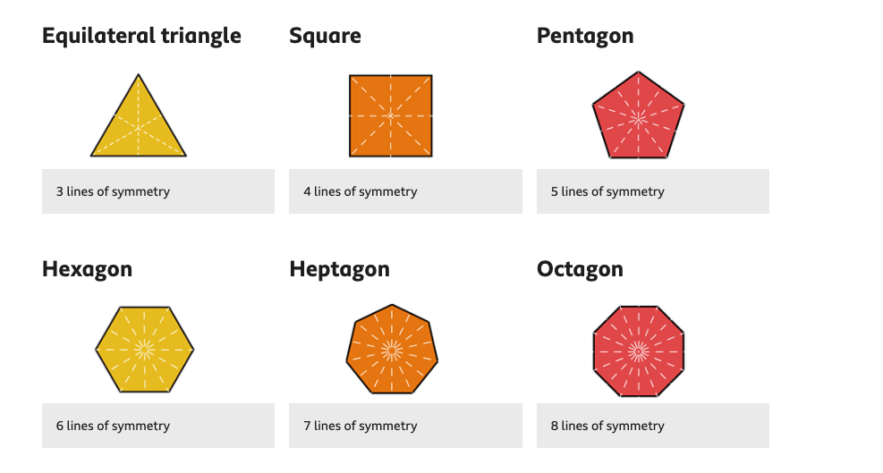
Symmetry
Symmetry of Regular Polygons
Regular polygons
These are shapes that have all equal sides and equal angles.
The number of lines of symmetry in a regular polygon is always the same as the number of sides!
Take a look at these examples:
CAN YOU SEE A PATTERN?
Symmetry

Slide 6
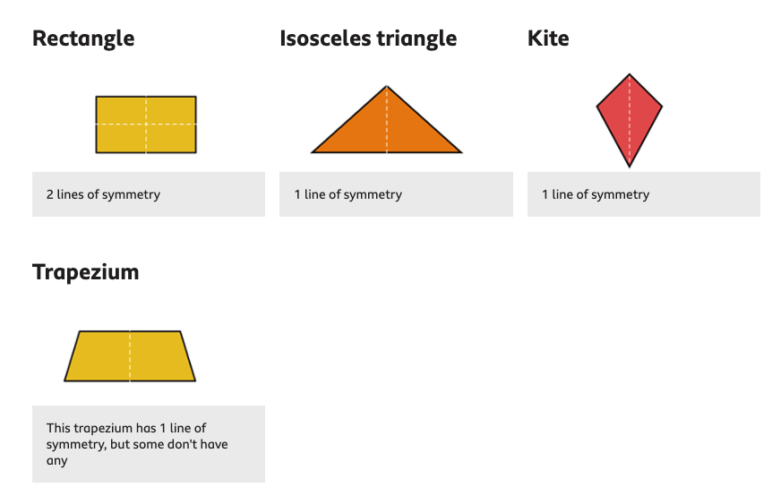
Symmetry
Symmetry of Irregular Polygons
Irregular polygons
These are shapes that have sides and angles of different sizes. Some irregular polygons also have lines of symmetry.
Take a look at these examples:
Symmetry

Slide 7
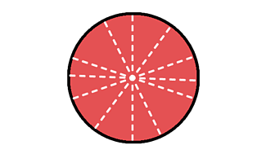
Symmetry
CIRCLES
Even though a circle isn’t a polygon, it is still a 2D shape. As long as the line of symmetry goes directly through the centre of the circle, it has unlimited lines of symmetry!
Watch this video to find out more about symmetry in 2D shapes:
https://www.bbc.co.uk/bitesize/topics/zrhp34j/articles/z8t72p3
Symmetry

