Slide 1

Maths Mastery
Negative Numbers

Slide 2
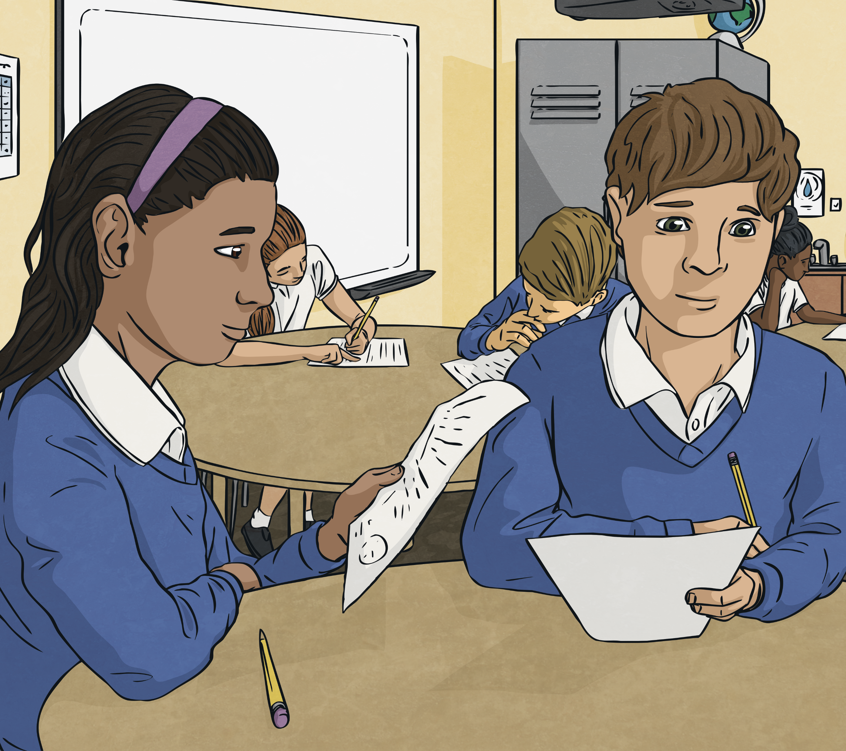
Counting Negatively
Work with a partner.
Challenge your partner by asking them to count by giving:
Starting number
Step
Direction
e.g. Count in 2’s, from 5, backwards:
5, 3, 1, -1, -3, -5, -7…..
A good challenge is one where your partner gets most correct, but may need to really think.

Slide 3
True or False
Giving reasons, explain whether the following are true or false:
Seven less than four is minus three.
True
-7 + 12 = -19
False - the answer is 5. The answer goes through 0, so +7 to 0, and +5 more to 5.
False - the answer is 12. The answer goes through 0, so +4 to 0, and +12 more to 12.
False - the answer is 24⁰C. The answer goes through 0, so -7 to 0 is 7, and 0 to 17 is 17. 7 + 17 = 24.
16 more than -4 is -12.
The temperature is -7⁰C outside and 17⁰C inside. The difference is 10⁰C.
Show Answers
Hide
Answers
Create your own similar questions for a partner.

Slide 4
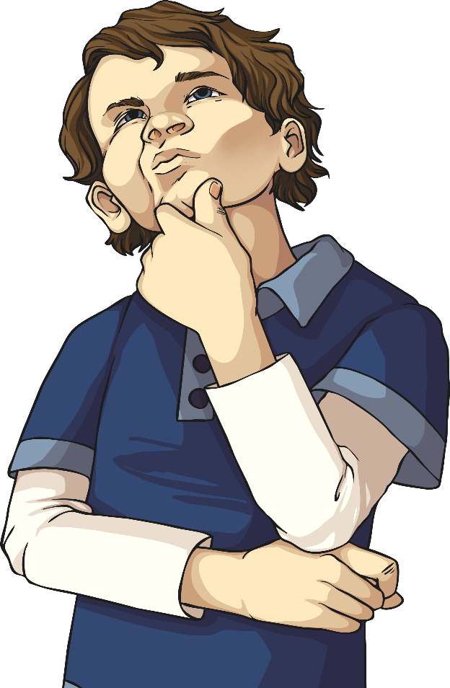
Order it
Order the following numbers from smallest to largest:
34, -23, 14, -12, 41, -2, -24, 13
9⁰C, -7⁰C, -9⁰C, 3⁰C, -5⁰C, 0⁰C, -12⁰C
45, 67, -23, 28, -12, 78, -59, -1
Write some positive and negative numbers for a partner to order.
-24, -23, -12, -2, 13, 14, 34, 41
-12⁰C, -9⁰C, -7⁰C, -5⁰C, 0⁰C, 3⁰C, 9⁰C
-59, -23, -12, -1, 28, 45, 67, 78
Show Answers
Hide
Answers

