Slide 1

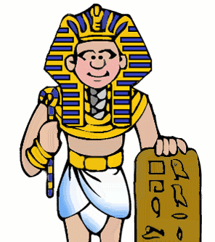
Ancient Egypt

Slide 2
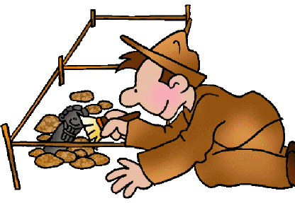
Become an Egyptologist!
An Egyptologist is somebody
whose job it is to find out about Ancient Egypt.
Throughout this topic, we are going to find out lots of interesting facts about life in Ancient Egypt.

Slide 3
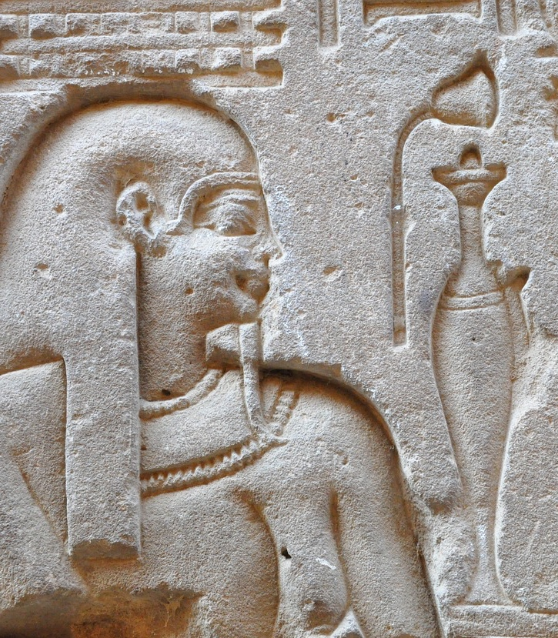
Who were the Ancient Egyptians?
This came up in last week’s Literacy!
Ancient: from a time long ago
Egyptian: from a country called Egypt
People lived in early settlements around the River Nile in Egypt from around 7000 years ago, and the Ancient Egyptian civilisation started to grow around 3100 BC.
The Ancient Egyptian civilisation is considered one of the greatest in history, known for its inventiveness and power. It lasted for just over 3000 years.
https://www.bbc.co.uk/bitesize/topics/zg87xnb/articles/z6x2382/ - watch this introductory video

Slide 4
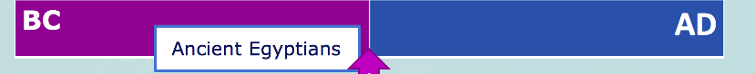
When did the Ancient Egyptians live?
Look at the timeline. It is split into 2 sections: BC and AD. These sections show the time before and after historians started recording history around the time of the birth of Jesus.
For this history topic we will be focusing on the BC section of this timeline. We will focus in from the time of the first pharaoh around 3100 BC to the time the Romans invaded in 31 BC and Egypt became part of the Roman Empire.
Where would you place other history units you have studied on the timeline?

Slide 5
Where is Egypt?
Egypt is a country in the north-east corner of Africa.
The climate is hot and dry, with plenty of desert. A large and important river called the Nile runs through Egypt.
Egypt
Can you locate any other countries on the world map? Which ones are closest to Egypt? Which are furthest away?

Slide 6
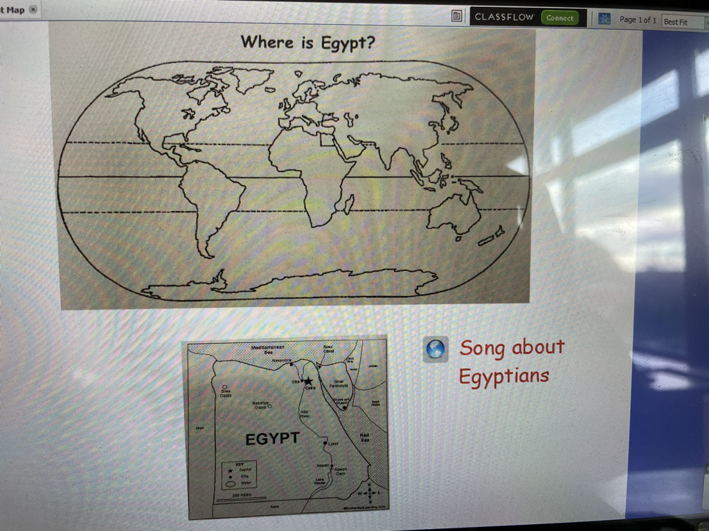
N.I
Egypt

Slide 7
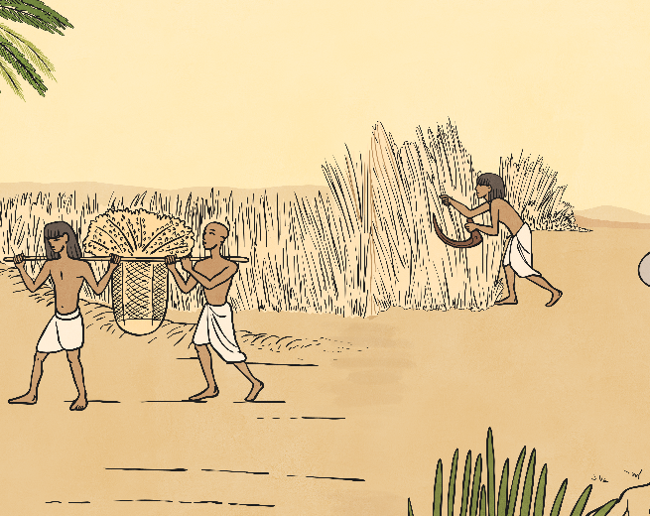
Ancient Egypt
Over 90% of Egypt is covered by desert, which was often referred to as the Red Land and was not easily habitable. The River Nile was a major influence on the daily lives of the people.
In ancient times, most of the population occupied the area on the banks of the river, the Kemet or Black Land, named after the dark silt that remained when the flood waters receded. This was where the farmers grew their crops.
https://www.bbc.co.uk/teach/class-clips-video/history-ks2-introducing-ancient-egypt/z6jrkmn - watch this video.

