Slide 1
Beginning Decimals
N
- MATHS TOPICS KS2 -

Slide 2

Beginning Decimals
What are decimals?
Decimals are parts of whole things;
They are a bit like fractions but we
write them in a different way.
Decimal numbers have a decimal point.
This separates the whole numbers (on left) from the part numbers (right).
‘Decimal’ means ‘ten’.
N
Beginning Decimals

Slide 3
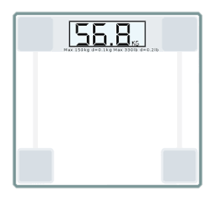
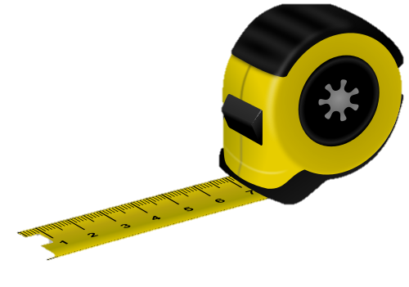


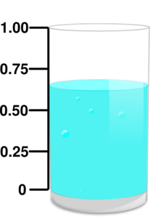

Beginning Decimals
Everyday decimals:
2.354
£1.99
N
Beginning Decimals

Slide 4

Beginning Decimals
Place Value
Look at this number…
This is also equal to:
What is the value of each digit?
8 2 1 4
. 2
THOUSANDS
HUNDREDS
UNITS
TENS
TENTHS
N
Beginning Decimals

Slide 5
Beginning Decimals
One tenth ¹/₁₀ 0.1 | Two tenths ²/₁₀ 0.2 | Three tenths ³/₁₀ 0.3 | Four tenths ⁴/₁₀ 0.4 | Five tenths ⁵/₁₀ 0.5 | Six tenths ⁶/₁₀ 0.6 | Seven tenths ⁷/₁₀ 0.7 | Eight tenths ⁸/₁₀ 0.8 | Nine tenths ⁹/₁₀ 0.9 | One ¹⁰/₁₀ 1.0
N
Beginning Decimals

Slide 6
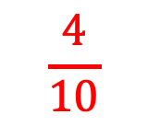
Beginning Decimals
Decimals of shapes
^{What fraction is shaded?}
$$\frac{4}{10}$$
N
Beginning Decimals

Slide 7

Beginning Decimals
Decimals of shapes
^{What decimal is shaded?}
$$\frac{4}{10}$$
0.4
WATCH -
https://www.youtube.com/watch?list=PLBKqAzM4hQF7LqMkrKm1B_PRttg4sa4SD&v=WgrTBxKbrgk&feature=emb_logo
N
Beginning Decimals

Slide 8
Beginning Decimals
What decimal fraction is shown?
= 0.3
0.3
0.6
0.8
N
Beginning Decimals

Slide 9
Beginning Decimals
What decimal fraction is shown?
0.1 | 0.1 | 0.1 | 0.1 | 0.1 | 0.1
= 0.6
0.3
0.6
0.8
N
Beginning Decimals

Slide 10
Beginning Decimals
What decimal is shown?
0
0.1
0.2
0.3
0.4
0.5
0.6
0.7
1
0.3
0.6
0.7
N
Beginning Decimals

Slide 11

Beginning Decimals
Where do these decimals appear on the number line?
0
0.3
0.4
0.7
0.9
1
0.2
0.6
0.5
0.8
0.1
N
Beginning Decimals

Slide 12
N
- MATHS TOPICS KS2 -

