Slide 1
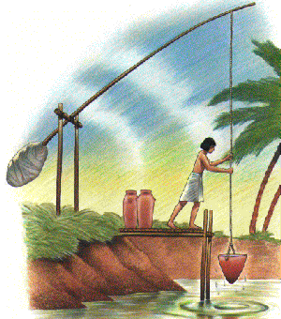
A Shaduf
Egyptian farmers use shadufs to get water from the river to dry land.
The bucket is dipped into the river,
and the weight on the other end of the "see-saw" makes it easy to lift the water.

Slide 2
How to make a model
Shaduf

Slide 3
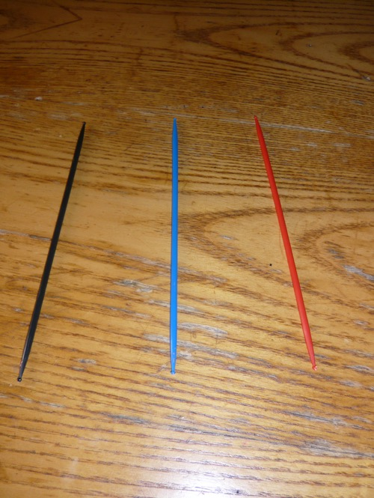
Take 3 sticks

Slide 4
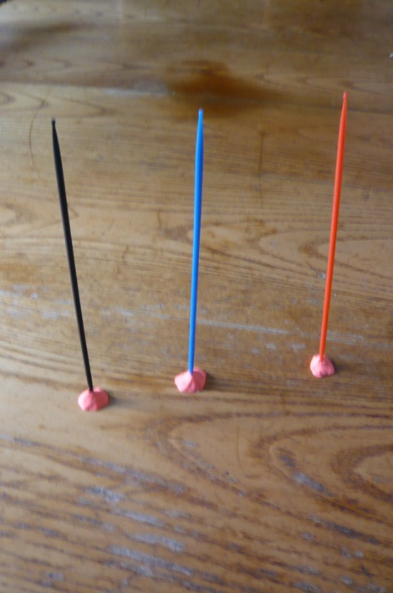
Put a ball of play-dough
on the end of each stick

Slide 5
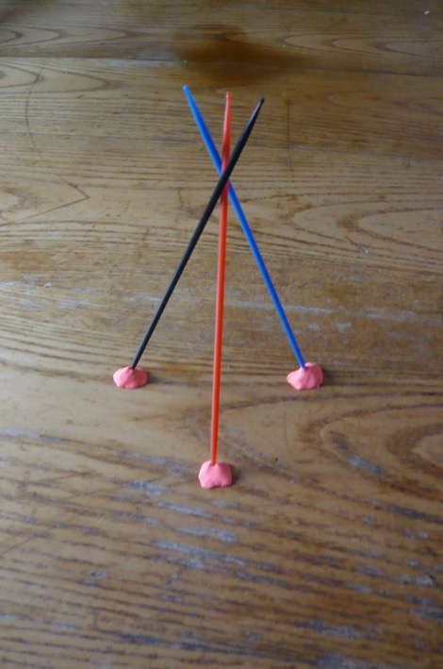
Stand the sticks up like a wig wam

Slide 6
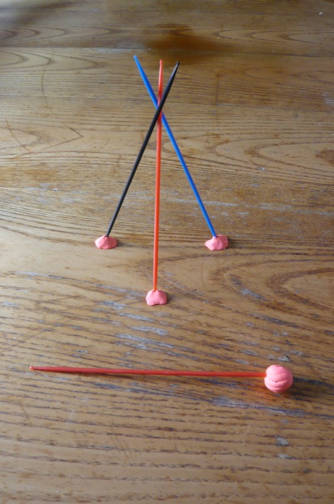
Take another stick and put some
play-dough on one end.

Slide 7
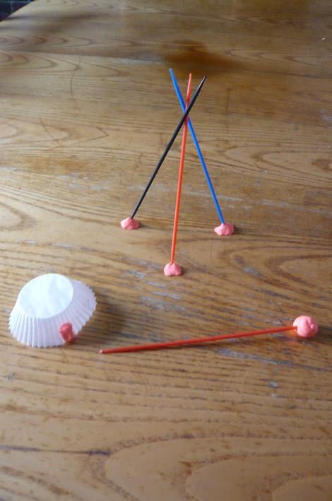
Take a bun case and put some
play-dough on the side

Slide 8
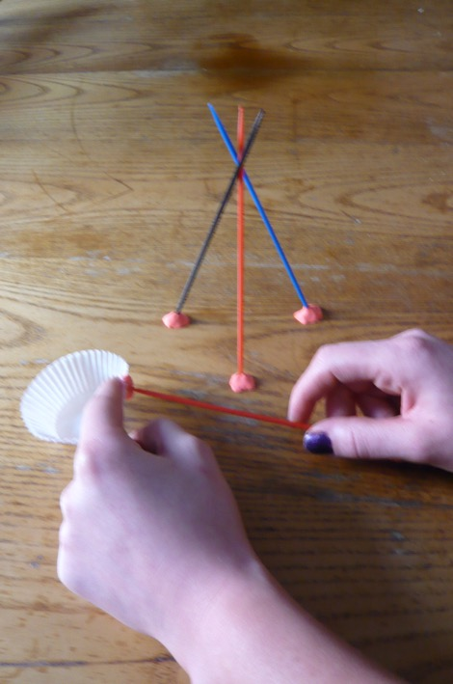
Attach the stick to the bun case
using the play-dough

Slide 9
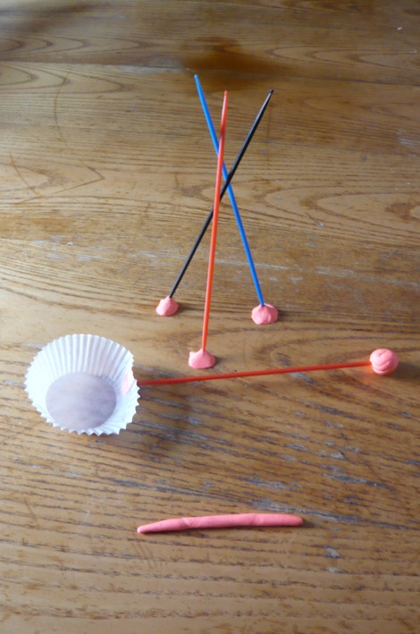
Roll out a piece of play-dough

Slide 10
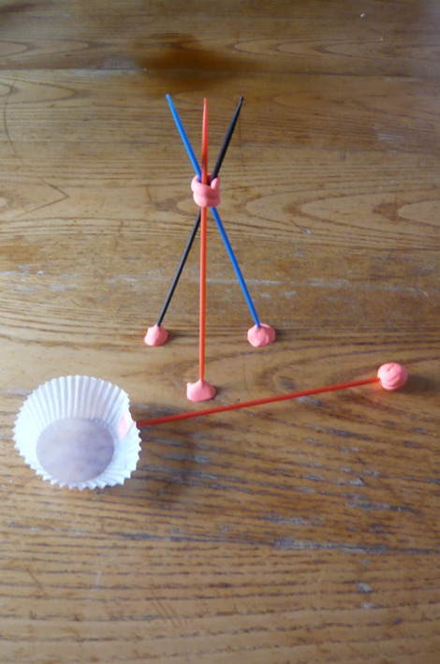
Wrap it around the
wig wam structure

Slide 11
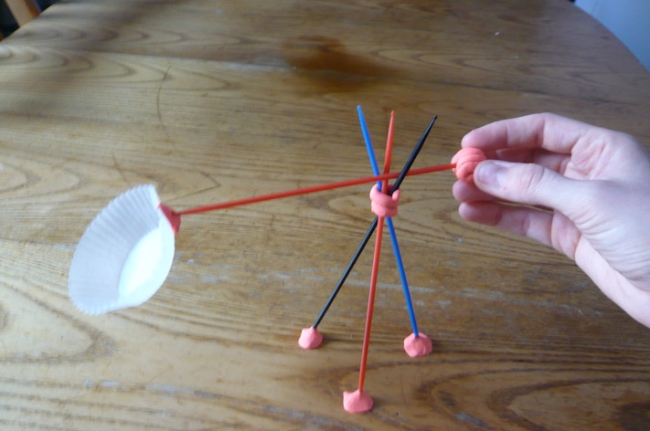
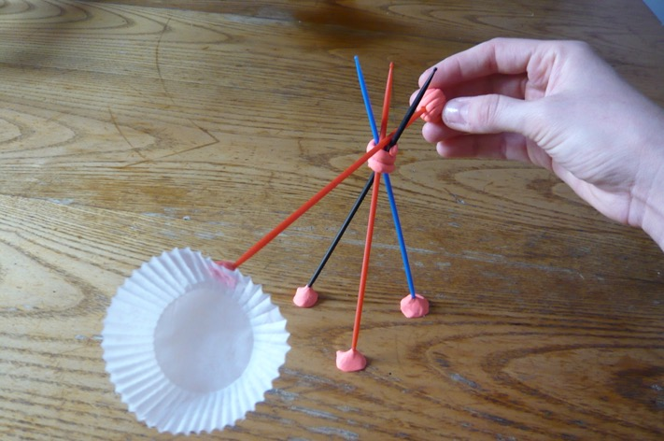
Now you can
use your shaduf!

