Slide 2

North America
Europe
Asia
Egypt
Africa
South America
Australia

Slide 3
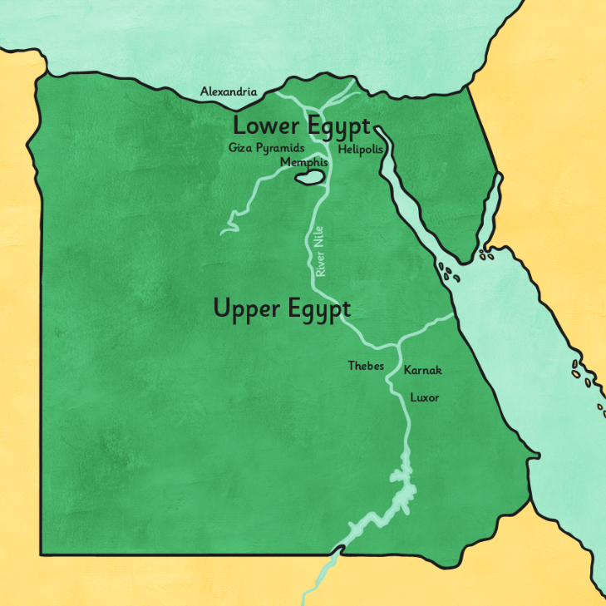
The Nile River
The Nile River runs through Egypt. Most people live along and around the Nile River.
The area around the Nile River is green. Crops can be grown in this area while the rest of Egypt is desert.
The people of ancient Egypt depended on the Nile to survive.

Slide 4
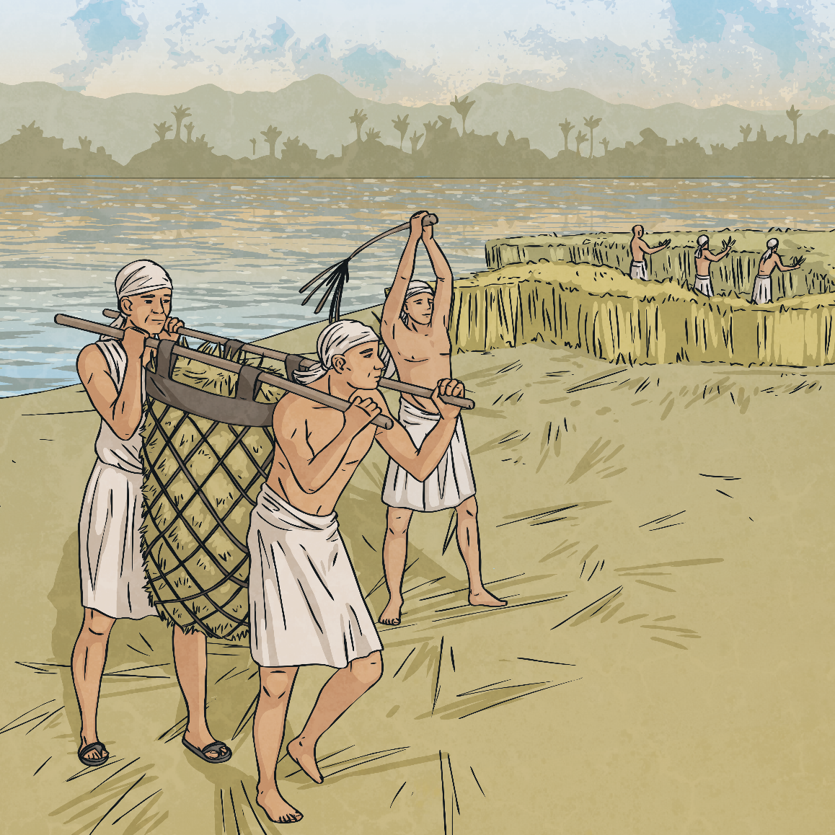
Floods
The Nile River would flood every year and leave behind a rich, black silt that fertilized the soil.
This was essential for growing food for everyone.
A system of canals that led from the Nile were also used to water fields in other areas. This is called irrigation.

Slide 5
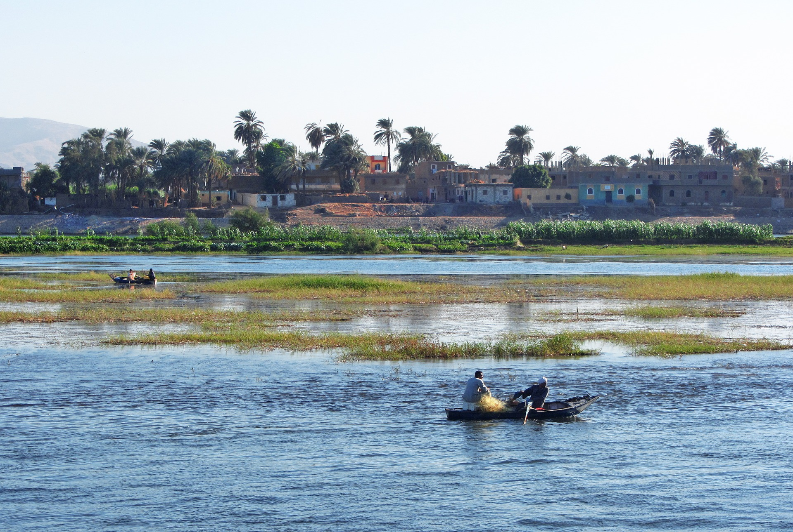
The Nile River

Slide 6
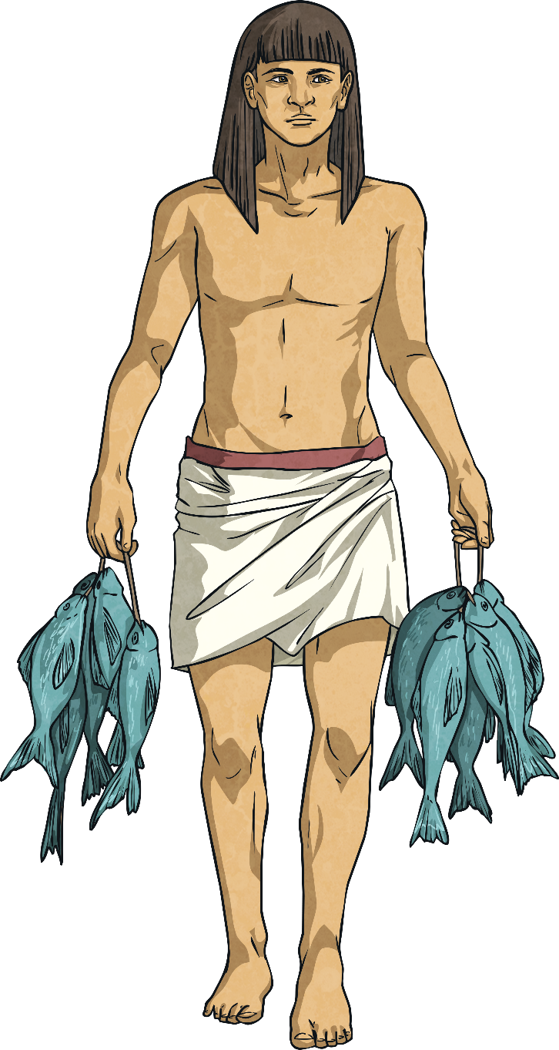
Crops and Food
The Egyptians grew wheat and barley as well as fruits and vegetables like melons, figs, peas, garlic, lettuce, and cucumbers.
Flax was grown for making linen to make clothes.
The Nile was also important for fishing.
This was done in boats with nets.

Slide 7
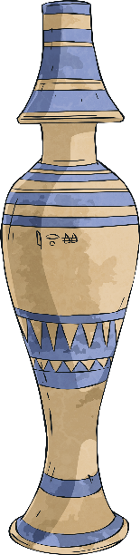
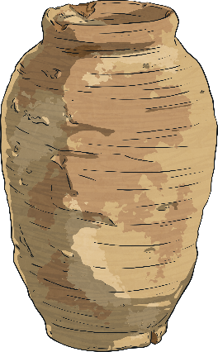
Transport and Trade
There was no such thing as money in ancient Egypt, so people would trade by swapping things like pottery, food, jewelry, art, etc.
Boats were used to travel up and down the Nile
to trade throughout the country.

Slide 8
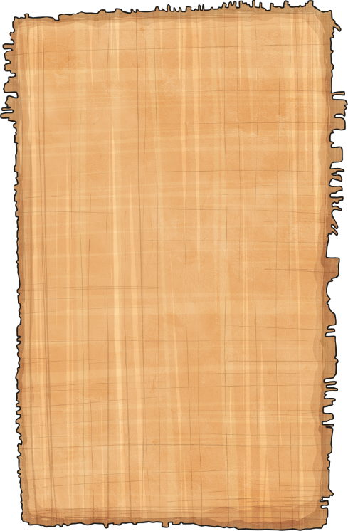
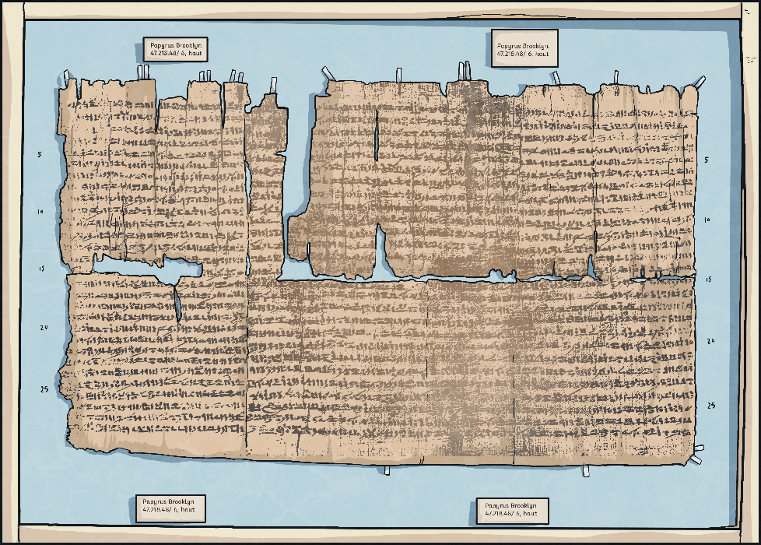
Building and Papyrus
Mud from around the Nile River would be used
to make bricks for building.
The papyrus plants around the river were used to make papyrus,
which was the paper of the ancient Egyptians.

Slide 9
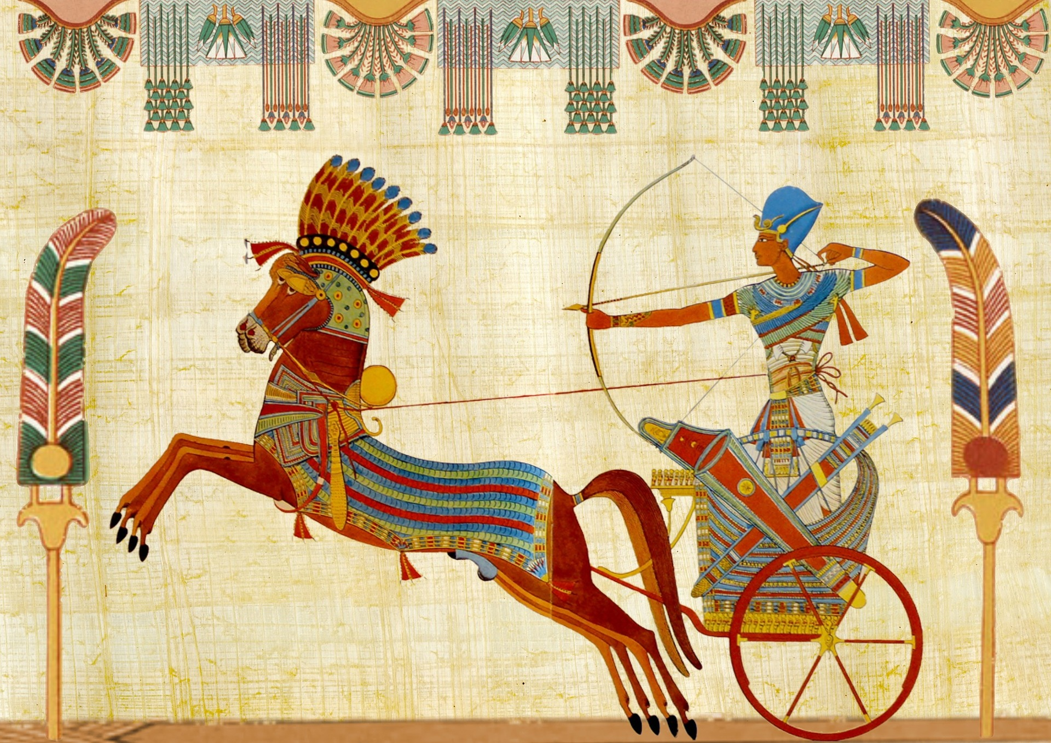
Papyrus

Slide 10
The Egyptian Calendar
The Egyptian calendar was based on the happenings of the Nile River.
It had three seasons, each one lasting four months:
AHKET
July – October, this was the flooding season
PERET
November – February, the fields were planted in this season
SHEMU
March – June, the crops were harvested

Slide 11
Watch these videos:
https://www.bbc.co.uk/bitesize/topics/zg87xnb/articles/zkkywty/
https://www.bbc.co.uk/teach/class-clips-video/history-ks2-the-river-nile/zkvmjsg

