Slide 2
Draw
Using a grid with coordinates, draw the following shapes where one corner is at the given coordinates, writing the coordinates of the other corners:
A rectangle (-8,1)
An isosceles triangle (7,-3)
A square (5,8)
A parallelogram (-7,-4)
Share your shapes with a partner. Do all your shapes meet the criteria correctly?
Challenge a partner to draw some shapes from one given corner.

Slide 3
Translate
Here are the coordinates of a rectangle: (-7,2), (-1,2), (-7,6), (-1,6).
The point (-7,2) translates to (2,-3).
To which coordinates do the other 3 points translate.
Check your answers by drawing the shapes on a coordinates grid.
Click for answer
(-7,6)
(-1,6)
Make your own questions on cards for others in your class, with a drawing showing the correct answer on the back.
(-7,2)
(-1,2)
(2,1)
(8,1)
(2,-3)
(8,-3)

Slide 4
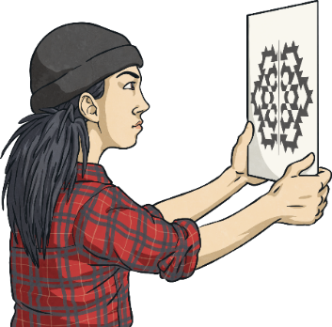
Reflect on the x-axis
This shape is drawn on the upper quadrants of a coordinates grid. Draw the complete grid on squared paper, copy the shape and reflect the shape on the x-axis.
y
Is it easier to keep the x-axis horizontal or to rotate it to the vertical?
Click for answers
It is useful to position the axis of symmetry vertically and hold the drawing vertically in front of your face.
x
Draw some of your own shapes on a grid for a partner to reflect on the x-axis.

Slide 5
Reflect on a Vertical Line
Here is a shape draw on a coordinates grid. It is reflected on a vertical line which passes through the point (2,0).
(1,6)
(3,6)
(-3,3)
(7,3)
(-3,-5)
(7,-5)
Write the coordinates of the reflected shape.
(1,-8)
(3,-8)
Click for answer
Create some of your own reflections about lines other than the x or y-axes.

