Slide 2
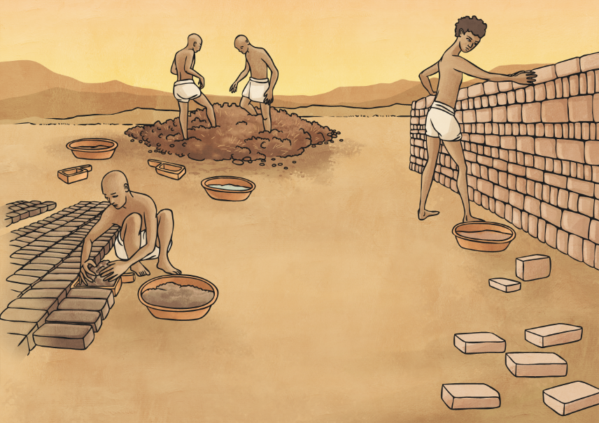
What Were Ancients Egyptian Houses Made Of?
Almost all of Egypt is a desert, and in ancient Egypt they needed to use any fertile land for growing crops. This means that there weren’t that many trees for building houses. The Egyptians had to use whatever they had around and that included mud and reeds.
Early in Egyptian history, the people made huts for their houses out of mud and papyrus reeds. Houses built close to the edge of the River Nile,
where water was accessible were a major problem. Each year at the time of the Nile flooding it would wash away the mud huts. They decided to start using the mud to create bricks, which were stronger than just plain mud.

Slide 3
What Were Ancients Egyptian Houses Made Of?
The bricks were created by mixing up mud with straw, placed in a form and then baked. Most bricks were not baked in an oven, although if they wanted the bricks to be extra strong, they might bake them. But mostly, bricks were dried in the sun. When they stacked the bricks up, they could make stronger walls and homes.

Slide 4
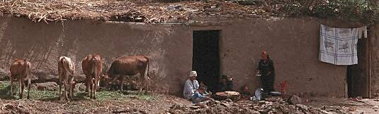
Average Ancient Egyptian Homes
Most people lived in villages, clustered along the banks of the River Nile. Village houses were built close together, for strength and security. The villages were surrounded by ditches and fields. Nearby was the bleak, endless desert; for the Egyptians this was the home of the dead.
The average home had four rooms– a central room with smaller rooms joined to it. A family spent most of their time in the central room and used it for sleeping quarters at night.
The rooms were generally spread over one or two floors. All homes had flat roofs. People often slept, cooked, and ate atop their houses’ flat roofs.

Slide 5
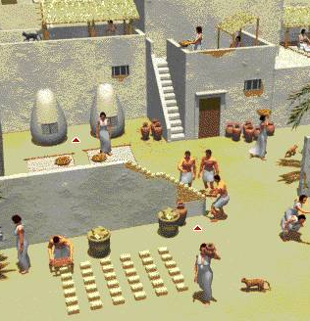
Middle Class Homes
The homes of the wealthy were made of double-thick walls that increased the security of the house.
They painted the outside of their homes white because it kept their homes cooler.
The very wealthy lined the outside of their homes with white limestone. Limestone was expensive but it made their homes sparkle in the sunshine.
Some of these huge homes had as many as 30 rooms.

Slide 6
Watch these video:
https://www.bbc.co.uk/teach/class-clips-video/history-ks2-introducing-ancient-egypt/z6jrkmn
https://www.bbc.co.uk/teach/class-clips-video/history-social-studies-ks2-daily-life-in-ancient-egypt/zfhtscw

