Slide 1
Northern
IRELAND

Slide 2
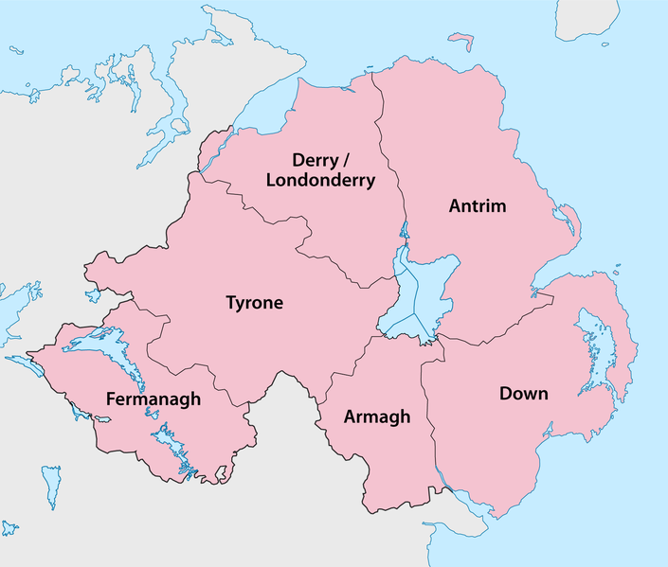
Northern Ireland is made up of six counties

Slide 3
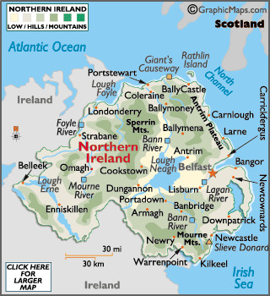
MAP SHOWING NORTHERN IRELANDS RIVERS & MOUNTAINS

Slide 4
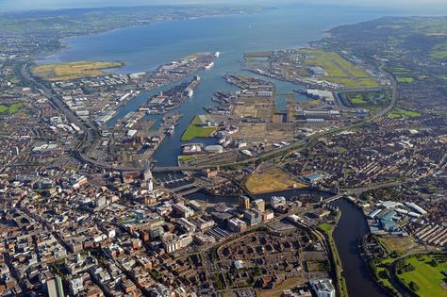
Belfast:
The population of Belfast is 280,211.
The area of Belfast is 115 km2.
Belfast is in Co. Antrim and Co. Down.
Belfast began in the early 17th century.
The province is Ulster.
The most famous tourist attractions; the titanic museum, Belfast castle, Belfast city hall and the Ulster museum.

Slide 5
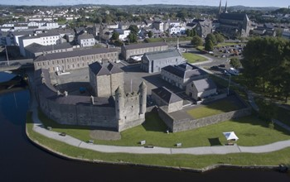
Co. Fermanagh:
The area of Fermanagh is 1,691 km2.
The population of Fermanagh is 62,527 since 2012.
The capital of Fermanagh is Enniskillen.
The province is Ulster.
The famous tourist attractions; the marble ach caves, Florence’s court and Enniskillen castle.
Fermanagh’s nickname is the Maguire county, the Lakeland county.

Slide 6
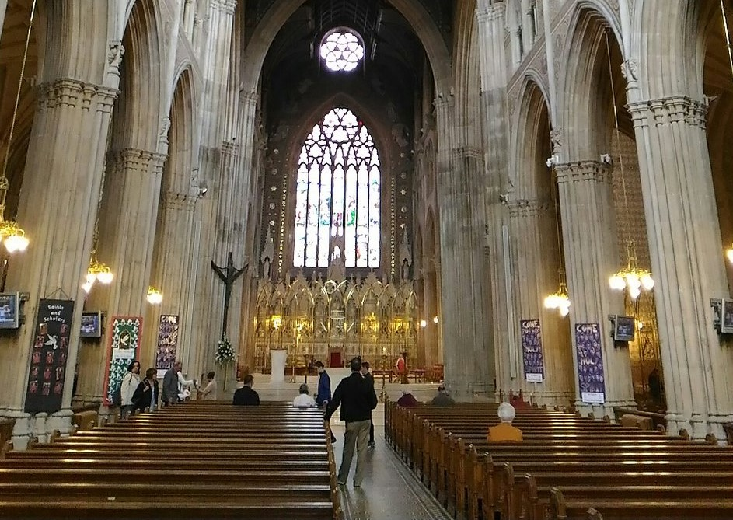
Co. Armagh:
The population is 174,792(2011).
The area is 1326km2.
The province is Ulster.
The county town is named Armagh.
Famous tourist attractions; Armagh city centre, St Patrick cathedral and the Milford house collection.

Slide 7
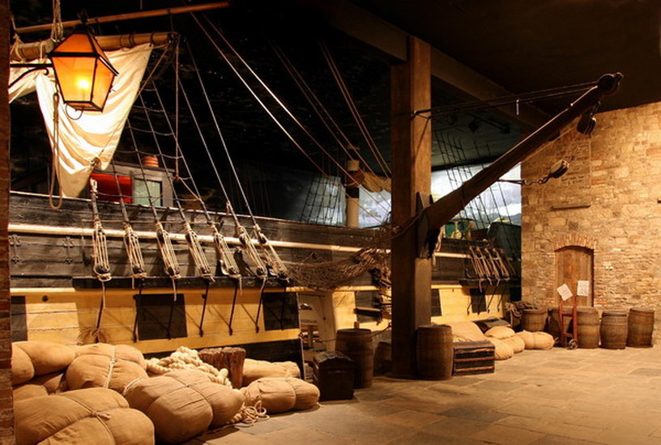
Co. Tyrone:
The population of Tyrone is 177,986 (2019).
The area of Tyrone is 1,260.0 sq ,mi (3,263km2).
the province is Ulster.
Tyrone’s nickname is the red hand county.
Famous tourist attraction; the Ulster Amercan folk’s museum, the Argory, palace stable hermitage centre, oxford island and Tayto castle factory.

Slide 8
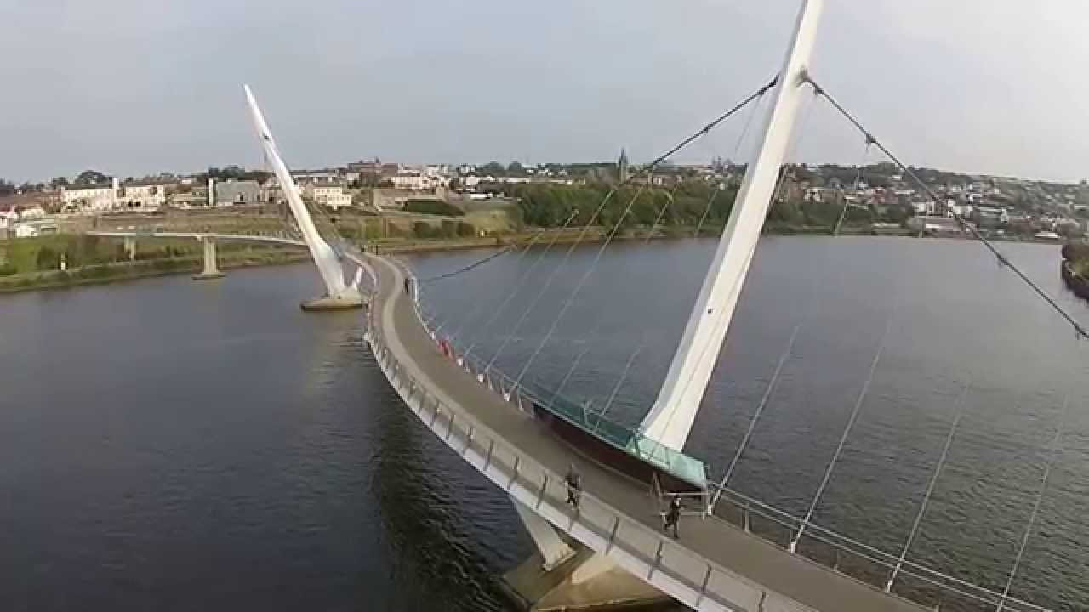
Co. Londonderry:
Londonderry is know as Derry.
The population is 247,132 (2011)
The area is 2074 km2.
The province is Ulster.
The tourist attractions: The 17th- Century walls, the story of the armada, the sunning guildhall, the open- air art, veiw from the peace bridge, the st columb’s cathedral and the Derry/Londonderry craft village.

Slide 9
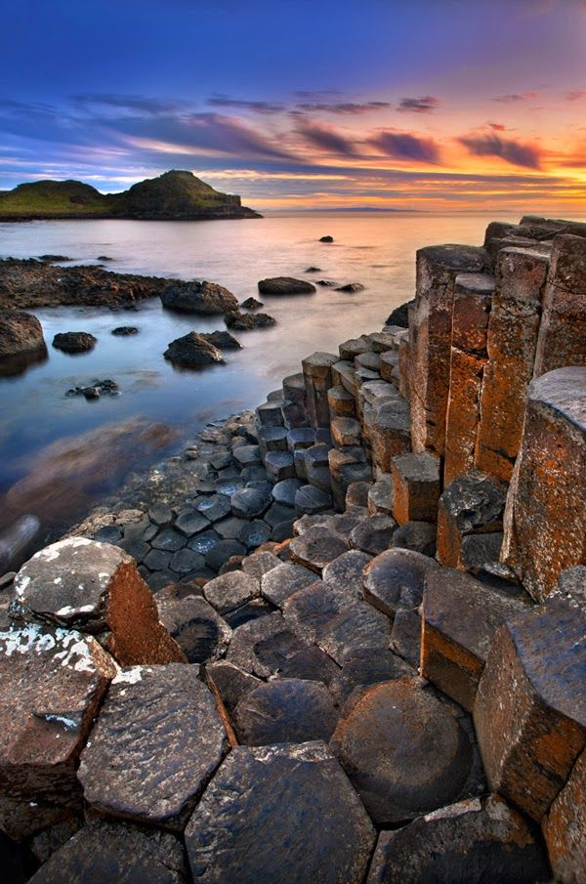
Co. Antrim:
The population is 2695(2018).
The area is 3046km2.
Antrim’s nickname is the Glens men and the Saffron.
Famous tourist attraction; Bushmills factory, Rathlin island, Crumlin road gaol, Glenoe water fall, Carrickfergus castle and the Giant’s Causeway.
The province is Ulster.

Slide 10
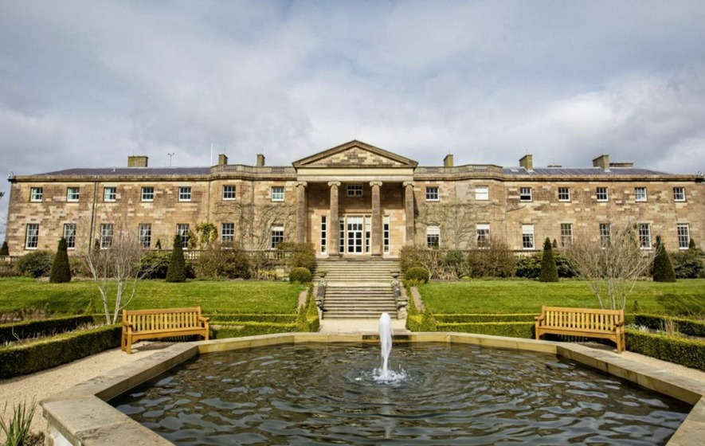
Co. Down:
The population is 531665(2011).
The area is 2448km2.
Down is named after co. town(Downpatrick).
The province is Ulster.
Famous tourist attraction; Hillsborough castle, Tollymore forest park, Down art centre, The peace maze, Castleward forest park and Glen river.

Slide 11
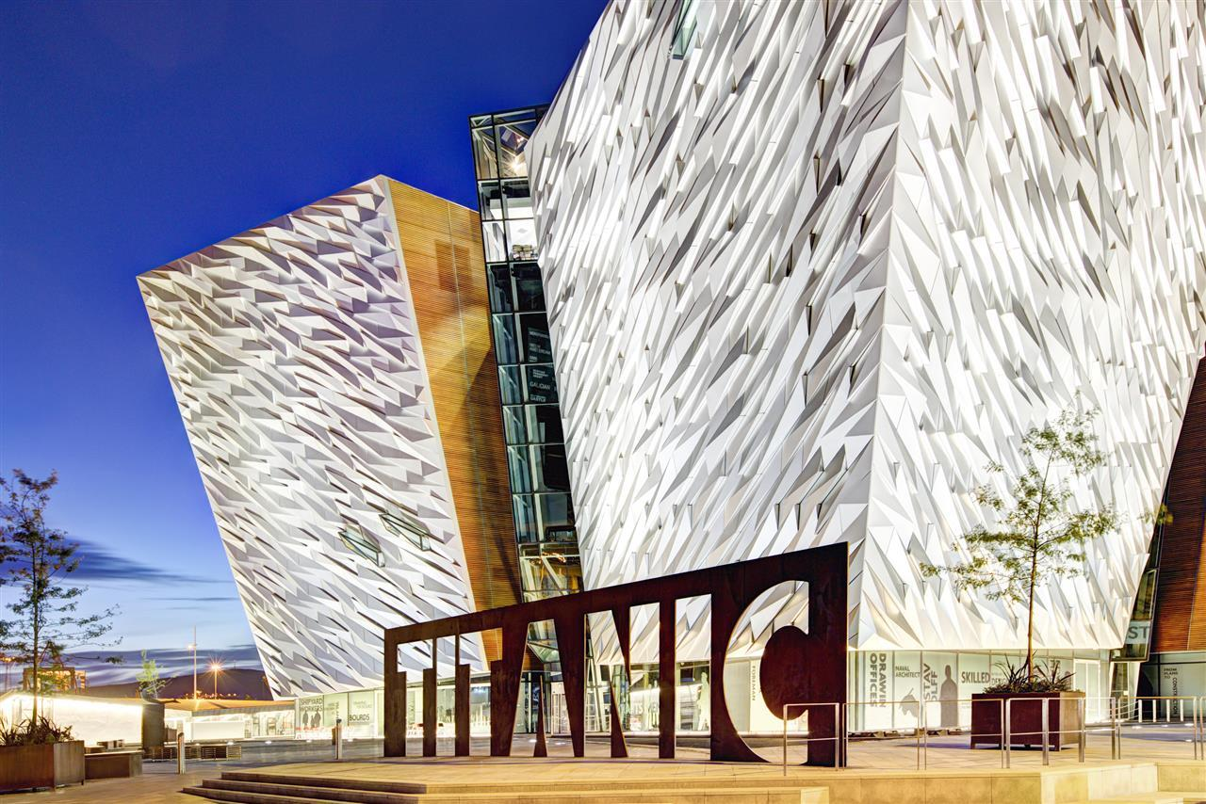
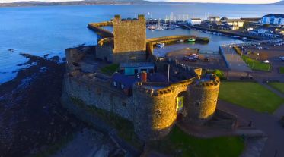
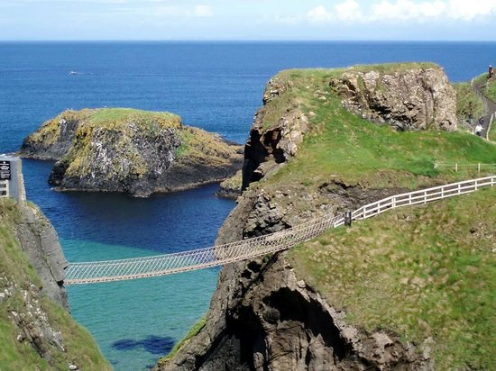
Tourist Attractions:
The Giant’s Causeway.
The causeway Coast.
The Carrick-a-Rede Rope Bridge.
The Titanic Belfast.
The Glens of Antrim.
Carrickfergus Castle.
Ards Peninsula.
The Ulster folk Museum.
Transport Museum

Slide 12
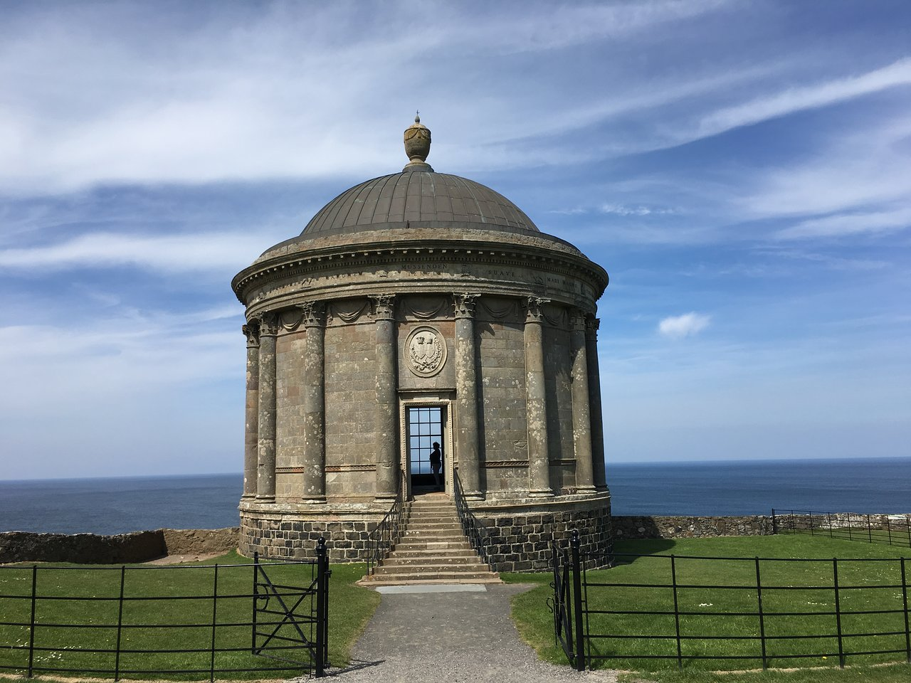
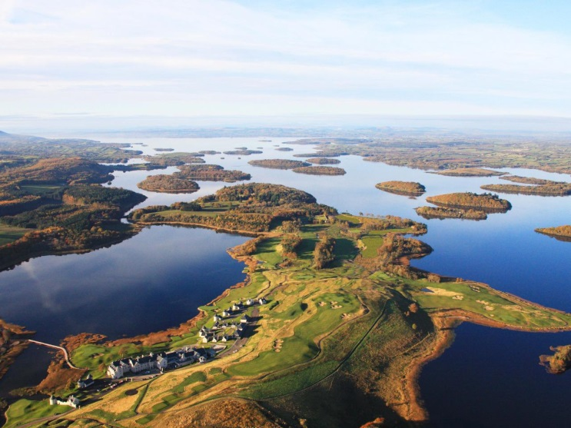
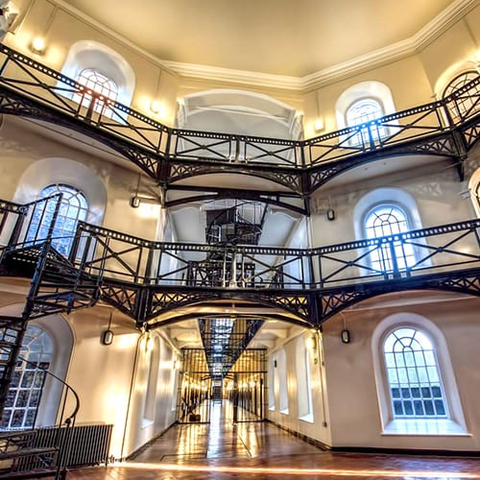
Lough Erne.
Londonderry(derry).
Ulster Museum.
Mussenden Temple.
Ulster American Folk Park.
Crumlin Road Gaol.
The peace Bridge.
Tayto castle factory.
Cuilcagh way boardwalk

Slide 13
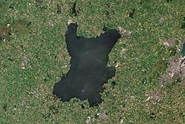
Lough Neagh:
The area is 392km2.
The depth is 82ft (25 m).
Lough Neagh is the largest lake in NI.
Lough Neagh is located in every county.
The coordinates ; 54*37’06’’N 6*23’43’’W.

Slide 14
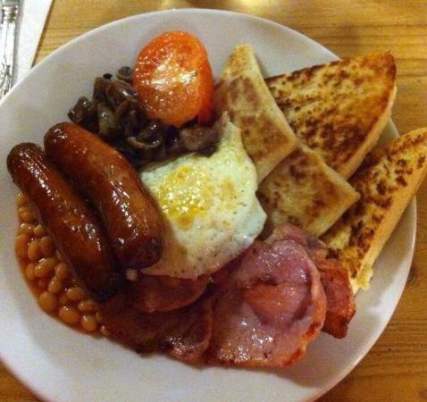
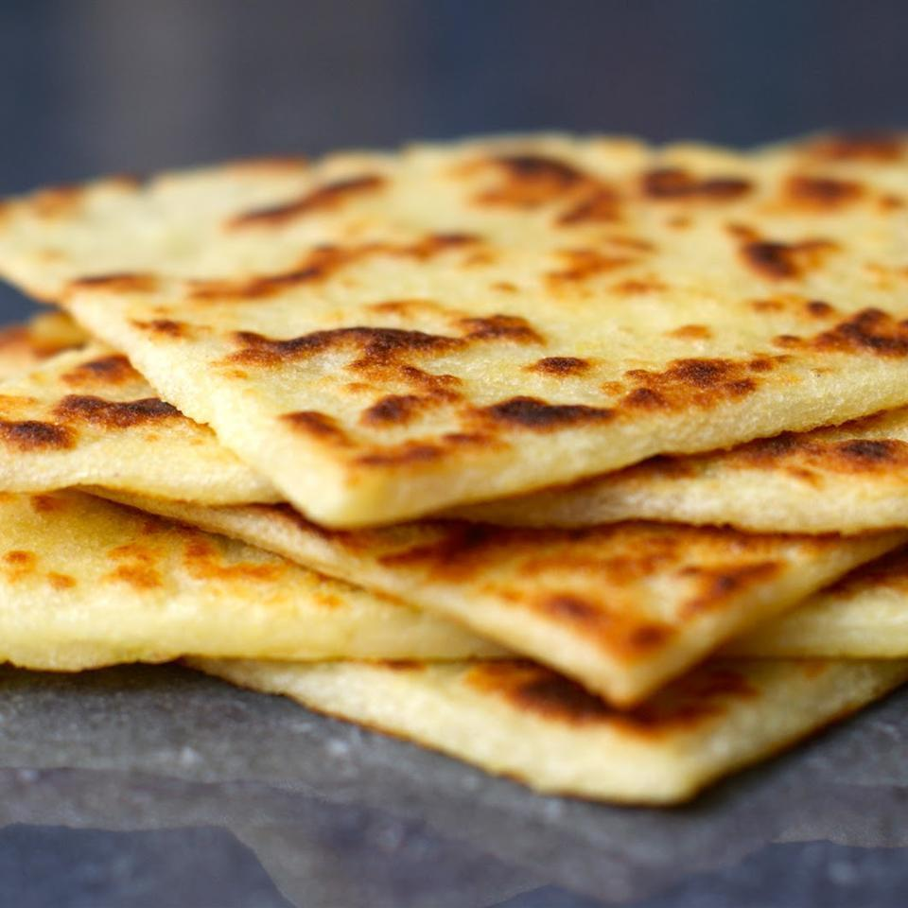
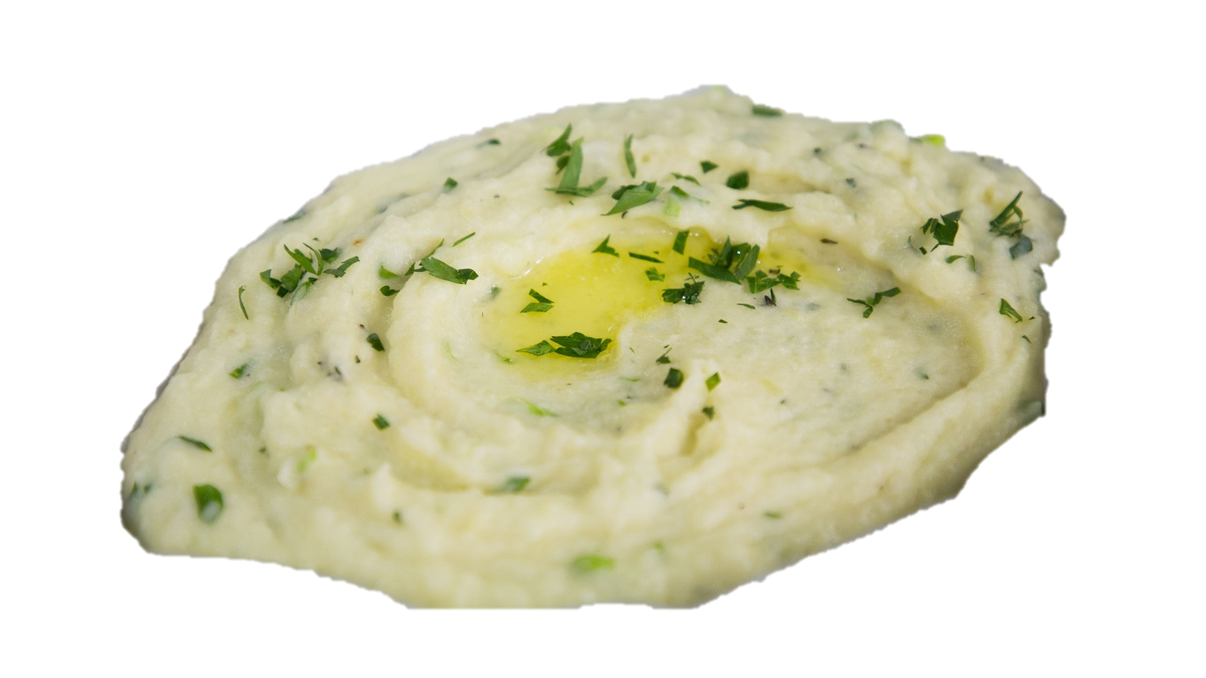
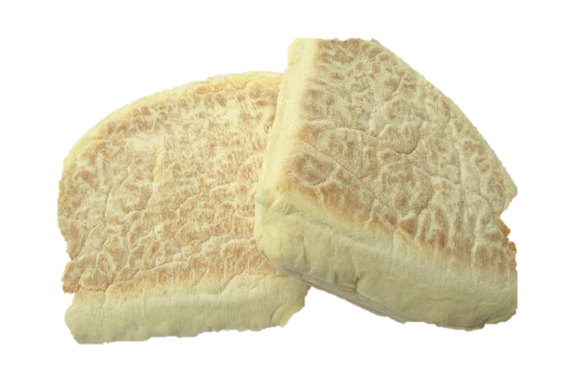
NI Food:
Potato apple bread.
Potato bread farl.
Fifteens.
Pastie.
Wheaten bread.
Champ.
Irish stew.
Vegetable rolls.
Ulster fry

Slide 15
NI Facts:
NI is part of the UK.
In 1921 the island of Ireland was divided into two parts.
Sometimes NI is called Ulster.
The population is 1.8 million.
Belfast is the capital of NI.
The Giant’s Causeway is the famous rocky area of the coast in co. Antrim.
NI is the second most sparsely populated co. in the UK.

