Slide 1
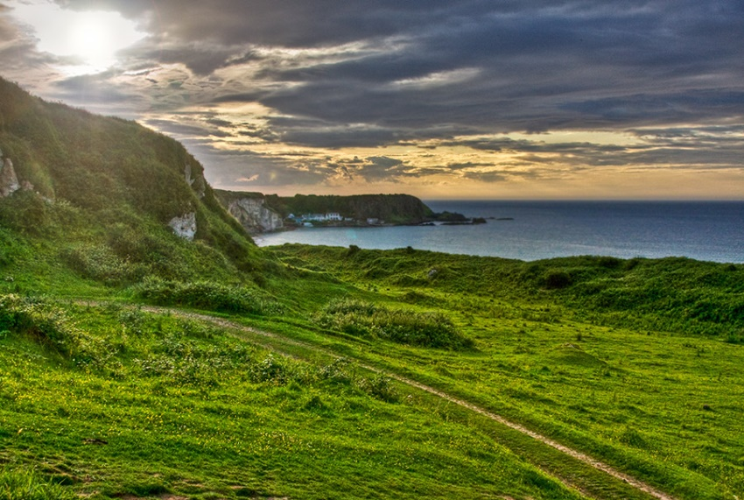
Northern
Ireland

Slide 2
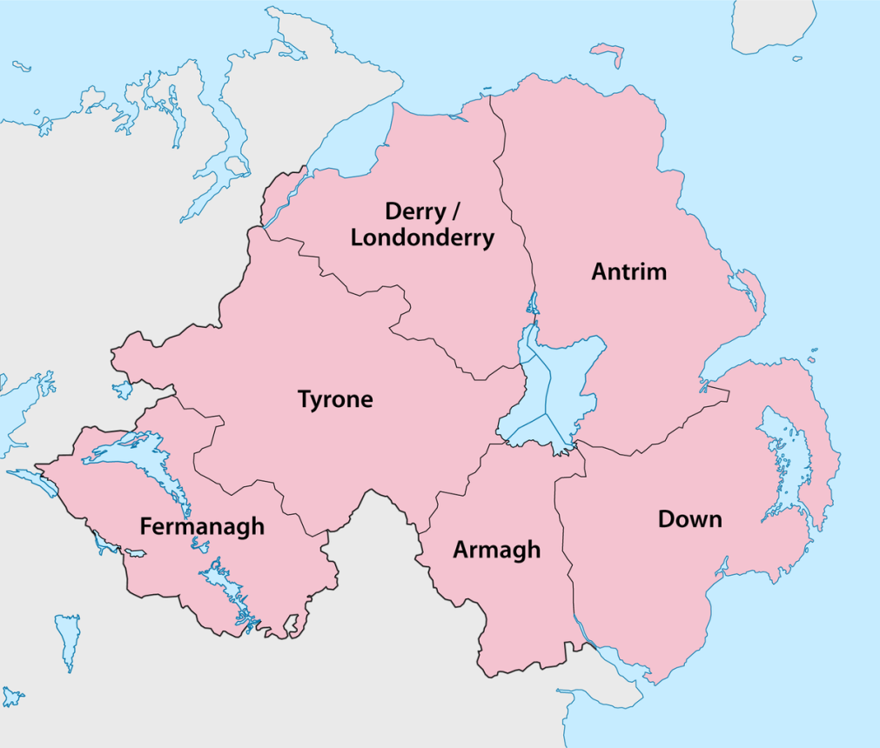
Map of counties
The counties names are:
Fermanagh
Armagh
Tyrone
Derry
Antrim
Down
A good way to remember is FAT DAD

Slide 3
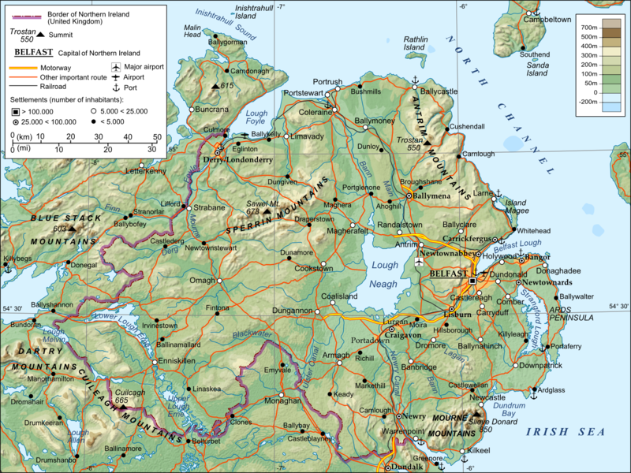

Slide 4
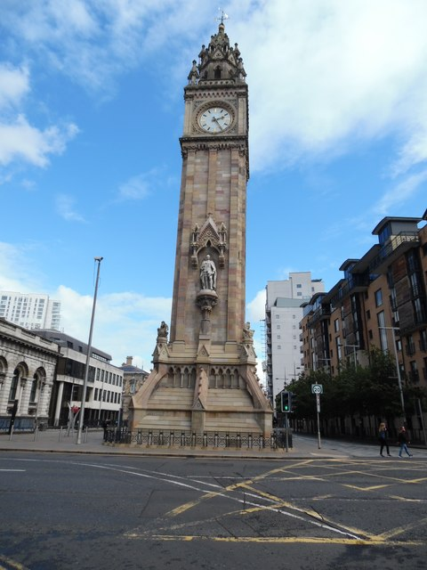
Belfast
This amazing place is the capital of Northern Ireland. It houses many tourist attractions, such as Titanic Belfast. The word Belfast comes from Irish words Béal Feirste meaning mouth of the sea bank ford. Albert Tower is sinking and leaning by 4 feet.

Slide 5
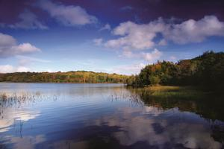
Co. Fermanagh
With its main town Enniskillen, it’s a very beautiful county. The word Fermanagh comes from the Irish words Fir Manach meaning Men of Manach. It is a county of the lakes.

Slide 6
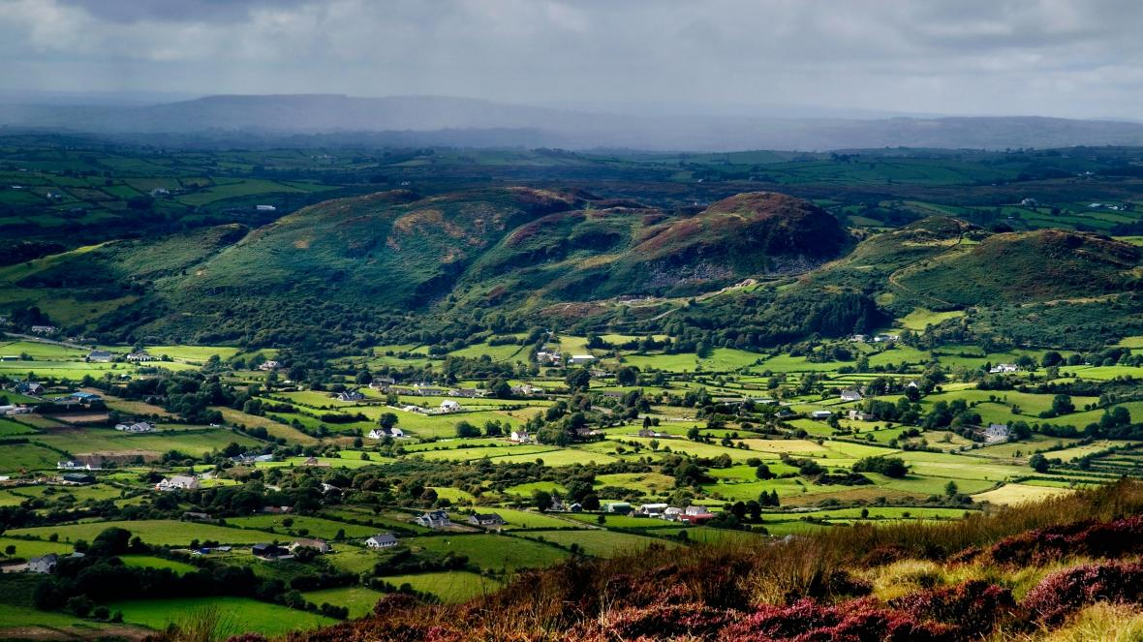
Co. Armagh
This places main city is also called Armagh and is believed to be one of the oldest cities in Ireland. Its soil is very fertile and good for growing apple trees so it is sometimes called the orchard county.

Slide 7
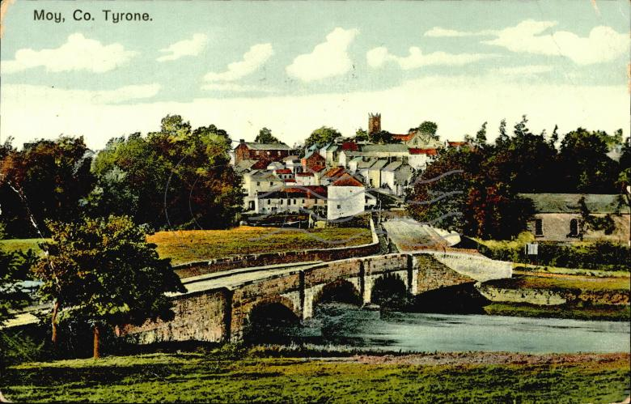
Co. Tyrone
Co. Tyrone’s main town is Omagh. It has a motto of By wisdom and prudence. It also houses many famous places and many good views. Co. Tyrone has the colours of red and white.

Slide 8
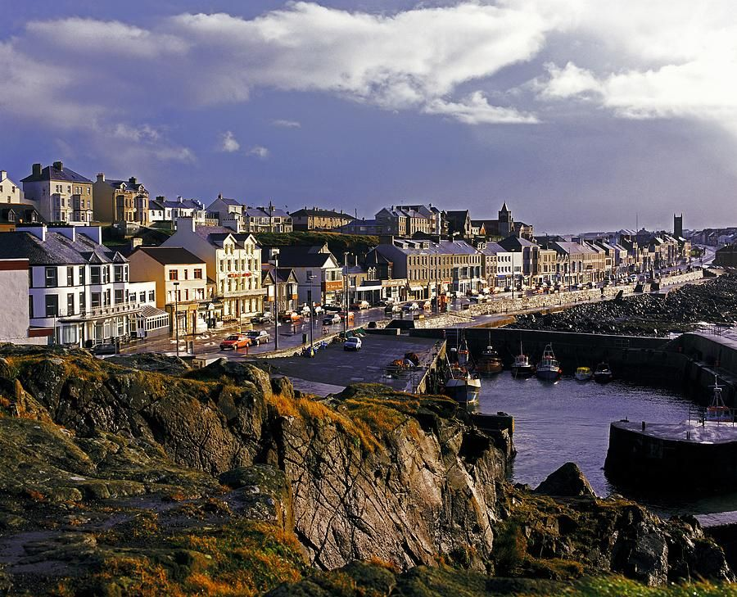
Co. Derry
Derry also called Londonderry houses many historic places and won first place prize for UK City of Culture. Its main city is also called Derry although sometimes called the walled city.

Slide 9
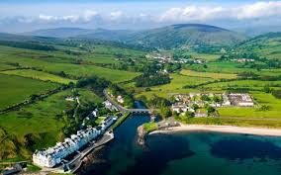
Co. Antrim
This county’s main town is Ballymena and its colours are deep yellow and white. It has a Motto of through trials to triumph. They have two nicknames, one The Glensmen and the other The Saffrons.

Slide 10
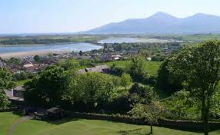
Co. Down
Belfast and Lisburn both are split in half by the River Lagan; half in Co. Down, half in Antrim. Newry is also split in half, with half in Down but the other half is in Armagh. Its colours are red and black.

Slide 11
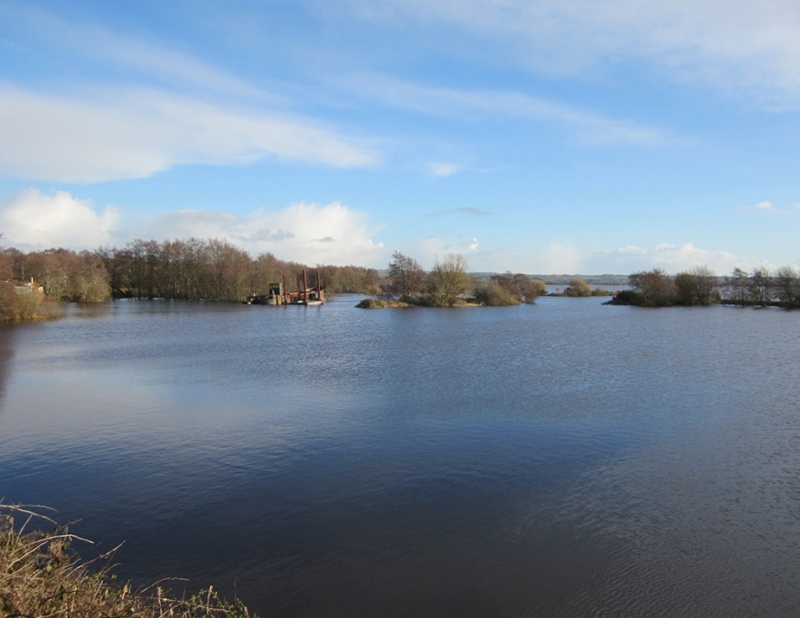
Lough Neagh
Lough Neagh is the biggest freshwater lake in the British Isles. It covers 151square miles or 392km squared. It is famous for its eels. There is also believed to be a Lough Neagh Monster which is cousins with the Lough Ness Monster.

Slide 12
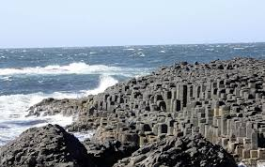
Famous Places
Giants Causeway
You can visit these wonderful hexagons created by an eruption, or not! The tale is that the Scottish giant made a causeway, to walk across to fight the Irish giant. You can find out the rest of the story there.

Slide 13
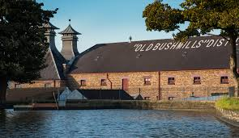
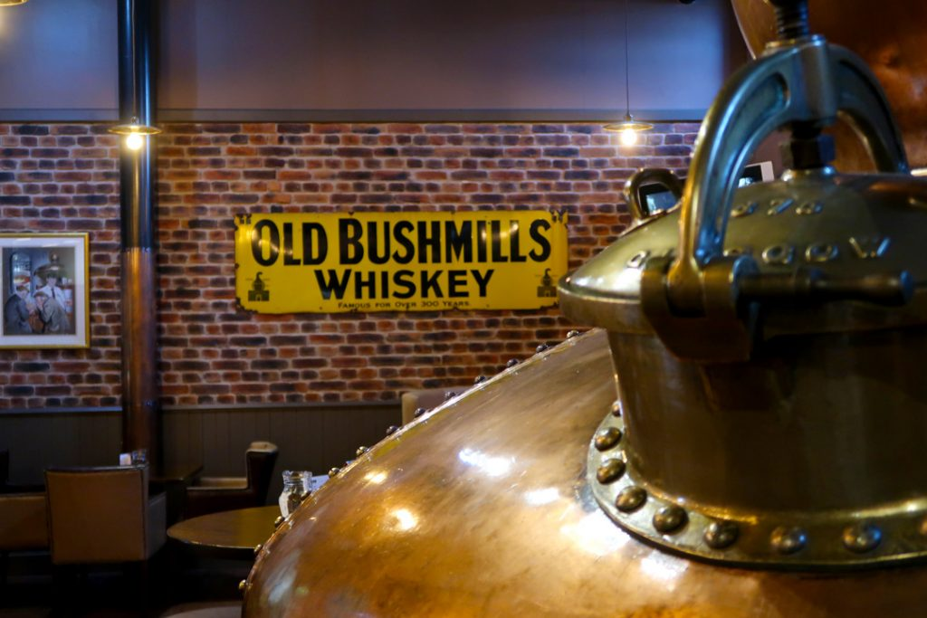
Bushmills Whiskey
This place is more than 400 years old and their grant to distil was signed by King James the First! You can take a tour around this amazing place and have a drink of some of their fine whiskey in the 1608 bar. They have 5 award winning whiskeys on their portfolio: including Bushmills Original, Black Bush, Bushmills 10 Year Single Malt, Bushmills 16 Year Single Malt and Bushmills 21 Year Single Malt. In 2017 they added Red Bush.

Slide 14
Traditional Northern Irish Menu
Breakfast:
Ulster Fry - eggs, potato bread, soda bread, pork sausages, bacon, black and white pudding, red tomato
Porridge - water, salt, oats, cream (optional)
Lunch:
Crubeens - pig’s trotters, (cooked with onion, carrot, bay leaf, parsley stalks, thyme, and peppercorns for flavour)
Vegetable Broth - carrot, whole soup celery, leek, flat leafed parsley
Dinner:
Irish Stew - potato, onion, carrot, parsnip, lamb/mutton, turnip
Boxty(potato pancake) - potato, flour, butter, salt
Guinness Pie - steak, Guinness, celery, garlic, bacon, pastry, carrots, onions, butter
Sides:
Bread Selection - potato bread, wheaten bread, soda
bread, veda bread
Champ - potato, spring onions/scallions
Colcannon - potato, butter, bacon, cabbage, cream
Pudding:
Apple Tart - pastry, apples
Barmbrack Bread – sultanas, raisins, cherries, butter
Drinks:
Bushmills Whiskey Apple Juice
Craft Beer Milk
Artisan Cider Water
Tea
For allergies ask at the counter

Slide 15
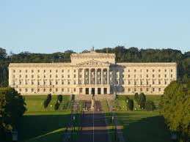
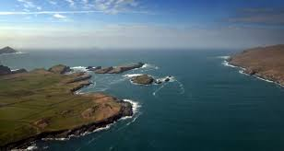
3 Facts
The Population of Ireland is about 1.8 million!
Although Ireland is part of the U.K. it makes its own laws.
At its closest point Scotland is 13 miles away and if you look across on a clear day you can see some houses on Scotland.

