Slide 1

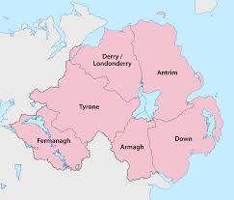
Northern Ireland
By Nathan Mitchell

Slide 2
Population and Counties
In Northern Ireland the population is 1.882 million people
Northern Ireland is in the province of Ulster
There are six counties in Northern Ireland
The counties are Armagh, Antrim, Down, Fermanagh, Tyrone and Derry these are all part of Ulster
The biggest lough is called Lough Neagh which is situated in Co. Antrim

Slide 3
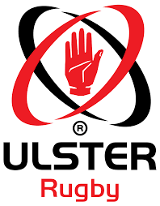
Sport and Leisure
In Northern Ireland sport is popular including; golf, rugby, tennis football and hockey. Also Gaelic games which include traditional Irish sports including hurling, camogie, Gaelic football, handball and rounders.
For leisure people go to the cinema, ten pin bowling, restaurants, walks, climbing up mountains and visiting lots of places.

Slide 4
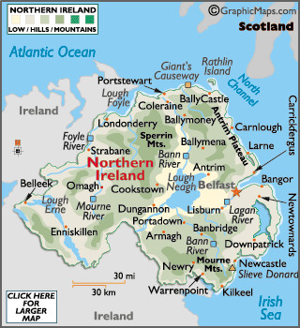
Mountains and rivers
There are three main upland areas in Northern Ireland:
The Mourne mountains in County Down
Sperrins in County Derry
Antrim Hills in County Antrim
There are three main rivers in Northern Ireland:
The river Lagan
The river Foyle
The river Bann

Slide 5
Tourist Attractions and Tourism
In Northern Ireland the main tourist attraction is the Giants Causeway which was created over 50 or 60 million years ago and is suited in Co Antrim
Another tourist attraction is Carrick a Rede rope bridge it was constructed in 2008 and is found in Antrim.
Another Tourist attraction is the Titanic centre in Belfast and was built in 2009 and has had 5000 visitors in one day.
In 2017 an estimated 4.9 million people visited Northern Ireland

Slide 6
Size and History
The area of Northern Ireland is 14,130 km²
Northern Ireland was created in 1921, when Ireland was partitioned between Northern Ireland and Southern Ireland by the Government of Ireland Act 1920.
The province of Ulster is made up of nine counties but with partition six became Northern Ireland and the other three part of Ireland (Donegal, Cavan and Monaghan).
Northern Ireland is famous for literary giants (eg C S Lewis), music legends (Van Morrison, Snow Patrol), legendary ships (Titanic), golf courses and the Giants Causeway UNESCO World Heritage site

Slide 7
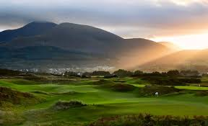
County Down
County Down biggest city is Bangor
County Down covers an area of 2,448 km2
The population of County Down is 531,665
Tourist Attractions in County Down are Slieve Donard, Tollymore Forest Park and the National Trust Castle Ward

Slide 8
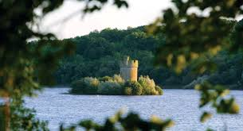
County Fermanagh
County Fermanagh’s biggest city is Enniskillen
The area of County Fermanagh is 1,851 km²
The population of County Fermanagh is 62,527
Tourist attractions in County Fermanagh are the Florence Court House and the Enniskillen Castle Museums

Slide 9
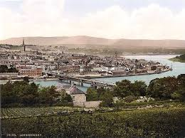
Co Londonderry
The largest city in Co Londonderry has 3 names it is called Derry/ Londonderry or Stroke city! Derry is used by people who see themselves as Irish and Londonderry is used by people who agree with the union with the rest of the United Kingdom and see themselves as British.
The people from the county also use the name Stroke City which avoids the labelling of the other terms as being either nationalist or unionist.
Total area 2074 km
Population 247132
Tourist attractions include the Derry Walls, St Columbs Cathedral, Ulster American Folk Park, The Argory and Oxford Island.

Slide 10
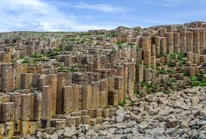
Co Antrim
Largest city is Belfast the capital of Northern Ireland
Area 3046 Km
Population 61800
Tourist Attractions: Glens of Antrim, UNESCO World Heritage Site Giant’s Causeway, Bushmills Whiskey Distillery, Titanic Centre

Slide 11
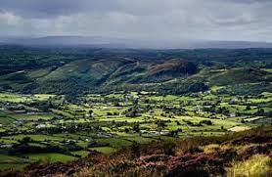
Co Armagh
Largest city/town is Armagh
Area: 1326 Km
Population: 174792
Known as the Orchard County because of the many farms growing apples
Tourist Attractions include: Palace Stables Heritage Centre, Tayto Castle Factory, Armagh Planetarium.

Slide 12
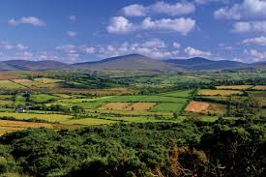
Co Tyrone
Main town is Omagh
Area is 3263 Km
Population 177966
Tourist attractions: Argory, Ardboe Cross, Beaghmore Stone Circles, Benburb Valley Park and Castle, Castle Caulfield

Slide 13
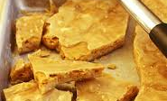
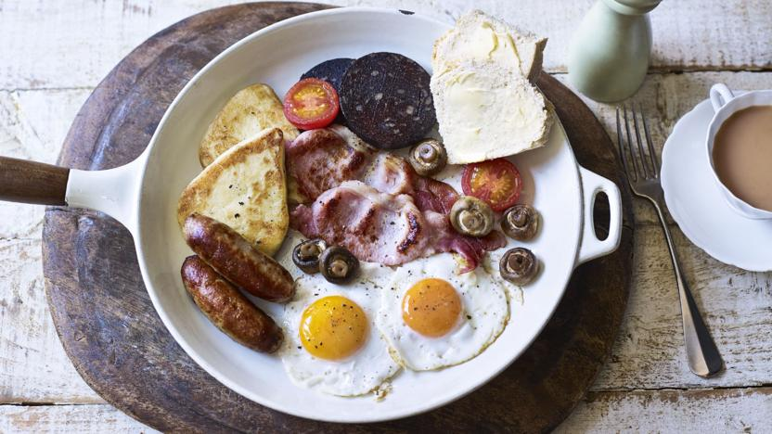
Food
Ulster fry
Potato bread
Soda bread
Bushmills whiskey
Dulse
Yellow man

