Slide 1
NORTHERN IRELAND
By Matthew Patterson

Slide 2
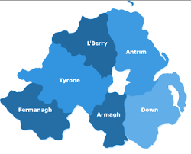





Counties of northern Ireland
There are 6 counties in N.I. There is:
TYRONE
ANTRIM
FERMANAGH
ARMAGH
LONDONDERRY
THIS IS THE WAY TO REMEMBER THE 6 COUNTIES
DOWN

Slide 3
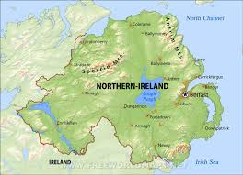
n.I Mountains & RIVERS
Northern Ireland has several rivers, the two biggest rivers are The River Bann (129km long) and The River Lagan (86km long)
The River Bann is the longest river in Northern Ireland. It starts at Mourne Mountains and flows through many places including Lough Neagh.
Northern Ireland is full of mountains the Highest are Slieve Donard (850m high) and Mourne Mountains (850m high)

Slide 4
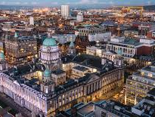
Belfast
Belfast is the capital city of Northern Ireland. It has a population of 333,871
It is a very popular place because the famous RMS Titanic was built in Belfast Harbour by Harland and Wolff
There were troubles in Northern Ireland in the late 1960s – 1998. Belfast greatly suffered from this as thousand of homes were destroyed and thousands of people died

Slide 5
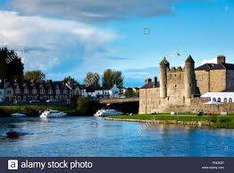
COUNTY fERMANGH
County Fermanagh has a population of 61,805 and covers an area of 1,691km²
Enniskillen is a famous town in county Fermanagh for it has many famous places which include Enniskillen Castle Museums and Castle Code, a National Trust Property

Slide 6
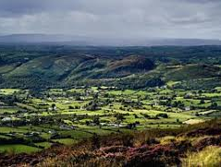
County Armagh
County Armagh has a population of 174,792 and has a total area of 1326km²
Armagh doesn’t have any cities. The town Armagh has a city status but is not a city. There are other towns in County Armagh which include Newry, Craigavon, Lurgan, and Portadown

Slide 7
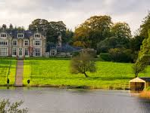
County TYRONE
County Tyrone is one of six counties in Northern Ireland it has a population of 177 986 and has an area of 3263km²
County Tyrone doesn’t have any cities, but it does have many towns some are Omagh, Cookstown, Dungannon and Strabane.
There are a few tourist attractions in County Tyrone some are Dungannon Park, Glenn Forest Park and Dirt Bike Tours IRL

Slide 8
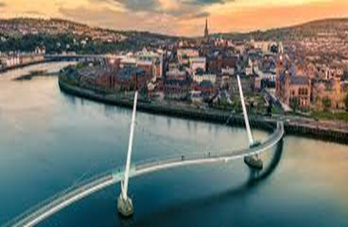
COUNTY LONDONDERRY
County Londonderry is one of six counties in Northern Ireland. It has a population of about 247,132 and an area of 2074 km²
It has a few towns, they are Coleraine, Limavady, Magherafelt and Portstewart
It has many tourist attractions including: The Peace Bridge, The Tower Museum and The Derry Walls

Slide 9
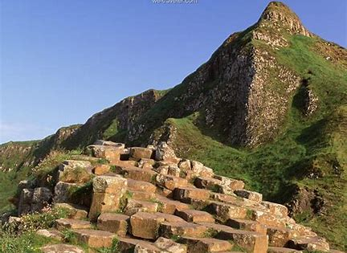
COUNTY ANTRIM
County Antrim has a population of 618,108 and has a total area of 3046km²
Antrim has two cities, Belfast and Lisburn. Has towns such as Portrush, Ballycastle and Ballymena
County Antrim has many famous places like the Giants Causeway, Ulster Museum and Belfast Zoo

Slide 10
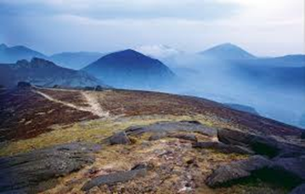
COUNTY DOWN
County Down is one of the six counties in Northern Ireland. It is on the north-eastern part of Northern Ireland. It covers an area of 2448km²
County Down has a population of 531,665 with 9 towns, which includes Bangor, Dundonald and Newcastle.
County Down has many tourist attractions some of which are, Tollymore Forest Park, Castle Ward and Murlough Beach

Slide 11
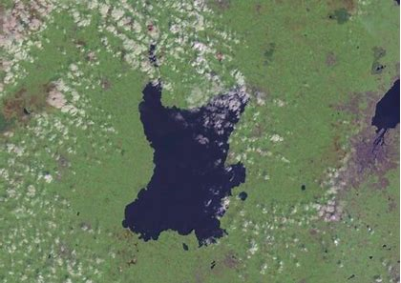
LOUGH NEAGH
Lough Neagh is the largest fresh water lake in Northern Ireland and in the United Kingdom
It is the 31st largest fresh water lake in Europe
It has a length of 30km and an average depth of 9m

Slide 12

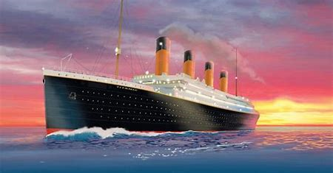
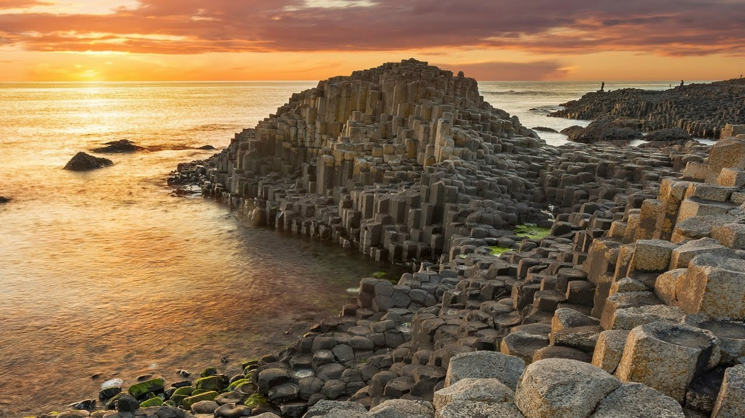
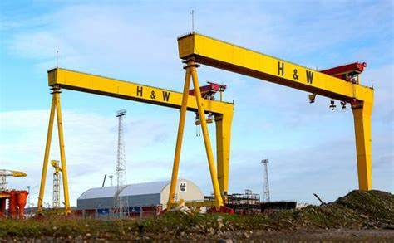
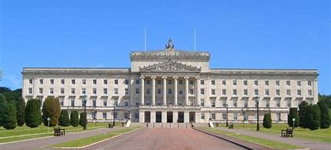
LANDMARKS & TOURIST ATTRACTIONS
IN NORTHERN IRELAND
There are many different landmarks in N.I. Examples include:

Slide 13
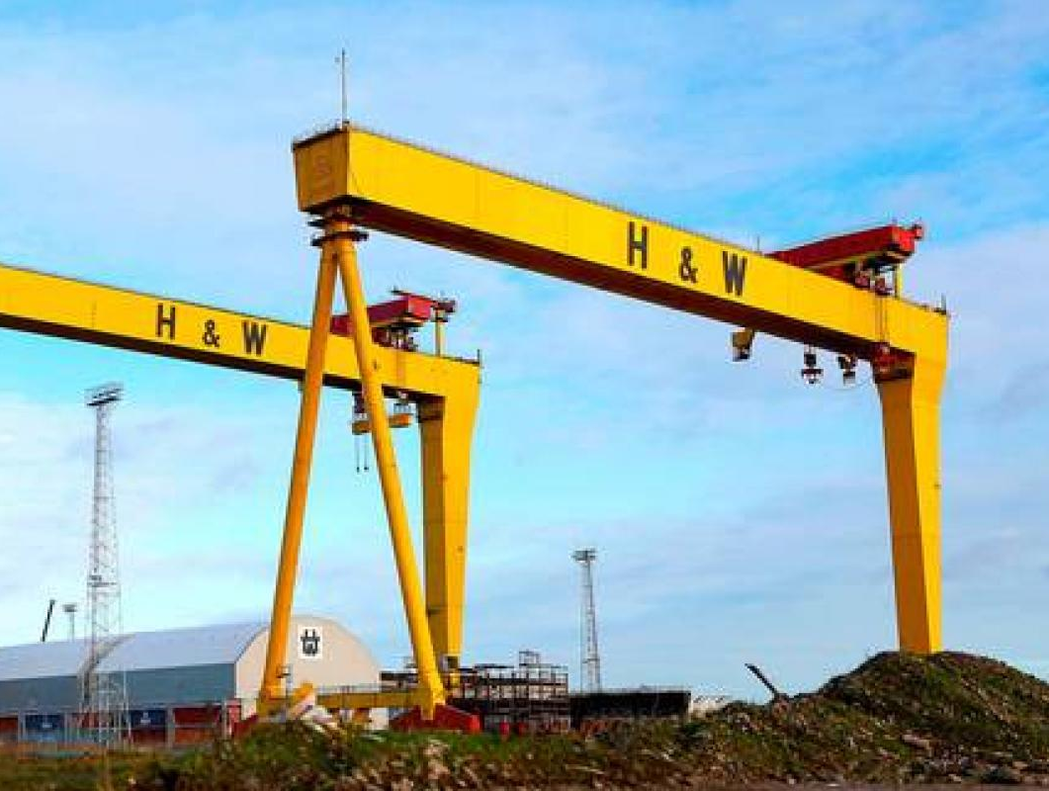
Harland and Wolff
Harland and Wolff is a shipyard located in Belfast
Harland & Wolff is famous for having built the majority of the ships in the olden days
The biggest ship they have built is the Titanic which sank on its first journey killing most of those on board
Harland and Wolff is famous also for its two big yellow cranes - Samson and Goliath

Slide 14
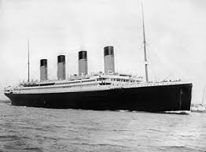
The titanic
The Titanic is the main attraction that bring lots of tourists to N.I
It was the biggest ship made by Harland and Wolff
The ship set off from Belfast in 1911. On April 11 the ship crashed into an iceberg
1500 people drowned and died but 705 individuals survived
There is still a Titanic museum in Belfast with all the information about the Titanic

Slide 15
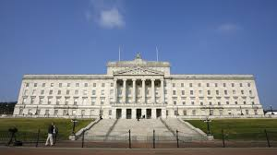
STORMONT
Parliament Buildings also referred to as Stormont because of its location in the Stormont Estate area of Belfast
In March 1987, the main building became a Grade A Listed building
In January 2017, the two main parties, the DUP and Sinn Féin split which ended up Stormont being closed for over 3 years!
In January 2020 the main N.I parties agreed on a deal to open up Stormont again

Slide 16
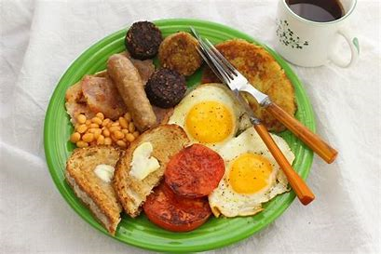
N.I FOOD
Traditional Northern Ireland food includes:
Comber Potatoes
Ulster Fry (includes Bacon, egg, sausages, black pudding, potato bread, soda bread, fried tomatoes, mushrooms and white pudding)
Irish Stew
Fish and Chips

Slide 17
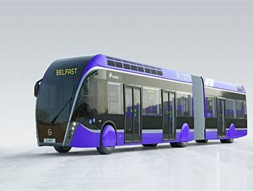
BELFAST TRANSPORTATION
(FACTS)
Belfast has various modes of transport. The most popular one more recently is the Glider
The Glider is a rapid transit system in Belfast and it is the most popular way of transport in Belfast since 2018
It is operated by Translink. The glider takes two routes, it takes the G1 (West to East Belfast) and G2 (North to South Belfast)

