Slide 1
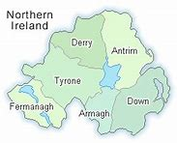

Slide 2
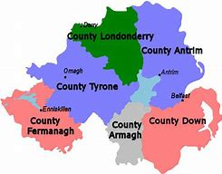
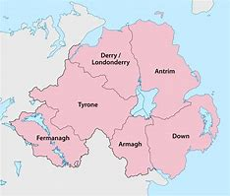
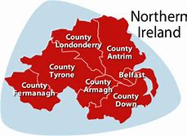
Maps of Northern Ireland

Slide 3
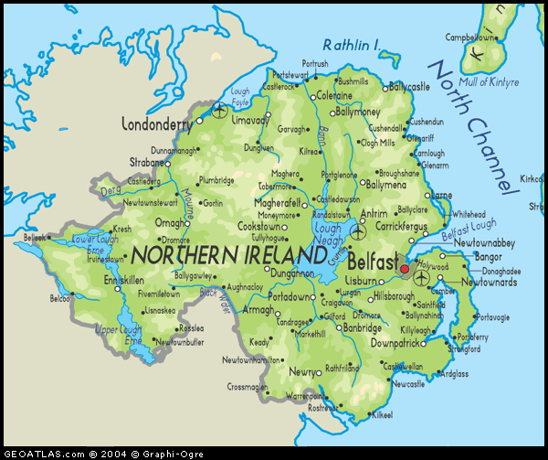
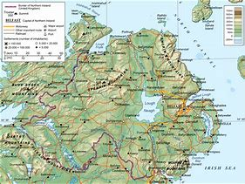
Physical Maps of Northern Ireland

Slide 4
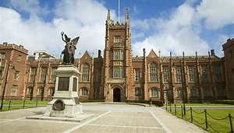
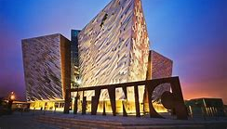
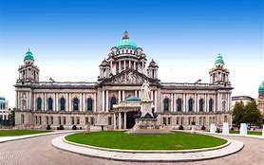
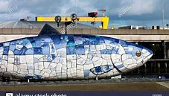
Belfast
Belfast is the Capital City of Northern Ireland.
Belfast is 44.40 sq.miles.
Belfast has an approximate population of 333 900 people.
Belfast is home to Harland and Wolff Ship Yard.
In the 1970’s the Troubles hit Belfast worst than any part of Northern Ireland.

Slide 5
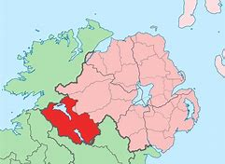
Co. Fermanagh
County Fermanagh is the 2nd smallest County in Northern Ireland.
It has an area of 714.7 sq. miles.
Co. Fermanagh has a population of approx. 61 810 people.
30% of Fermanagh is covered in lakes.
Fermanagh’s nickname is the ‘Lakeland County’.
It is the only County that does not touch the Lough Neagh.

Slide 6
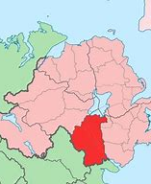
Co. Armagh
Co. Armagh is the smallest County in Northern Ireland.
The size of Co. Armagh is 512 sq. miles.
The population is approx. 174 800 people.
Co. Armagh’s nickname is the ‘Orchard County’.
Its County town is Armagh.

Slide 7
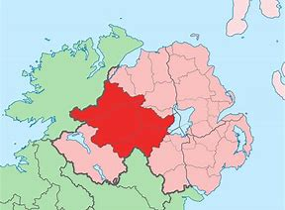
Co. Tyrone
Co. Tyrone is the biggest County in Northern Ireland.
Its size is 1218 sq. miles.
It has a population of approx. 178 000 people.
Its nickname is the ‘Red Hand County’.
Its County town is Omagh.

Slide 8
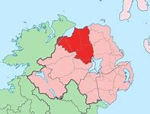
Co. Londonderry
Co. Londonderry is the 4th largest County in Northern Ireland.
County Londonderry has a total of 71 Towns/Villages.
Co. Londonderry has an area of 801 sq. miles.
It has a population of approx. 233 550 people.
It is also known as Co. Derry.

Slide 9
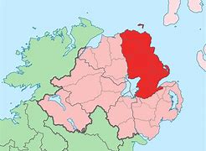
Co. Antrim
Co. Antrim is the 2nd largest County in Northern Ireland.
The size of County Antrim is 1 176 sq. miles.
The population is approx. 618 100 people.
It is home to the Mountains known as ‘The Glens of Antrim’.
County Antrim’s nickname is ‘The Glens County’.

Slide 10
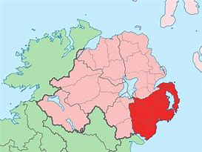
Co. Down
Co. Down is the 3rd largest County in Northern Ireland.
The size of Co. Down is 2466 sq. miles.
The population is approx. 531 665 people.
The Mourne Mountains are famous in Co. Down.
Its nickname is the ‘Mournes County’.
Known for the Comber Potato grown around Strangford Lough in Co. Down.
Its County town is Downpatrick.

Slide 11
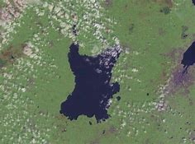
Lough Neagh
Lough Neagh is a large freshwater Lake in Northern Ireland.
It has a surface area of 151 sq. miles.
It is the largest lake in the UK.
The Lough Neagh touches every County apart from Co. Fermanagh.
It supplies 40% of Northern Ireland’s water.

Slide 12
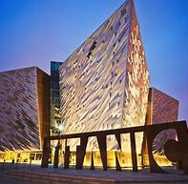
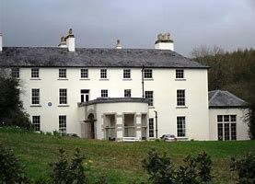
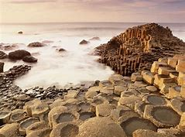
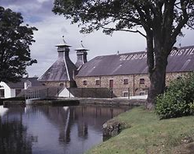
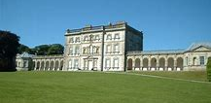
Tourist Attractions
Carrick-a-Rede Rope Bridge
Giants Causeway
The Dark Hedges
Lissan House
Botanic Gardens
Hillsborough Castle
Stormont Buildings
Grand Opera House
HM Prison Crumlin Road
St Georges Market
Bushmills Distillery
Ulster American Folk Park
Ulster Folk & Transport Museum
Ulster Museum
Castle Ward
Mount Stewart House
Titanic Belfast
Florence Court

Slide 13
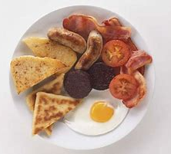
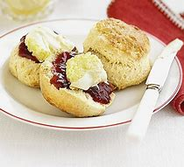

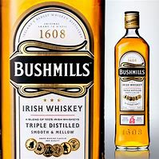
NI Food & Drink
Foods and Drinks served in Northern Ireland include:
Irish stew
Ulster Fry
Scones
Soda Farl, Potato Bread & Wheaten Bread
Champ
Fifteens
Irish Whiskey

Slide 14
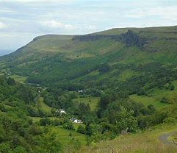
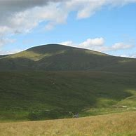
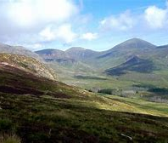
Mountains
Mountain Ranges in Northern Ireland include:
The Mourne Mountains – which include Slieve Donard, Slieve Commedagh and Slieve Binnian.
The Glens of Antrim - which include Slemish Mountain and Tievebulliagh.
The Sperrin Mountains – which include Sawel Mountain and Benbradagh.

Slide 15
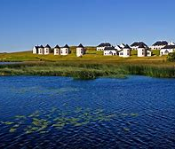
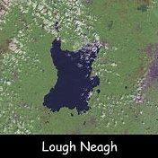
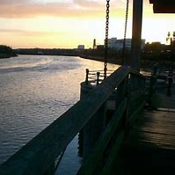
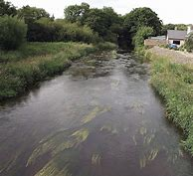
Rivers and Lakes
Rivers:
River Bann – runs through Down, Armagh, Antrim and Londonderry.
River Erne – runs through Tyrone.
River Foyle – runs through Tyrone and Londonderry.
River Lagan – runs through Down and Antrim.
River Finn – runs through Tyrone.
Fane River – runs through Armagh.
Lakes:
Lough Neagh.
Upper Lough Erne.
Lower Lough Erne.

Slide 16

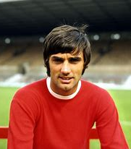
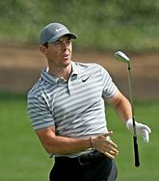
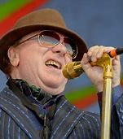
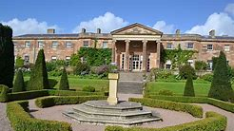
Other Facts
Northern Ireland has a total population of approx. 1,908, 250 people.
The Climate in Northern Ireland is mild, moist and changeable with abundant rainfall and a lack of temperature extremes.
It has the Largest lake in the UK.
Hillsborough Castle in Co. Down is residence to the Royal Family.
It has been home to famous people like George Best, Rory McIlroy, Liam Neeson, James Nesbitt, Christine Lampard, Patrick Kielty and Van Morrison.

Slide 17
Thank You for watching my Presentation on Northern Ireland
By Dawn Erwin

