Slide 1
Dividing Decimals by 10 and 100
N
- MATHS TOPICS KS2 -

Slide 2
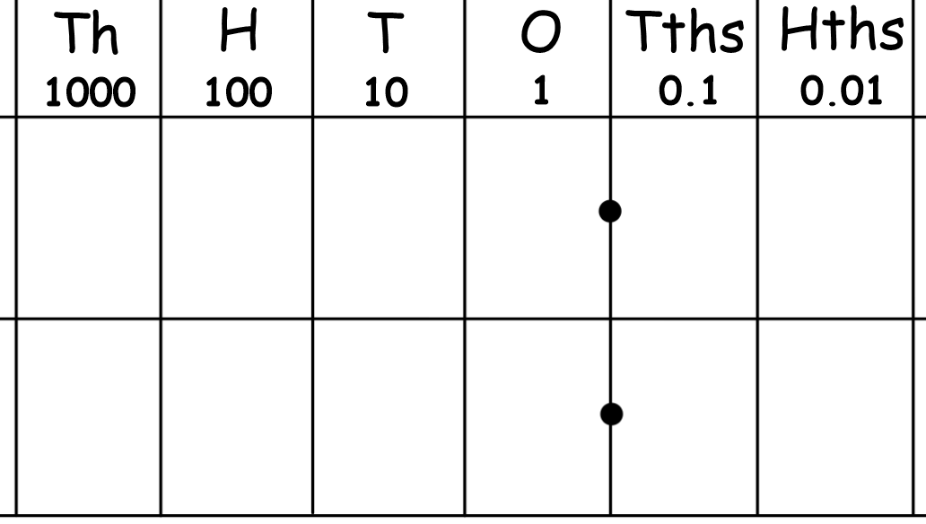
Dividing Decimals by 10 and 100
Dividing by 10
We use place value to divide by 10 by moving digits.
We make every digit ten times smaller by moving it one place to the right.
3
8
3
8
The decimal point never moves.
The digits move.
The digits never change.
The digits never change order.
÷ 10 ?
N

Slide 3


÷ 10 by moving digits:
9
6
0
Do we need this zero?
Why / why not?
What is it worth?
Is it a place holder?
9
6
0
The decimal point never moves.
The digits move.
The digits never change.
The digits never change order.
÷ 10 ?

Slide 4
÷ 10 by moving digits:
6
6
6
6
The decimal point never moves.
The digits move.
The digits never change.
The digits never change order.
÷ 10 ?

Slide 5


Dividing Decimals by 10 and 100
Dividing by 100
We use place value to divide by 100 by moving digits.
We make every digit ten times smaller by moving it two places to the right.
4
0
5
0
5
4
The decimal point never moves.
The digits move.
The digits never change.
The digits never change order.
This zero is a place holder.
It makes the decimal point clearer.
÷ 100?
N

Slide 6
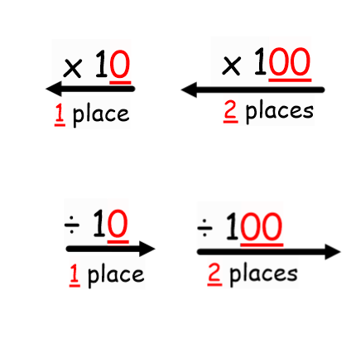
N
- MATHS TOPICS KS2 -

