Slide 1
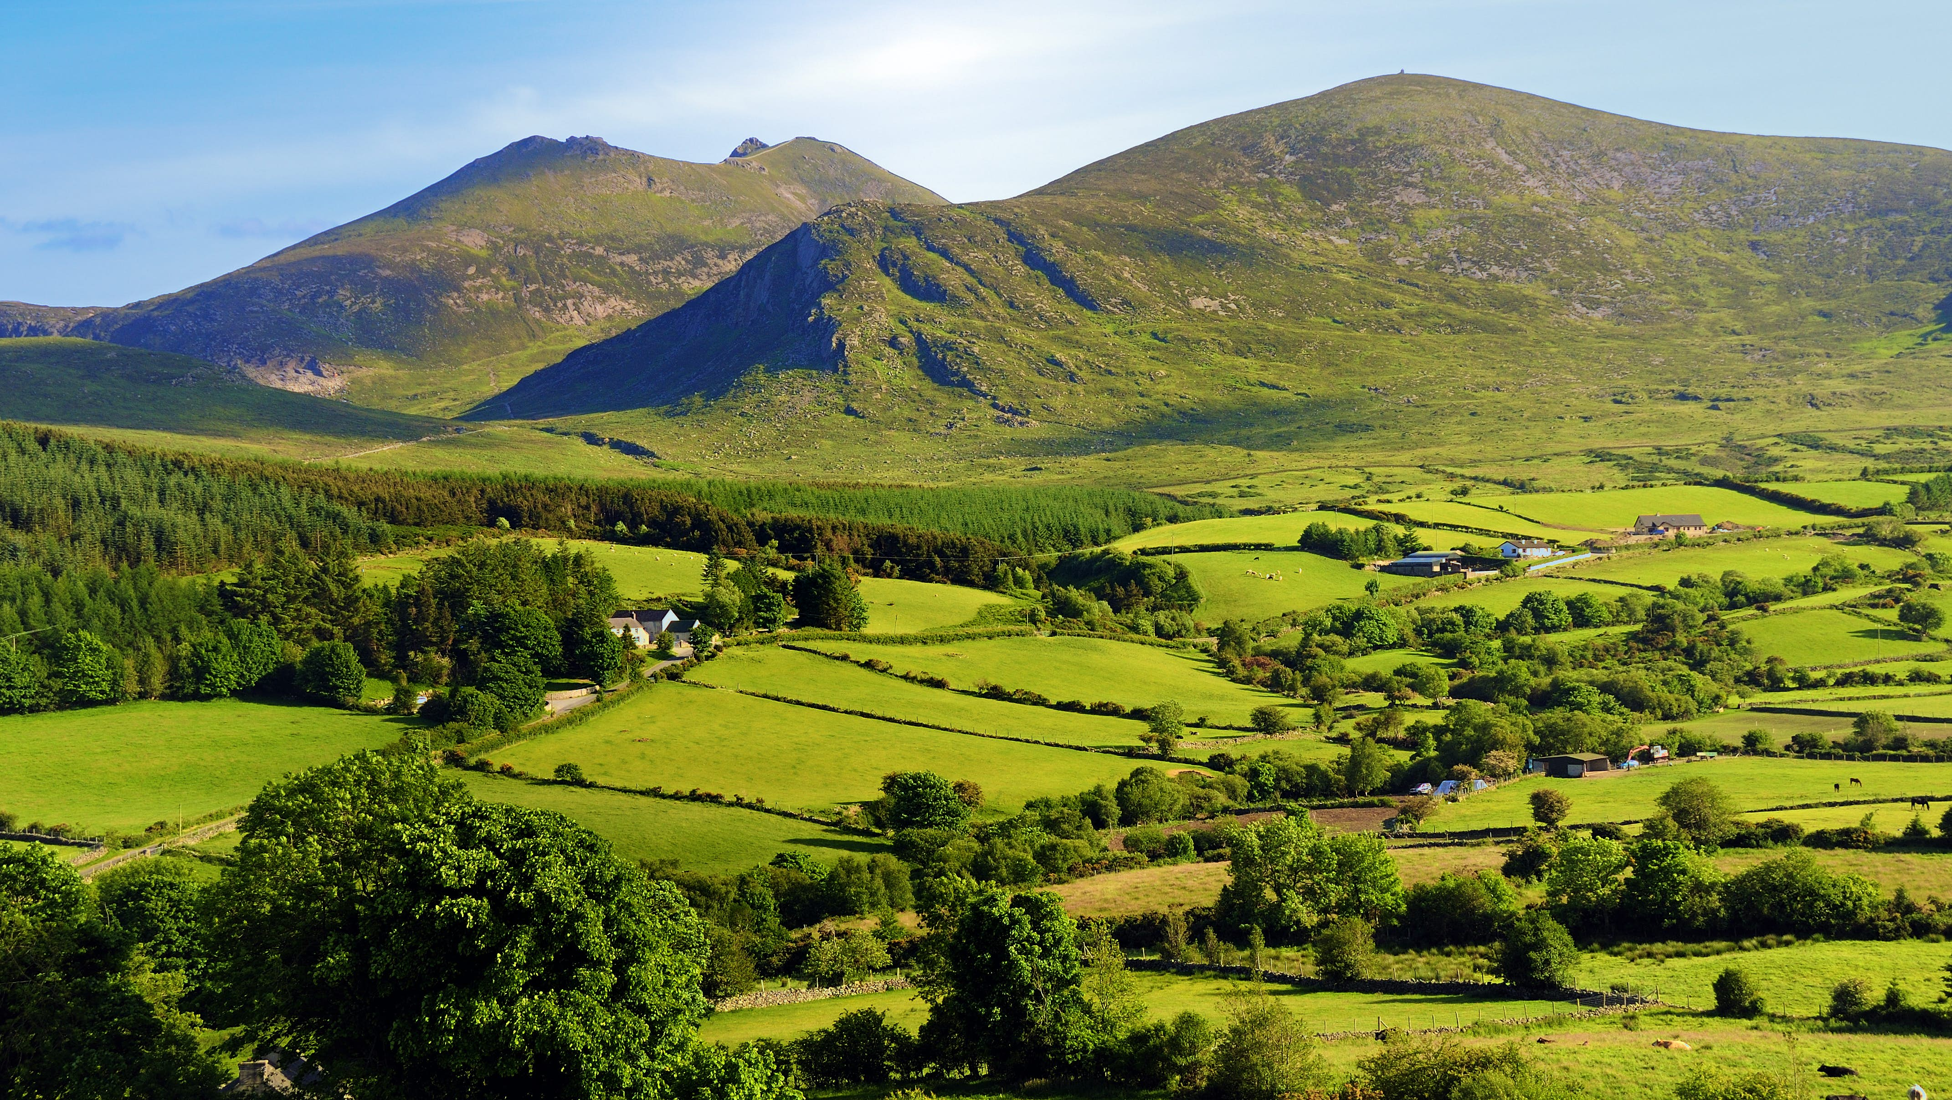
Northern Ireland
Presentation by Thomas Reid

Slide 2
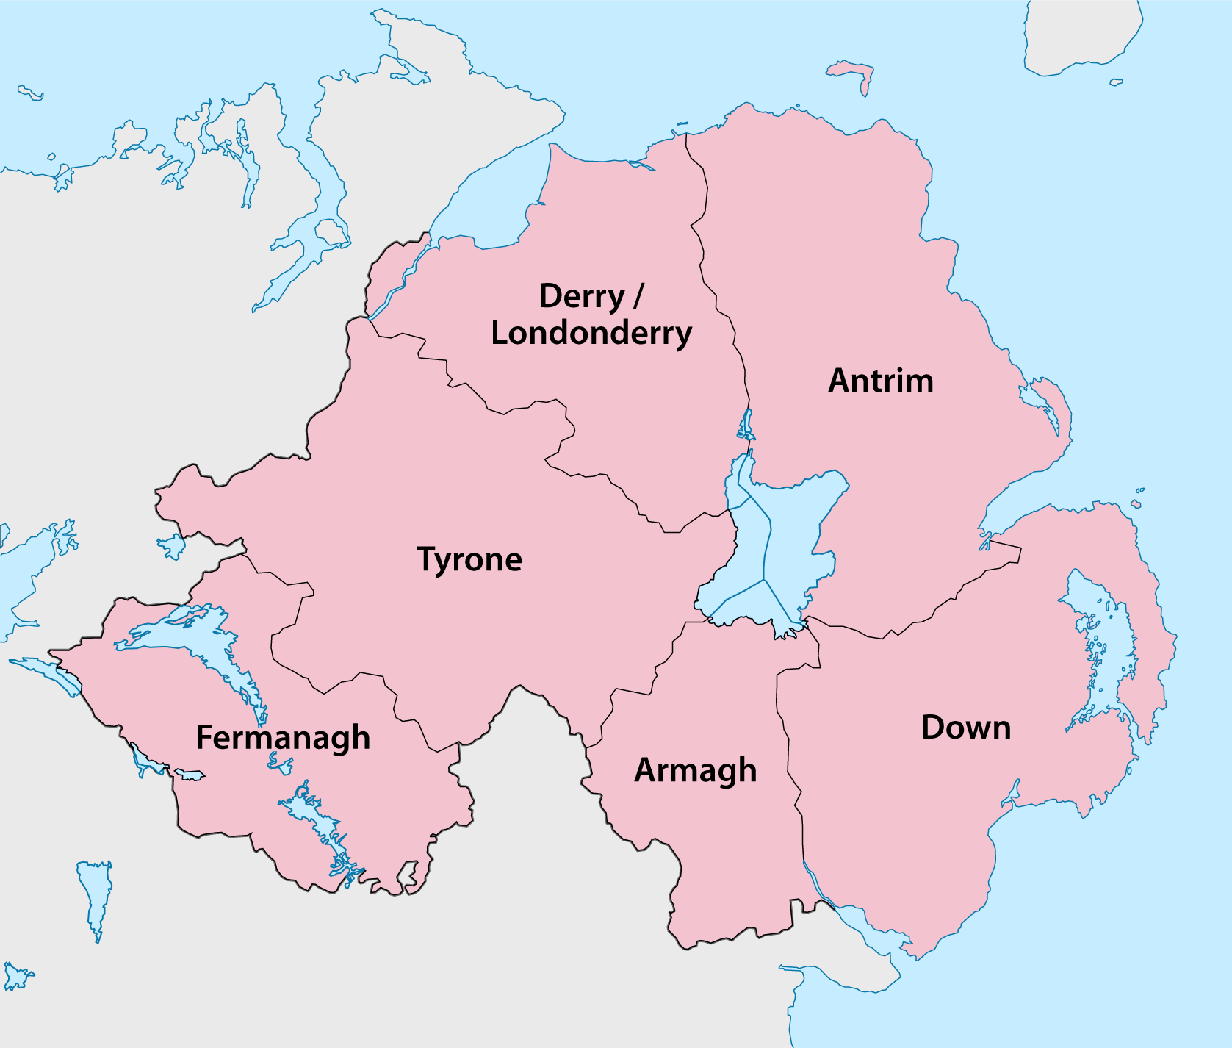
Geography of Northern Ireland
There are 6 counties:
Fermanagh
Antrim
Tyrone
Londonderry
Armagh
Down

Slide 3
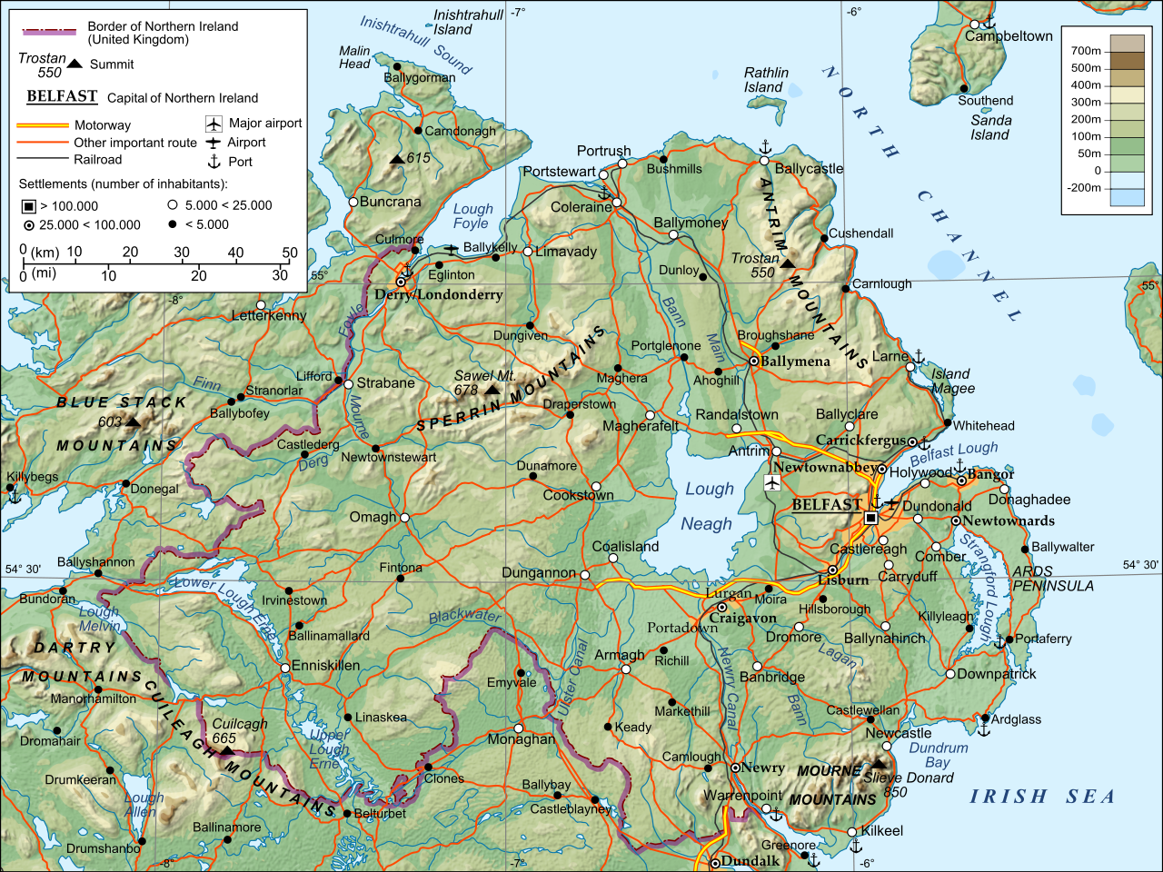
Rivers and Mountains in Northern Ireland
There are many beautiful lakes, rivers and mountains that you can visit:
Mourne mountains
Sperrin mountains
Lough Neagh
Upper/Lower Lough Erne
River Foyle
River Lagan
This Photo by Unknown Author is licensed under CC BY-SA

Slide 4
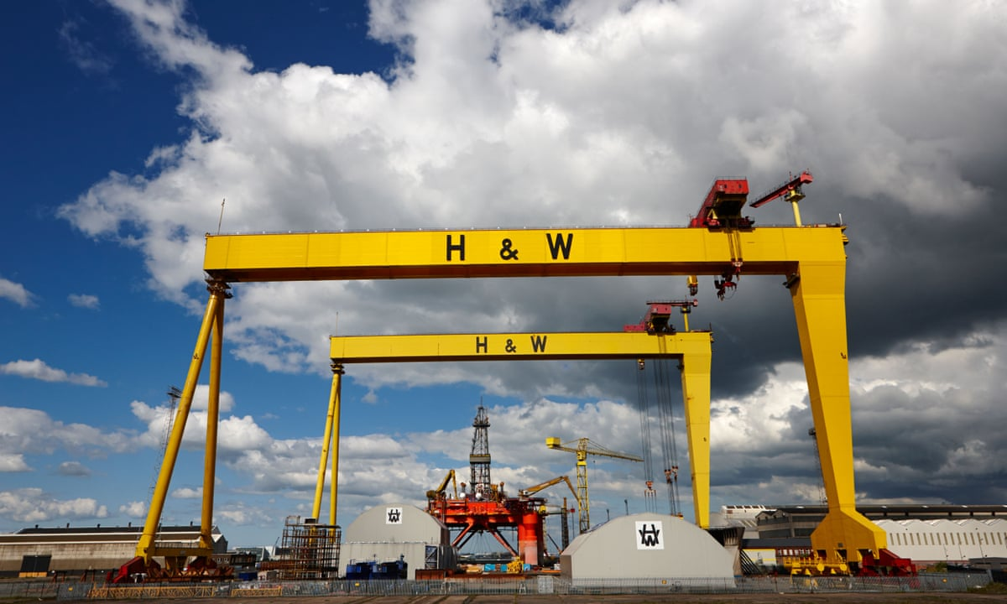
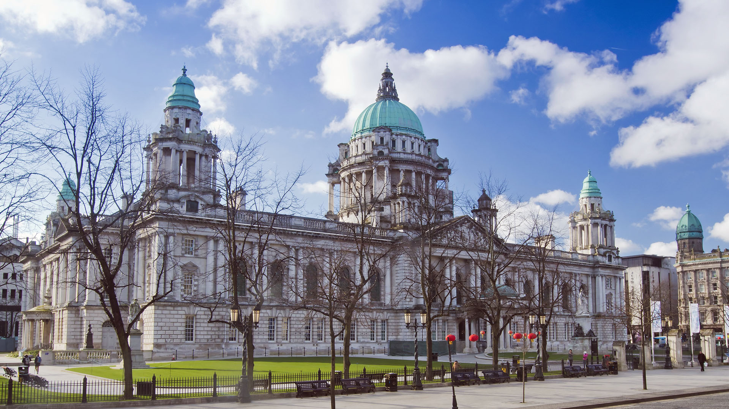
Belfast
Belfast is the capital of Northern Ireland.
Belfast is famous because the Titanic Ship was built here in the Harland and Wolff shipyard between 1909 and 1911.
Belfast has many beautiful old buildings like the City Hall, Queens University, St Anne’s Cathedral, Stormont Parliament Buildings, Belfast Castle, The Grand Opera House and the Albert Clock

Slide 5
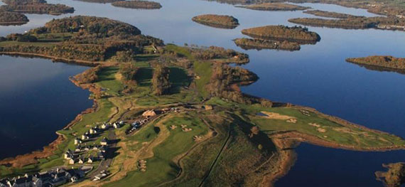
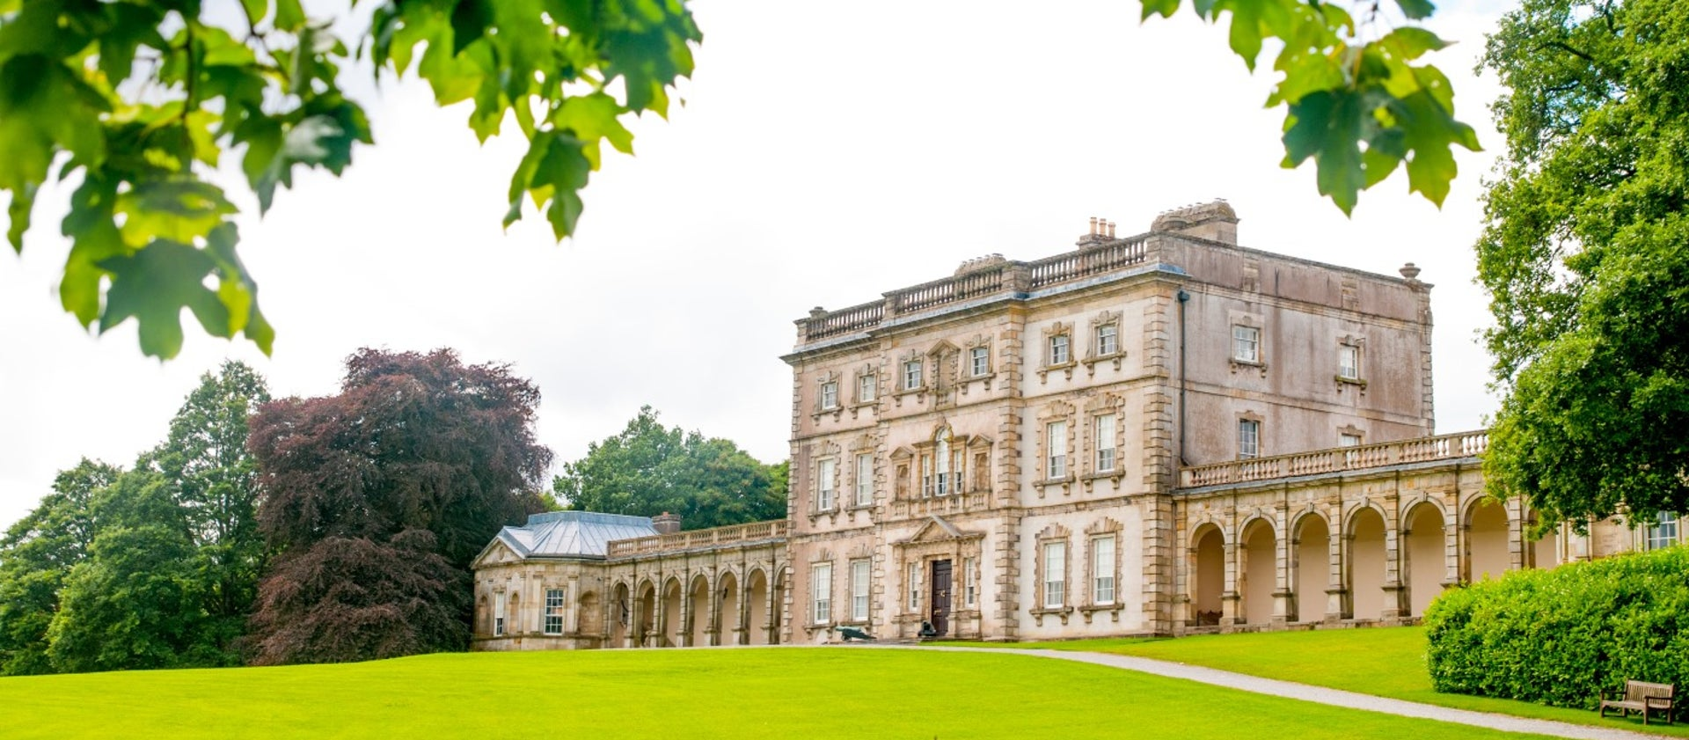
County Fermanagh
County Fermanagh is in the Southwest of Northern Ireland. County Fermanagh is the least populated county in Northern Ireland. It is the second smallest county in size.
Upper and Lower Lough Erne:
There are many beautiful spots to visit on the Loughs in County Fermanagh. People like to fish here, or hire boats or take their own to travel along the loughs and rivers. A very interesting fact is that Lough Erne and the Shannon-Erne Waterway Canal is the longest waterway that can be navigated in Europe.
Historic Buildings:
There are 34 listed buildings. One of the most beautiful is Florence Court, built by John Cole in 1730 and named after his wife Florence.

Slide 6
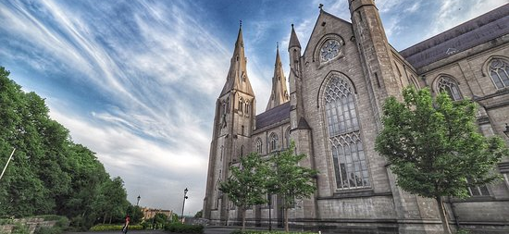
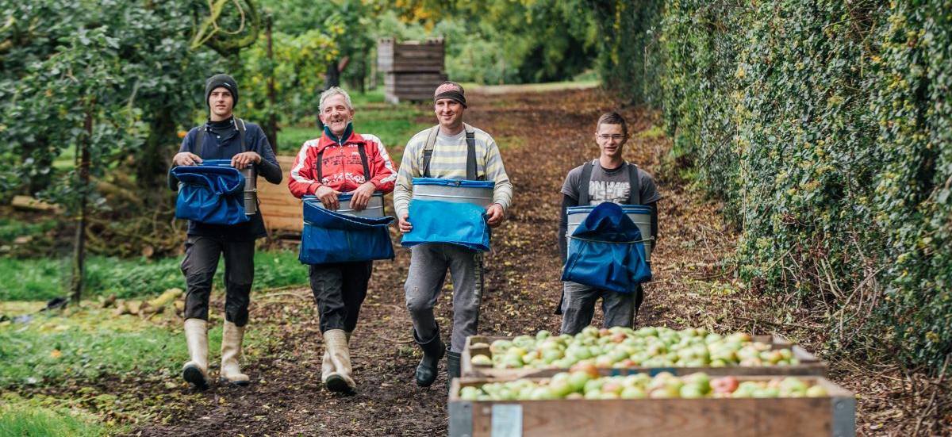
County Armagh
County Armagh is in the South of Northern Ireland.
The Orchard County:
County Armagh is famous for its many orchards and its applies. Loughgall is the main apple growing area in County Armagh. By 1921 the Bramley apple was the main variety of applie grown and today 90% of the apples grown here are Bramleys.
County Town:
Armagh is the county town and a city in Northern Ireland. It has two cathedrals and is known for its Georgian architecture. Armagh was given city status in 1994. It is the least populated city in Ireland and the 5th smallest in the UK.

Slide 7
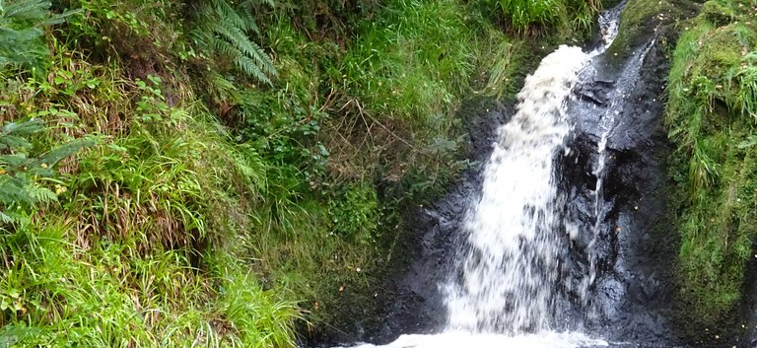
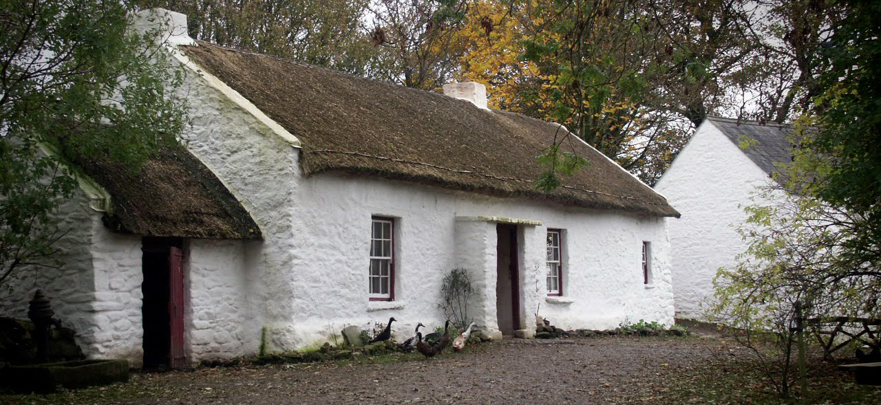
County Tyrone
County Tyrone is in the West of Northern Ireland.
O’Neill Country:
The nickname for County Tyrone is O’Neill Country. This is because of the ancient O’Neill clan who ruled the area. The county town is Omagh.
Famous Places:
Ulster American Folk Park
Todds Leap Activity Centre
Hill of the O’Neill and Ranfurly House Arts and Visitor Centre
Beaghmore Stone Circles
Gortin Glen Forest Park

Slide 8
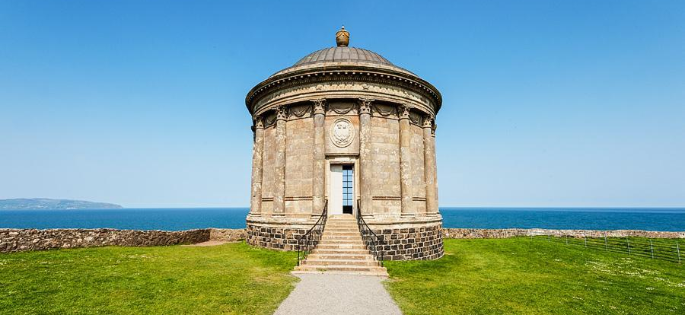
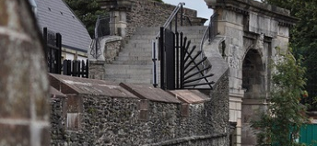
County Londonderry
County Londonderry is in the Northwest of Northern Ireland.
Oak Leaf County:
The nickname for County Londonderry is Oak Leaf County because the word Derry comes from the Irish word Doire which means Oaktree. London was added to the name of the city and the county by King James I in 1613. The county flower is the Purple Saxifrage.
Londonderry City:
Londonderry is the 4th biggest city in the whole of Ireland. It is also very old and is the only remaining completely walled city in Ireland. You can walk right around the city on the top of the walls.

Slide 9
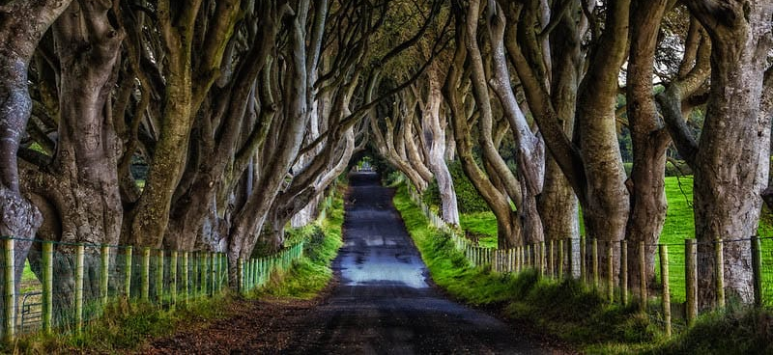
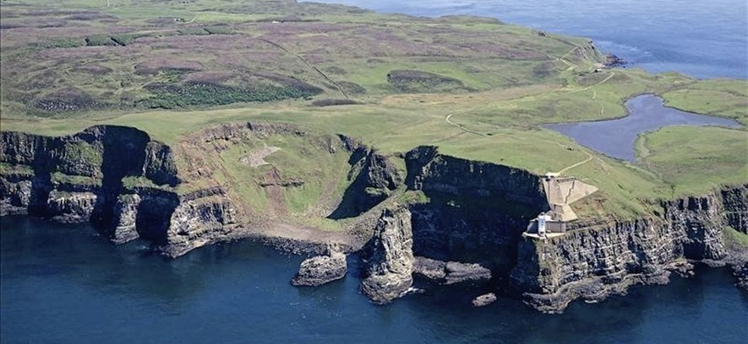
County Antrim
County Antrim is in the Northeast of Northern Ireland. It has a very beautiful coast and many people visit here from all over the world.
The Glens County:
A glen is another word for a valley. The Glens of Antrim is known for its nine glens. Glenoe Waterfall is one of the most beautiful waterfalls in Northern Ireland and it is in a small glen near the village of Glenoe.
Famous places:
The top 10 places to visit are: Bushmills Distillery, Rathlin Island, Crumlin Road Gaol, Glenoe Waterfall, Carrickfergus Castle, The Dark Hedges, Causeway Coastal Route, Dunluce Castle, Carrik a rede rope bridge and the Giants Causeway.

Slide 10
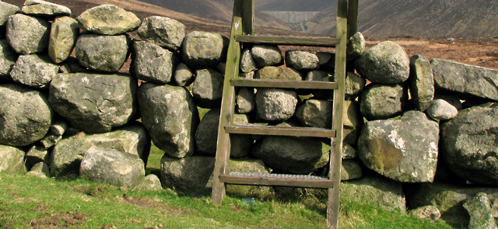
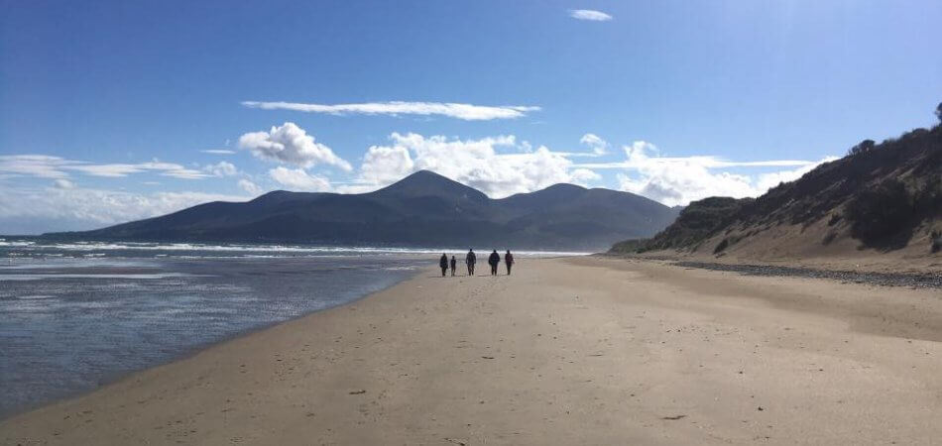
County Down
County Down is in the East of Northern Ireland. The coastline goes from Belfast Lough to Carlingford Lough.
Mourne Mountains and Mourne Wall:
The Mourne Mountains are an area of outstanding natural beauty in County Down. The includes some of the highest mountains in Northern Ireland. The highest mountain is Slieve Donard which is 2,790 ft high.
The Mourne Wall is a dry stone wall which is 19.5 miles long and goes over 15 peaks. It was started in 1904 and finished in 1922. It is a listed building even though it is not a building. The wall was built to keep cattle and sheep away from the water in Silent Valley, a reservoir owned by NI Water.

Slide 11
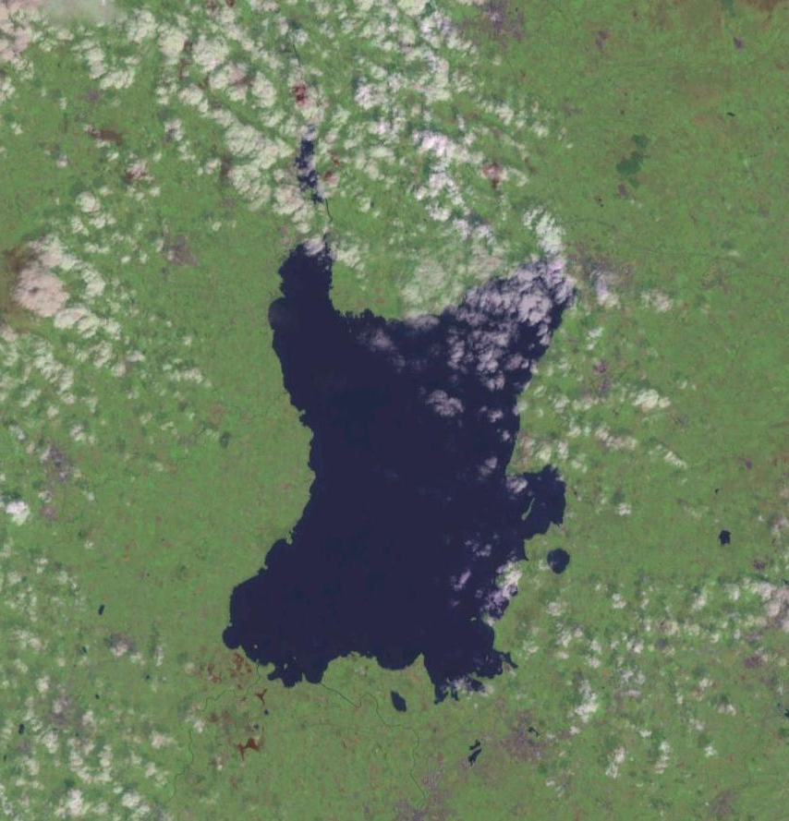
Lough Neagh
Lough Neagh is the largest lake in the UK. The things that live in Lough Neagh are fish, eels and algae
Here are some statistics:
Max length (30 km) 19 mi
Max width 9.3 mi (15km)
Max depth 82 ft (25 m)
Average depth 30 ft (9 m)
You can swim in certain parts of Lough Neagh or you can take a boat. You can fish in Lough Neagh.

Slide 12
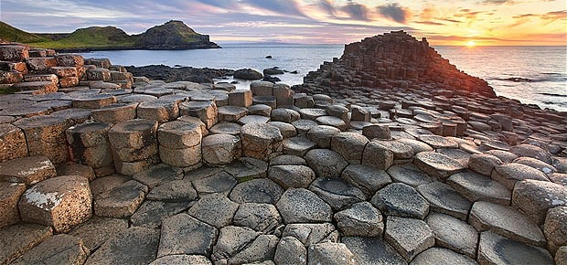
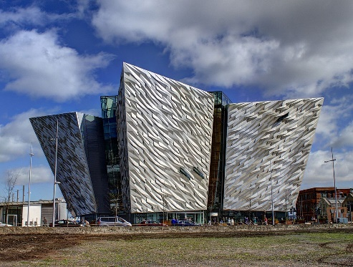
Tourist Attractions
Northern Ireland is a great place to visit. There are many tourist attractions that people come here to visit but here are 4 top places!
Titanic Belfast
The Titanic is one of the most famous ships ever built, it was built in Belfast at Harland and Wolff shipyard.
The Giants Causeway
The Giant’s Causeway is a spectacular basalt rock formation on the North Antrim Coast.

Slide 13
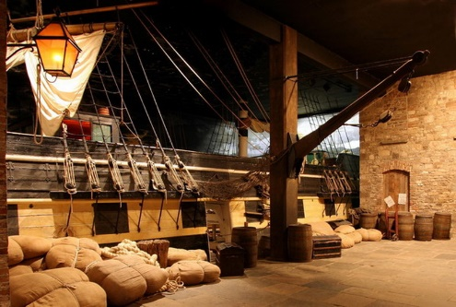
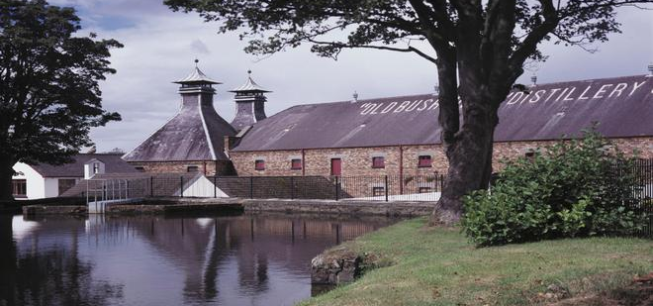
Tourist Attractions
Old Bushmills Distillery
Bushmills is a small Distillery on the Antrim coast and it is the site of the world’s oldest Distillery.
Ulster American Folk Park
The Ulster American Folk Park is one of the best museums in Ireland. It explains the connections between Northern Ireland and the USA.

Slide 14
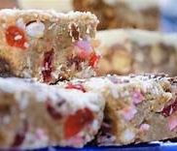
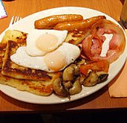
Northern Ireland Food
Northern Ireland has really nice food and a lot of it is traditional in both the country and in the towns. Many of the recipes go back for many hundreds of years and have been handed down from generation to generation. You can see many of these old recipes being made at places like the Ulster Folk Museum.
Some foods that you can try from Northern Ireland are:
Ardglass potted herring
Potato bread.
Soda bread
Wheaten bread
Boxty
Ulster fry
Vegetable roll
Champ
Vegetable soup
Dulse
Pasties
Yellow man
Fifteens

Slide 15
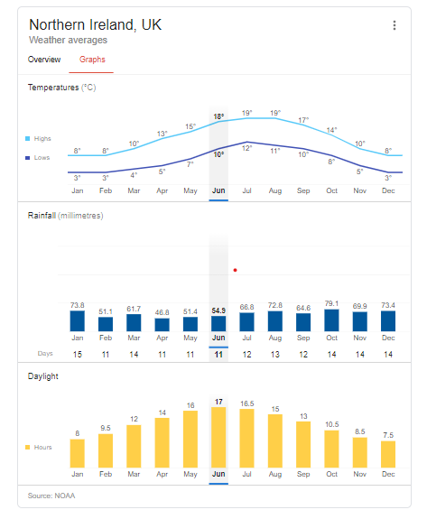
Northern Ireland Facts
Climate
Population – 1.8 million
Area - 14,130 km²
Famous People from Northern Ireland:
C.S. Lewis - Author
Liam Neeson – Actor
Seamus Heaney - Poet
George Best - Footballer
Dame Mary Peters - Sports
Van Morrison - Singer

