Slide 1
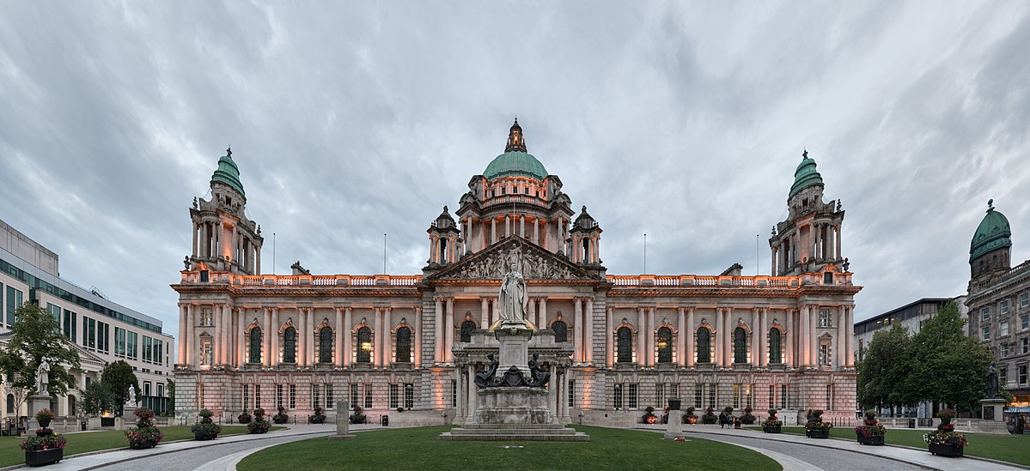
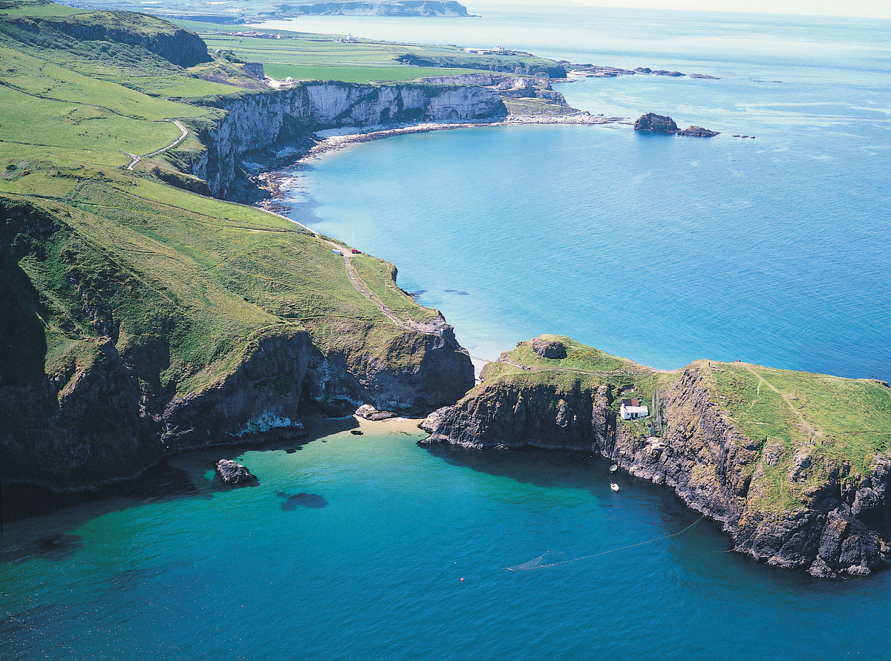
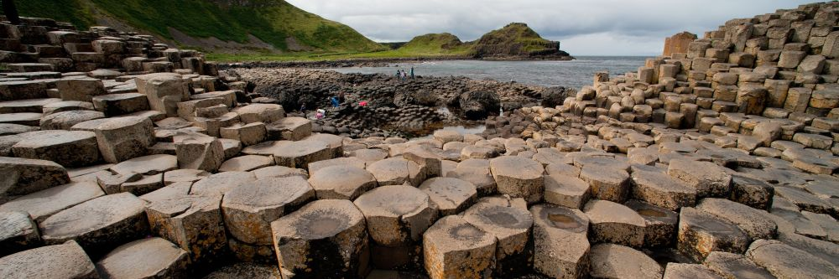
Northern Ireland
Facts About Northern Ireland
By Tilly Vaughan 2nd June 2020

Slide 2
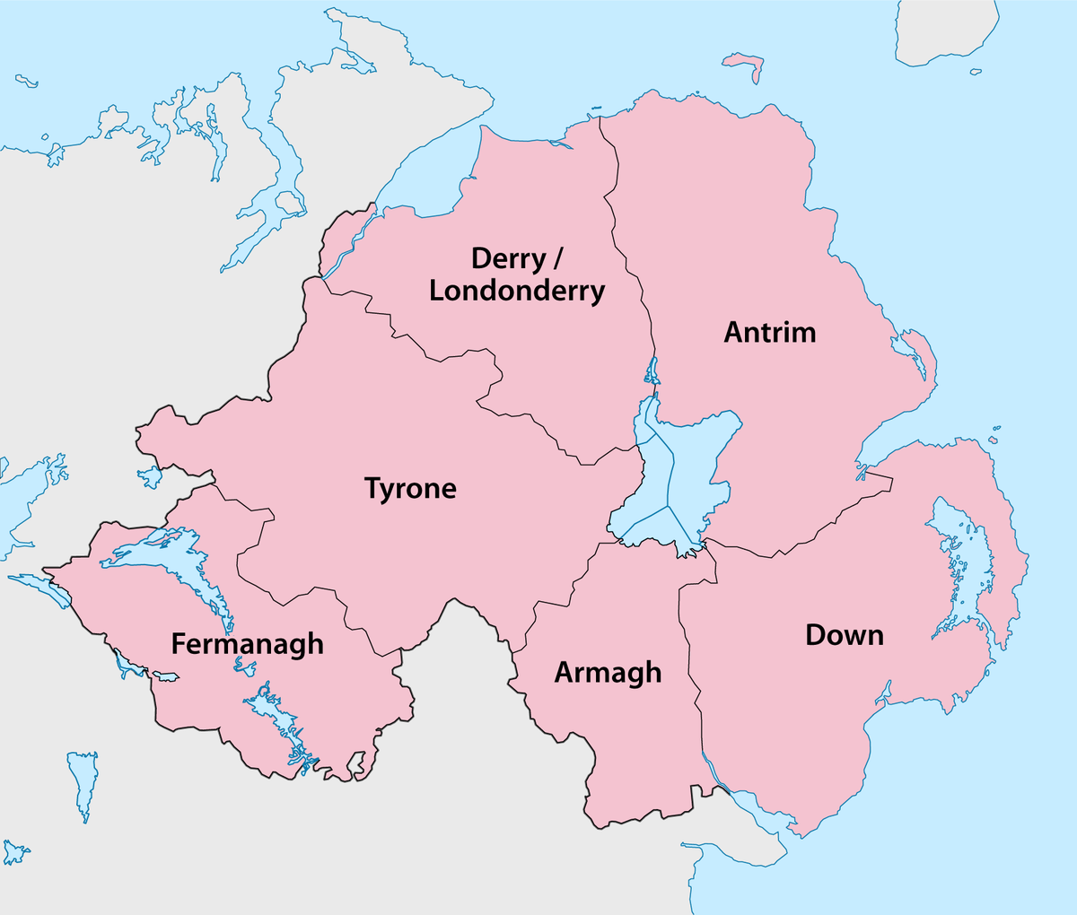
The Counties Of Northern Ireland
There are six counties in Northern Ireland:
Co.Fermanagh
Co.Tyrone
Co.Londonderry
Co.Antrim
Co.Down
Co.Armagh

Slide 3
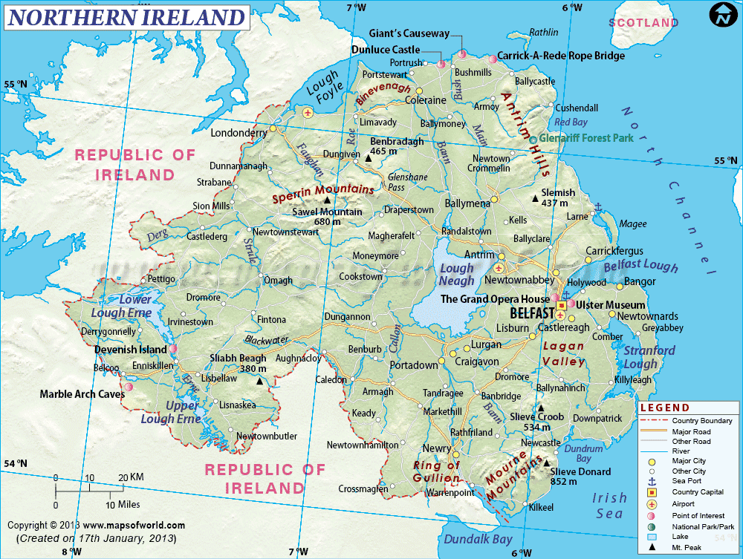
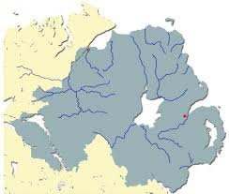
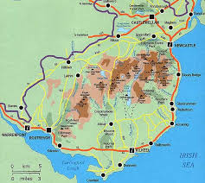
Northern Ireland’s Rivers and mountains

Slide 4
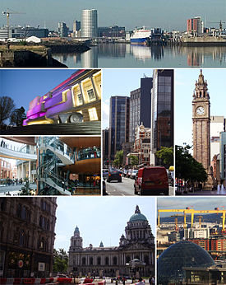
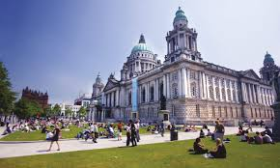
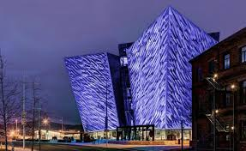
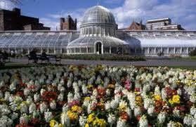
Belfast
It is the capital city of Northern Ireland
Population 333,000
Area 44.4 square miles
Its Nickname is rivermouth of the sandbanks
Occupied since the Bronze Age
Originally a small market town
Famous for Harland and Wolff. This is where the Titanic was built.

Slide 5
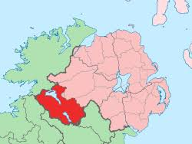
County Fermanagh
Largest town in Co.Fermanagh is Enniskillen
Population is approximately 61,805
Majority Catholic
Popular surnames - Maguire, Cassidy, Wilson
Only county that doesn’t border Lough Neagh
Means ‘Men of Manach’

Slide 6
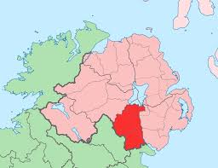
County Armagh
Population 14,749
Area is 1,326 square kilometres
Named after the town Armagh
Armagh comes from the Irish word and meaning ‘high place’
Armagh was the main town for the historic Ulaid kings of Ulster
Slieve Gullion is the highest mountain
South Armagh is mostly Catholic

Slide 7
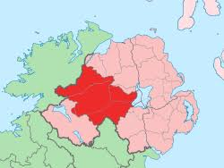
County Tyrone
Nick name is ‘The Red Hand County’
Area is 3,155 square kilometres
Irish name is ‘Tir Eoghain’ which means ‘Land of Eoghan’
Majority Catholic
Population is 180,000
Sperrin Mountains found here.
Biggest county in N.I.

Slide 8
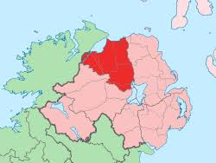
County Londonderry
Nick name is ‘The Oak-leaf County’
Area is 2000 square kilometres
River Foyle runs through the county
Population is 240,000
Largest city is Derry City
Top tourist attractions: City Walls, Museum of Free Derry, Peace Bridge and Portstewart Promenade

Slide 9
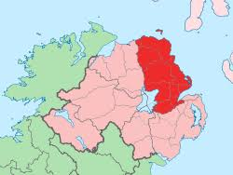
County Antrim
Located in the province of Ulster
Population is approximately 615,384
Nickname is ‘The Glens County’
The mountain “Knoclayd” is a dormant volcano
Tourist attractions- Giants Causway, Carrick-a-Rede Rope Bridge, Dunluce Castle

Slide 10
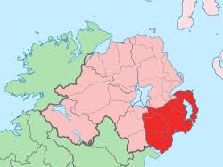
County Down
Largest town is Bangor
Population is approximately 531,665
Majority Protestant
Slieve Donard - tallest mountain in N.I.
Harry Ferguson is from Co.Down
Has 3 of N.I. poshest towns: Hillsborough, Holywood and Bangor

Slide 11
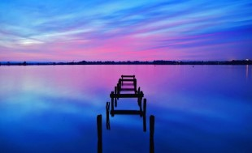
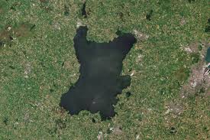
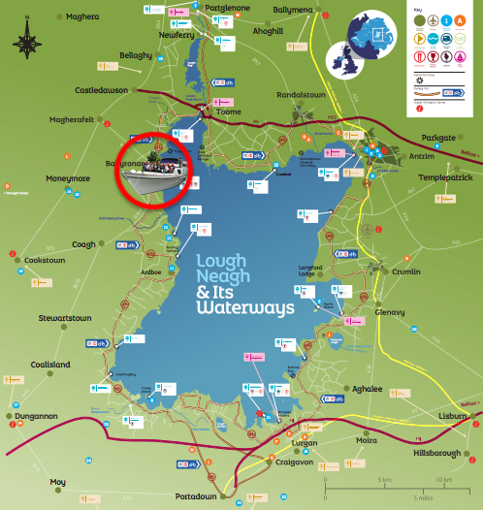
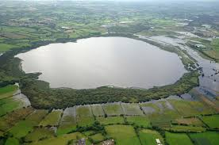
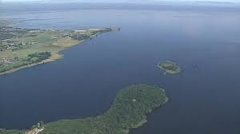
Lough Neagh
Located in centre of N.I.
5 out of 6 counties border it
Largest freshwater lake in British Isles
Surface area of 383 square kilometres
Name means The lake of the horse-god Eochu

Slide 12
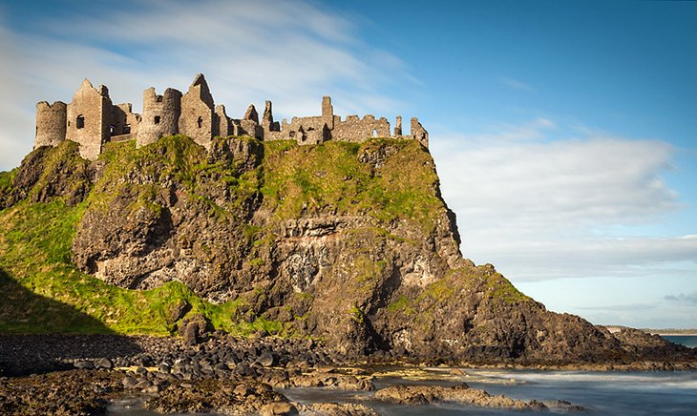
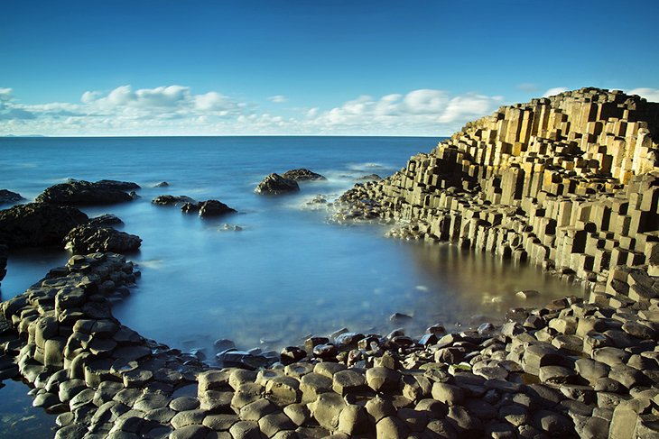
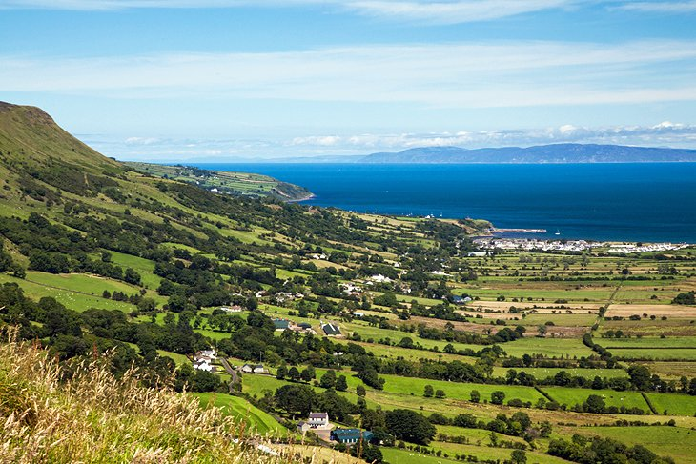
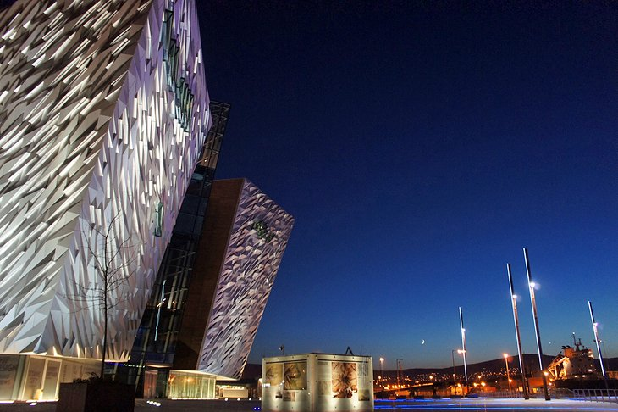
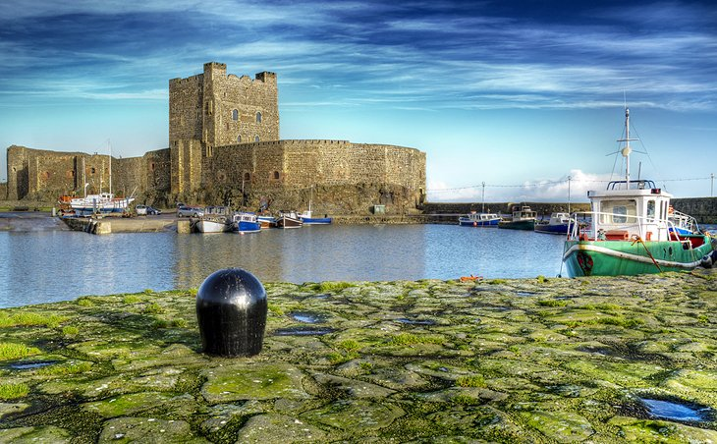
Tourist Attractions
Giant’s Causeway
Causeway Coast and Carrick-a-Rede Rope Bridge
Titanic Museum, Belfast
Carrickfergus Castle
Glens of Antrim

Slide 13
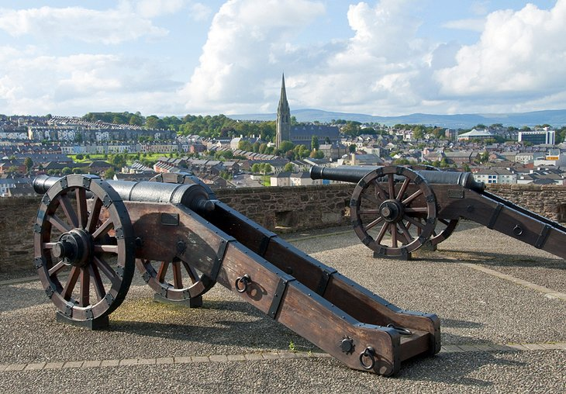
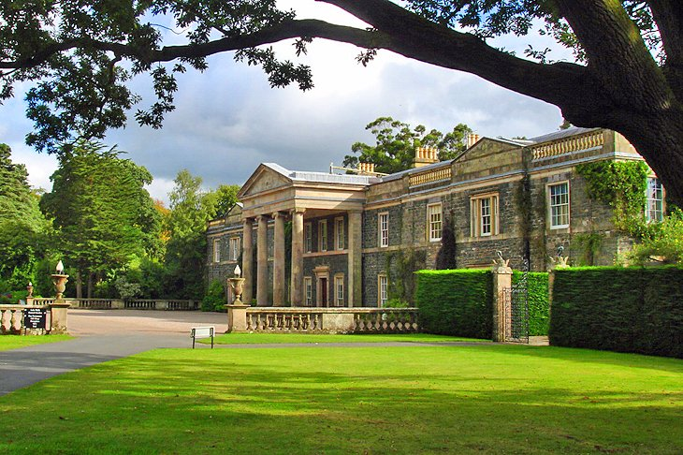
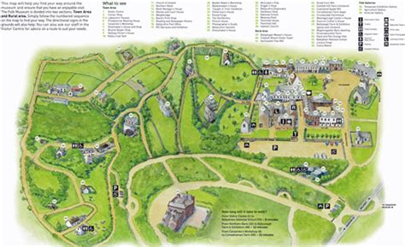
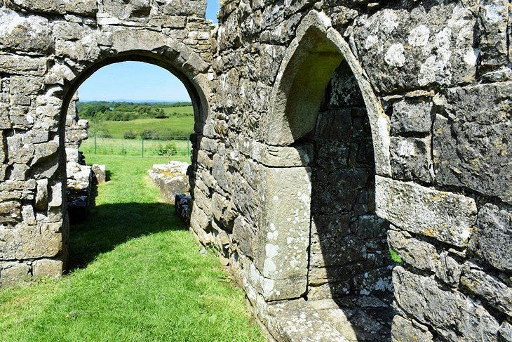
Tourist Attractions
Ards Peninsula
Londonderry City Walls
Lough Erne
Ulster Folk and Transport Museum

Slide 14
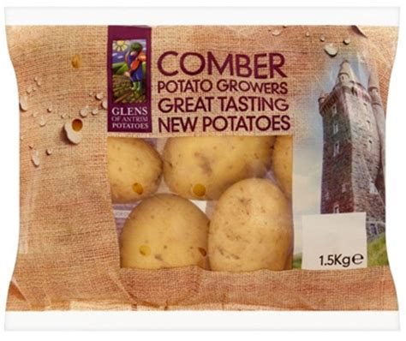
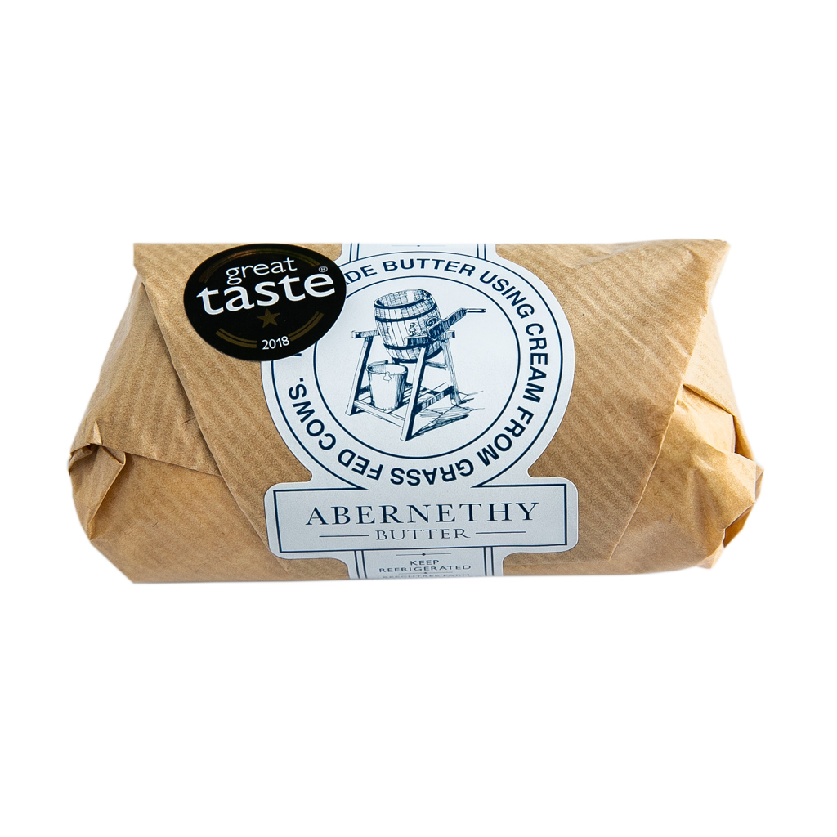
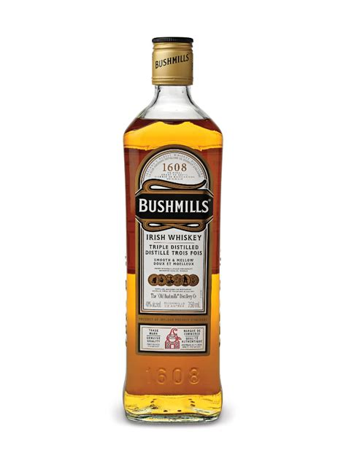
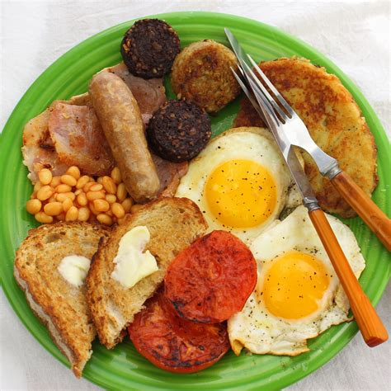
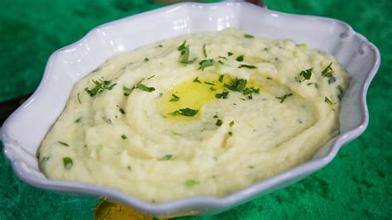
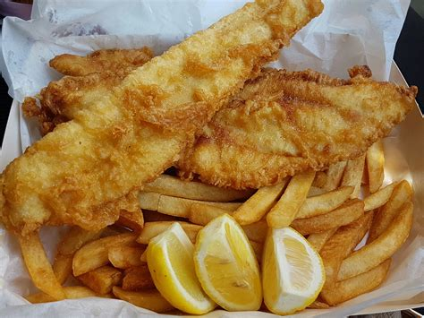
Northern Irish Food
Abernethy butter
Comber potatoes
Bushmills Whiskey
Champ
Ulster fry
Fish and Chips

Slide 15
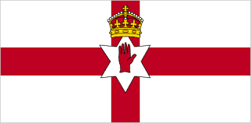
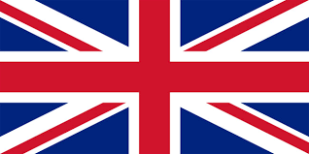
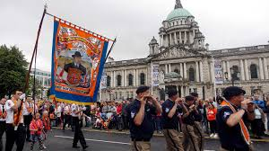
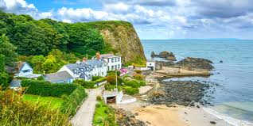
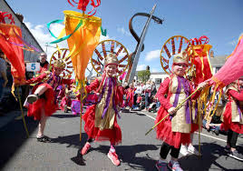
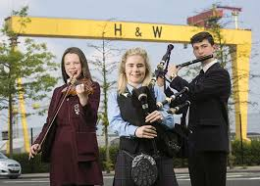
Northern Ireland Facts
14,139 square kilometres
Second most sparsely populated part of the UK after Scotland
HMS Titanic ship was built in Belfast
Celebrates St Patrick’s Day
Language - English, Irish and Ulster Scots
Currency - pound sterling
Anthem - God Save the Queen
Longest river - River Bann
Highest point - Slieve Donard
Nationality - British and Irish
Mild and wet weather most of the year.

