Slide 1
Northern IRELAND
Brought to you by Jacob Wilson

Slide 2
Map of northern Ireland

Slide 3
Physical map of northern ireland

Slide 4
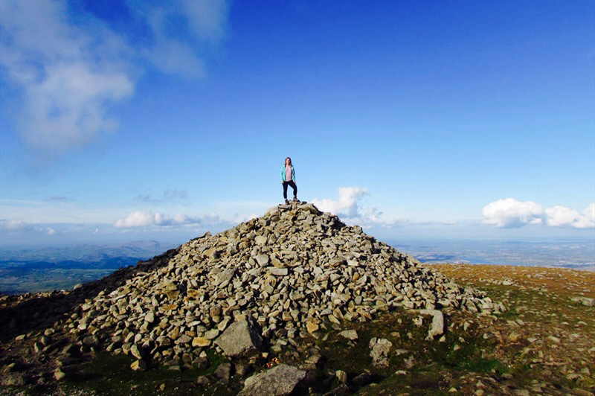
County down
County Down is one of six counties in Northern Ireland. County Down is 2448 km2 and has a population of 531 665 people. County Down is in the province of Ulster. The largest town in County Down is Bangor.
Places in County Down are Anahilt, Ballynahinch, Banbridge, and Dromore, that’s only four out of approximately 134 places in County Down.
County Down is home to the Mourne Mountains, Tollymore Forest Park, Castle Ward and Castlewellen which are all big tourist attractions.

Slide 5
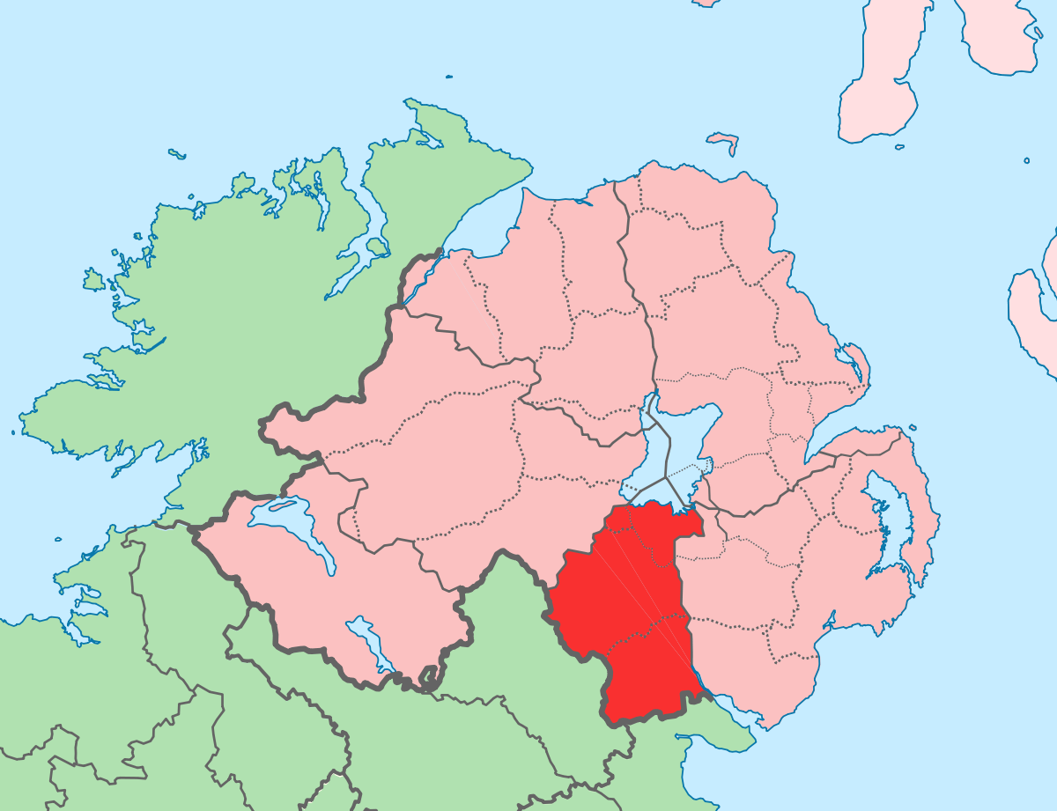
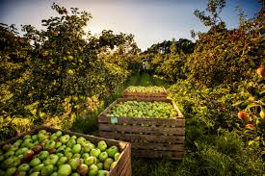
COUNTY ARMAGH
Nicknamed “The Orchard County”
Population of 174,800
Covers an area of 1,326 km²
Part of the Province of Ulster
The main town is Portadown
Main attraction is Navan centre

Slide 6
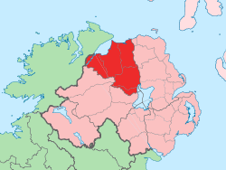
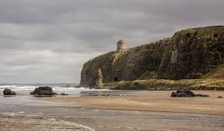
COUNTY LONDONDERRY
Nicknamed “The Oak Leaf County”
Population of 247,100
Covers an area of 2,000 km²
Part of the Province of Ulster
West of County Antrim
Main attractions are The Peace Bridge, The Derry Walls, Castlerock and Mussenden Temple.

Slide 7
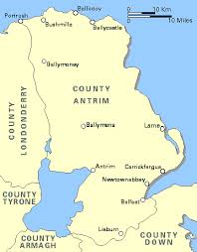
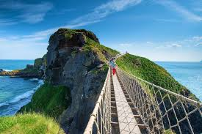
County antrim
Nicknamed “The saffron county”
Population of 618,000
Covers an area of 3,050 km²
Part of the Province of Ulster
North of County Down
The main towns are Belfast city and Antrim
Main attractions are Giants Causeway, Carrick-A-Rede Rope Bridge and Titanic Belfast

Slide 8
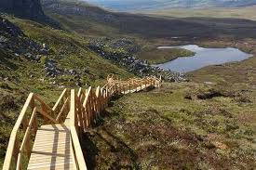
County fermanagh
Nicknamed “The Lake Land County”
Population of 61,000
Covers an area of 1,850 km²
Part of the Province of Ulster
On the South West part of Northern Ireland
The main town is Enniskillen
Main attractions are Cuilcagh Board Walk, Lough Erne, Devenish Island and Marble Arch Caves

Slide 9
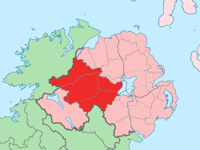
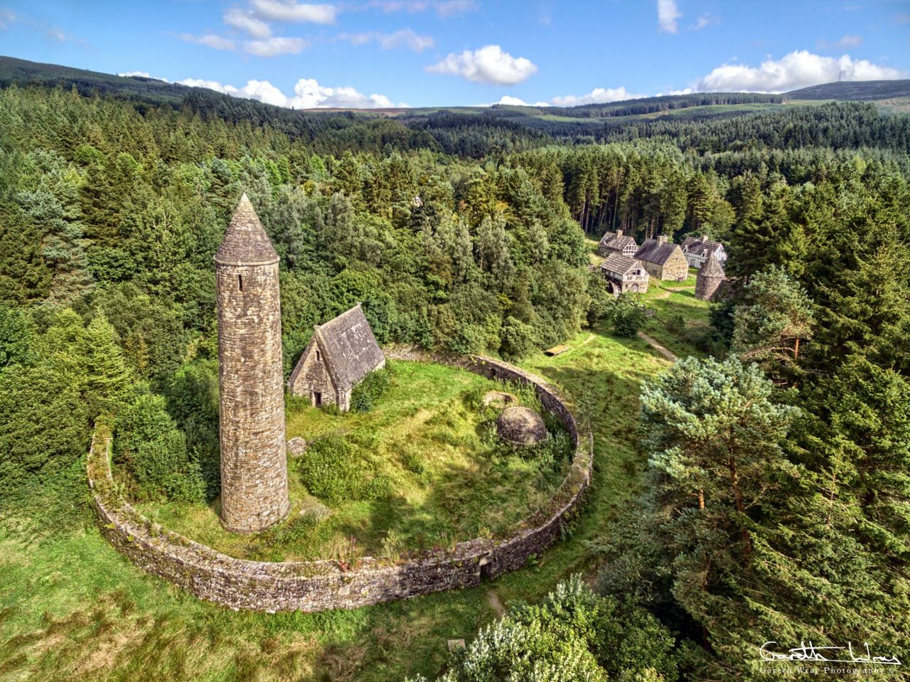
County tyrone
Nicknamed “The Oak Leaf County”
Population of 178,000
Covers an area of 3,263 km²
Part of the Province of Ulster
Part of Northern Ireland
The main town is Omagh
Main attractions are Ulster American Folk park

Slide 10
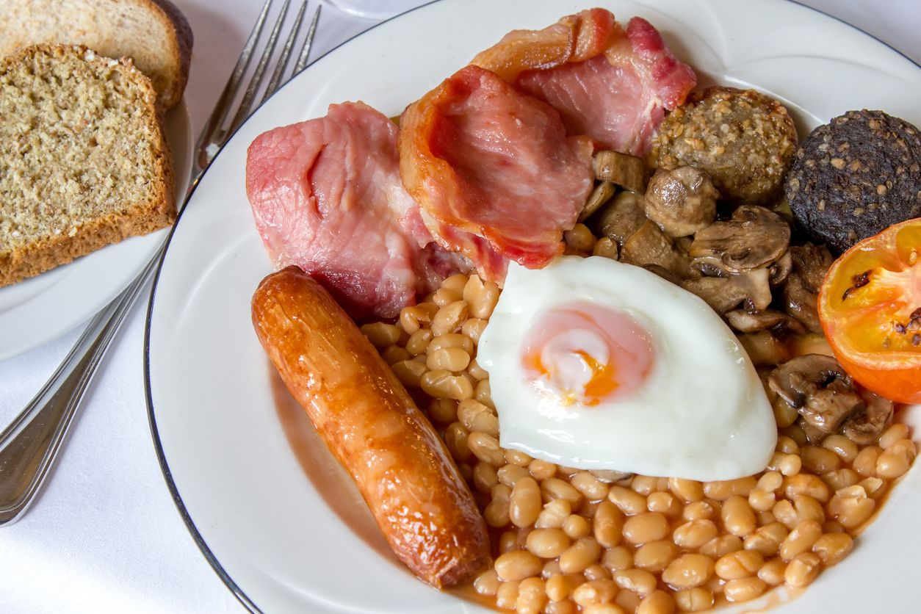
Northern Ireland food
  Typical Irish Menu
  Breakfast:
  Porridge with honey and oats
  Ulster fry with sausage, bacon, egg, mushroom, soda bread, tomato, potato bread and pancake
  Lunch:
  Vegetable soup with wheaten bread and butter or jam
  Dinner:
  Irish stew and HP sauce
  Smoked salmon, cabbage, bacon and mashed potato
  Beverages:
  Guinness, Irish cider, tea, coffee, water, Doctor Pepper and Pepsi
  Dessert:
  Chocolate cheesecake, chocolate cake and apple tart

Slide 11
Ni population is 1.9 million

Slide 12
Ni weather
Days of Sunshine
0
Days of Rain
365

Slide 13
Thanks for watching
Cheerio

