Slide 1
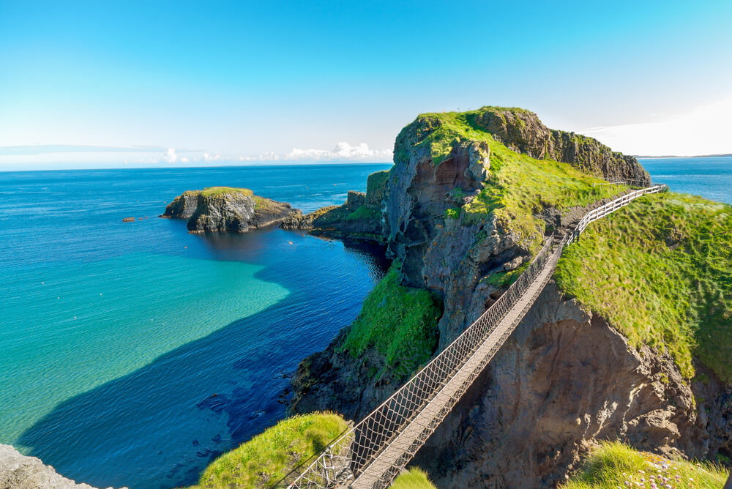
Northern Ireland

Slide 2
Northern Ireland
Has a population of 1,897,893 (2019 census)

Slide 3
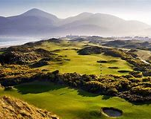
County Down
County Down is one of the six counties of Northern Ireland. It is in the North East of the island of Ireland.
County Down includes Belfast and Lisburn cities, Bangor and Newry are some of the other large towns in the county.
Based on the census conducted in 2001, it was reported that most people who lived in County Down, had a Protestant background. Catholicism dominated in, South Down.
There are several rivers in County Down, these include River Quoile, Clanrye, Bann and Lagan.

Slide 4
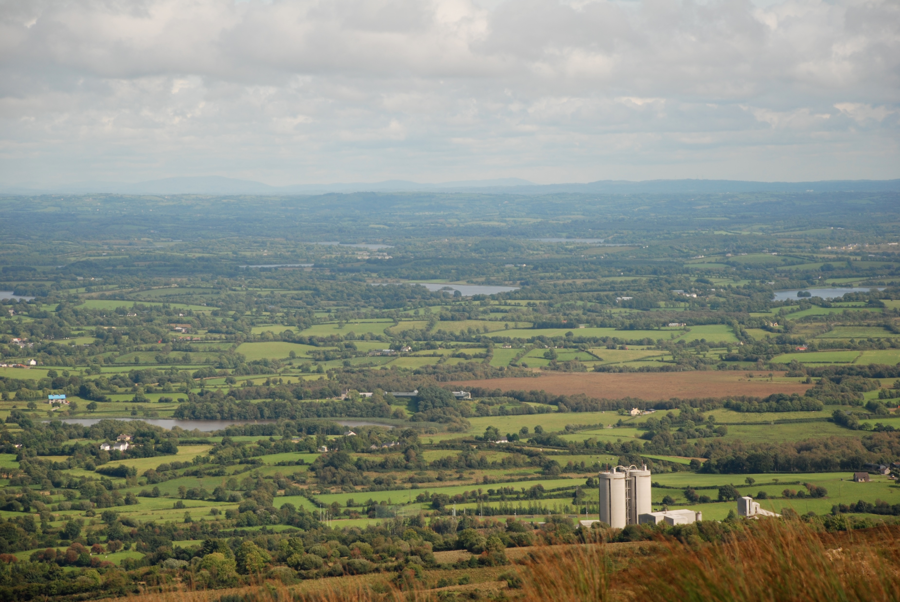
County Fermanagh
The county covers an area of 1961 km2.
The county has a population of 62,527 (2012 census).
The majority of its population has a Catholic background.
Its nicknames are the Maguire county or the Lakeland county.
Fermanagh is famous for, its lakes, particularly Lough Erne and waterways.
Farming and Tourism, are the two major economic activities in this rural county.

Slide 5
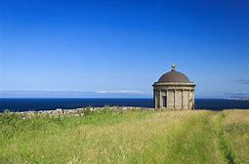
County Londonderry
Londonderry is also known as County Derry, it is one of the six counties of Northern Ireland. It was one of the counties in the kingdom of Ireland from 1613 and then of the United Kingdom after the acts of Union in 1800. County Londonderry is home to some of the world’s most scenic coastline.

Slide 6
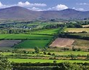
County Tyrone
County Tyrone is no longer used as an administrative division for the local government but remains a strong identity in local identity. The county has an area of 3,155 km2, making Tyrone the largest county in Northern Ireland.

Slide 7
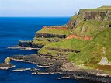
County Antrim
County Antrim is known for its great scenery and Portrush too. Main tourist attractions in County Antrim include the Old Bushmills Distillery, The Giants Causeway and Carrick-a-Rede Rope bridge. Co. Antrim’s Nickname is the Saffron county.

Slide 8
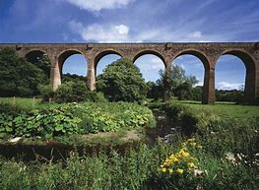
County Armagh
Armagh is known as the Orchard county because of the number of orchards there. The smallest county of Northern Ireland is in fact Armagh at 1,254km2. Armagh city was the capital of Ulster in the earlier times. West of Armagh town is Navan Hill Fort, from were Ulster Kings ruled for a millennium.

Slide 9
The area of Northern Ireland is
14,130 km2

Slide 10
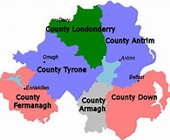

Slide 11
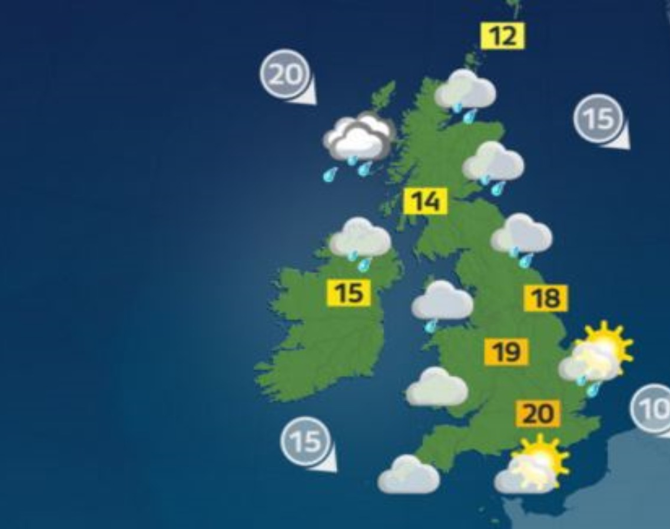
Northern Ireland weather
NI weather can be summed up as unpredictable many would describe it as being mild, moist and changeable with abundant rainfall.

Slide 12
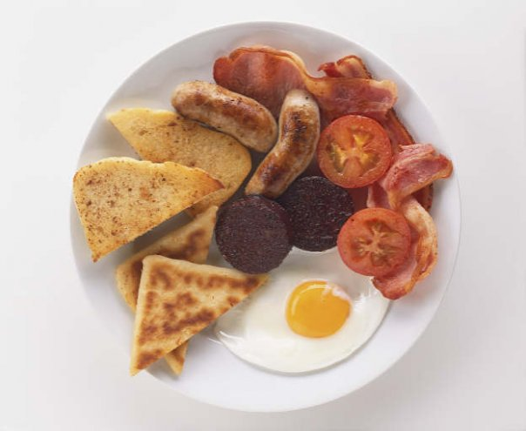
Northern Irish Foods
Some Northern Irish foods include potatoes, potato apple bread. A Full Ulster Fry, including soda bread farl, sausage, beans and bacon. Hearty homemade Irish stew served with homemade wheaten bread. Most popular Northern Irish dessert would have to be homemade apple crumble served with ice cream and custard.

Slide 13
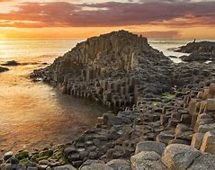
Some of the top Tourist Attractions in Northern Ireland.
The Ulster Museum, St Anne’s Cathedral, Giants Causeway, Carrickfergus Castle, Titanic Belfast, Dunluce Castle, Donegal Castle, Crumlin Road Gaol, Botanic Gardens, Belfast Zoo, St Georges Market, Mourne Mountains, Carrick-a-Rede Rope Bridge, Belfast Castle and The Marble Arch Caves.

Slide 14
I hope you enjoyed watching my PowerPoint presentation on Northern Ireland and found it interesting and informative
I had lots of fun putting it together and creating it for you.
Ellie Sloan

