Slide 1
Northern Ireland
By Abigail Weatherhead

Slide 2
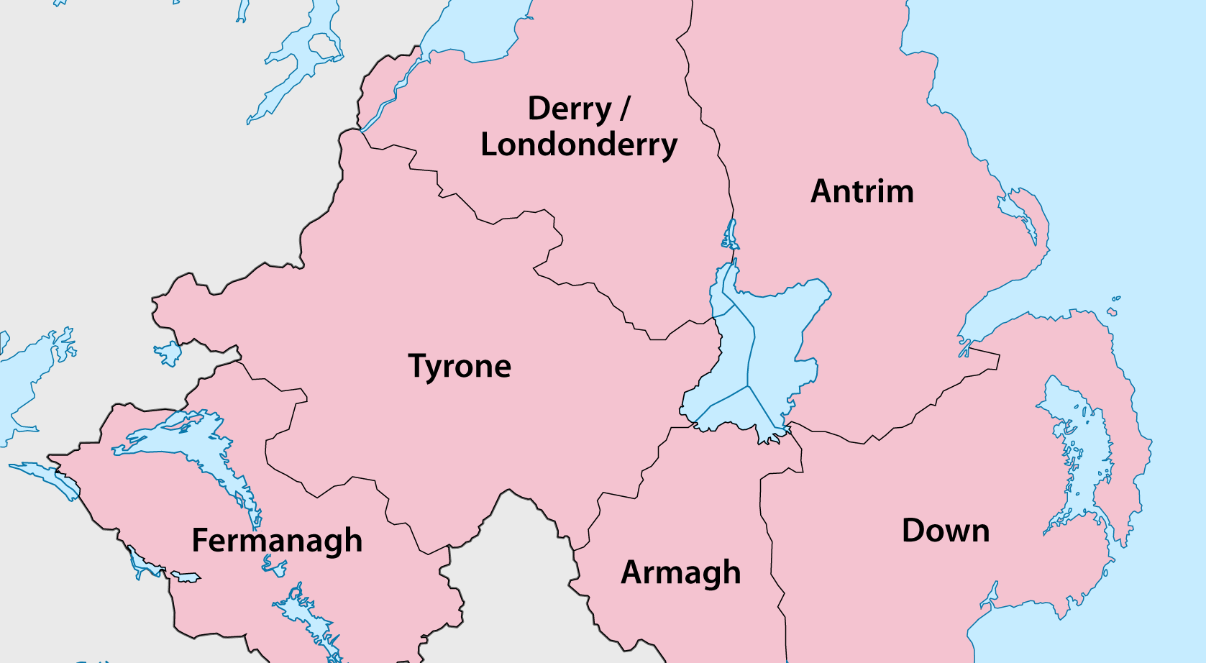
Map

Slide 3
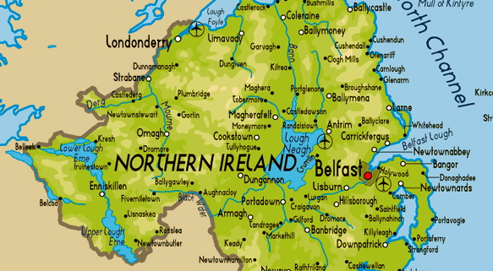
Physical Map

Slide 4
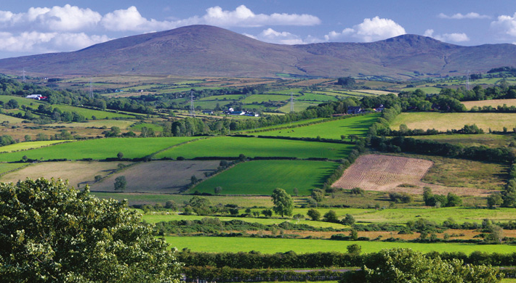
County Tyrone

Slide 5
Key Facts
Consilio et Prudentia – By Wisdom and Prudence
Red Hand of Ulster
Population – 177,986
Established in 1585
Area – 3,263km2
Mediaeval name from the O’Neill clan

Slide 6
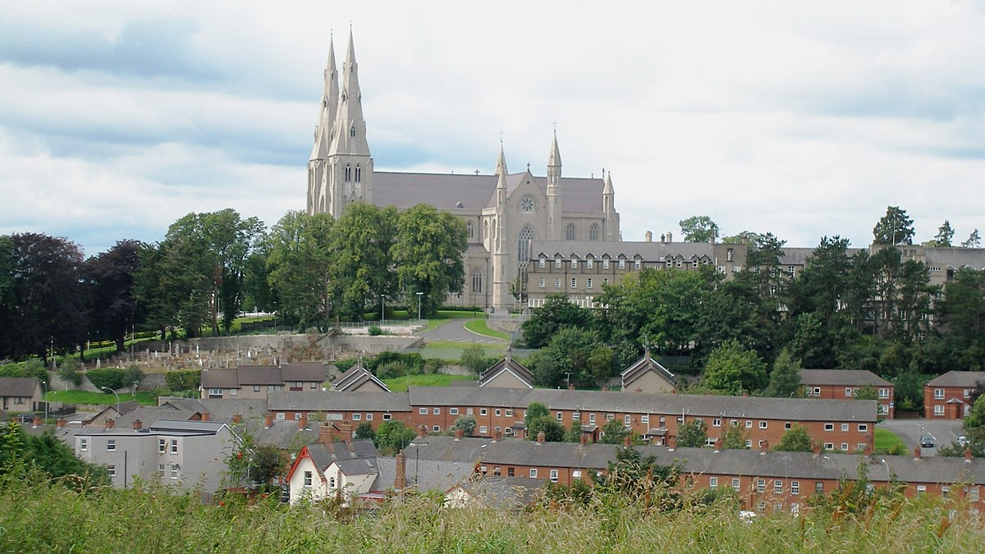
County Armagh

Slide 7
Key Facts
Smallest County in Northern Ireland
Nicknamed “the Orchard County”
Founded in 45AD
In Concilio Consilium – In Council is Wisdom
Population – 174,792
Slieve Gullion was an extinct volcano with a crater lake, it has the highest burial spot in the Province

Slide 8
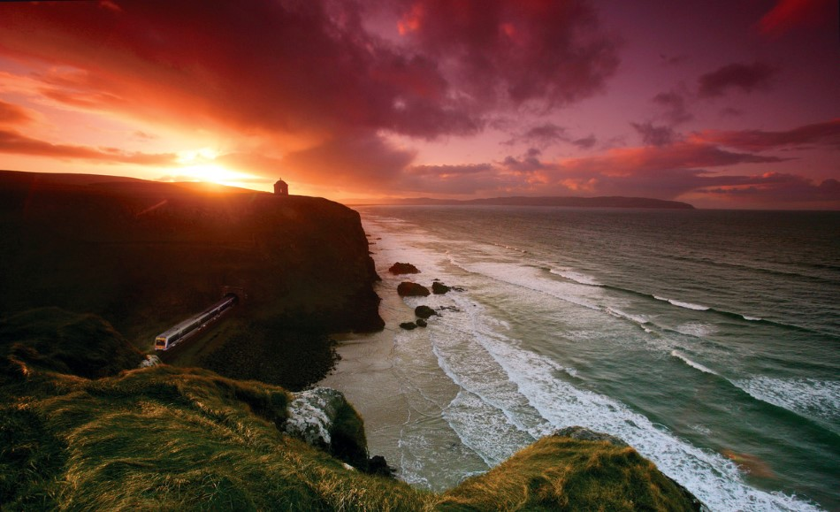
County Londonderry

Slide 9
Key Facts
Irish name is Contae Dhoire or Coontie Lunnonderrie
Since 1981 it has become one of the 4 Counties with a Catholic majority
Nicknamed “The Oakleaf County”
Auxilium A Domino – Help Comes from the Lord
Childhood home of Seamus Heaney

Slide 10
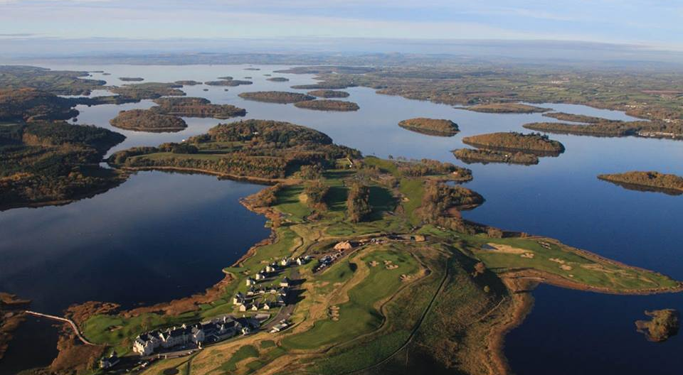
County Fermanagh

Slide 11
Key Facts
Irish name – Fear Manach – Men of Manach
Nicknamed the Lakeland (for obvious reasons)
County Town – Enniskillen
The Maguire clan was the dominant Celtic tribe
Highest mountain is Cuilcagh at 2,182ft
Attractions include Crom Castle, Marble Arch Caves and Devenish Island

Slide 12
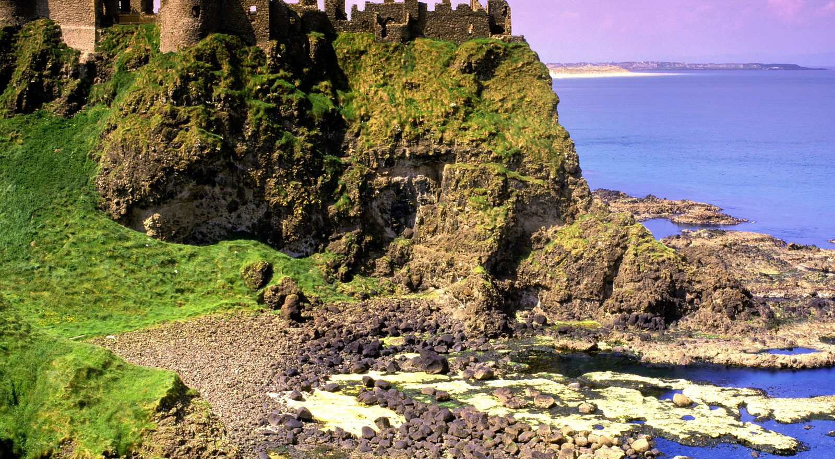
Country Antrim

Slide 13
Key Facts
Motto – Per Angusta Ad Augusta – Through Trial to Triumphs
Established c.1400
The majority of Belfast, the Provinces capital, is in this County
It is nicnamed “The Glens”
It was named after its major town, Antrim
Population 618,000

Slide 14
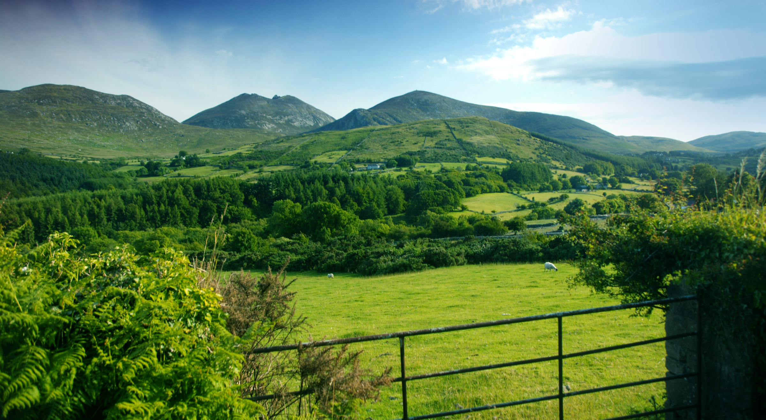
County Down

Slide 15
Key Facts
Motto – Nothing Without Labour
The Mourne Mountains are in the County
Major towns include Ballynahinch and Bangor
The Battle of Ballynahinch took place in the County
It boarders County Antrim to the North
Its main river is the River Lagan

Slide 16
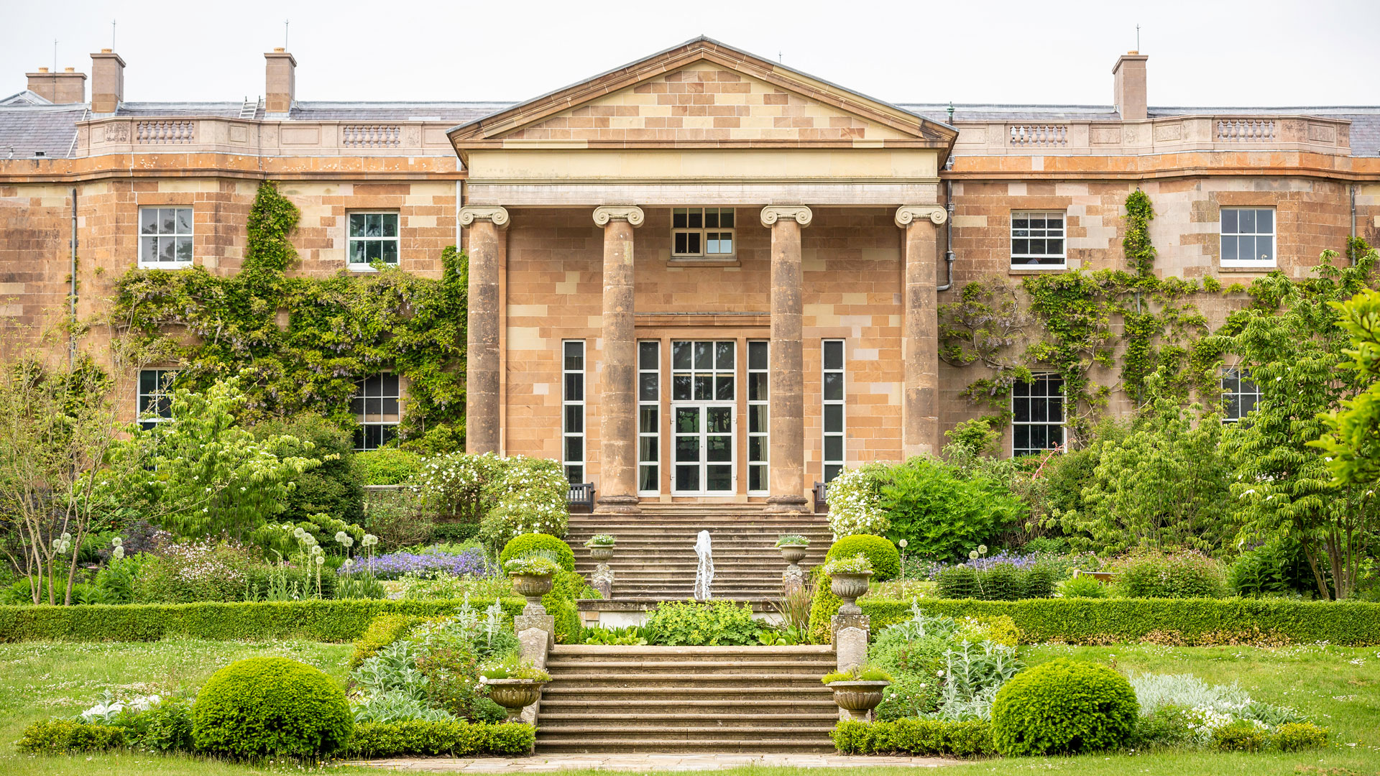
Hillsborough

Slide 17
Key Facts
Hillsborough Castle is a 2 storey Georgian mansion where the Queen and Royal Family stay when they visit
Hillsborough is 19km from Belfast
It was originally a compact settlement
Before 1661 the townland was known as Crumlin (Crooked)
The forest park is 200 acres

Slide 18
Food Glorious Food!!!
Northern Ireland is famous for its food, here are some of my favourites:
Ulster Fry
Soda Bread
19’s
Irish Stew

Slide 19
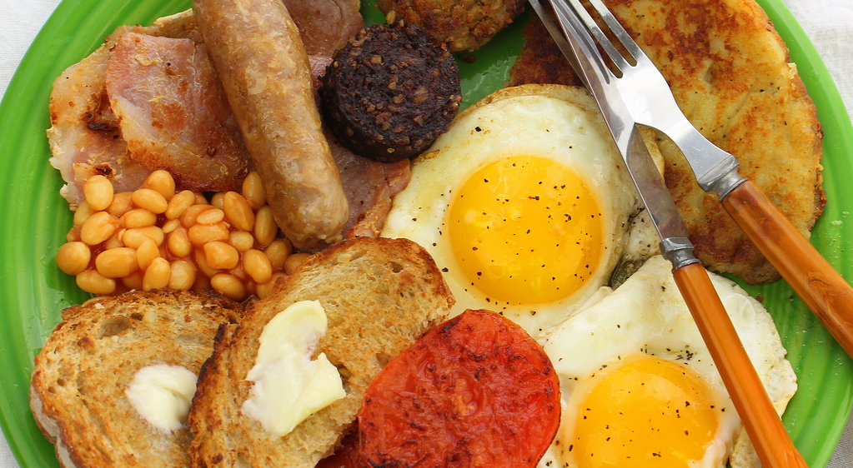
Ulster Fry

Slide 20
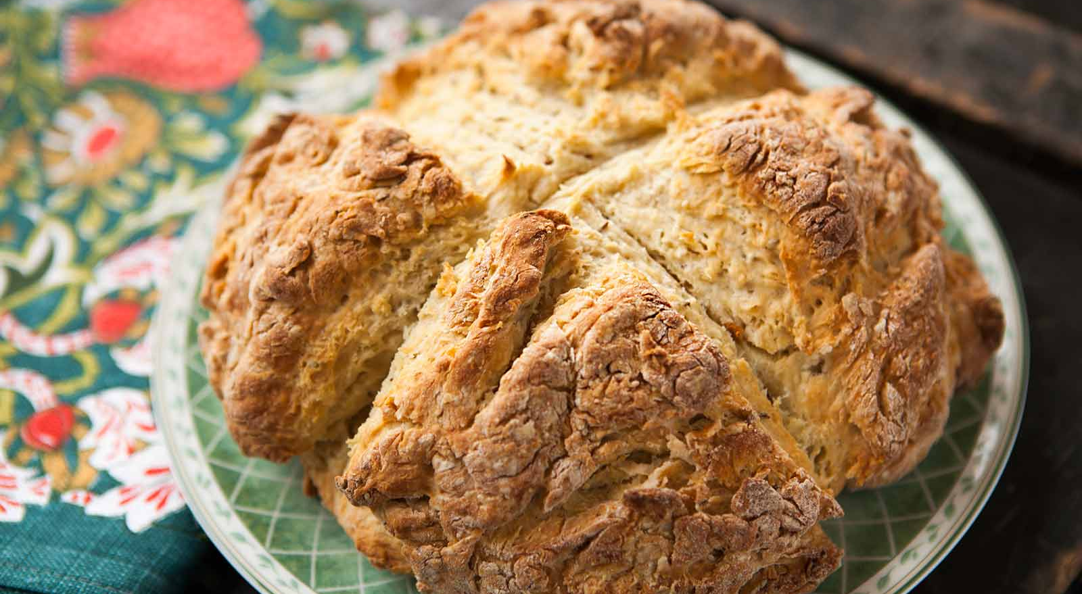
Soda Bread

Slide 21
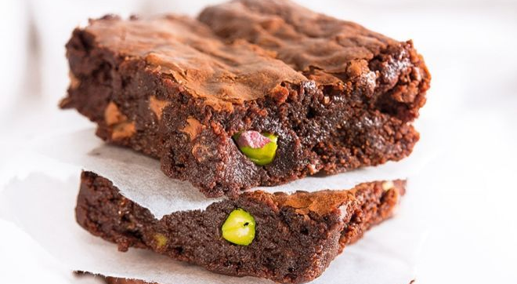
Tray Bakes

Slide 22
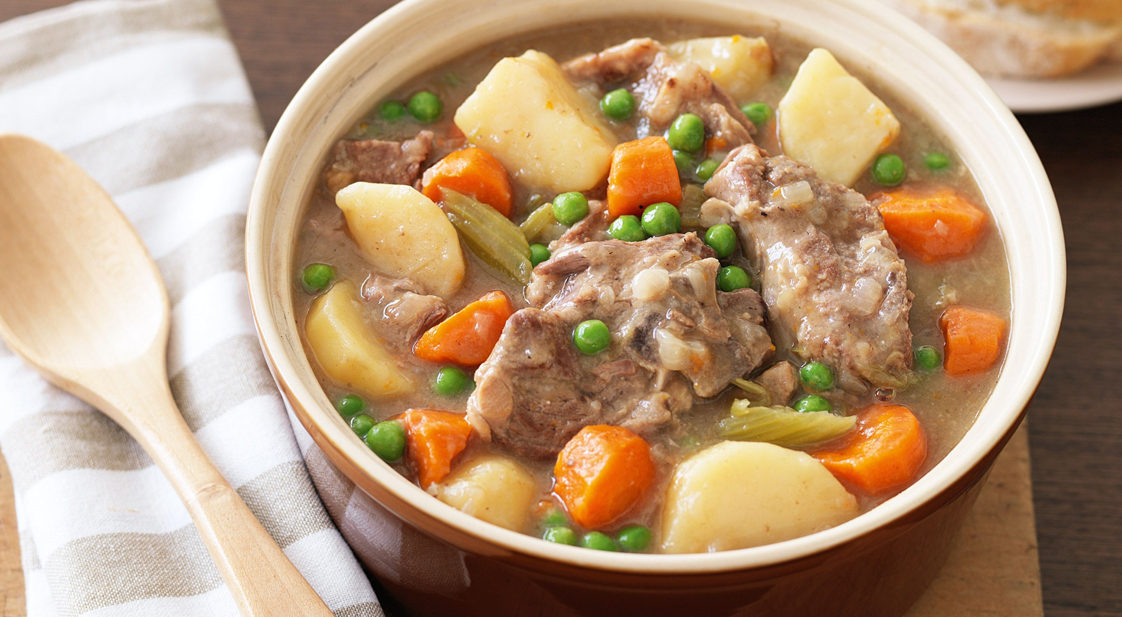
Irish Stew

Slide 23
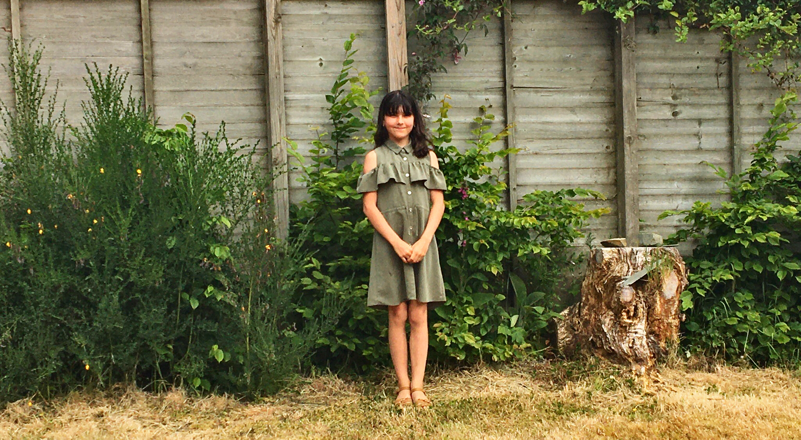
But what NI is really famous for…..

