Slide 1

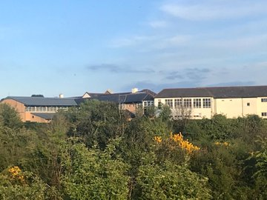
Down High School

Slide 2
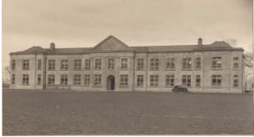
History of the School
The school opened in 1933 and celebrated its 80th Anniversary in 2013/14.
It is built on one of the four distinctive hills in Downpatrick, looking over the ruins of Inch Abbey on the site of the 19th century gaol.
Originally there were two schools joined on the same site, a Grammar School and a Technical School, now it is just the Grammar School.

Slide 3
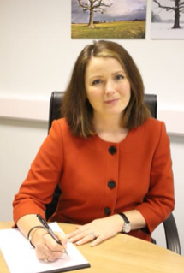
Staff and Pupils
The School has approximately 950 Pupils and 70 Teachers.
The Current Principal is Mrs M. Perry.

Slide 4
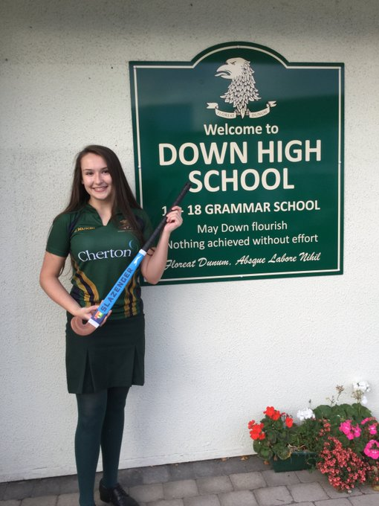
The Crest
The Crest says in Latin ‘ Floreat Dunum’ which means ‘ May Down Flourish’.
The School Crest is a yellow and green colour.
The colours are taken from the arms of Lady Southwell who was the 4th last Earl of Ardglass.
The Crest was designed by the late RWH Blackwood.
The design Is based upon the supposed badge of John De Courcy, a Norman Knight who captured Downpatrick in 1177 and established himself as ruler of North East Ulster.

Slide 5
Aims and Values of the School
Promote wellbeing by providing a safe, caring and supportive environment for every member of our school community.
Nurture life-long friendships and positive relationships through respect for diversity and sensitivity towards others.
Foster personal qualities such as kindness, optimism, integrity and respect.
Develop leadership, independence, confidence and resilience in every pupil.
Encourage curiosity, creativity and resourcefulness in pupils who, as fully engaged learners, embrace the knowledge and skills required for a changing world.
Inspire participation, effort and excellence in the rich extra-curricular life of the school.
Raise pupils’ awareness of the world around them and their wider responsibilities as members of society.
Celebrate the strong partnerships within the Down High School community.

Slide 6
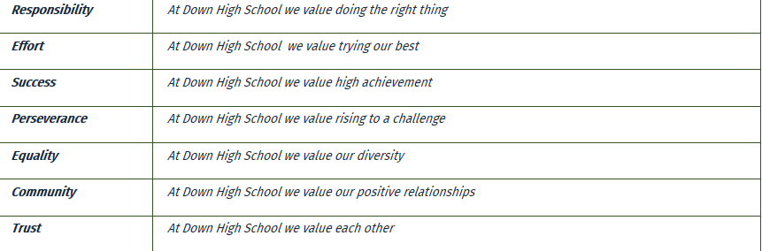
Down High School Core Value of RESPECT means:
Responsibility
Effort
Success
Perseverance
Equality
Community
Trust

Slide 7

The School Day
The school Day starts at 8.55am and finishes at 3.20pm.
First class is at 9.15am and each class is 3o minutes.

Slide 8
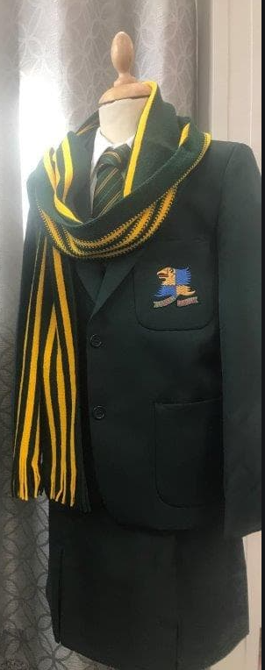
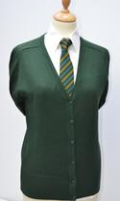
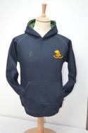
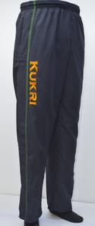
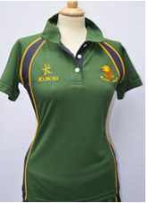
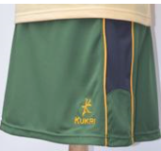
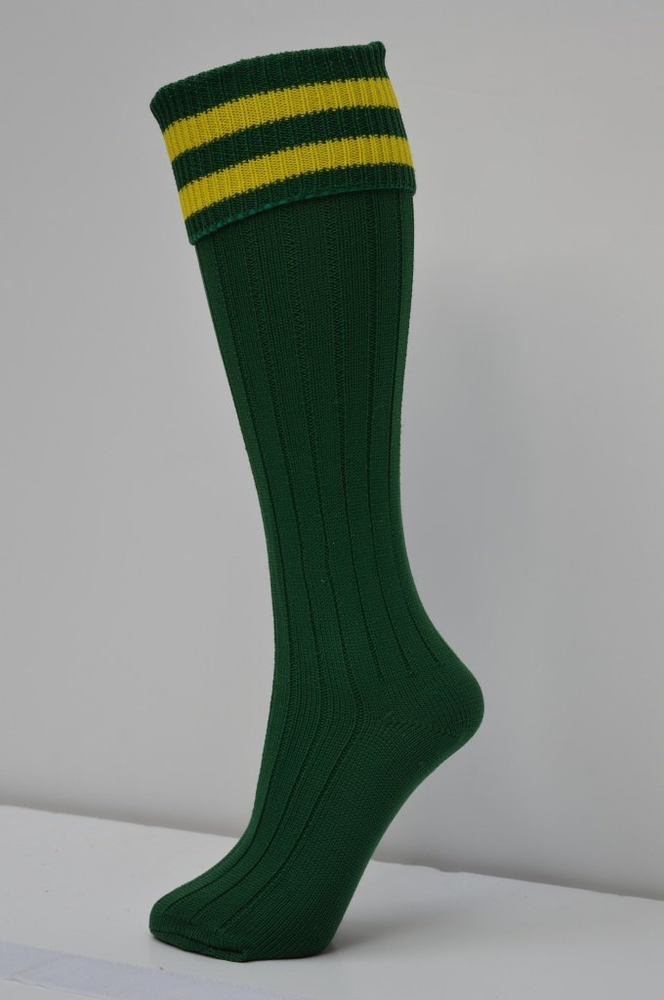
School Uniform
Girls Uniform
White shirt.
Skirt of regulation size and colour.
Green v–neck cardigan/pullover.
School tie with distinctive house colour.
School blazer.
Dark green socks or opaque tights.
Plain black flat shoes.
The school scarf may be worn.
Down High School navy Kukri hoodie.
Girls PE Uniform
Green Kukri sports top.
Green Kukri skort.
Navy blue/green tracksuit bottoms.
Hockey socks green with gold stripe.
Short white socks.
Indoor/outdoor trainers.

Slide 9






Curriculum
Subjects taught in Year 8 are:
French.
Mathematics.
Religious Studies.
Physical Education.
Science.
History.
Geography.
Art.
Home Economics.
Technology.
Music.
Drama.
ICT.
Year 9 is the same only with the addition of Spanish.

Slide 10

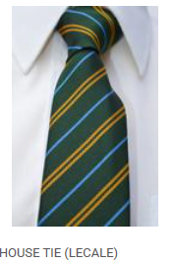
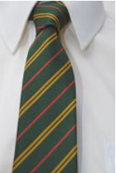
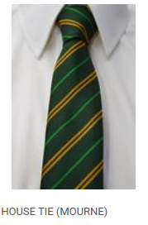

The House System
There are 5 Houses in Down High. Every pupil is assigned to one of the five Houses and therefore must wear the distinctive tie relating to their House.
Down - purple, on account of its ecclesiastical connection with the town. The Hill of Down (Dun being a fort) is the hill on which Downpatrick’s religious history is based. Down Cathedral stands on the Hill of Down.
Lecale – blue, an armorial colour of Lady Betty Cromwell, daughter of the 4th and last Earl of Ardglass, owner of Downpatrick estate. The name Lecale derives from the Gaelic Leth Cathail (Cathal’s portion), the land marked out by an eighth century warrior tribesman.
Rathkeltair – red as Celtair, or Red Branch Knight who ruled the district in ancient times and who is buried close to the school site. The name Rathkeltair is often given to the Mound of Down, although it is likely that Celtair was in fact buried on the Hill of Down, where the Cathedral now stands.
Mourne – green, reflecting the major colour of the school and the countryside of the Kingdom of Mourne.
Strangford – white, reflecting the turbulent waters of the Narrows – mouth of Strangford Lough.
House Tie (Rathkeltair)

Slide 11
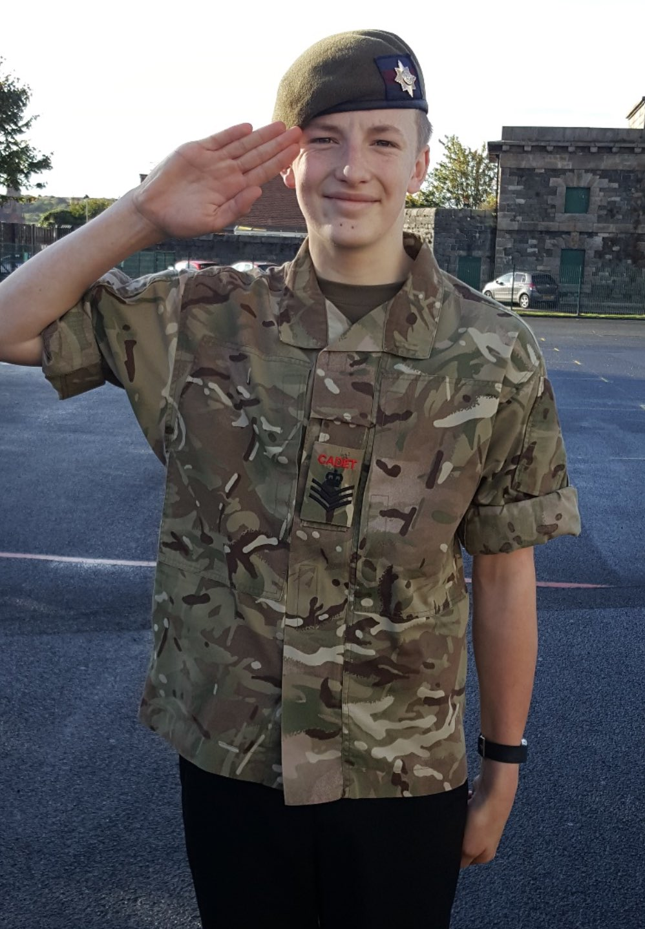
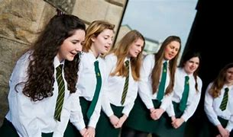
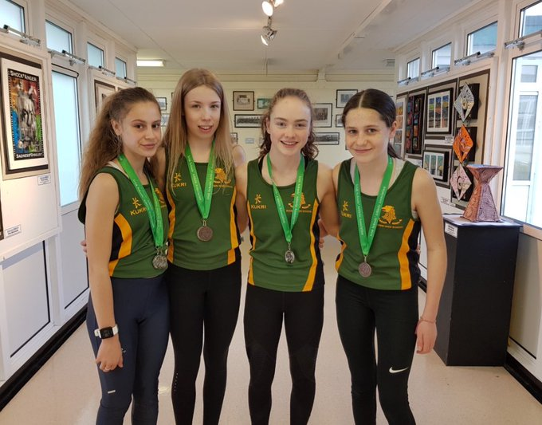
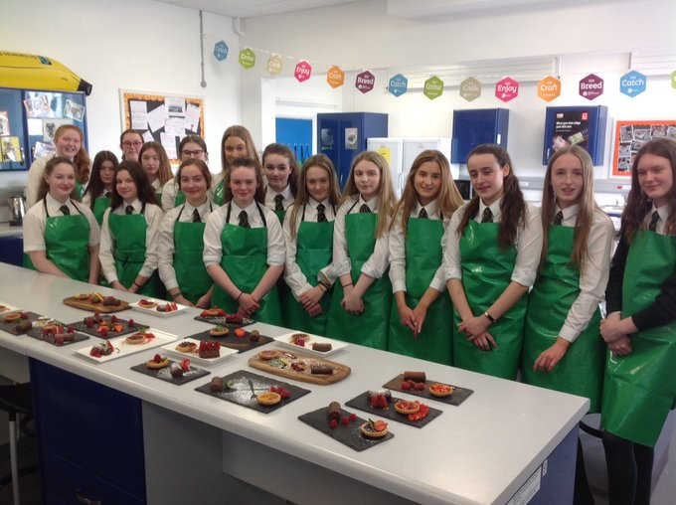
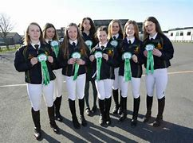
Extra Curricular Activities
Army Cadet Course
Cookery Club
Junior & Senior Choir
Rugby
Athletics
Creative writing
Junior & Senior Scripture Union
Biological Society
Cricket
Show jumping/Equestrian Society
School Shows
Book club
Cross Country
Tennis
Chamber Choir
Current Affairs Society
Sailing
Public Speaking
Running Club

Slide 12
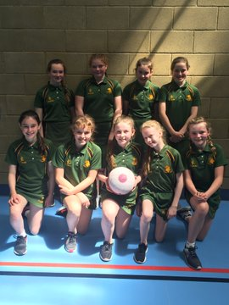

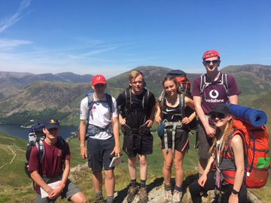
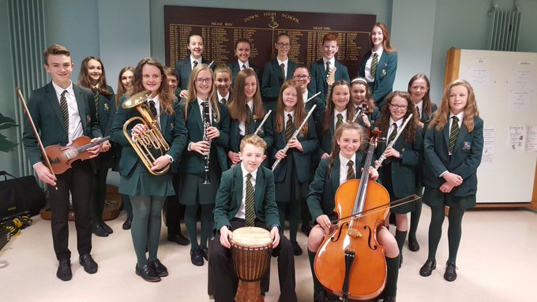
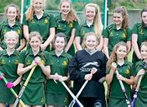
More Extra Curricular Activities
Making a Difference
Senior Debating Society
Charity Support Group
Duke of Edinburgh Award
Netball
Chemistry Club
Eco Group
Orchestra
Squash
Climbing Club
Swimming
Hockey
Programming Club
Community Action Club
Girls Football
Concert Band
Zoology
Reading Mentor

Slide 13
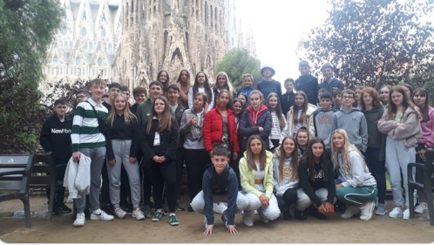
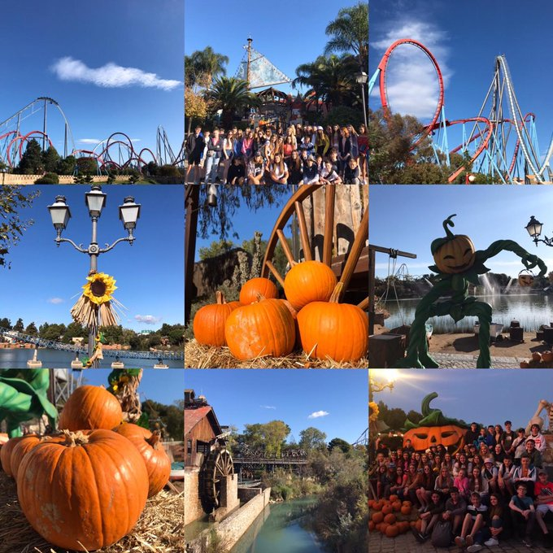
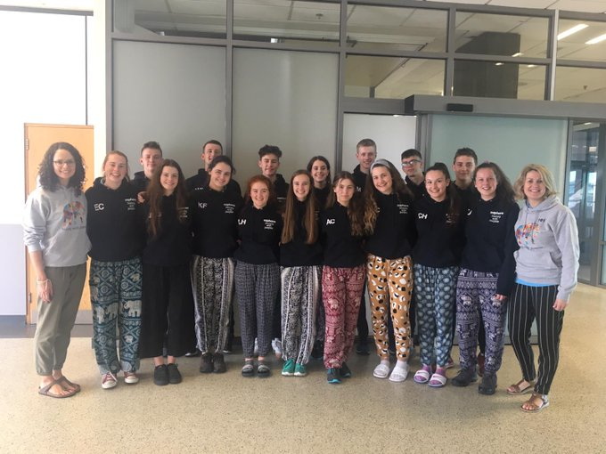
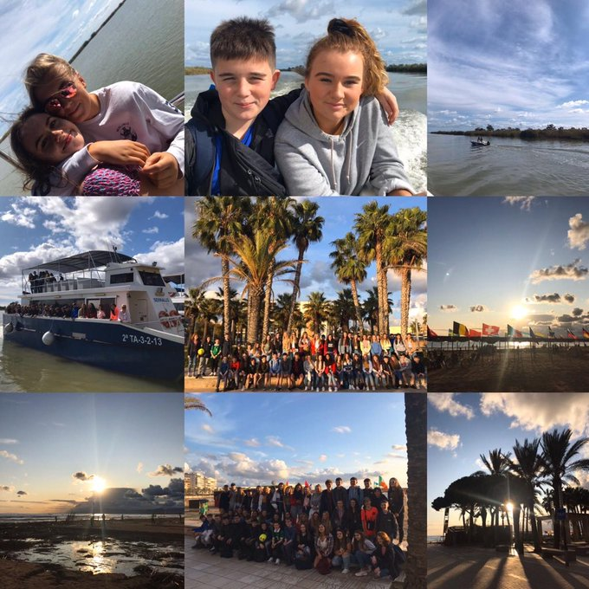
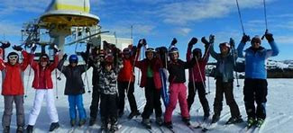
School Trips
School Trips in Year 8 include:
A two night residential trip to Cultra Ulster Folk Museum for all the new Year 8 Pupils to get to know each other.
Other Year trips have included:
Politics & Art Class going to London.
History Class going to Berlin & Krakow
Spanish & Geography Classes going to Barcelona.
The Saphara team going to India.
Various Ski trips etc….

Slide 14
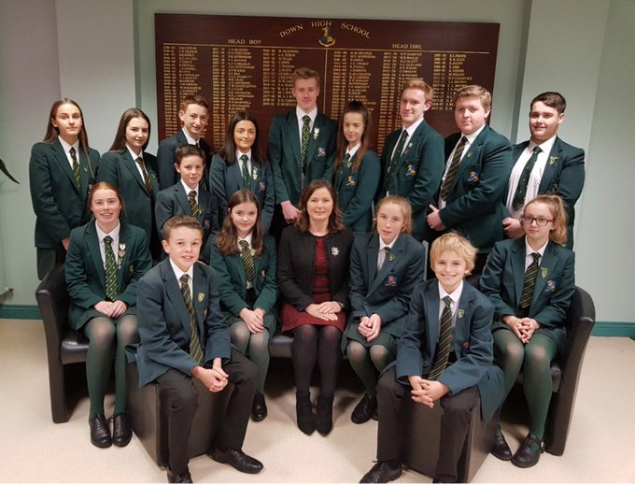
Down High School Council Representatives with Principal Mrs M. Perry

Slide 15
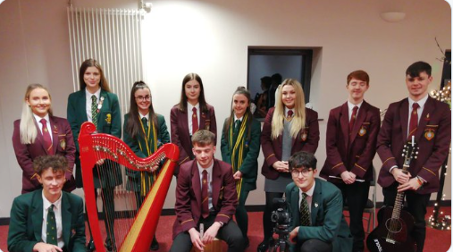
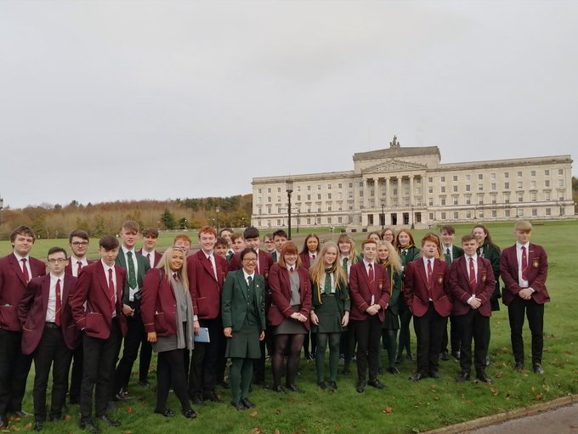
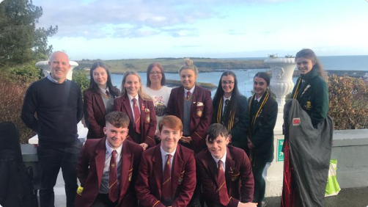
Shared Education
"Red and Green Working Together“
March 2017 saw the formal launch of the Shared Education partnership between Down High School and St Patrick's Grammar School (affectionately known as the Green and Red Highs.

Slide 16
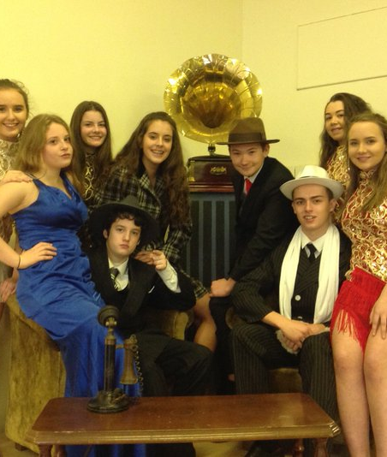
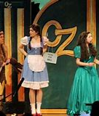

School Productions
Down High School Drama Group have produced various Productions throughout the Years including:
Calamity Jane.
Joseph & his Amazing Technicolour Dreamcoat.
The Sound Of Music.
Grease.
The Wizard of Oz.
Bugsy.
Annie.
Sister Act.

Slide 17
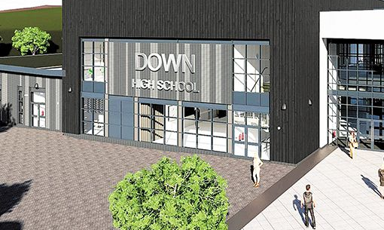
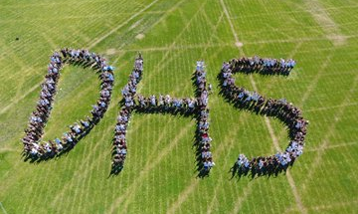
THE NEW DOWN HIGH SCHOOL BUILDING IS TO BE LOCATED ON THE STRANGFORD ROAD IN DOWNPATRICK – COMPLETION APPROXIMATELY 2021/2022!!!

Slide 18

Conclusion
I think Down High School will be a good School for me because:
It is offering a lot of various subjects including a good variety of sport which will be my favourite subject.
The pupils also participate in a lot of events throughout the year like the Christmas Carol Service at Down Cathedral.
I will also have the opportunity to gain my Duke of Edinburgh Awards.
Down High will be getting a new School over the next couple of years so that will be a very exciting time for me.
Finally, my Dad also attended Down High School many years ago so it is nice for me to follow in his footsteps

Slide 19

The End
By Dawn Erwin

