Slide 1
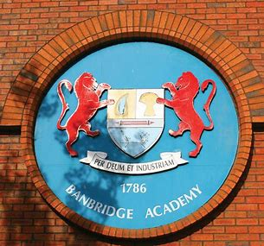
Banbridge Academy

Slide 2
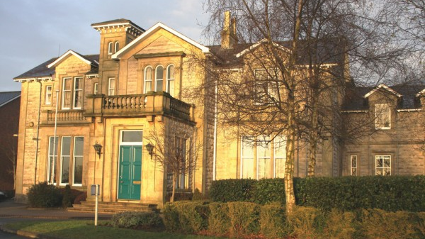
History
There is so much history behind Banbridge Academy. It was first founded in 1786 by James Withers. The school was originally a private business that was housed in a small terraced house in Banbridge on Library Lane beside the railway line. The small accommodation did not stop the numbers rising to 72 in 1837. An early report from Seapatrick Parish, notes that the income from the children is £150 and the accommodation bill was only £18 per annum. Surprisingly the school was a mixed school and for the time this was very unusual. Banbridge was one of the first schools to have a football club in the province and a rugby club as well.
One of the strangest things to me was that every time a new headmaster came they had to get grant from the government to build more buildings. This was because of the increasing numbers of children coming and it is still the same way to this very day.
The current headmaster Mr McLoughlin began in 2015 and is encouraging children to work to the best of their ability. Even though the school is 225 years old it is still producing at the end of seven years young adults to think for themselves and care for others.

Slide 3
Departments
Classes:
Art and Moving Images
Biology
Business studies
Careers
Chemistry
Computing
Drama
Economics
English
Geography
Government and Politics
Home Economics
Mathematics
Modern Languages
Music
Religious Studies
Science
Technology and Design

Slide 4
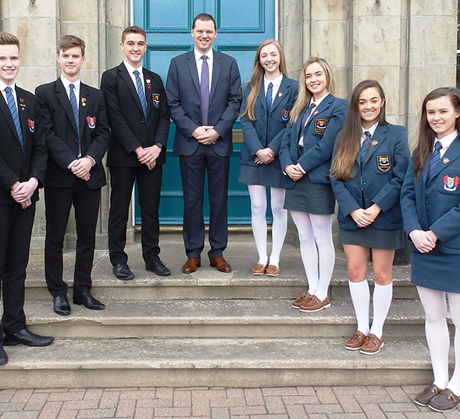
Uniform
The girl’s uniform is petrol blue. You can wear cream tights or socks and your shoes must be a light brown. Your tie is petrol blue with red and black stripes you wear a petrol blue blazer and skirt and a white shirt.
The boy’s uniform is black and you must wear black shoes. Again your tie is petrol blue with red and black stripes you wear a black blazer and trousers With a white shirt.

Slide 5
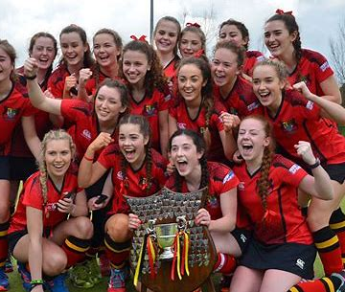
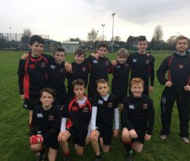
PE Uniform
This is the PE uniform for hockey, the uniform is red with navy shorts and in this photo the had won a trophy. (Mrs McCune can you spot Charlie Brush?)
The Rugby kit is a red and black top with red and black shorts ( Also my brother is in the rugby picture his hair is the one that is very long and tall).

Slide 6
School Day/Canteen food
The school day starts at 09:15 and each lesson is 45mins long, break time is at 11:00. You bring your own break and lunch is at 13:30 the lunch menu is:
Main: Dessert: Drinks:
Pizza Muffins Milk
Hotdogs Ice cream Sparkling Water
Burgers Orange juice
Goujons and chips Water
Salad Fizzy Apple Juice
These are only some of the things that are in the menu though.

Slide 7

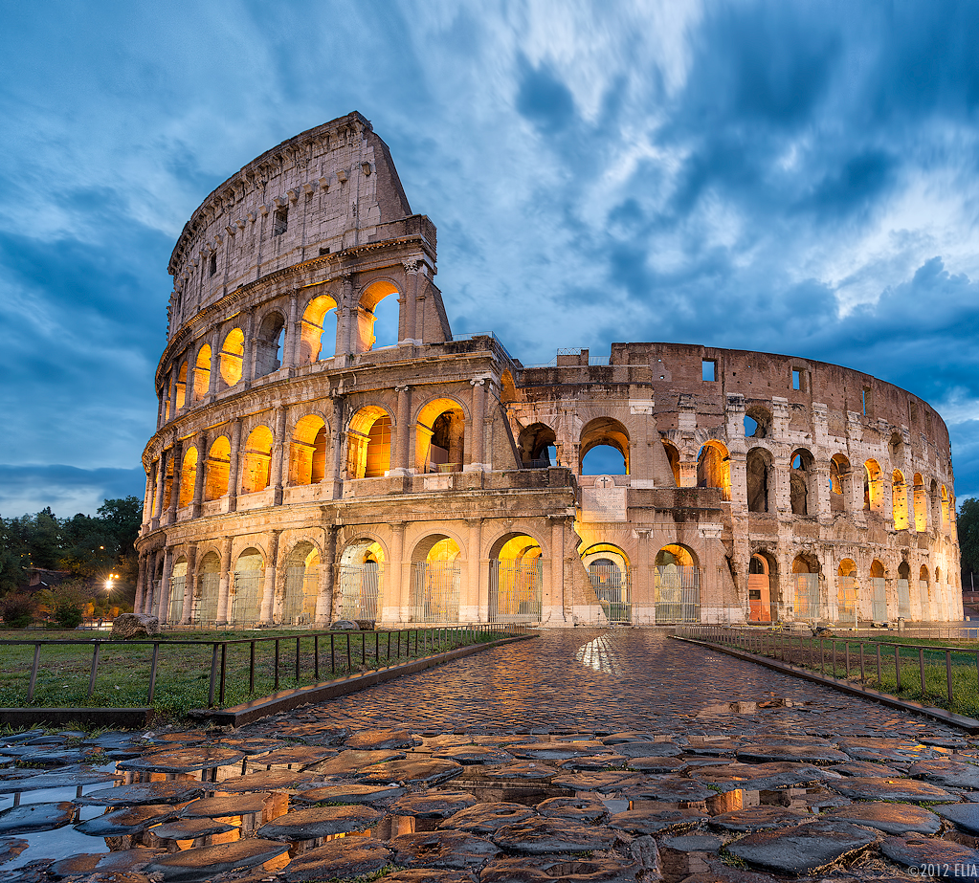
School Trips
The main school trips are in fourth year when you go skiing and in lower sixth you go to America and stay for a week.
When you go to America you go around and look at all the tourist attractions

Slide 8
Why I like this school and why I want to go there
I like this school because my Brother, Dad and my Auntie all went there. So we have lots of family history there. I know many of people there all ready because of the sports that I do. I also know people through Daniel because his friends think I am quite cute. I also like the teachers there and the classes they teach, but most of all the reason I am excited is for the bigger choice of food and the chance to make new friends.
I want to go to this school because I love cooking and they have Home Economics and loads of other classes that I love. This school will give me loads if options on what I can be when I’m older. I am also good friends with two of the teacher’s kids Katie and Sam Leslie.

Slide 9
By Rachel Douglas
Hope you enjoy my slide show.

