Slide 1




Slide 2
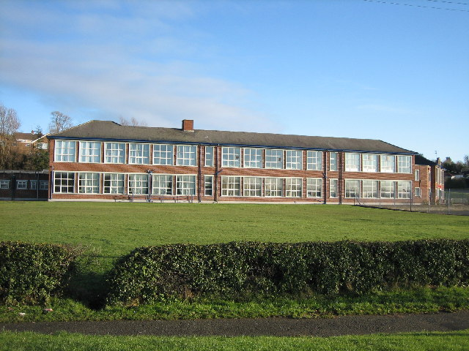
the school
We are a thriving co-educational school situated in the market town of Ballynahinch. The school is justly known for high academic standards and excellent pastoral care. We are a family school with many parents and staff being former pupils themselves. The school was opened in September 1955.

Slide 3
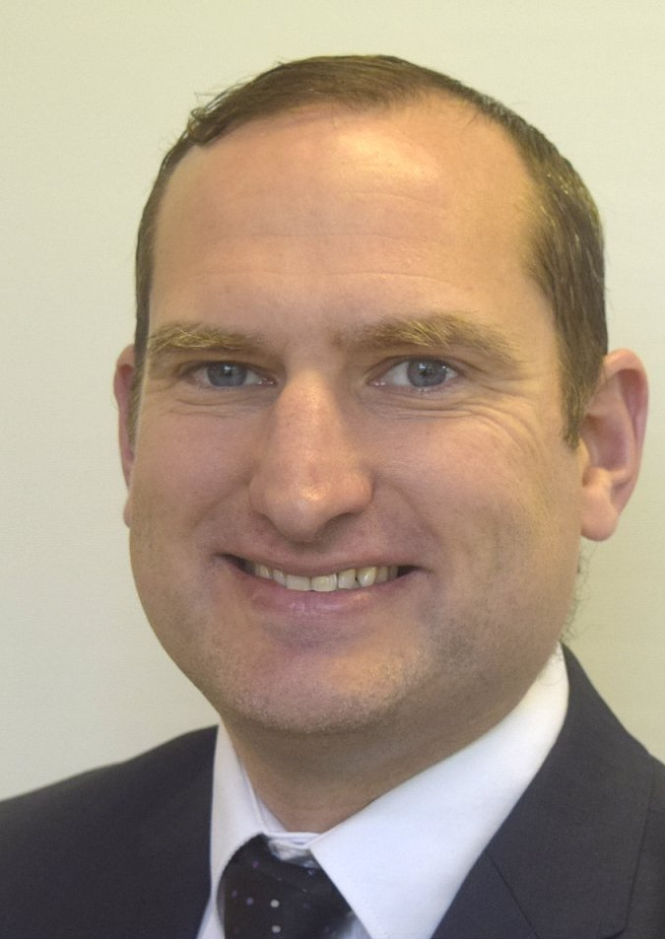
Meet the principal –
Mr paul marks
We place a huge emphasis on the relationships between parents, staff, pupils and our local community. The school has a tradition of close family ties which are reflected in strong pupil and parent involvement in all areas. An ‘open door’ policy whereby parents and pupils have easy and comfortable access to staff is one of our strengths and contributes significantly to the family ethos.
A feature of which we are particularly proud is our induction procedure for Year 8 pupils which aims to make the transition from primary school to secondary school an exciting positive experience. It is an opportunity for the children to quickly forge new friendships. The school accepts pupils from a large number of primary schools covering an extensive geographical area. It is important to us that our diverse intake quickly feel a part of the school and comfortable in their new surroundings.

Slide 4
Values and aims
“Preparing Pupils for
a Changing World”
Values:
Respect
Equality
Fairness
Honesty
Dignity
Kindness
Safety
Aims:
Through quality teaching and learning provide a broad and balanced curriculum with a range of experiences which will prepare pupils for a changing world and to provide opportunity for pupils to develop and encourage progression in the areas of Literacy, Numeracy and ICT.
To promote learning through quality teaching in a caring, disciplined school environment within the local community and further afield and to meet the needs of all pupils and staff by securing strong partnerships with parents and the wider community.
To provide opportunities to challenge each pupil to meet their full potential, academically, physically, spiritually and emotionally and to promote a sense of self esteem and respect for others in a safe, comfortable, caring environment.

Slide 5
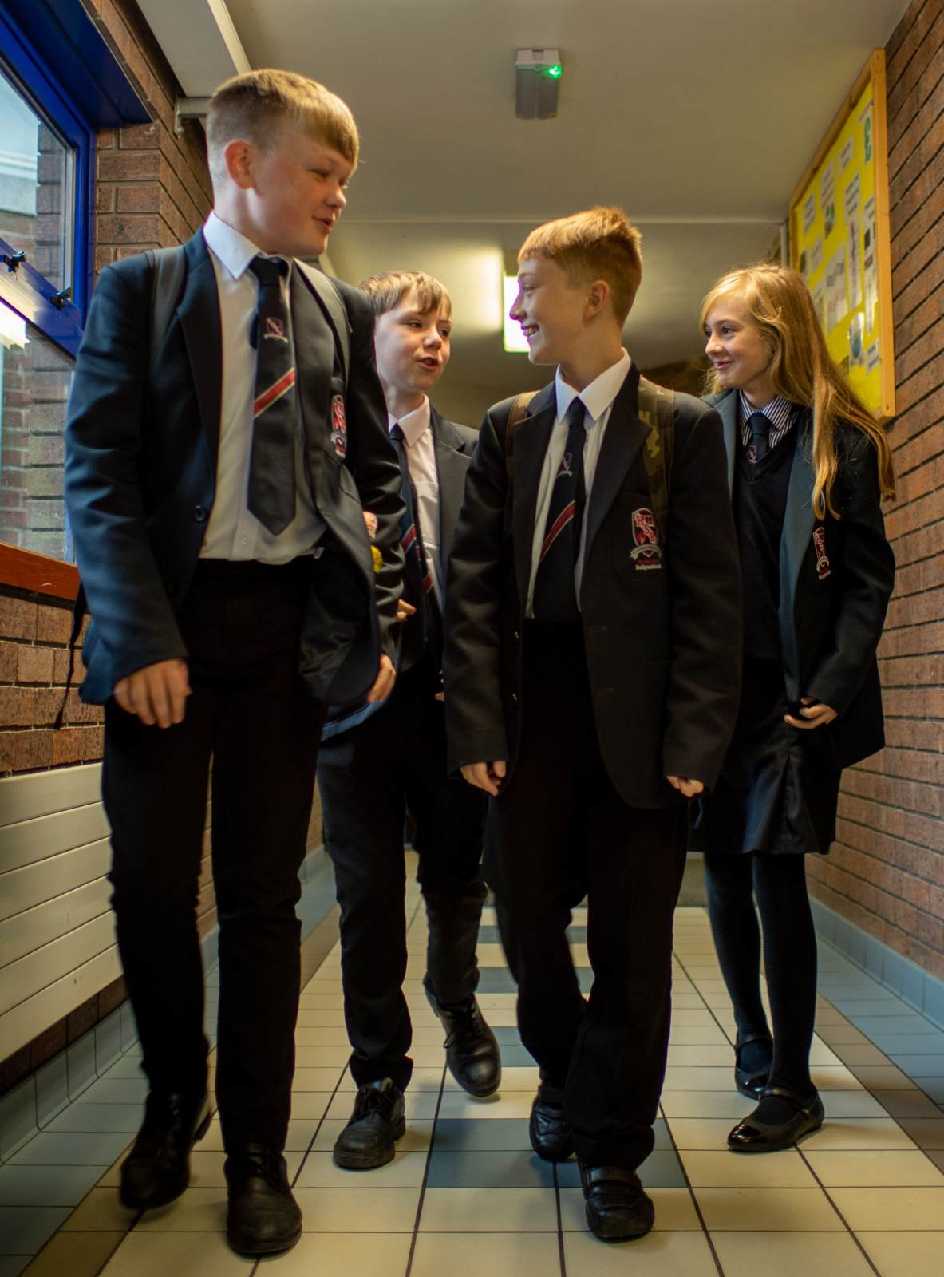
Uniform
BOYS | GIRLS
Navy blazer with school badge Charcoal grey or black trousers White shirt Navy ‘V’ neck pullover Grey Socks School tie Black school shoes Navy/Black school outdoor coat or school fleece School scarf (optional) | Navy blazer with school badge Navy skirt - knee length Navy and white striped blouse Navy ‘V’ neck pullover Navy socks/tights School tie Black flat shoes Navy/Black school outdoor coat or school fleece School scarf (optional)

Slide 6
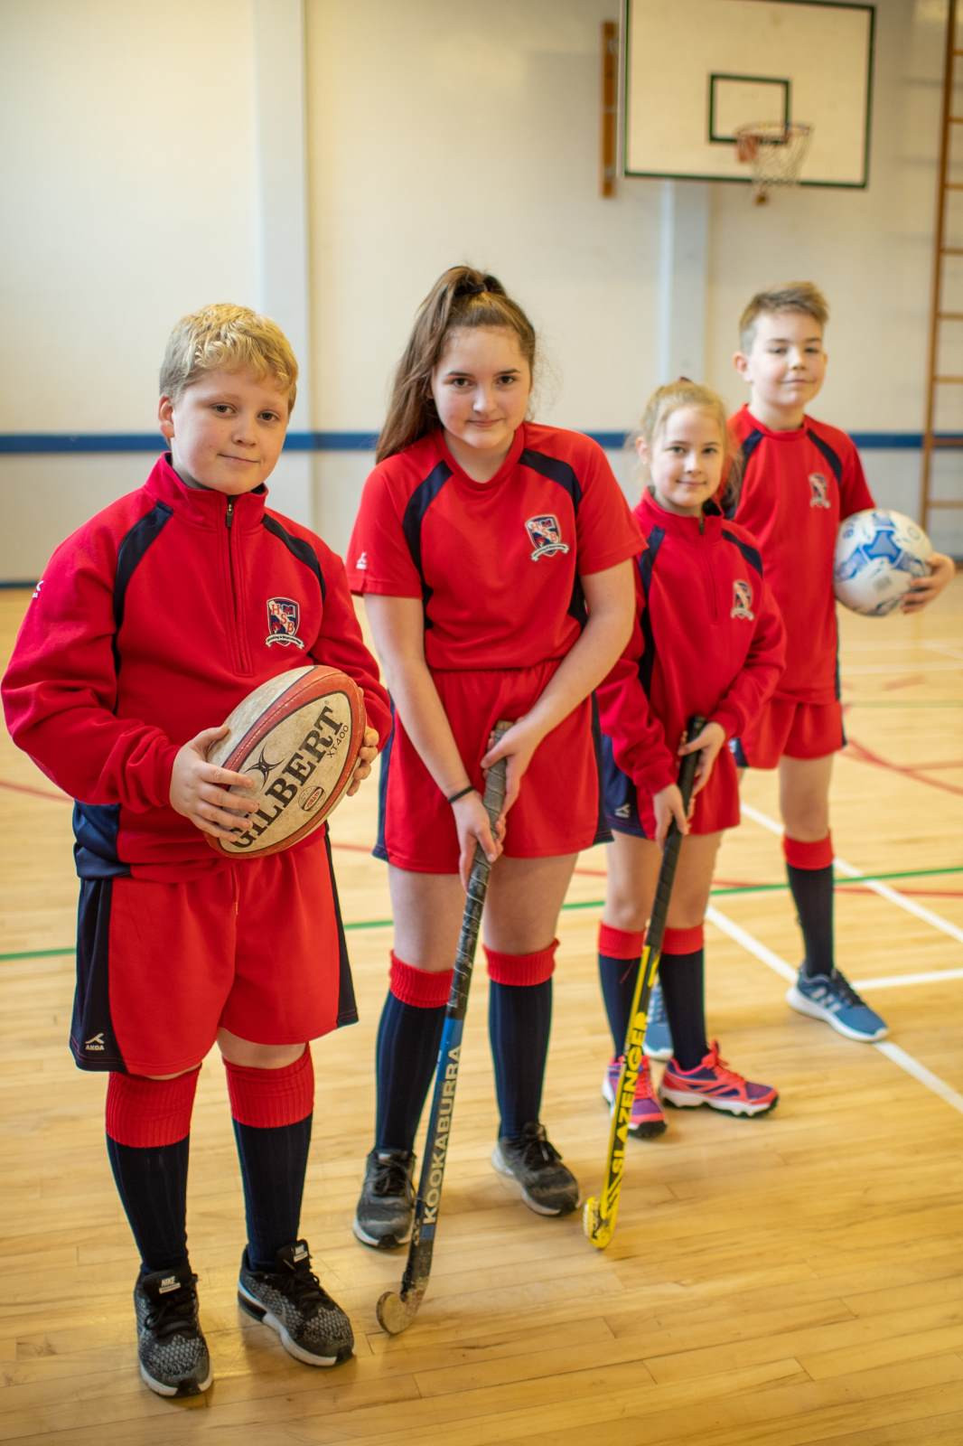
Pe kit
BOYS | GIRLS
Red polo shirt Red shorts Red & blue socks Suitable gym shoes | Red polo shirt Red skirt Red & blue socks Suitable gym shoes
A school sports fleece is also available

Slide 7

The curriculum
In Year 8 there are 13 subjects in the Curriculum studied at Ballynahinch High School
Art
English
French
Geography
History
Home Economics
ICT
Mathematics
Music
Physical Education
Religious Education
Science
Technology and Design

Slide 8

School day
School begins for pupils each morning with registration at 8.50 am.
The school day is divided into ten teaching periods:
Classes begin at 9.00 am with four periods of 35 minutes duration, followed by a break of fifteen minutes from 11.20 - 11.35 am.
There are three periods of 30 minutes duration before and after lunch, which is for 30 minutes from 1.05 - 1.35 pm.
The school day ends at 3.05 pm.
There is a full school Assembly on a Tuesday morning.

Slide 9

After school activities
To complement the curriculum pupils are encouraged to become involved in extra-curricular activities through which they can further develop skills, interests and attitudes in preparation for adult life.
Those activities available at present are:
Art Club
Athletics
Badminton
Choir
Computer Club
Drama Club
Duke of Edinburgh’s Award Scheme
Educational Trips
Guitar Club
Hockey
Netball
Rugby
School Band
Scripture Union
Soccer
Table Tennis

Slide 10
A great school!
The school has continued to grow in popularity as parents have realised the benefits of a small school in a largely rural community.
The size of the school allows for small classes and therefore close attention can be given to all pupils.
I am looking forward to starting Year 8 at Ballynahinch High School. I will be the third generation of my family to go to this school.

Slide 11
Thank you for watching
my presentation!
By Thomas Reid

