Slide 1
Multiplying Decimals by 10 and 100
N
- MATHS TOPICS KS2 -

Slide 2
Multiplying Decimals by 10 and 100
Recap
In the decimal system, the number in each column is 10 times bigger than the number to its right.
x10
x10
x10
Th | h | t | u
1 | 1 | 1 | 1
1000
100
10
1
N

Slide 3
Multiplying Decimals by 10 and 100
The method is the same as for whole numbers, but there’s a decimal point.
Th | h | t | u
 |  |  | 6
 |  | 6
0
We must put a 0 in the empty units column to hold the place so 6 x 10 = 60
N

Slide 4
Multiplying Decimals by 10 and 100
Examples::
1 x 10 =10
4 x 10 = 40
7 x 10 = 70
9 x 10 = 90
10 x 10 = 100
12 x 10 = 120
53 x 10 = 530
It is tempting to say
“Just add a zero”
But when we start to work with decimal numbers, for money, measures and other things, if we “Just add a zero” we will have big problems!
N

Slide 5
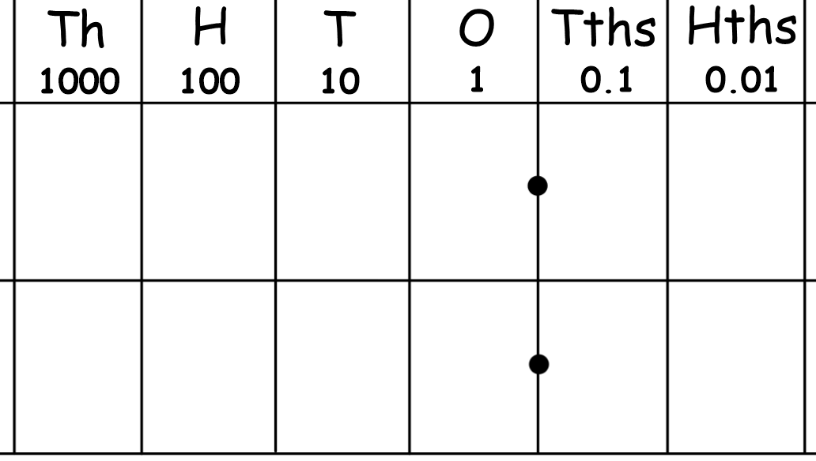

Multiplying Decimals by 10 and 100
The method is the same as for whole numbers, but there’s a decimal point.
We use place value to multiply by 10 by moving digits.
We make every digit ten times bigger by moving it one place to the left.
2
9
2
9
X 10 ?
N

Slide 6


Multiplying Decimals by 10 and 100
The method is the same as for whole numbers, but there’s a decimal point.
When we multiply by 100 the digits move 2 places to the left.
4
3
4
3
0
X 100 ?
N

Slide 7
Multiplying Decimals by 10 and 100
Your turn:
Try these.
See if you can write the answer before it appears.
3
5
The decimal point never moves.
The digits move.
The digits never change.
The digits never change order.
3
5
X 10 ?
N

Slide 8
Multiplying Decimals by 10 and 100
Your turn:
1
2
1
2
The decimal point never moves.
The digits move.
The digits never change.
The digits never change order.
X 10 ?
N

Slide 9
Multiplying Decimals by 10 and 100
Your turn:
2
6
Why do we need this zero?
It is called a place holder.
Without it we might think the number is 26.
2
6
The decimal point never moves.
The digits move.
The digits never change.
The digits never change order.
0
X 10 ?
N

Slide 10
Multiplying Decimals by 10 and 100
X 100
Notice when we multiply by 100 the digits move 2 places to the left.
4
3
Now we are going to multiply by 100.
What do you think we will do with the digits?
Why do we need this zero?
It is the place holder.
Without it we might think the number is 43.
The decimal point never moves.
The digits move.
The digits never change.
The digits never change order.
4
3
0
X 100 ?
N

Slide 11
Multiplying Decimals by 10 and 100
Your turn:
Remember when we multiply by 100 the digits move 2 places to the left.
9
6
Try these.
See if you can write the answer before it appears.
Sometimes you will need to put in zeros as place holders.
9
6
0
The decimal point never moves.
The digits move.
The digits never change.
The digits never change order.
X 100 ?
N

Slide 12
Multiplying Decimals by 10 and 100
Your turn:
Remember when we multiply by 100 the digits move 2 places to the left.
7
2
7
2
0
The decimal point never moves.
The digits move.
The digits never change.
The digits never change order.
X 100 ?

Slide 13
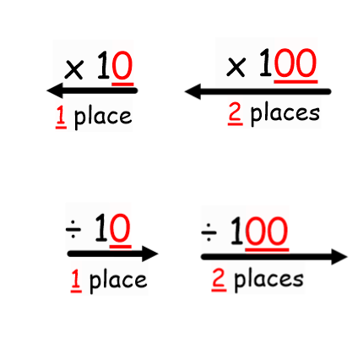
N
- MATHS TOPICS KS2 -

