Slide 1


Slide 2


Slide 3
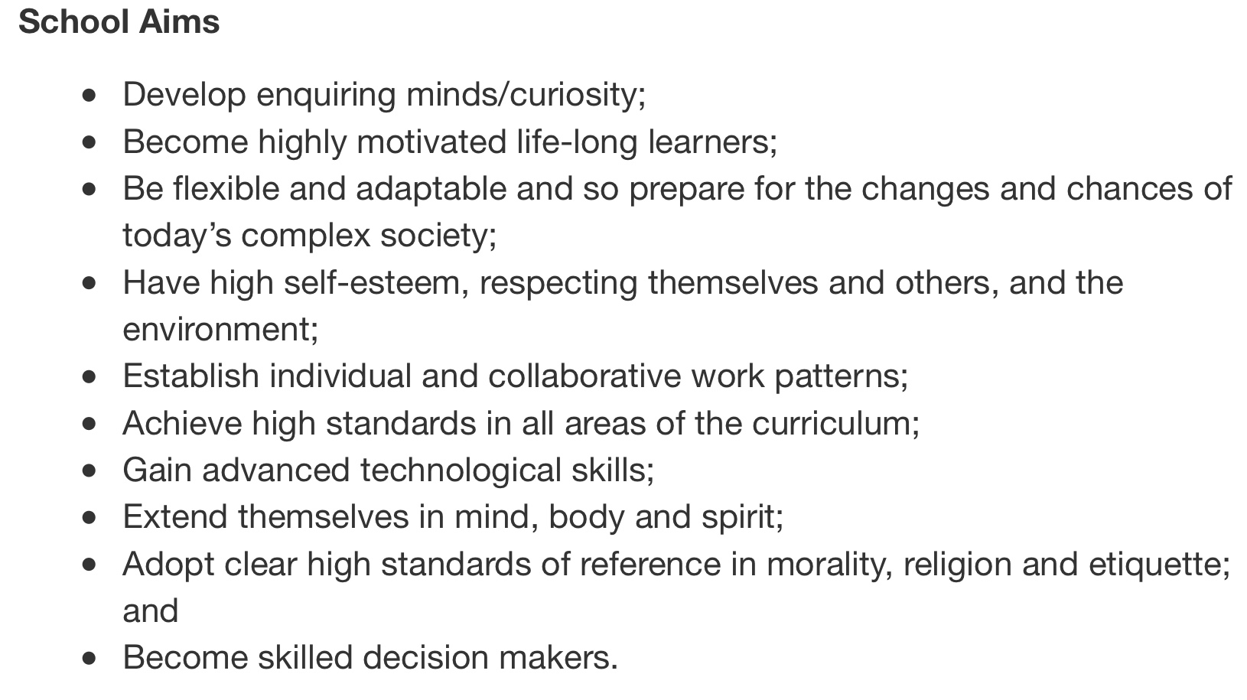
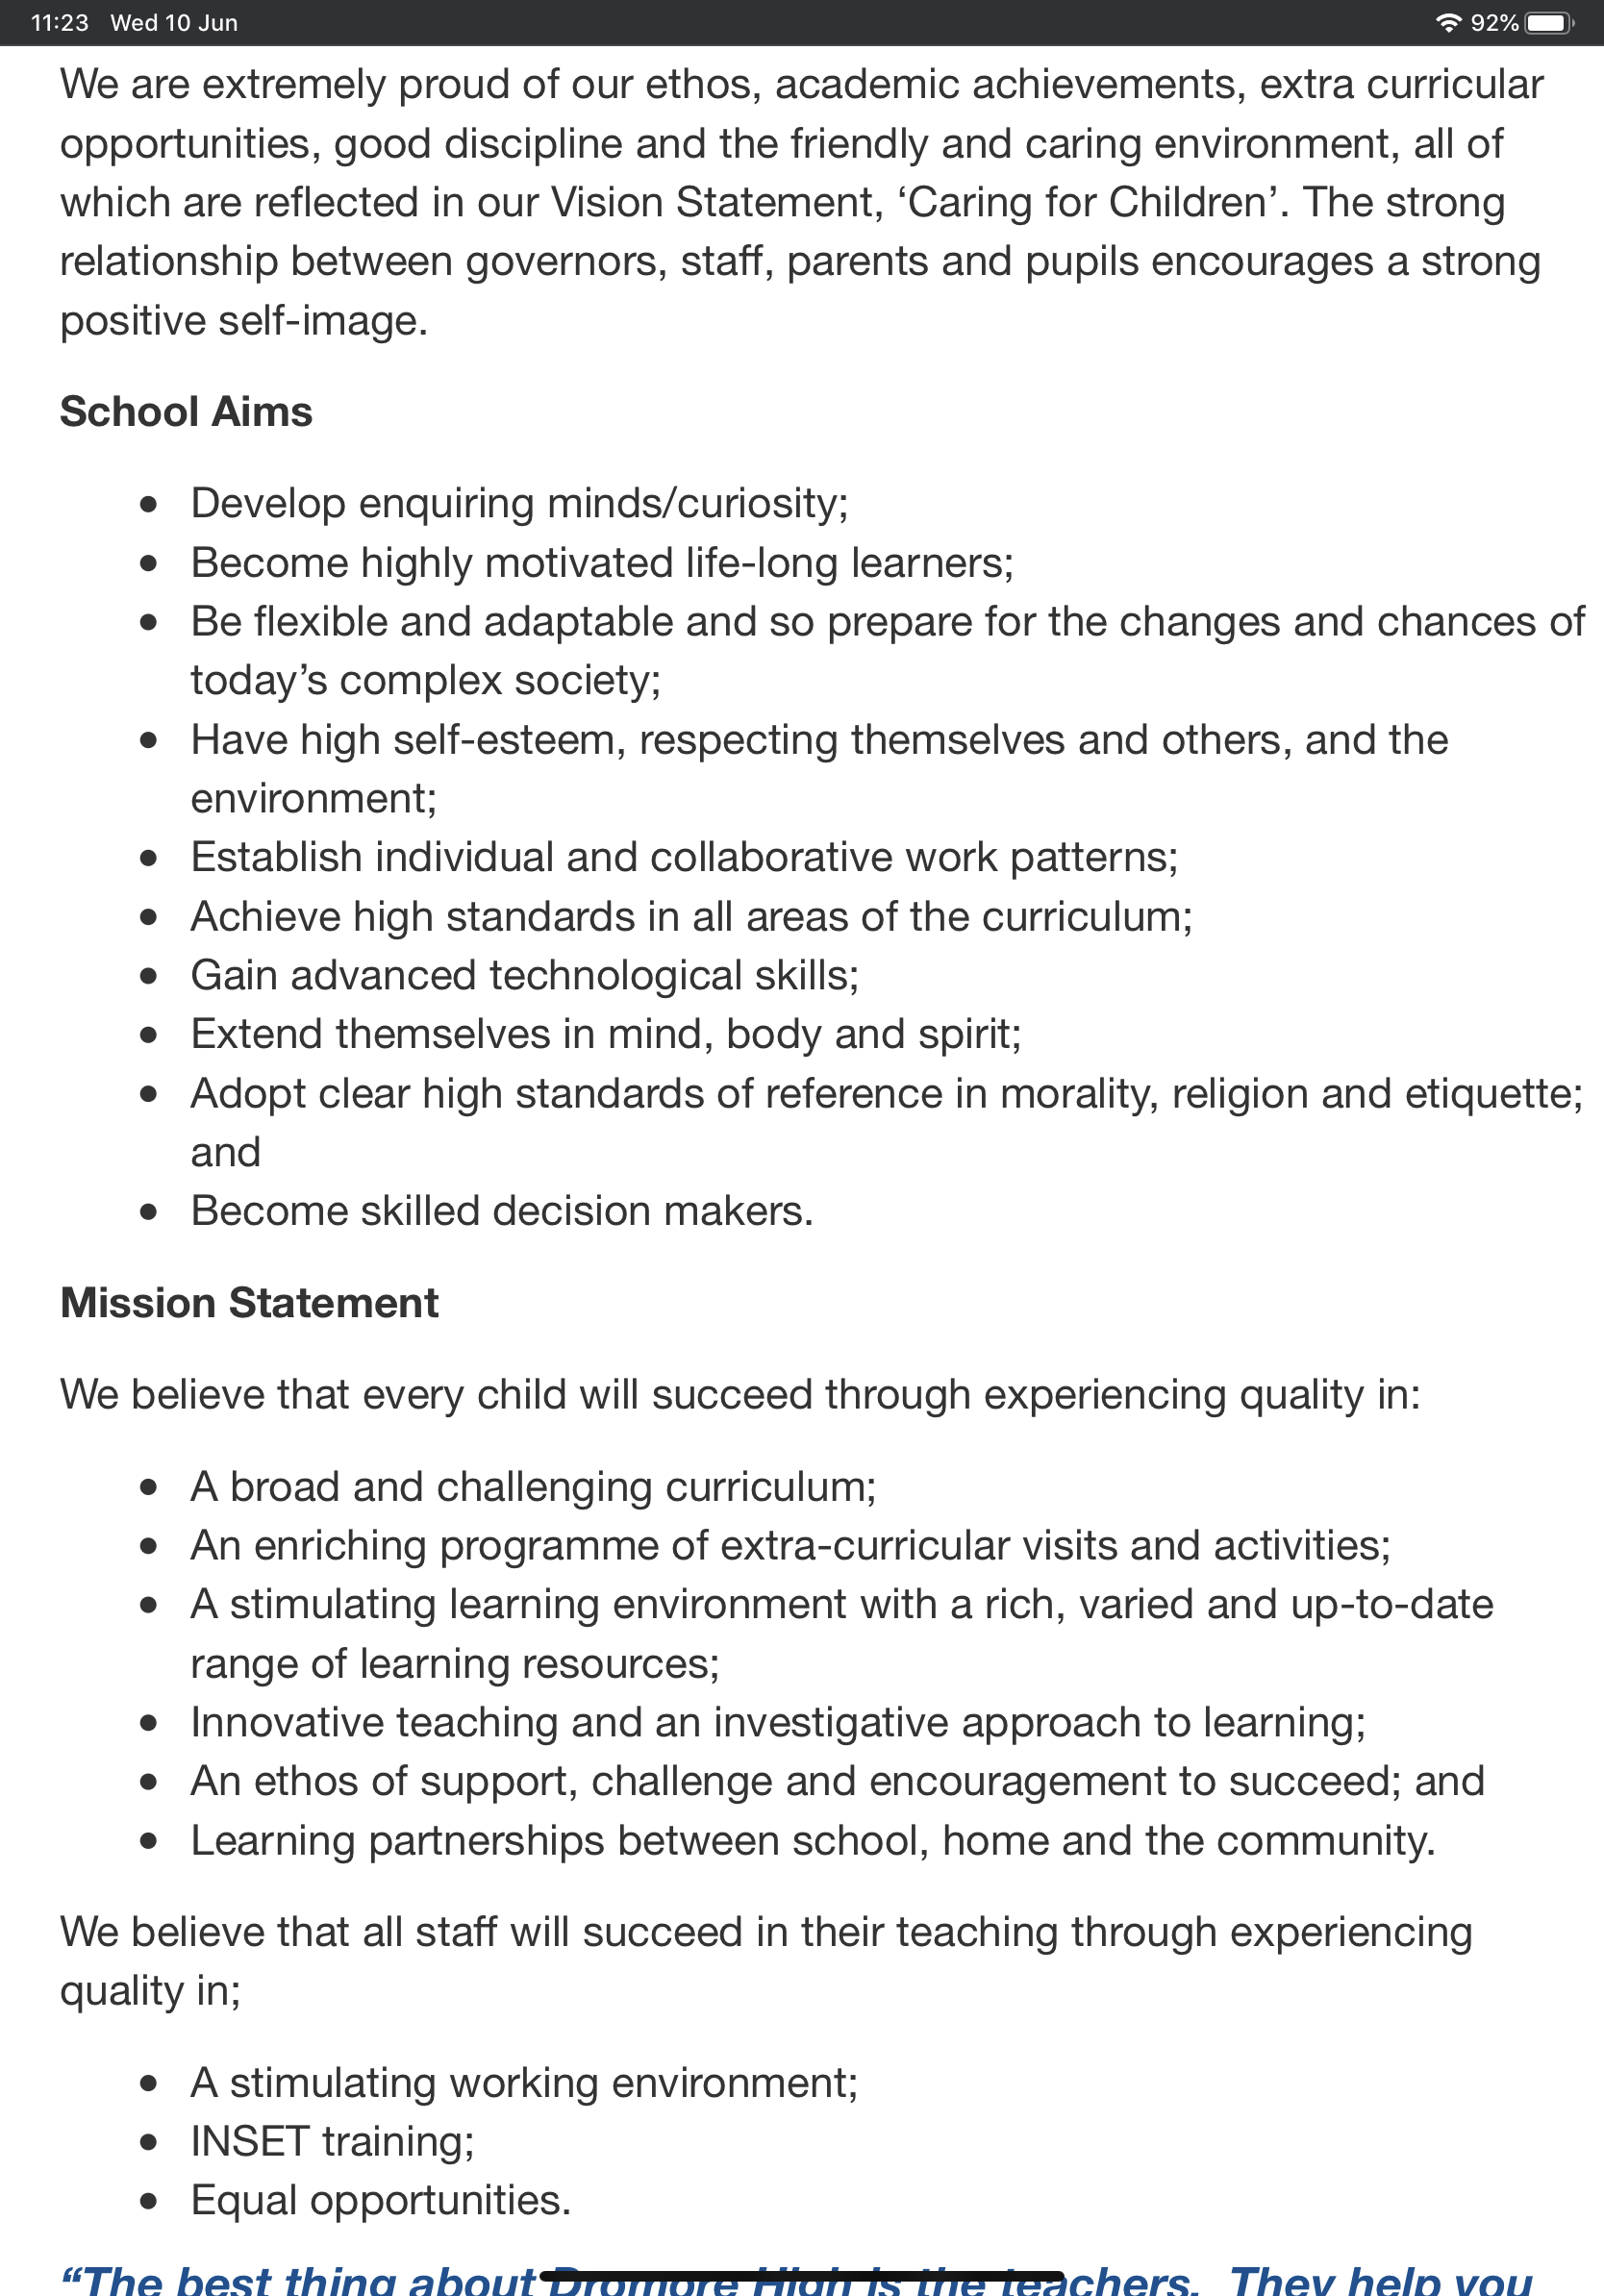

Slide 4


Slide 5


Slide 6
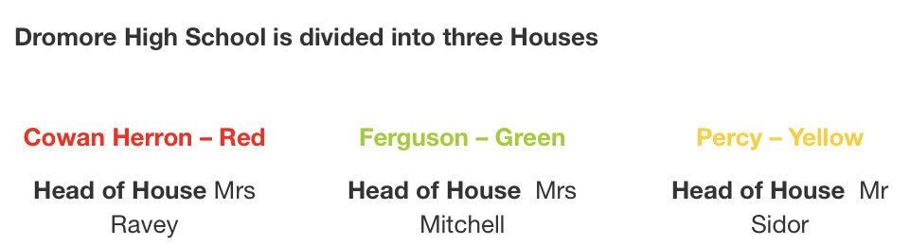


Slide 7
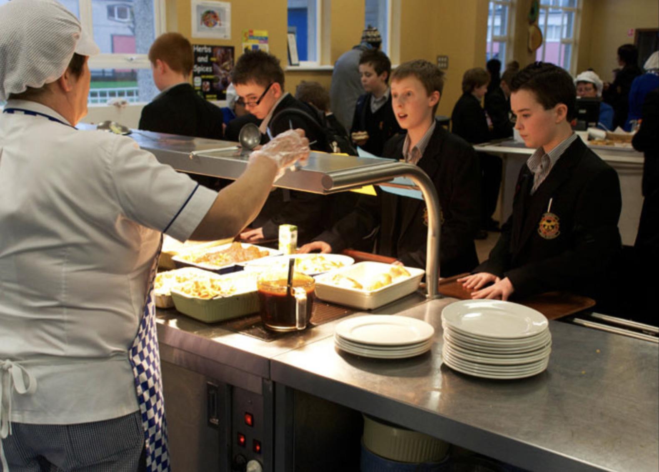


Slide 8
Summing up
It’s unique in its own way
It’s got a nice atmosphere
Since my sister goes there I can feel more at ease with someone I know going there ( as well as some people from Anahilt).

