Slide 1
Wallace
High School

Slide 2
About Wallace
Wallace high school is in Lisburn it has 3 floors and has around 1160 pupils.
Wallace uses a slogan called Core meaning Commitment, Opportunity, Respect and Excellance.
On Wallace’s logo it says Esperance which is French for Hope.
Wallace was founded in 1880 by a bequest from the estate of Sir Richard Wallace, local landowner, and was originally named Lisburn Intermediate and University School. It was built on a site fronting the Antrim Road.

Slide 3
The Uniform
The Wallace girls uniform includes a blazer with detailing , grey tights, grey skirt, white shirt and a house tie.
The Wallace boys uniform include a blazer without detailing, grey trousers, white shirt and house tie.
The PE uniform includes a navy T-shirt with the Wallace logo and shorts also with the logo.

Slide 4
Curriculum
The curriculum for year 8 is: Art and Design, Biology, Chemistry, Computing, Drama, English French, Geography, History, Home Economics, Learning for life and work, Maths, Music, Physics, PE, Religious Studies and Technology and Design.

Slide 5
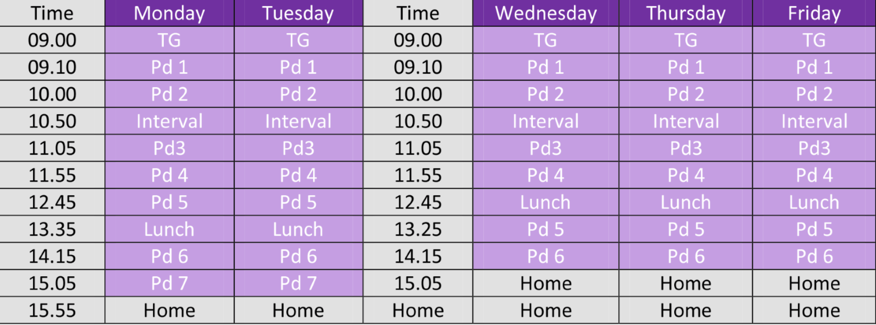
A School Day
Wallace starts at 9:00 and ends at 3:25.

Slide 6
After School Activites
In Wallace there are lots of different clubs to join including: Athletics, Hockey, Netball, Rugby, Cricket, Badminton, Swimming, Tennis, Gymnastics, Cross country. Also Art club, Computer club, Book club, Scripture union, Choir, Debating club, Film club, Modern Language club, Chess club, Eco club, Technology club, and Song Writing club.
So there are plenty of things you can join in on.

Slide 7
School Trips
In Wallace you can go on lots of optional trips with your clubs and subjects like Hockey trips or trips to France with your French class.
In 2015 and 2019 a 6th form class went to Rome.
In 2016 The boys hockey team went to Holland.
In 2017 the boys hockey team went to Manchester.
The city of Rome

Slide 8
House System
In Wallace there are 6 houses 3 boys versions and 3 girl versions .
If you have a brother or sister in the school you would belong in there house but if your brother was in Conway and you were a girl you would be in the girl version Gracey
The houses are:
Conway, Gracey which is green
Hannah, Hamilton which is red
And Seymour and Barbour which is yellow
I am in Gracey

Slide 9
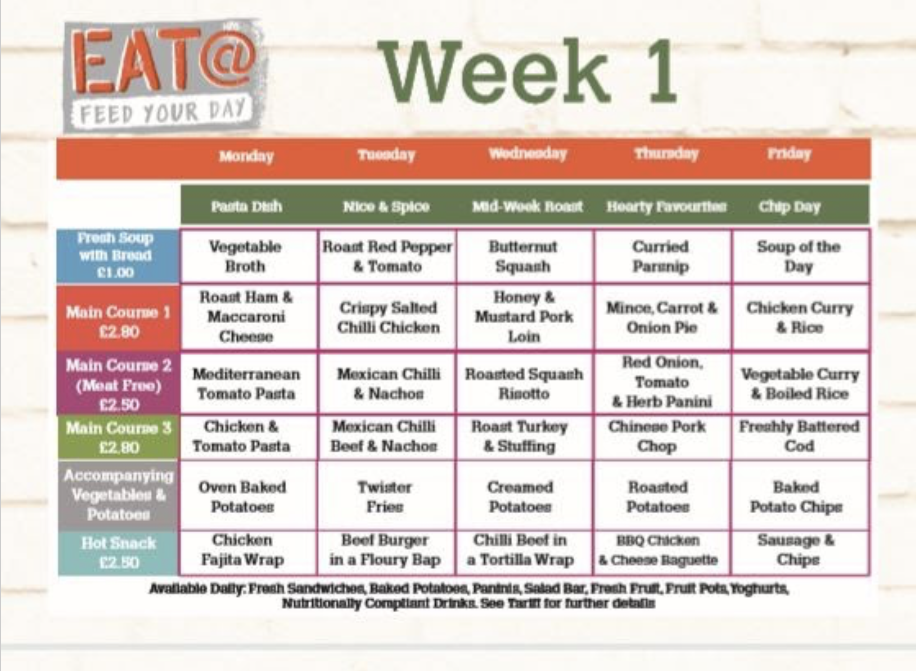
The Canteen
In Wallace they use an electronic system, which is where there is a big machine and you use your fingerprint, and you put your money in the machine and use your fingerprint when you need it out again.
This is a Wallace menu from a few years ago

Slide 10
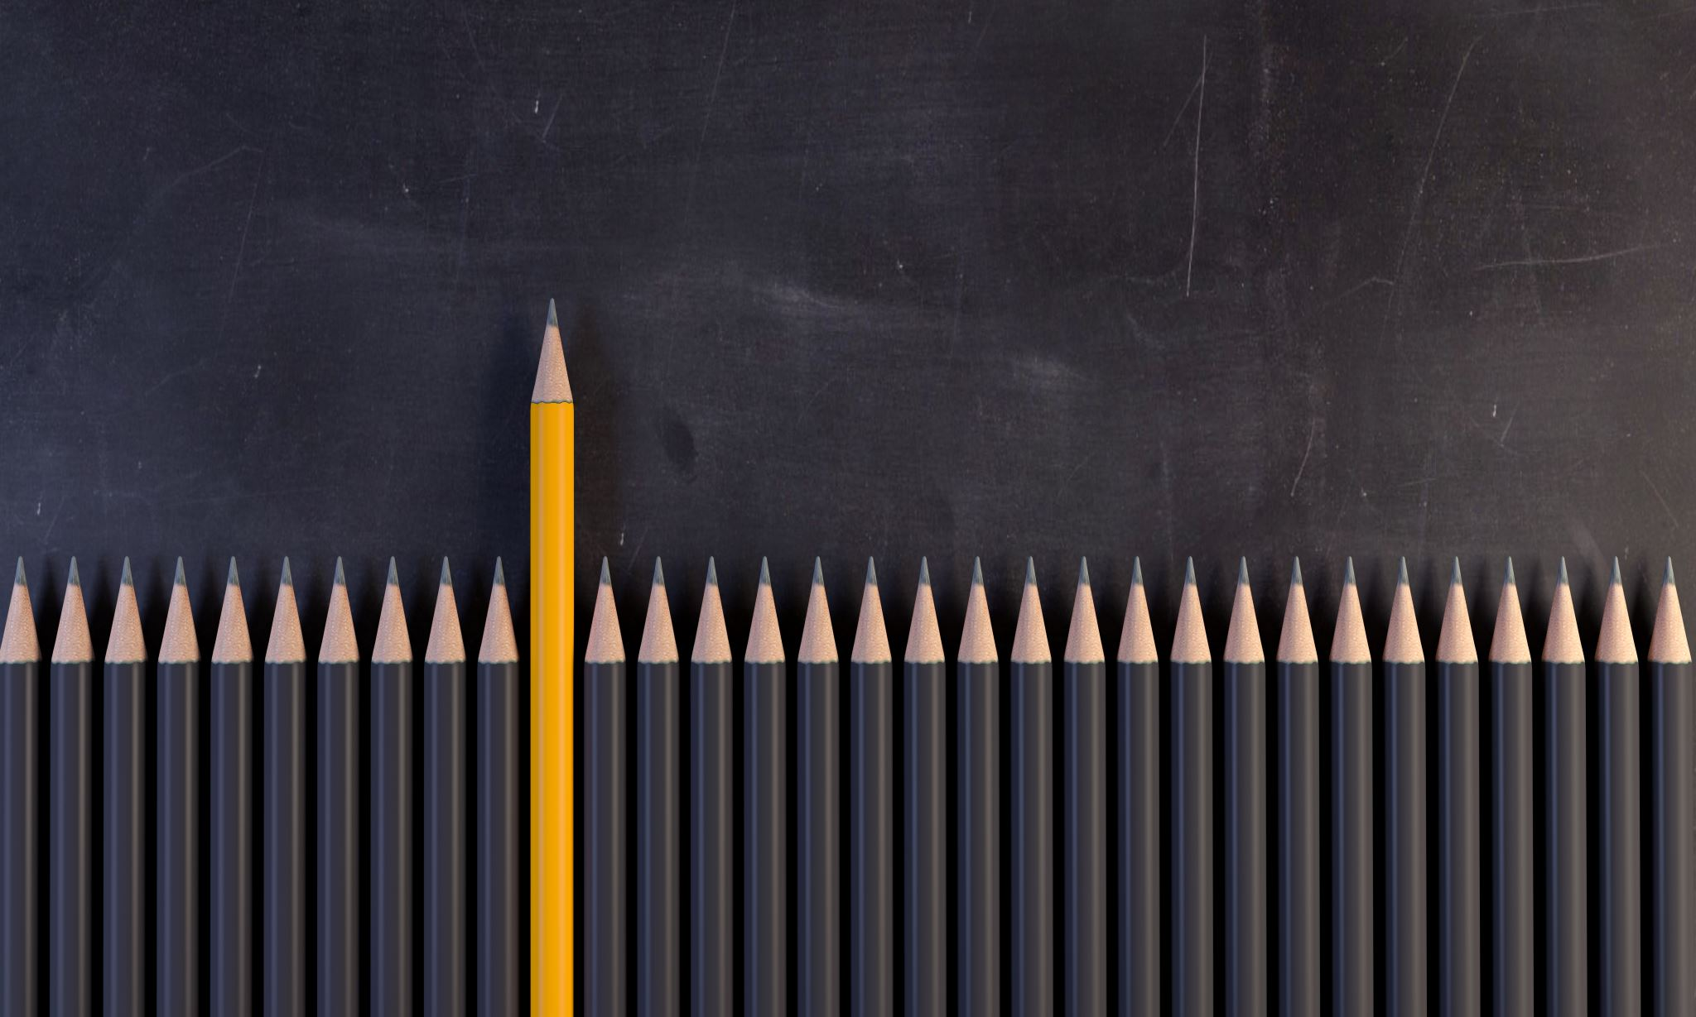
What does this school have that Anahilt didn’t
Wallace has a lot of things which are quite different such as a lot more pupils, a lot more subjects, so many different classes and teachers and lots of new people.

Slide 11
Conclusion
I am very excited for high school, meeting new people, but I will also miss Anahilt very much.
By Charlotte Brisbane

