Slide 1
Hunterhouse College
By Abigail

Slide 2

School Logo

Slide 3
School History
Formed in 1987 by the amalgamation of Ashleigh House and Princess Gardens schools, both Principals had the surname “Hunter” so hence the name “Hunterhouse College” was chosen.
Hunterhouse College is an all girls school.

Slide 4
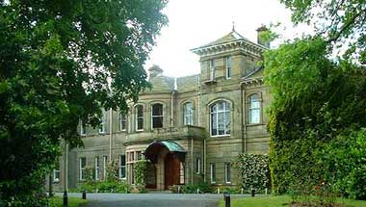
School Building

Slide 5
Values and Aims
Co-operation with Parents
Enriching whole school experience
Strives to enable every girl to reach the highest academic and personal distinction of which she is capable
Hunterhouse College strives to stimulate and challenge its pupils

Slide 6
Location
Hunterhouse College is located in Finaghy, just outside of Belfast
I will travel to the school by bus from our village – this is going to be a very exciting and new experience for me!

Slide 7
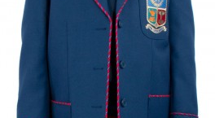
Uniform

Slide 8
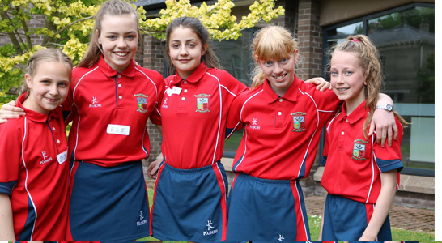
PE Kit

Slide 9
Curriculum
Art
Drama
English
Geography
History
Home Economics
ICT
Languages (French, German, Spanish)

Slide 10
Curriculum continued!
LLW
Mathematics
Music
PE/Games
Religious Studies
Science
Technology and Design

Slide 11
School Day
School starts 8:45am and ends at 3:20pm
There is a 25 minute registration followed by 5 hour long lessons each day
The school operates a 2-week timetable to allow for all subjects to be taught
Assembly is twice a week
On Friday I will get to finish an hour early!

Slide 12
After School Clubs
Arts and Crafts
Choir
Coding Club
Debating
Drama
Orchestra
Ukulele Club
Science

Slide 13
More Clubs!
Equestrian Club
Hockey
Netball
Tennis
Badminton
Soccer
Athletics
Cross-Country

Slide 14
School Trips in Year 8
Residential trip to Cultra – this is so the 100 girls starting Year 8 can get to know each other
Ski trip to Italy – if the Covid-19 pandemic lets us
Geography trip to Iceland
Language exchanges to Germany
Art trip to Amsterdam

Slide 15
House System
Duncan – Blue badge
Lewis – Green badge
Sherman – Red badge
Welch – Yellow badge
House points are earned by winning events like sports day and public speaking

Slide 16
Summing Up!
It is unique and in a natural setting
It is a child-centred environment
Warmth of pupils and staff make for great learning
It is proven that girls work better without the distraction called “boys” and I want to be the best version of ME!

Slide 17
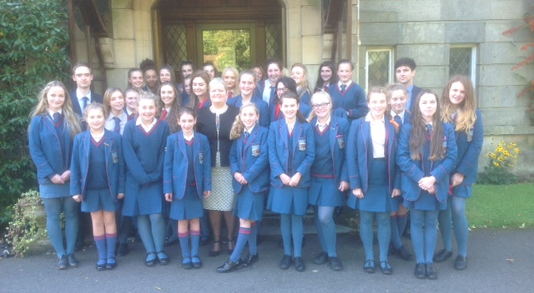
See you in August Hunterhouse College!

