Slide 1
Money:
Rounding to the nearest £
N
- MATHS TOPICS KS2 -

Slide 2
Money
Round each number to the nearest 100 and match it to the number line
851
126
575
386
100 | 200 | 300 | 400 | 500 | 600 | 700 | 800 | 900
164
849
270
548
655
N
Money

Slide 3
Money
Round each number to the nearest 100 and match it to the number line
164
386
575
849
100 | 200 | 300 | 400 | 500 | 600 | 700 | 800 | 900
126
270
548
655
851
N
Money

Slide 4
Rounding to the Nearest Pound
All decimal monetary values lie between two whole pounds.
Example 1: Round £12.89 to the nearest pound.
£12.89 is between
£12.00 and £13.00.
12.89
To decide which number to write, we look at the first digit after the decimal point.
So round this digit up by 1 to make it into
3
This is over 5.
If this digit is LESS THAN 5
we ignore everything
after the decimal point.
If this digit is 5 OR MORE
we round up.
13
£12.89 = £13.00 (to the nearest pound)
N
Rounding Numbers: Rounding to the Nearest Whole Number

Slide 5
Rounding to the Nearest Pound
Example 2: Round £18.32 to the nearest whole number.
£18.32 is between
£18.00 and £19.00.
18.32
To decide which number to write, we look at the first digit after the decimal point.
So leave
this digit
as it is.
This is less than 5.
If this digit is LESS THAN 5
we round down.
18
If this digit is 5 OR MORE
we round up.
£18.32 = £18.00 (to the nearest pound)
N
Rounding Numbers: Rounding to the Nearest Pound

Slide 6
Money
Which whole pounds does the given amount come in between?
£7.82
Round the amount to the nearest pound.
N
Money

Slide 7
Money
Which whole pounds does the given amount come in between?
£7.82
£7.00
£8.00
Round the amount to the nearest pound.
£8.00
N
Money

Slide 8
Money
Match the amounts to the letters on the number line
A
B
C
£5
£5.95
559p
£5.05
N
Money

Slide 9
Money
Match the amounts to the letters on the number line.
A
B
C
£5
£5.95 | C
559p | B
£5.05 | A
N
Money

Slide 10
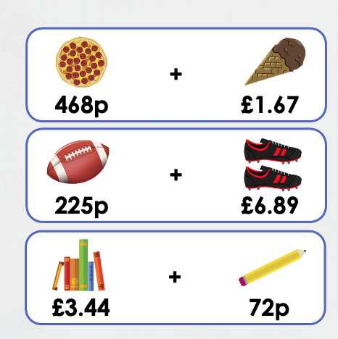
Money
Match the items to the rounded totals
£4.00
£7.00
£9.00
N
Money

Slide 11
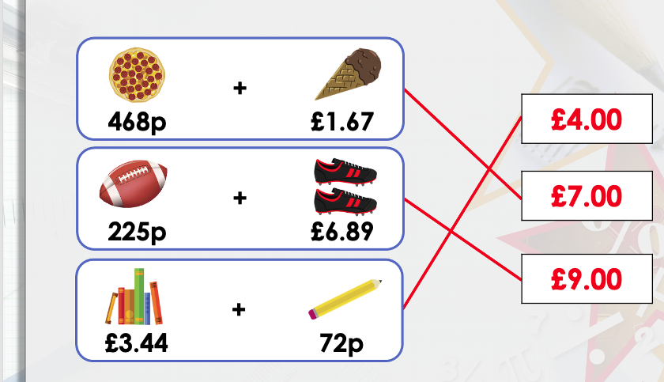
Money
Match the items to the rounded totals
N
Money

Slide 12
N
- MATHS TOPICS KS2 -

