Slide 1
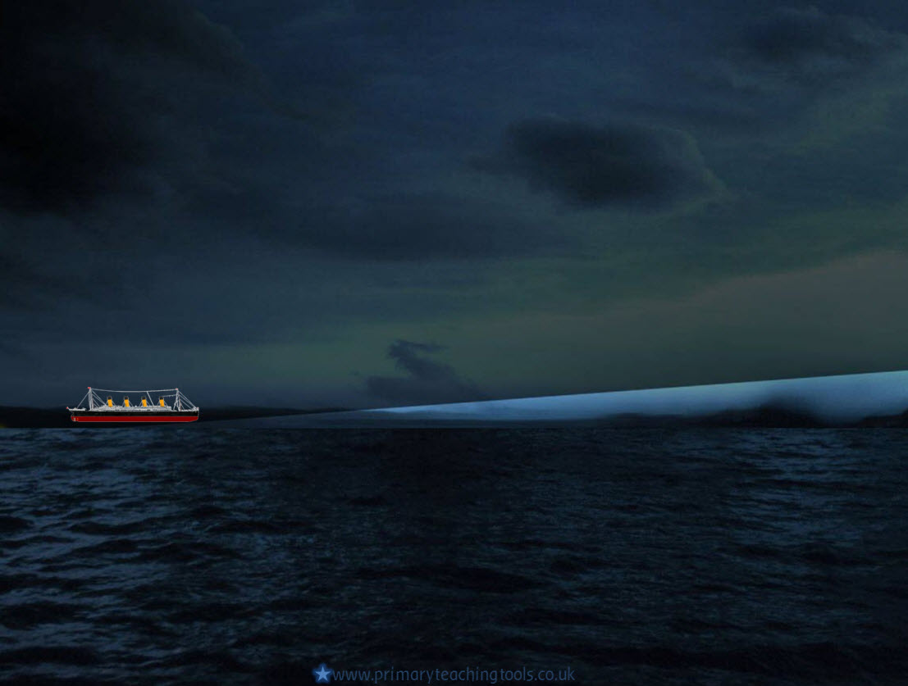
Finding the Titanic

Slide 2
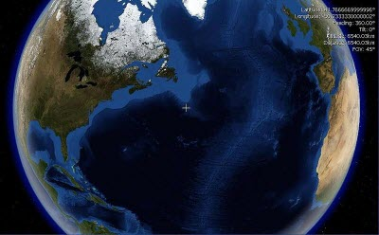
Finding the Titanic
For many years there had been talk of finding the wreck of the Titanic on the ocean floor, but it wasn’t until 1985 that anybody started searching.
A team of French and American scientists from Woods Hole Deep Submergence Lab set out on July 1st 1985 to locate the wreckage of the Titanic. They had an approximate location to search, from the last position reading the Titanic had sent out, approximately 640 kilometres south of Newfoundland.

Slide 3
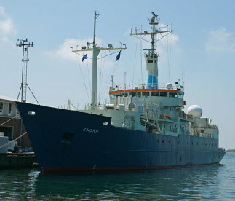
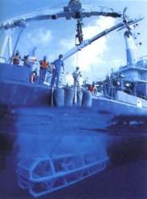
Finding the Titanic
A sledge-like device was towed by the research vessel Knorr. This device, called ‘Argo’ was fitted with TV cameras, and reached 4 kilometres (2 ½ miles) beneath the surface of the sea.
The Knorr
The scientists took turns in watching the live footage sent back to the ship, to see if they could spot anything that looked like the Titanic.
Argo

Slide 4
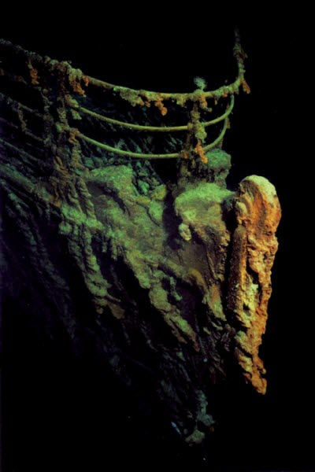
Finding the Titanic
In the early morning hours of September 1st, 1985 the scientists began seeing something besides the mud and sand of the seabed. Small chunks of man-made materials came into view, and then parts of a ship.
The Titanic was again seen for the first time in over 73 years.

Slide 5
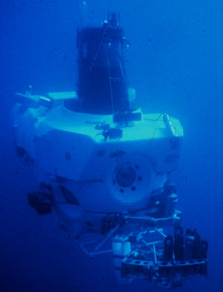
Finding the Titanic
Almost a year later, on the 12th July 1986, the team returned to the wreck site with Alvin, a deep diving submersible, and Jason Junior – a small, remotely operated underwater vehicle that could fit though small gaps to see into the ship’s interior.
They discovered that the ship had broken in two, and many objects lay scattered about over an area of 2.6km². This is called the ‘debris field’.

Slide 6
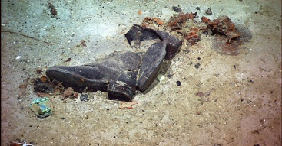
Objects found
Picture by Lady Linky Iwakura Flickr, Creative Commons licence
These shoes were photographed lying on the sea bed.

Slide 7
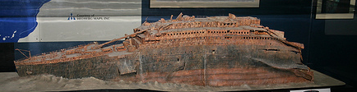
Finding the Titanic
Picture by Cliff1066 Flickr, Creative Commons licence
This is a model of part of the wreck of the Titanic, lying at the bottom of the sea. It shows how it looked when it was first discovered by Dr Robert Ballard in 1985.
Dr. Ballard and his team did not bring any artefacts up from the wreck site.

Slide 8
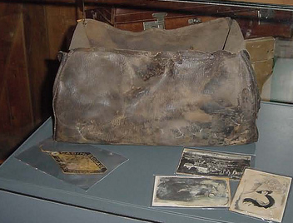
RMS Titanic Inc.
In 1996, the company RMS Titanic Inc. was given the ownership and salvaging rights of the wreck.
They have removed 6,000 objects from the Titanic, and put many of them on display.
A bag and personal belongings, brought up from the wreck.
Picture by Craig Hawkins, Flickr, Creative Commons licence

Slide 9
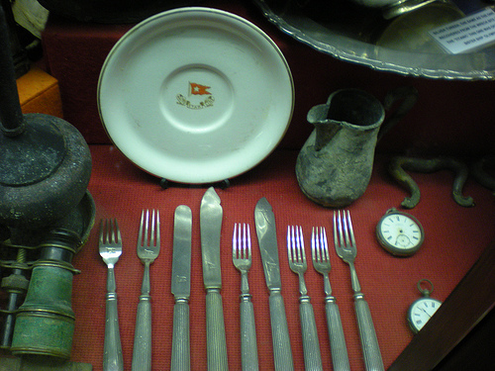
Objects found
Picture by Ben Sutherland Flickr, Creative Commons licence
White Star Line cutlery

Slide 10
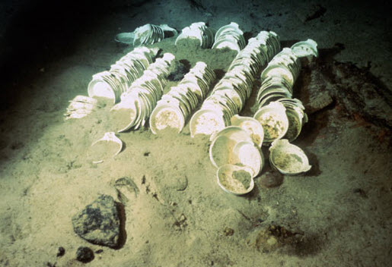
Expedition Titanic
RMS Titanic Inc. have started a new expedition, called Expedition Titanic. This is a project that sets out to photograph and video the shipwreck and debris field.
Many scientists are concerned that the shipwreck is decaying faster because of visits by tourists in submarines, and the recovery of objects. It is predicted that the structure of the Titanic may collapse in the next 50 years.
Explore the Expedition Titanic website

Slide 11
Online links
BBC LZB – Exploring the wreck of the Titanic
BBC – Titanic journey
Explore the wreck – flash activity
All acknowledged images used published under a Creative Commons Licence
All other images in the Public Domain

