Slide 1
Money Revision
Over the last 2 weeks, we have been learning about decimals.
In money, a decimal point is used to separate the pounds and pence.
N
- MATHS TOPICS KS2 -

Slide 2
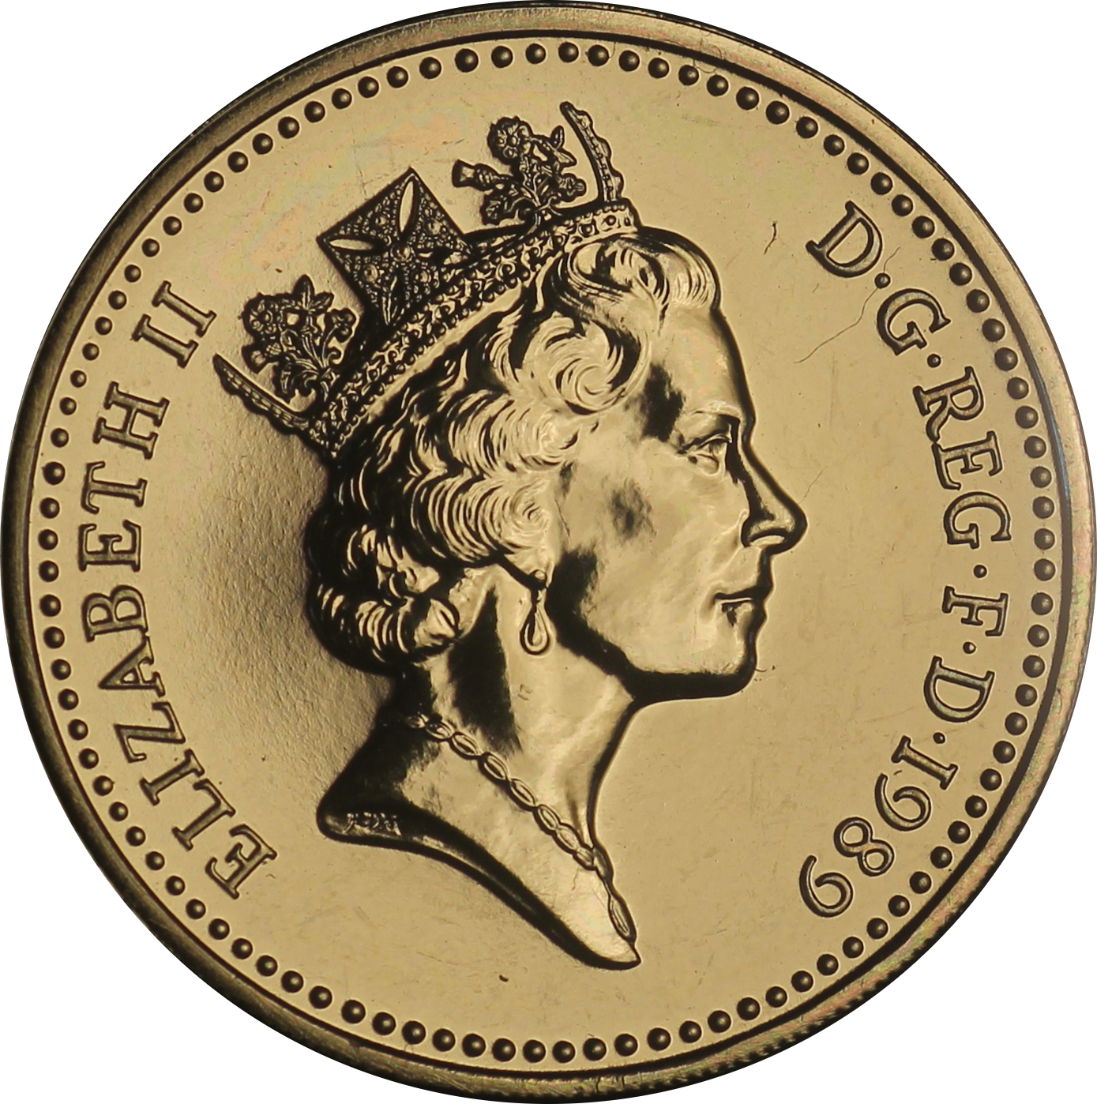
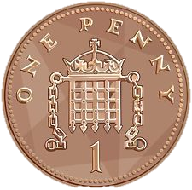
Money
What sort of money do we use?
We use money everyday to pay for things;
In our country, we pay for things in ‘pounds’(£) and ‘pence’ (p).
What is worth more – 1 pound or 1 penny?
How many pennies make up 1 pound?
N
Money Revision

Slide 3
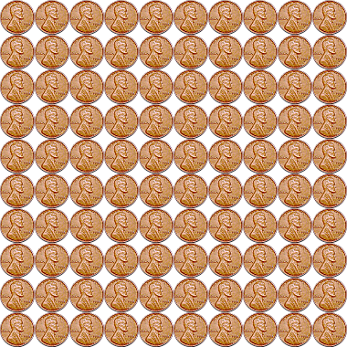
Money
How many pennies are in a pound?
There are 100 pennies in £1.00
=
100 p
£1.00
N
Money Revision

Slide 4
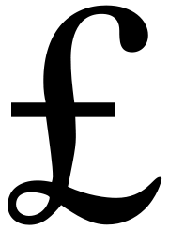
Money
Writing monetary values
We can change money that is written in pence and write it as ‘pounds’ using a ‘£’ sign.
When writing values as ‘pounds’, a decimal point separates the pounds from the pence.
pence
pounds
3
5
0
350 p = £3.50
N
Money Revision

Slide 5
Money
Writing pence in pounds
100 p = £1.00
300p = £3.00
700p =
680p =
45p =
Can you write these pence values in pounds, using a £ sign?
£7.00
£6.80
There is less than 100p – so there is not enough for there to be one whole pound.
£0.45
N
Money Revision

Slide 6
Money
Writing pounds as pence
Sometimes, we might be given a value written in ‘pounds’ and have to write it in pence.
When this happens, we must take the ‘£’ sign away and remove the decimal point.
We must write a ‘p’ at the end of our number, to show we are writing it in pence.
Example: £9.00 = 900p
£6.50 = 650 p
£5.80=
580 p
^{Can you write £5.80 in pence?}
N
Money Revision

Slide 7
Money
Pounds and pence
https://www.bbc.co.uk/bitesize/clips/zm487ty
Watch this video:
N
Money Revision

Slide 8
Money
Revision games:
https://www.topmarks.co.uk/money/coins-game
Choose Ordering, any six coins and Counting, any six coins ☺
https://www.topmarks.co.uk/ordering-and-sequencing/coconut-ordering
Choose Prices, up to £10.00
Play the games linked above to revise ordering and counting money.
N
Money Revision

Slide 9
N
- MATHS TOPICS KS2 -

