Slide 1
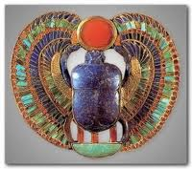
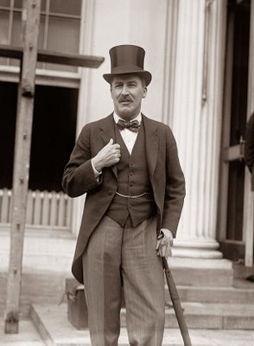
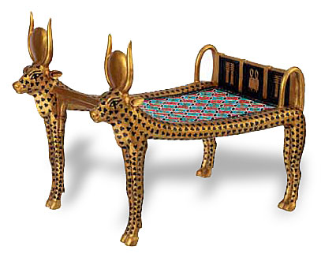
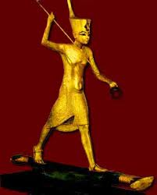
My name is Howard Carter. I discovered the treasures of Tutankhamun’s tomb.
Let’s find out more about Him and the other rulers of Egypt.

Slide 2
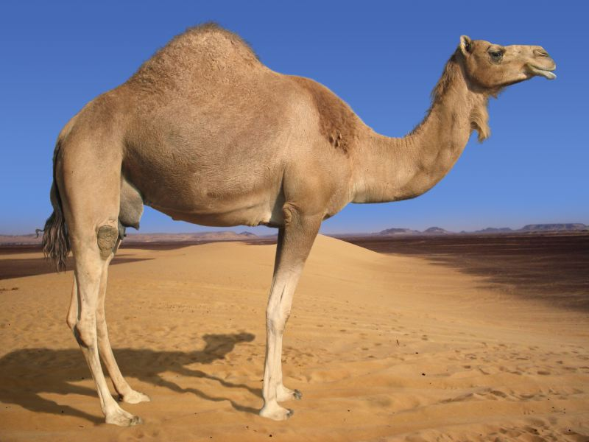
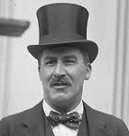
Really easy
Q:
What did the Ancient Egyptians call their kings?
Pharaohs, of course. Everyone knows that!

Slide 3
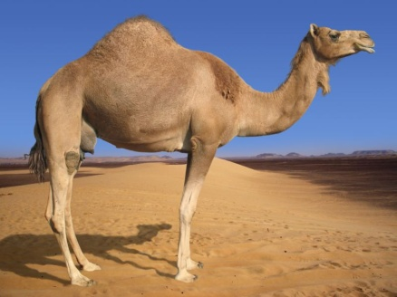
The word pharaoh comes from ‘per-aa’ which means ‘great house’ or ‘palace’. The Hebrews and the Greeks heard it wrong and started calling the Egyptian kings: Pharaoh.
Not so fast Clever Clogs! The Ancient Egyptian word for king was not pharaoh at all. It was: Nisu.
Somehow the name Pharaoh stuck - and in the end, everyone called them that!!!

Slide 4
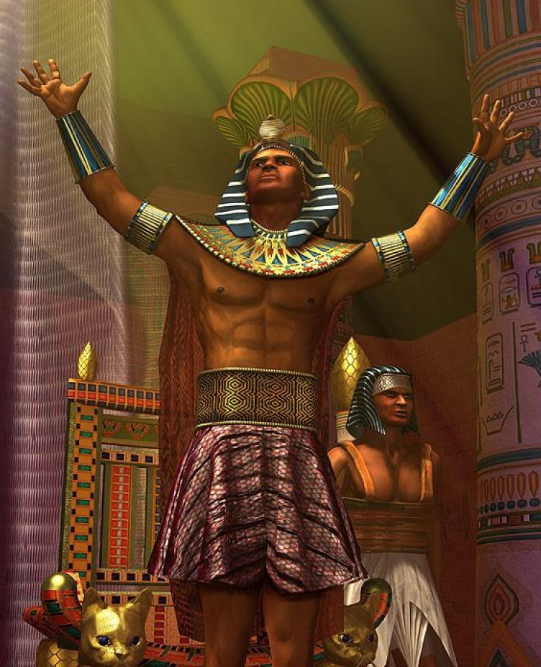
Why were the Pharaohs so powerful?
The pharaohs ruled Egypt for 3000 years.
The Ancient Egyptians believed that each pharaoh became Horus, son of Ra – a god on earth.
Because the pharaoh was considered to be a god he or she was the only one allowed to ask the gods for help.
THAT’S WHAT MADE THE PHARAOHS SO POWERFUL!!!
In our country, it’s like being ruled by the pharaohs from before Roman times until now.

Slide 5
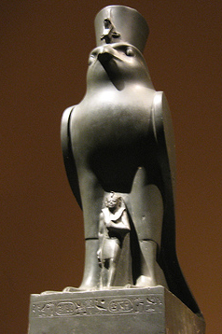
Other names for the pharaoh, which showed how powerful they were, included:
Lord of the Two Lands
High Priest of Every Temple
I wouldn’t let any pharaohs boss me around!!
Horus wearing the pharaoh’s crown
Unlucky! They didn’t have camels in ancient Egypt.

Slide 6
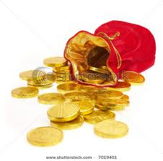
What did the pharaohs have to do?
A pharaoh’s ‘responsibilities’ included:
ruling the whole country and keeping order
owning all the land of Egypt and collecting
all the taxes
commanding the army & defeating all the enemies of Egypt
asking the gods for help - especially to make sure that the Nile flooded during the season of Akhet.
Apart from living in beautiful palaces, eating wonderful food and enjoying all that treasure you mean?

Slide 7
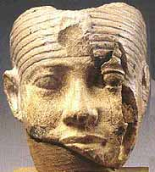
Some famous pharaohs...
He ruled for 94 years ... from age 6 to age 100.
Claim to fame:
Pepi 2
That makes him the longest ruling king or queen in human history!!

Slide 8
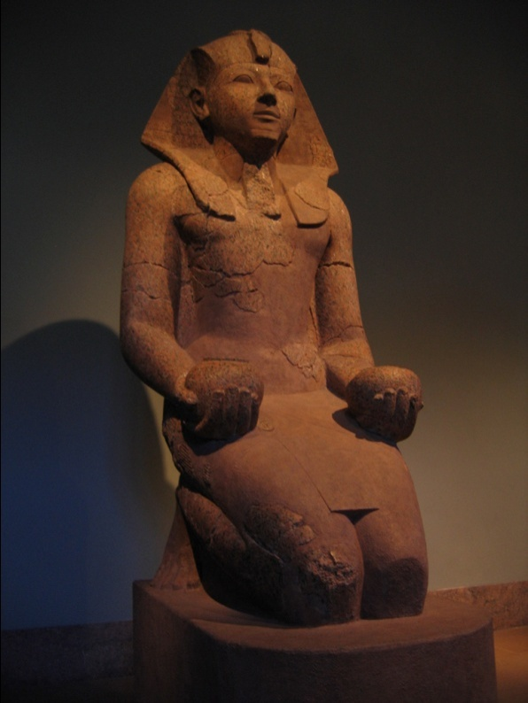
Some famous pharaohs...
One of the few successful queens of Egypt, she showed her strength to the people by dressing as a man.
Claim to fame:
Queen
Hatshepsut
Queen Hatshepsut even put on the fake ceremonial beard that all male pharaohs wore!!

Slide 9
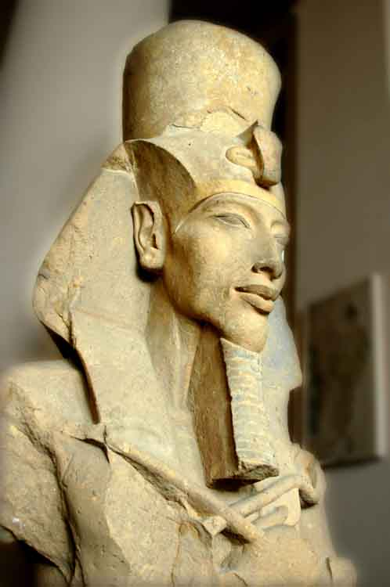
Some famous pharaohs...
He scrapped all the other gods and made everybody worship just the one sun god Aten.
Claim to fame:
After he died, the priests brought all the other gods back and tried to get rid of all memories of Akhenaten.
Akhenaten

Slide 10
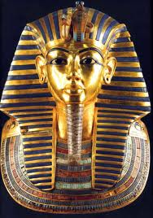
Some famous pharaohs...
He was only about nine when he came to the throne and died when he was just 18. His amazing tomb, full of treasure, was found undisturbed in the Valley of the Kings...
Claim to fame:
Tutankhamun
By me! Howard Carter (Oh and Lord Carnarvon)

Slide 11
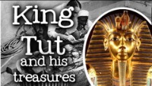
Watch this video for more information on Tutankhamun!

