Slide 1
Kilometres
N
- MATHS TOPICS KS2 -

Slide 2
Length
Units recap
Centimetres (cm)
The prefix ‘cent’ means 100; think of century (100 years!)
Metres (m)
100cm = 1 m
N
length

Slide 3
Length
There are other units that can be used to measure length.
Centimetres (cm)
Units of Length
Millimetres (mm)
Metres (m)
Kilometres (Km)
N
length

Slide 4
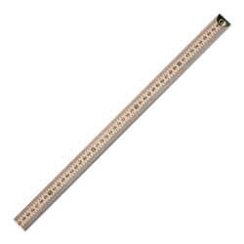
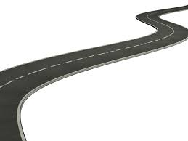
Length
There are other units that can be used to measure length.
1,000 meters = 1 kilometer
N
length

Slide 5
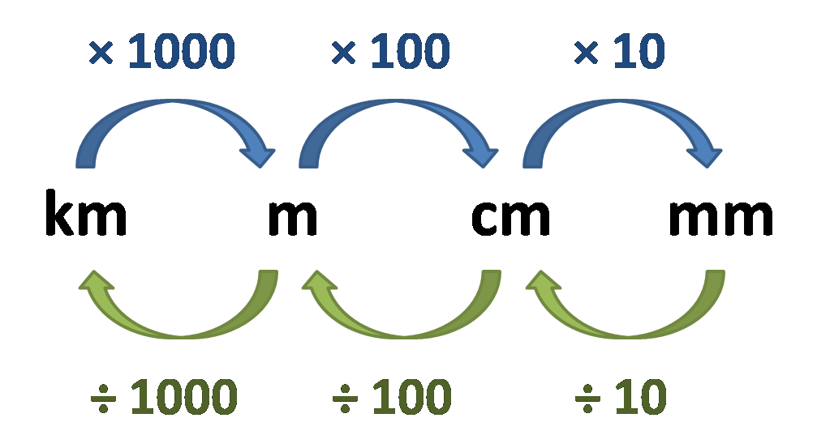
Length
Units:
Examples:
5000m = 5km
2 km = 2000m
1500 m = 1 ½ km
N
Length

Slide 6
Convert: m to km
X 1000
How many m in 1 km?
1000
in 2 km?
2000
in 10 km?
10,000
in 50 km?
50,000

Slide 7
Convert: km to m
÷ 1000
How many km in 1000 m?
1
in 2000m?
2
in 10,000 m?
10
in 50,000 m?
50

Slide 8
I can measure length and convert lengths
Which is longer?
1m or 200 cm?
2.5 m or 300cm?
1km or 1000m?
50,000m or 500 km?
200cm
300cm
the same!
500km

