Slide 1

Measuring Length
N
- MATHS TOPICS KS2 -

Slide 2
Length
Units.
Centimetres (cm)
The prefix ‘cent’ means 100; think of century (100 years!)
Metres (m)
100cm = 1 m
N
length

Slide 3
Length
There are other units that can be used to measure length.
Centimetres (cm)
Units of Length
Millimetres (mm)
Metres (m)
Kilometres (Km)
N
length

Slide 4
Length
Units
How many mm in a cm?
10 mm
100 cm
How many cm in a m?
How many m in a km?
1 000 m
N
Length

Slide 5
Length
Units
50 cm
How many cm in ½ m?
500 m
How many m in ½ km?
250 m
How many m in ¼ km?
N
Length

Slide 6
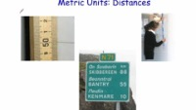
Length
Units.
https://corbettmathsprimary.com/2018/07/31/units-length-video/
N
length

Slide 7
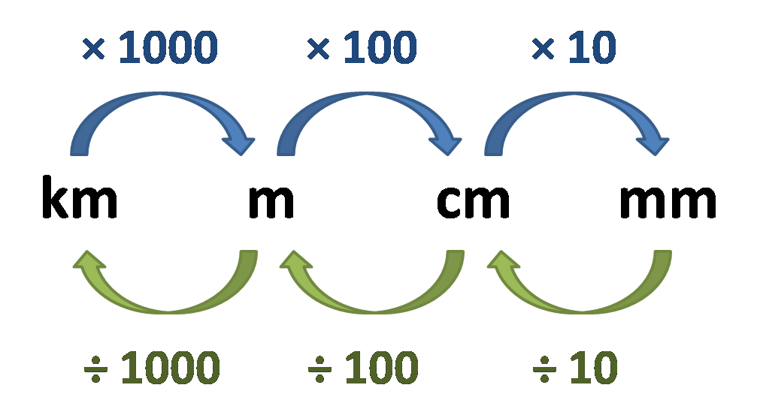
Length
Units:
Examples:
2 km = 2000m
50 mm = 5 cm
N
Length

Slide 8
Questions

Slide 9
Convert: cm to mm
X 10
How many mm in 1 cm?
10 mm
in 2 cm?
20 mm
in 10 cm?
100 mm
in 50cm?
500 mm

Slide 10
Convert: m to cm
X 100
How many cm in 1 m?
100 cm
in 2 m?
200 cm
in 10 m?
1 000 cm
in 50 m?
5 000 cm

Slide 11
Convert: km to m
X 1000
How many m in 1 km?
1 000m
in 2 km?
2 000m
in 10 km?
10,000 m
in 50 km?
50,000 m

Slide 12
Convert: mm to cm
÷ 10
How many cm in 10mm?
1 cm
in 20 mm?
2cm
in 100 mm?
10 cm
in 500 mm?
50 cm

Slide 13
Convert: cm to m
÷ 100
How many m in 100 cm?
1m
in 200 cm?
2m
in 1000 cm?
10m
in 5000 cm?
50m

Slide 14
Convert: m to km
÷ 1000
How many km in 1000 m?
1km
in 2000m?
2km
in 10,000 m?
10km
in 50,000 m?
50km

Slide 15
Length
Units:
Watch this video on length:
https://www.bbc.co.uk/bitesize/clips/z8487ty
N
Length

Slide 16
I can measure length and convert lengths
Which is longer?
1m or 200 cm?
2.5 m or 300cm?
50mm or 4 cm?
1km or 1000m?
50,000m or 500 km?
200cm
300cm
50mm
the same!
500km

Slide 17
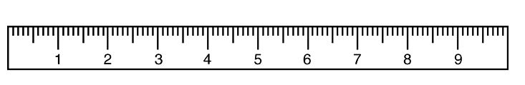
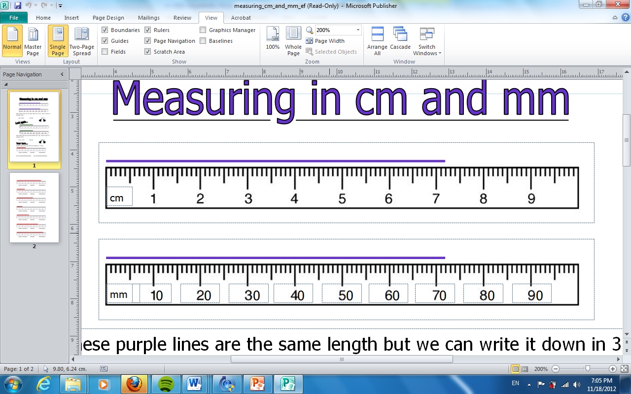
Measuring in centimetres (cm)
cm
Measuring in millimetres (mm)

Slide 18
7cm 2mm
7.2cm
72mm
7cm 2mm

Slide 19
cm
How many cm?
5.5cm

Slide 20
How many cm?
8.4cm

Slide 21
cm
How many cm?
3.3cm

Slide 22
Length
Games:
Practise reading a ruler using this game:
https://www.topmarks.co.uk/maths-games/measuring-in-cm
Have fun measuring length and weight:
http://flash.topmarks.co.uk/4769
N
Length

