Slide 1

Calculating Perimeter
N
- MATHS TOPICS KS2 -

Slide 2
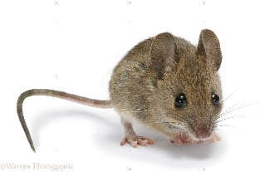
Perimeter
What is perimeter?
The perimeter is the length of, or distance around, the outside of a 2D shape.
Rim = outer edge
Perimeter
N
Perimeter

Slide 3
Perimeter
What is perimeter?
https://www.bbc.co.uk/bitesize/topics/zvmxsbk/articles/zsr4k7h
Follow this link and watch the video ☺
N
Perimeter

Slide 4
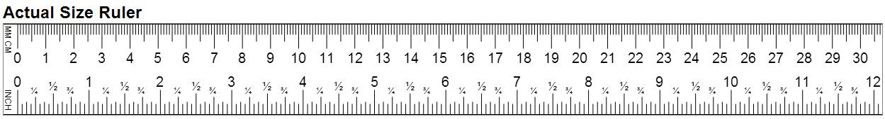
19cm
8cm
8cm
19cm

Slide 5
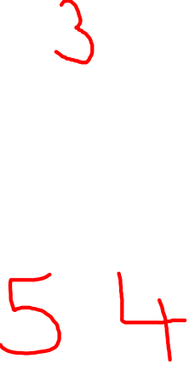
Perimeter
Calculating Perimeter
1 9
+ 1 9
+ 8
+ 8
Don’t forget to include your unit of measurement (cm).
Perimeter = 54 cm
N
Perimeter

Slide 6
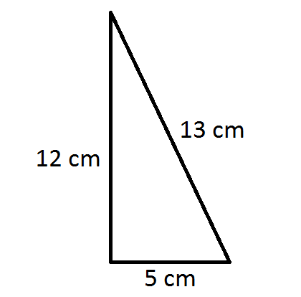
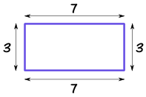
Perimeter
Calculating Perimeter
7+3+7+3 = 20
7 + 3 + 7 + 3 = 20 cm
13 + 12 + 5 = 30 cm
N
Perimeter

Slide 7
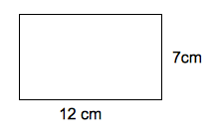
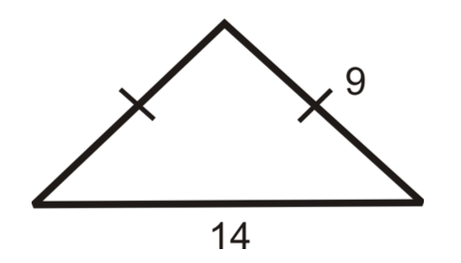

Perimeter
Calculating Perimeter
7+3+7+3 = 20
m
m
12
12
7
7
14
9
9
P = 38 cm
P = 32 m
38
32
N
Perimeter

Slide 8
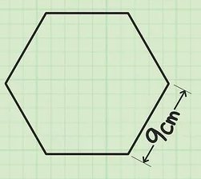

Perimeter
Calculating Perimeter
7+3+7+3 = 20
Find the perimeter of this regular hexagon.
9 +9 +9 + 9 + 9+ 9 = 54
9 x 6 = 54
P = 54 cm
N
Perimeter

Slide 9

Perimeter
Using perimeter to calculate length
7+3+7+3 = 20
The perimeter of this regular pentagon is 35cm. What is the length of each side?
35 ÷ 5 = 7
7 + 7 + 7 + 7 + 7 = 35
7 cm
N
Perimeter

Slide 10
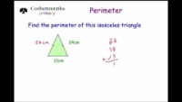
Perimeter
Video:
https://corbettmathsprimary.com/2018/07/17/perimeter-video/
N
Perimeter

