Slide 1

Town
Here are some pictures showing what you would find in the town.

Slide 2
Good things about living in the town
(the pros)

Slide 3
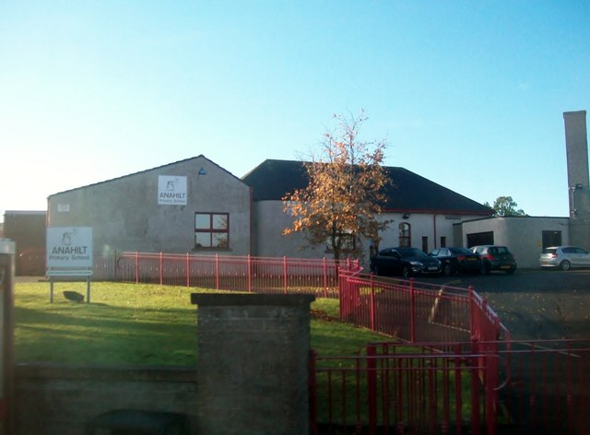
school

Slide 4
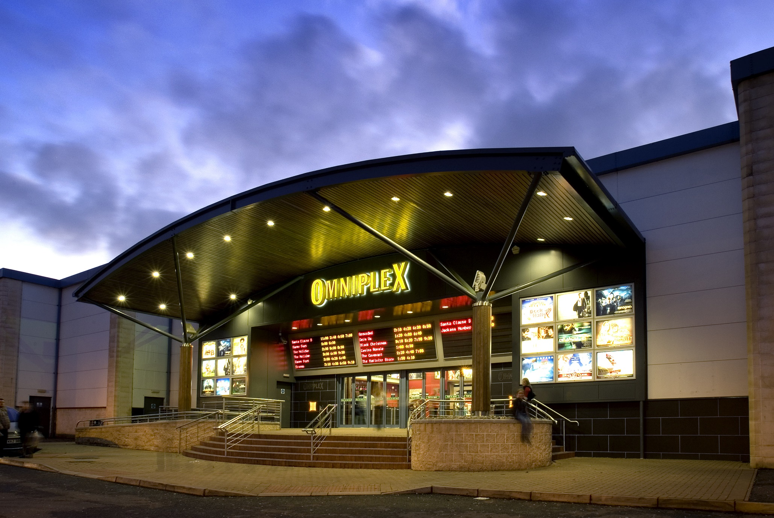
cinema to visit

Slide 5
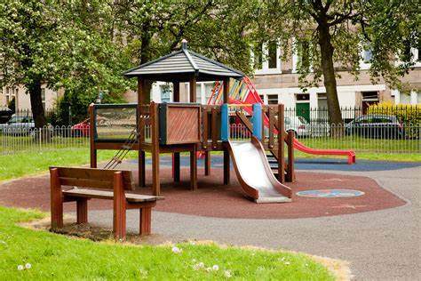
play park to visit

Slide 6
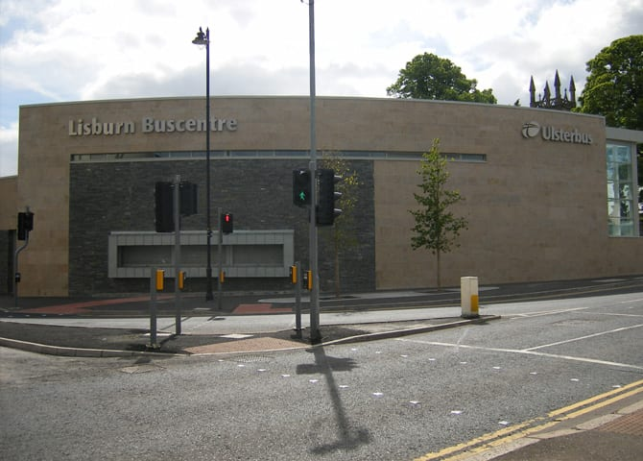
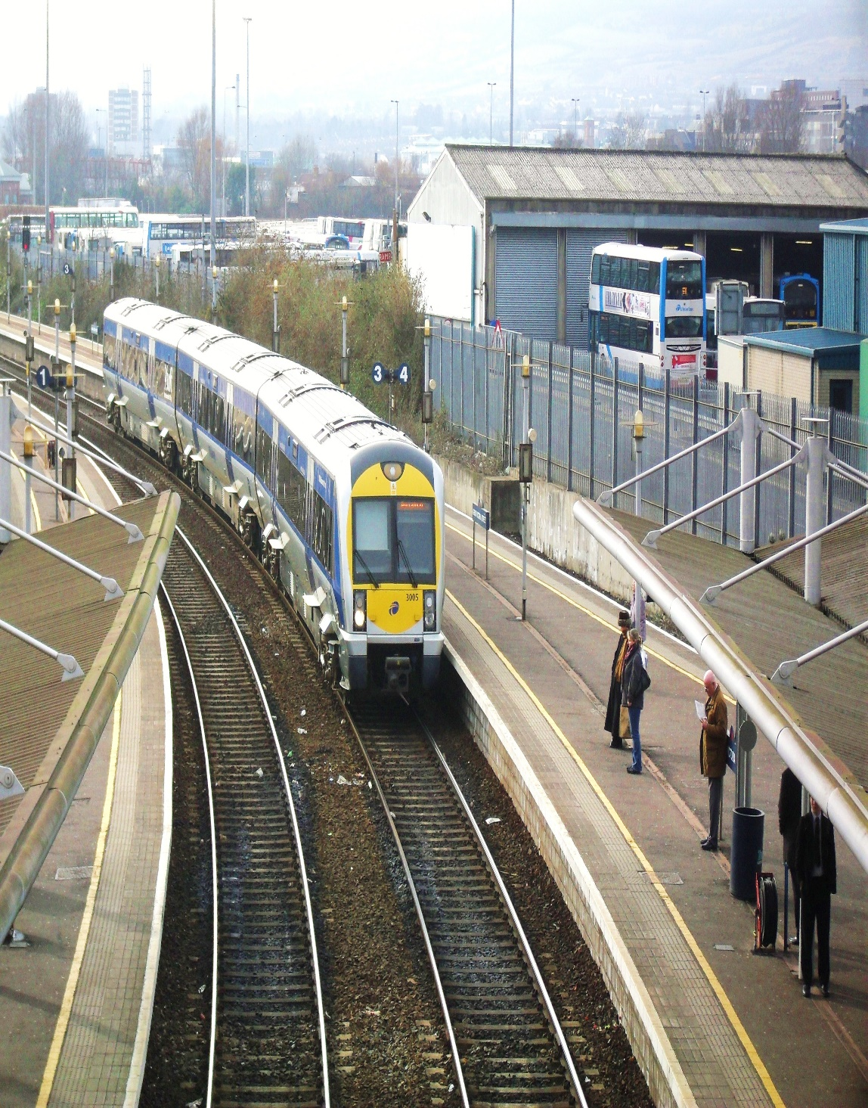
more transport
bus station
train station

Slide 7
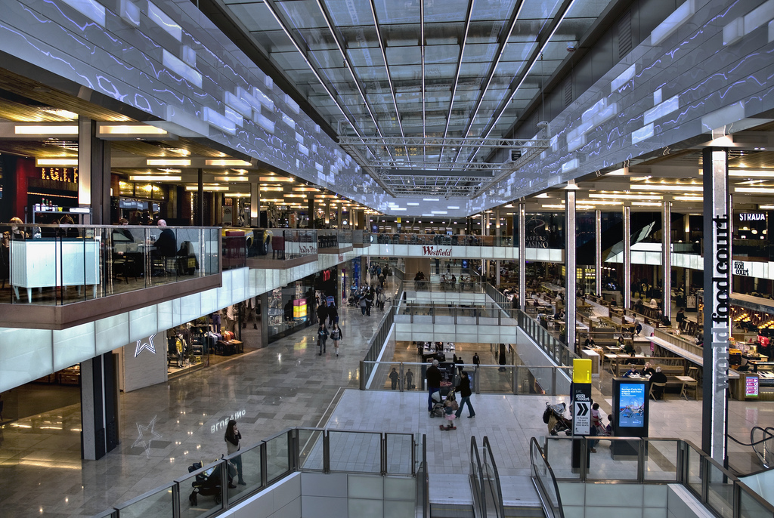
shopping centre with lots of shops
Photo courtesy of Ben124. (@flickr.com) - granted under creative commons licence - attribution
Notes:
Adult Guidance Insert photographs accordingly.

Slide 8
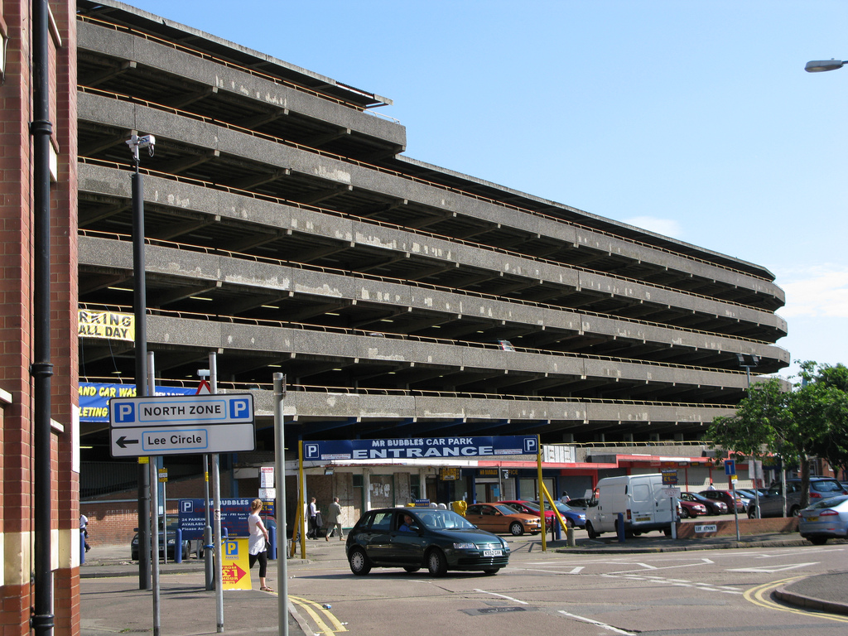
multi storey car park with lots of parking spaces
Photo courtesy of Fiery Fred (@flickr.com) - granted under creative commons licence - attribution
Notes:
Adult Guidance Insert photographs accordingly.

Slide 9
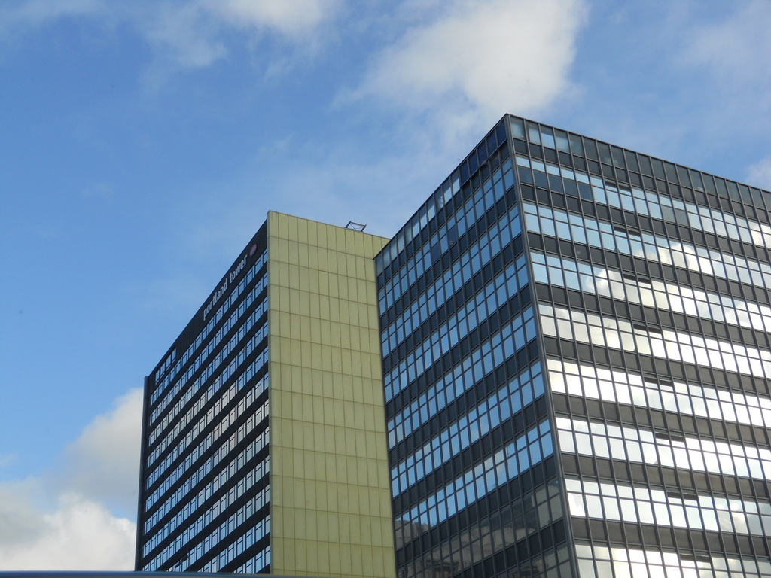
office blocks – more jobs
Photo courtesy of Gene Hunt (@flickr.com) - granted under creative commons licence - attribution
Notes:
Adult Guidance Insert photographs accordingly.

Slide 10
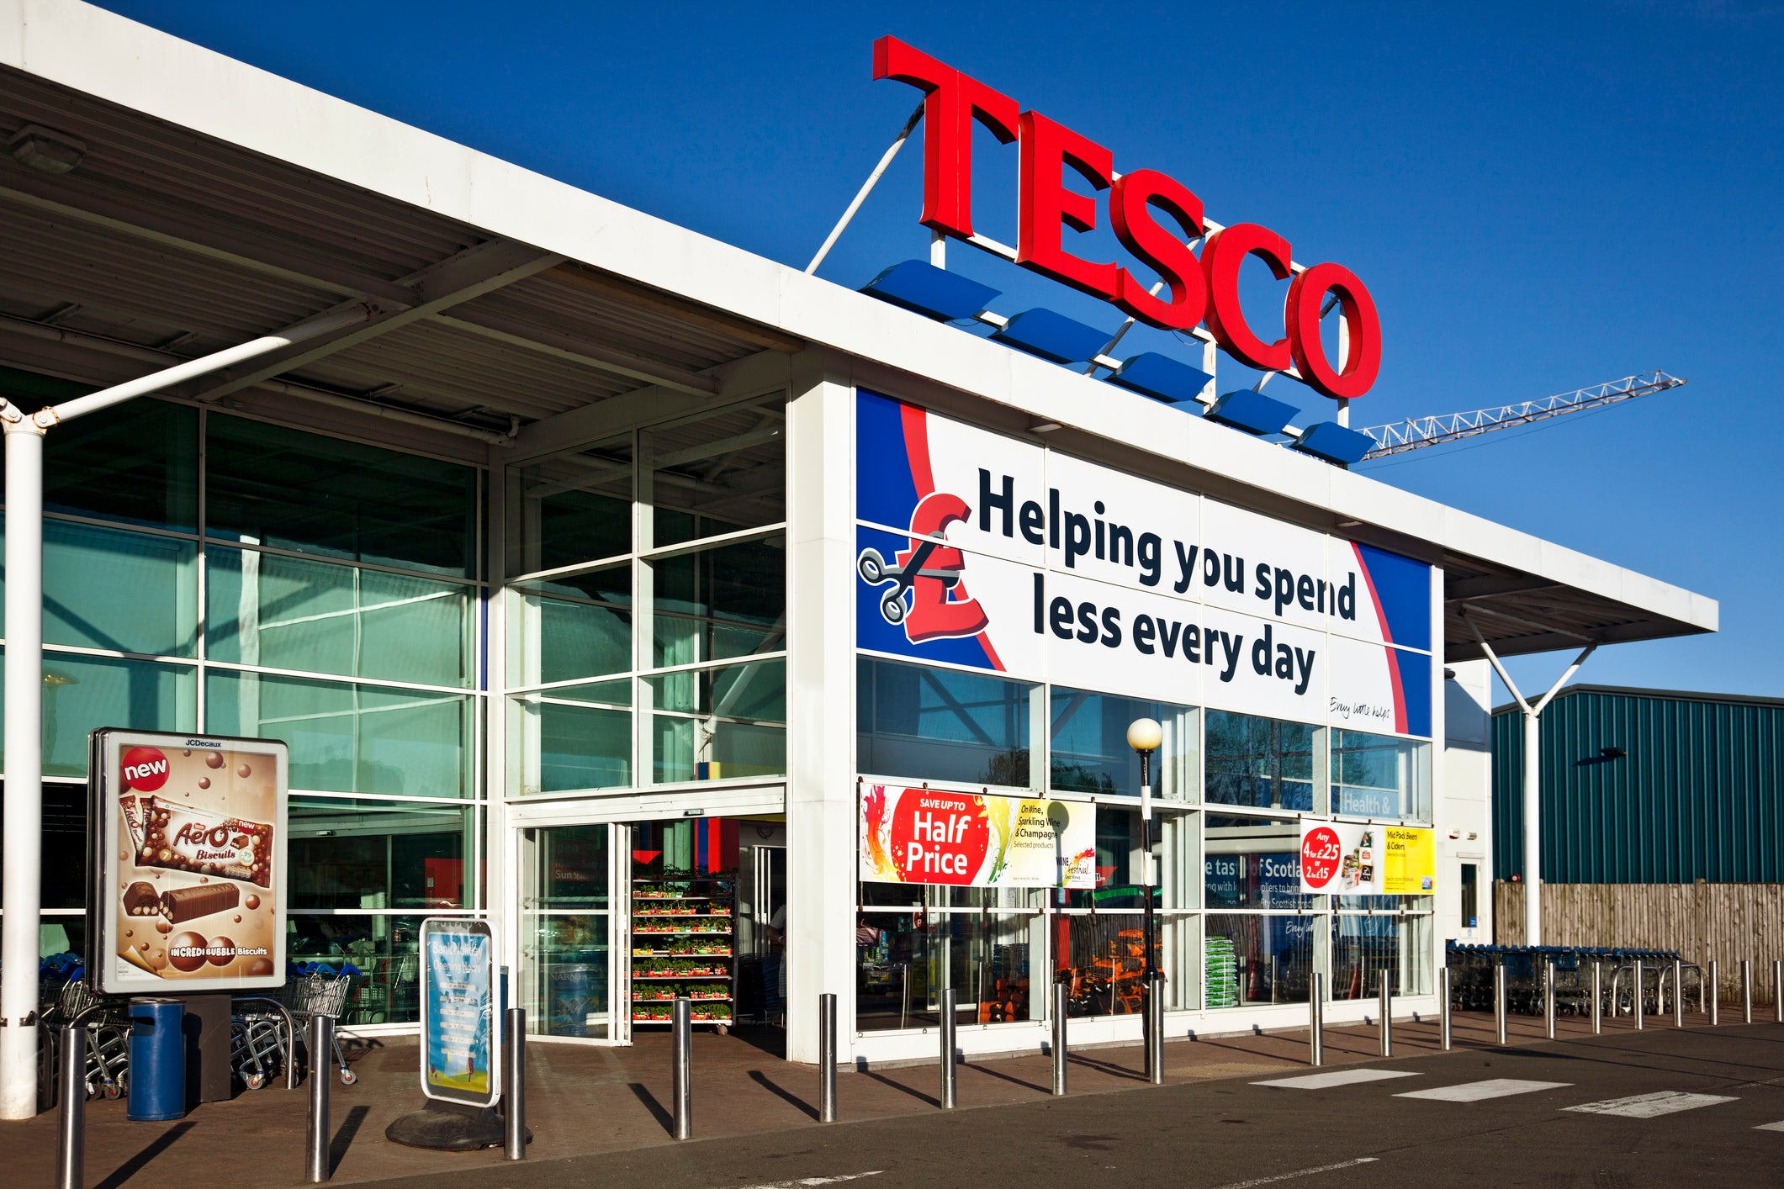
large supermarket

Slide 11
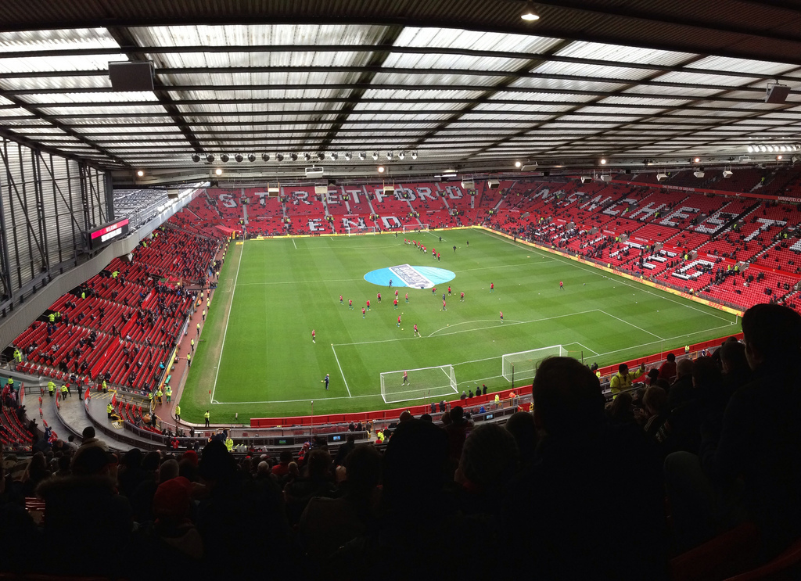
football stadium to go and watch a match
Photo courtesy of stacey.cavanagh (@flickr.com) - granted under creative commons licence - attribution
Notes:
Adult Guidance Insert photographs accordingly.

Slide 12
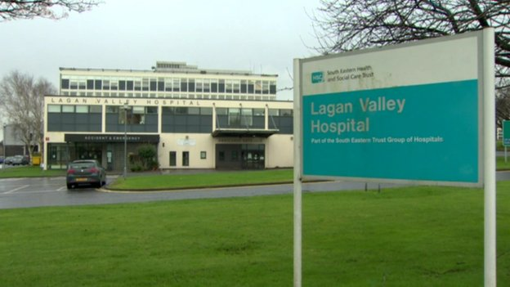
hospital – an important service

Slide 13
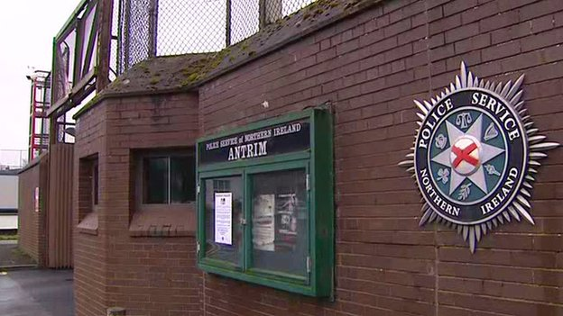
police station – an important service
Photo courtesy of garryknight (@flickr.com) - granted under creative commons licence - attribution
Notes:
Adult Guidance Insert photographs accordingly.

Slide 14
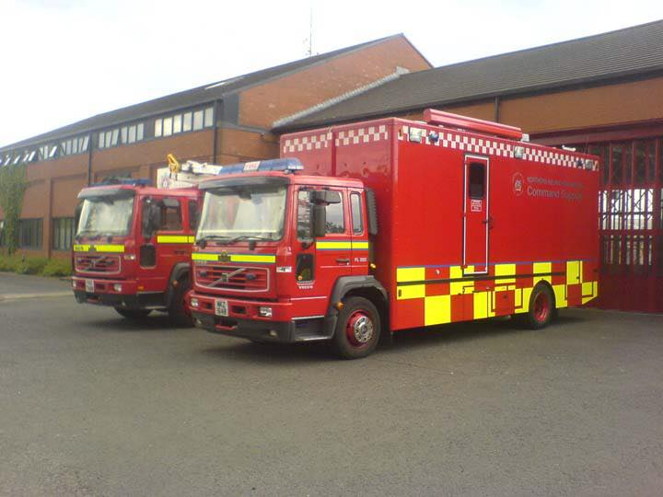
fire station –
an important service

Slide 15
Bad things about living in the town
(the cons)

Slide 16
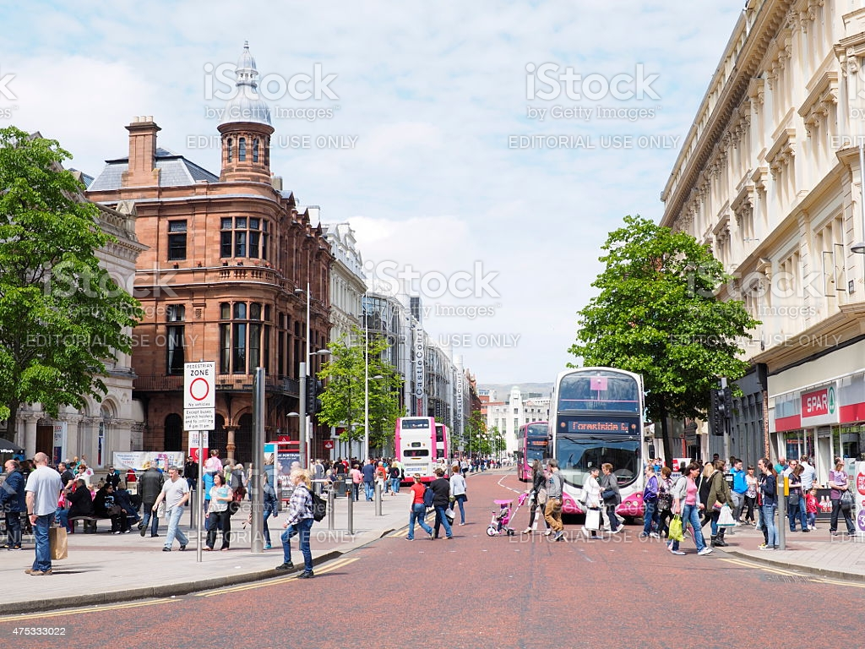
busy crowded street

Slide 17
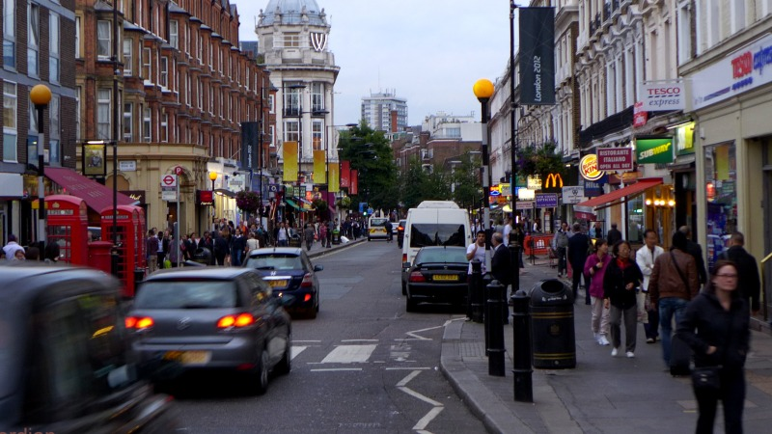
noisy town

Slide 18
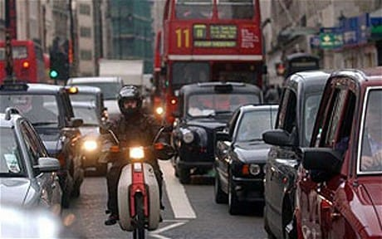
traffic jam

Slide 19
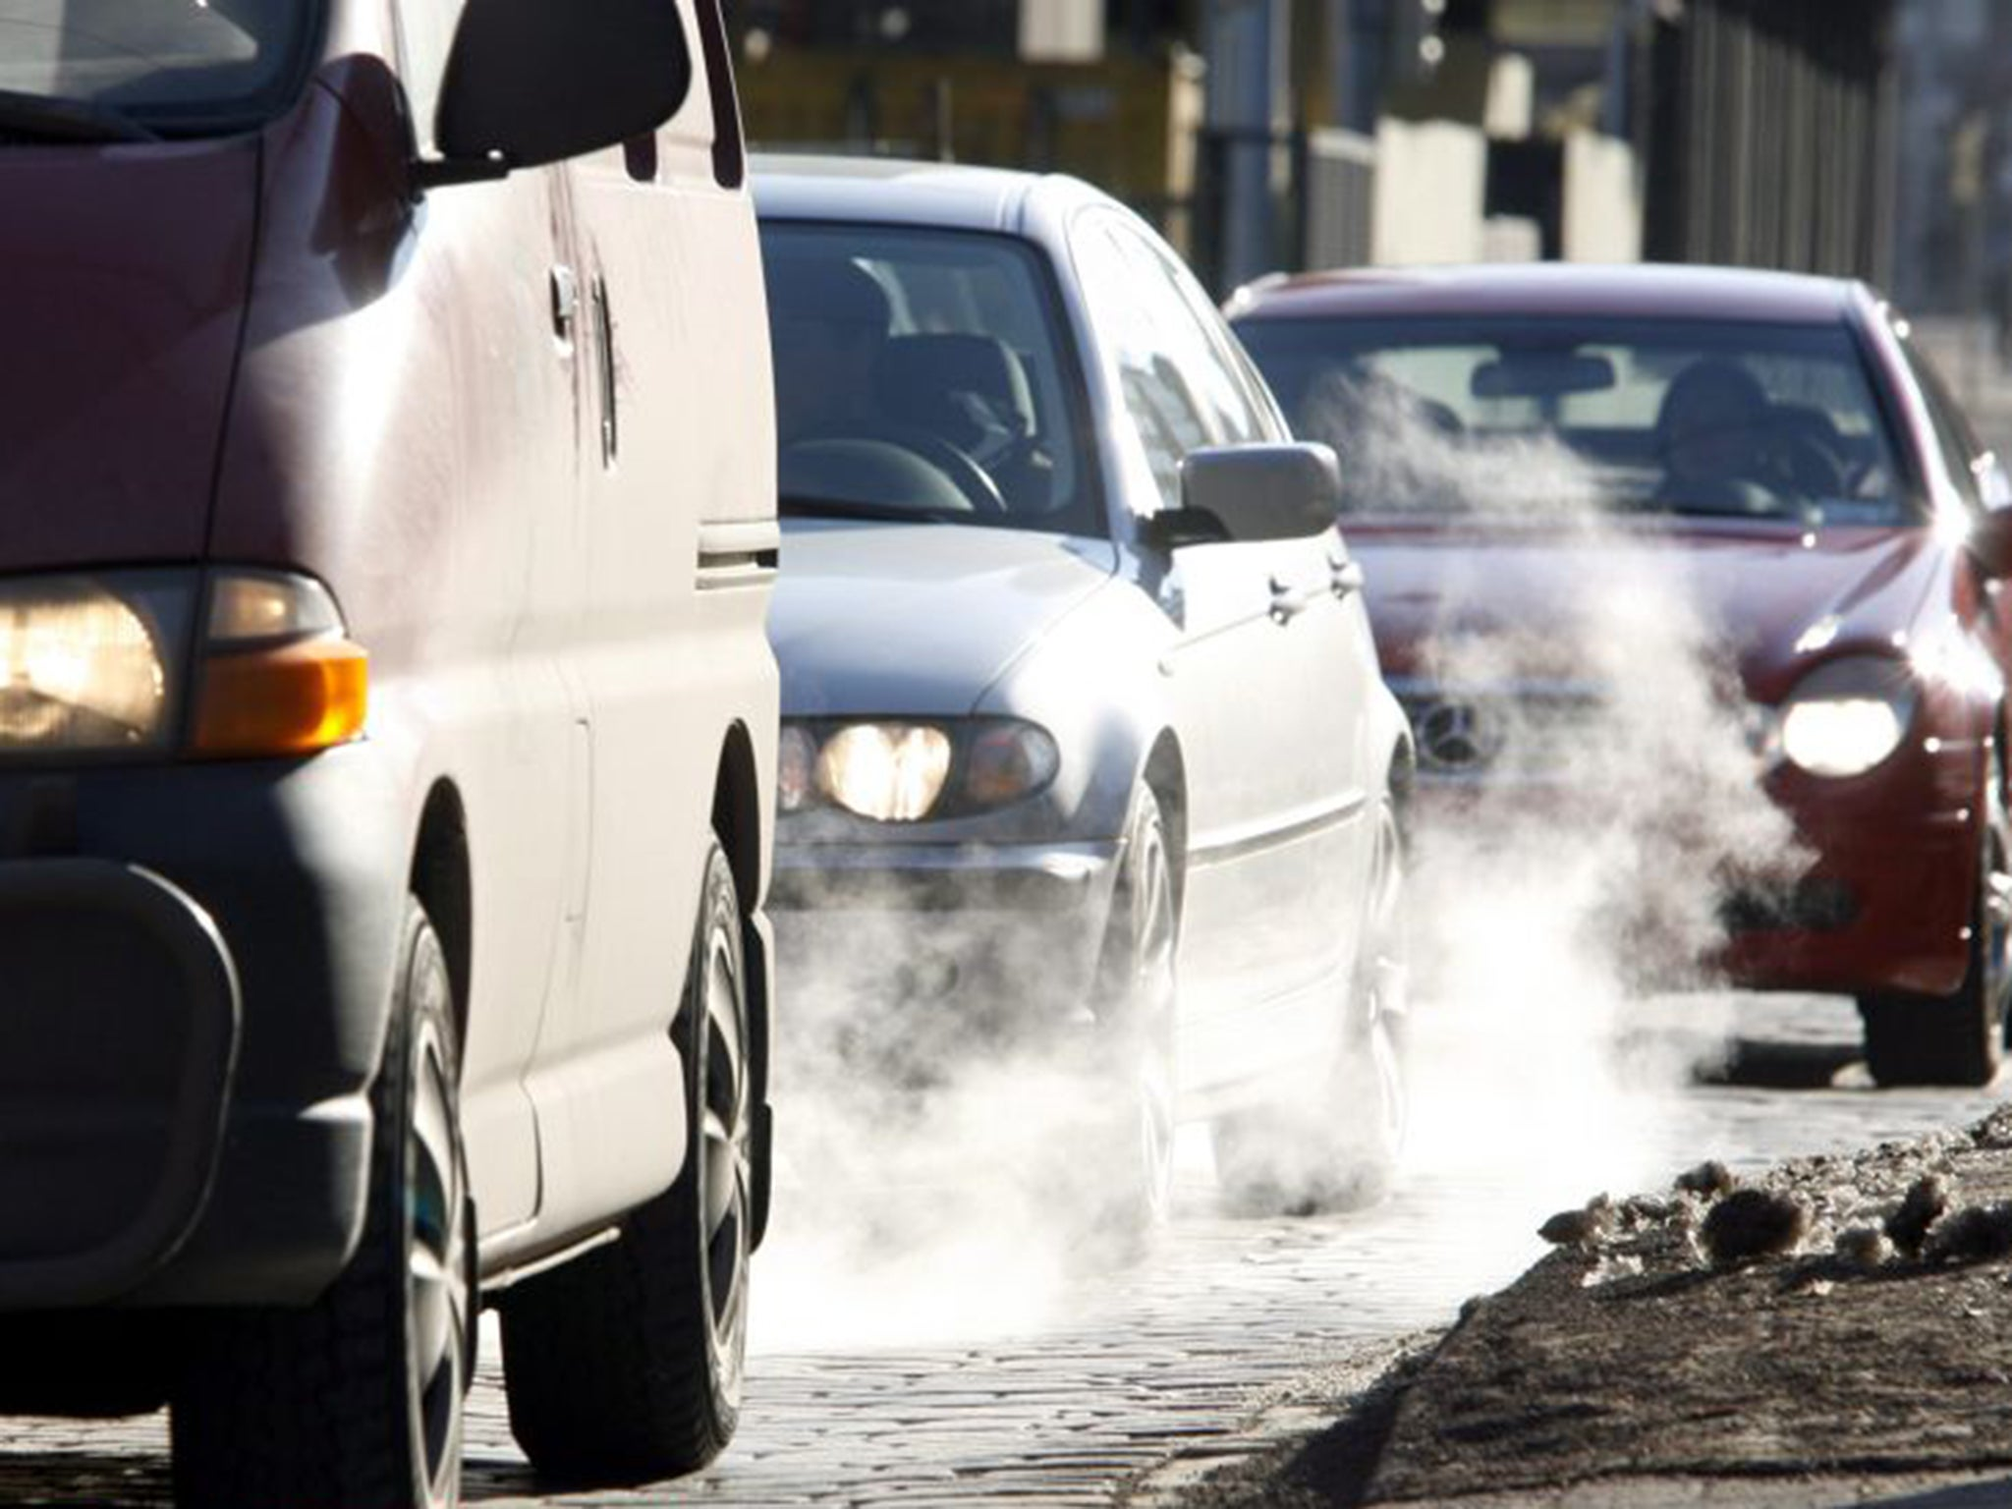
less fresh air

Slide 20
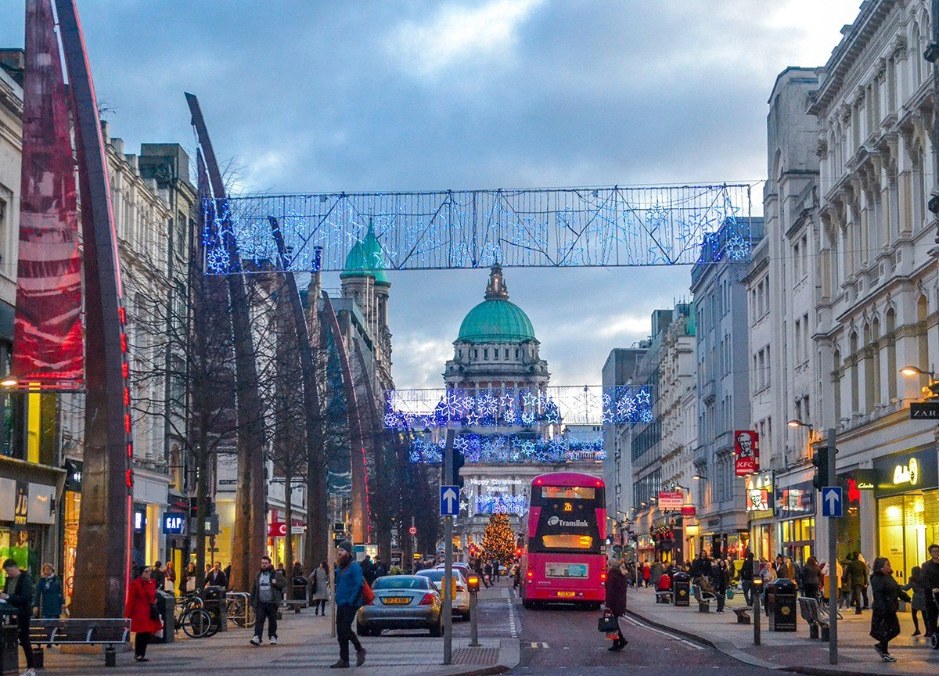
more expensive to live in the
town

