Slide 1

Parts of Speech
Nouns, Verbs and Adjectives.

Slide 2

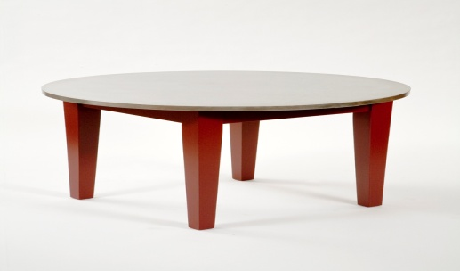


What is a noun?
A noun is a naming word.
It is the name of a person, place or thing.
Can anyone think of any examples?
table, car, rainbow, London

Slide 3




What is a verb?
A verb is a ‘doing word.’
It tells us what people (or things) are doing or being.
Can be past, present or future
Can anyone think of any examples?
Sing, think, jump, walk, read

Slide 4




What is an adjective?
An adjective is a describing word.
It tells you more about a noun
Adjectives make your sentences more interesting.
Can anyone think of any examples?
blue, big, scared, happy

Slide 5
Find the nouns, verbs and adjectives
The tall man walked up the hill.
I ate a large sandwich.
The fence fell down in the windy weather.

Slide 6
Revision
What are..
            Pronouns?
            Common nouns?
            Proper nouns?
            Adverbs?
            Conjunctions?

