Slide 2
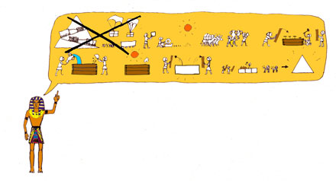
Ancient Egypt civilization lasted over 3000 years.
Egyptian monuments have been around so long
that they were ancient even in Greek
and Roman times…. but one key question has
always loomed: how and why were the pyramids built?

Slide 3
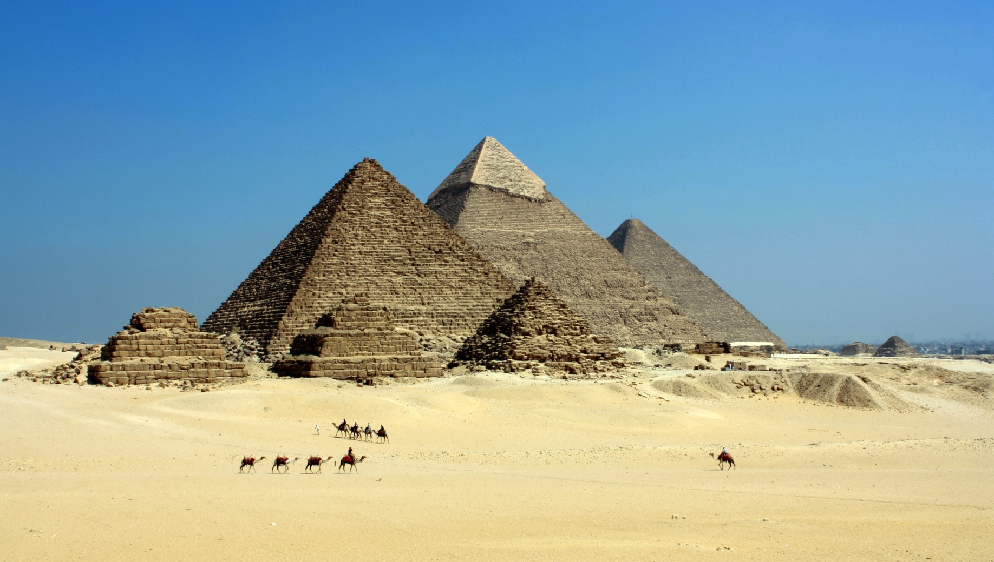
The Egyptian pyramids are stone structures,
mostly built as tombs for Egyptian Kings.

Slide 4
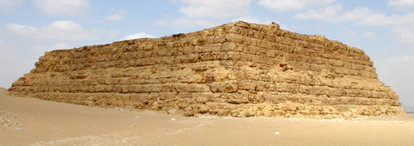
Mastaba
Although more trapezoid than pyramid shaped, the mastaba was the basis that the pyramids came from. This flat-topped building with sloped sides was erected over a burial chamber, which was carved deep into the ground below.
The burial chambers were lined with wood and often decorated with paintings. As time went on, the chambers became more complex and would include a small ‘chapel’.
At ground level, there were rooms where offerings were left for the deceased.
The word ‘mastaba’ comes from the Arabic word meaning ‘bench’.

Slide 5
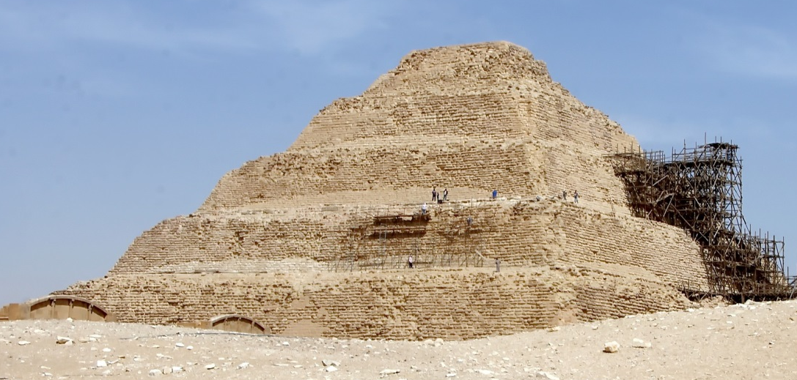
Step Pyramid
The first ‘pyramid’ was the Djoser, built in Saqqara, south of Cairo. It began as a traditional, flat-roofed mastaba.
It has six tiers and was built in stages. Each step was made of rough stones before being covered in limestone. The limestone was polished to make the pyramid gleam.
Before the creation of the true pyramid, three other step pyramids were built – the pyramids of Sekhemkhet, Khaba and Lepsuis.
Similar to the mastaba, the burial chambers of the step pyramids were underground and complex. However, tunnels and passages of the Djoser were lined with limestone instead of wood.

Slide 6
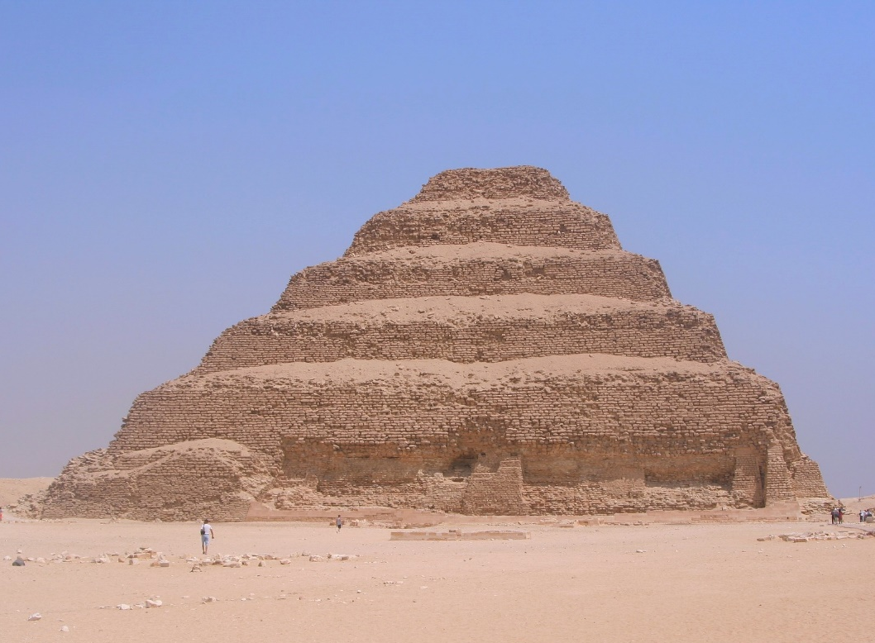
Pyramid of Djoser
There are over one hundred pyramids in Egypt, the first was the Pyramid of Djoser, built over four thousand years ago in Saqqara, south of Cairo.
It was designed by the architect Imhotep and built during the third dynasty.
This is thought to be the oldest monumental structure in the world made from cut stone.

Slide 7
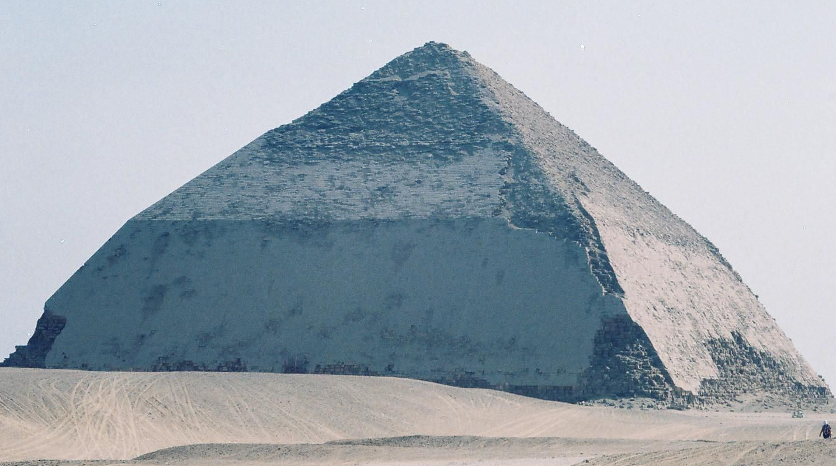
The Bent Pyramid
The Bent Pyramid at Dahshur was created by accident and was King Sneferu’s attempt to build the first smooth-sided (true) pyramid.
However, when the building began, the 55° angle of the slope was too steep and while building, engineers realised it was unstable. So, half way up, the angle was changed to 43° to make it more shallow.
Sneferu learnt lessons in this error and would have the first true pyramid – The Red Pyramid – created in his name with this knowledge.

Slide 8
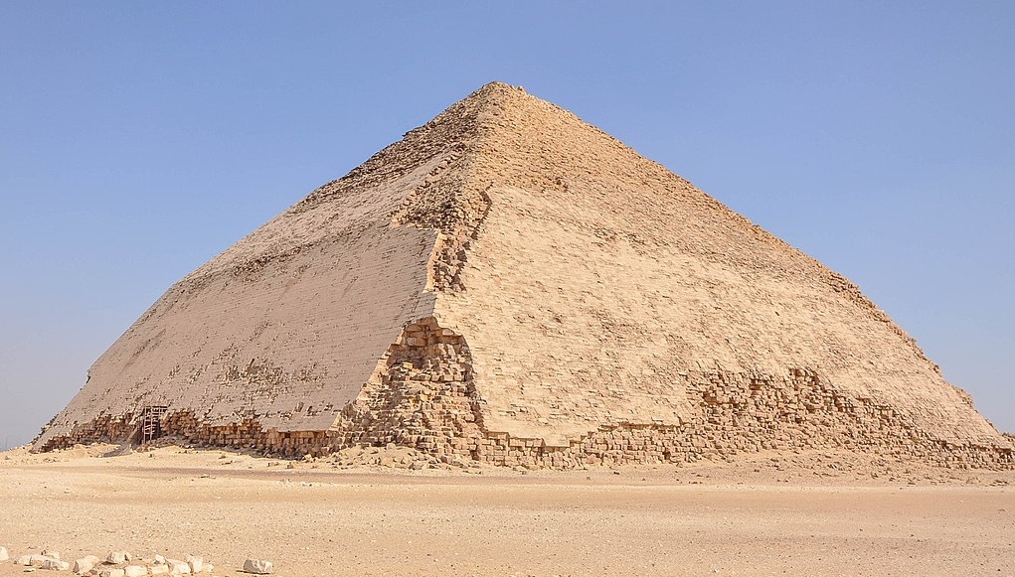
The Bent Pyramid
With it’s two-angled shape, the Bent Pyramid is the only pyramid of its kind. Not only does it provide valuable information about the development of the pyramids, but is unique for another reason.
Unlike the other pyramids, the limestone casing surrounding the bricks is largely intact so this pyramid provides great insight into how the rest of the pyramids would have looked.

Slide 9
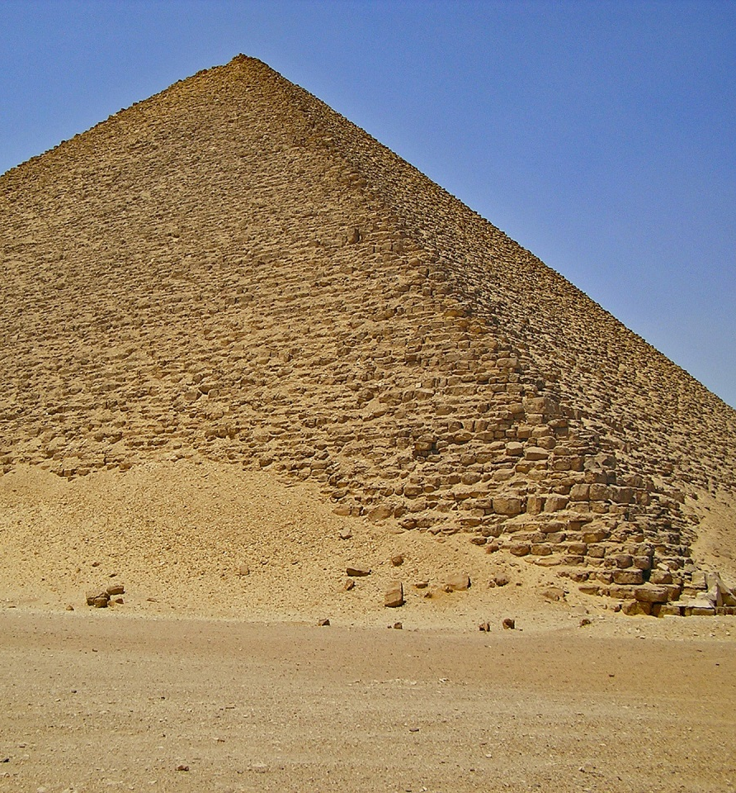
True Pyramid
Believed to be the first ‘true’ pyramid, the Red Pyramid was built in Sneferu’s name after the lessons learnt in the Bent Pyramid.
The construction of a true pyramid was initially similar to the step pyramid; however, the final product was cased in limestone to create the more appealing, smooth effect.
Historians believe the Red Pyramid took 17 years to build.

Slide 10
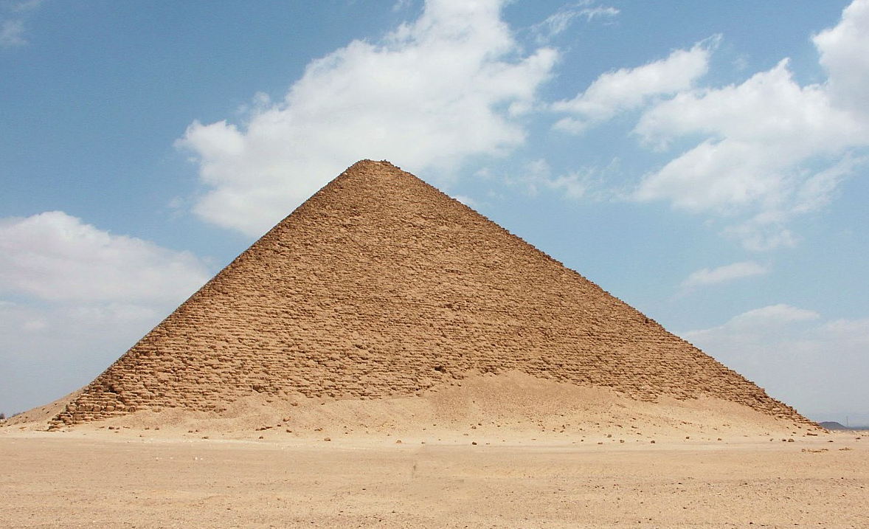
The Red Pyramid
The Red Pyramid of Dahshur gets its name from the sandstone used in its construction – it has a reddish hue.
Although the Red Pyramid is the third largest pyramid of Egypt at 104 metres tall, it
has the second largest base of all
Egyptian pyramids, each side
measuring 220 metres.
Most of the outer, white limestone casing was removed and used in the building of Cairo.

Slide 11
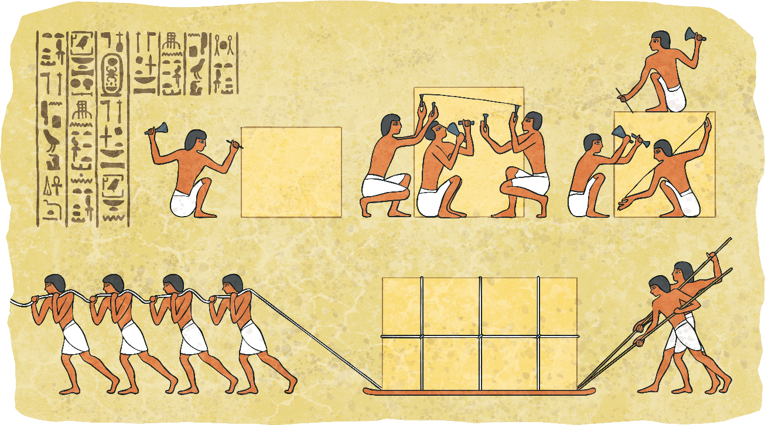
It is not known how many men it took to build a pyramid - estimates are anything from two thousand to a hundred thousand!
Pyramid building would happen when the Nile was in flood.
Q: Why do you think they chose this time of year to build?
A: It was impossible to farm the land so many men were available for work.

Slide 12
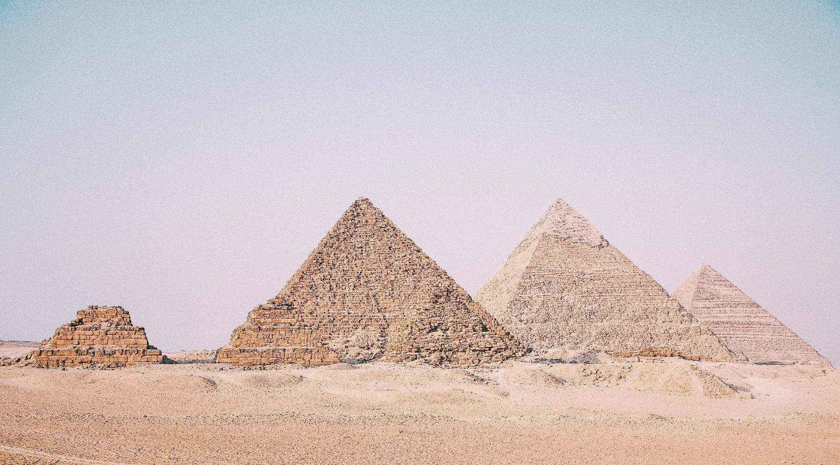
The most famous pyramids are those in Giza.

Slide 13
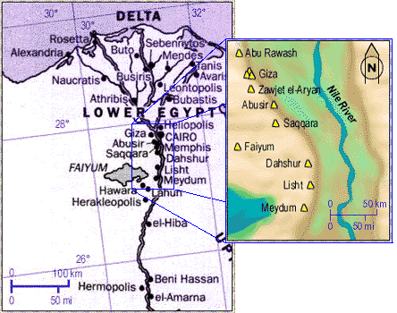
The Pyramids were built on the
west side of the Nile, as the sun
sets in the west. This represented the cycle of life (east = rebirth);
west= death).
Notes:
There are actually over 90 pyramids in Egpyt

Slide 14
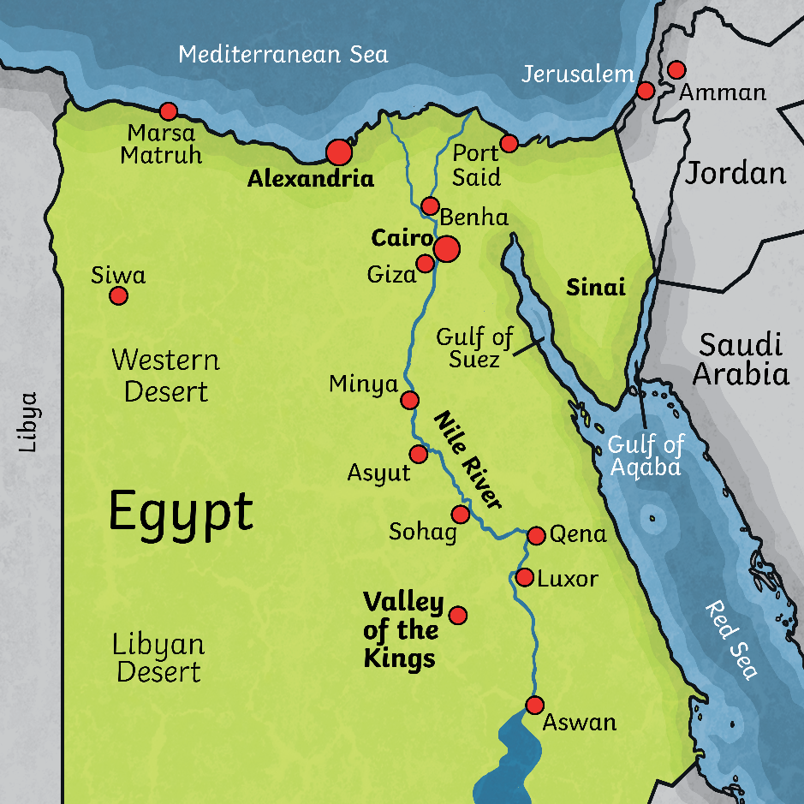

Can you spot the
River Nile on the map?
Are you ready for a fact hunt?

Slide 15
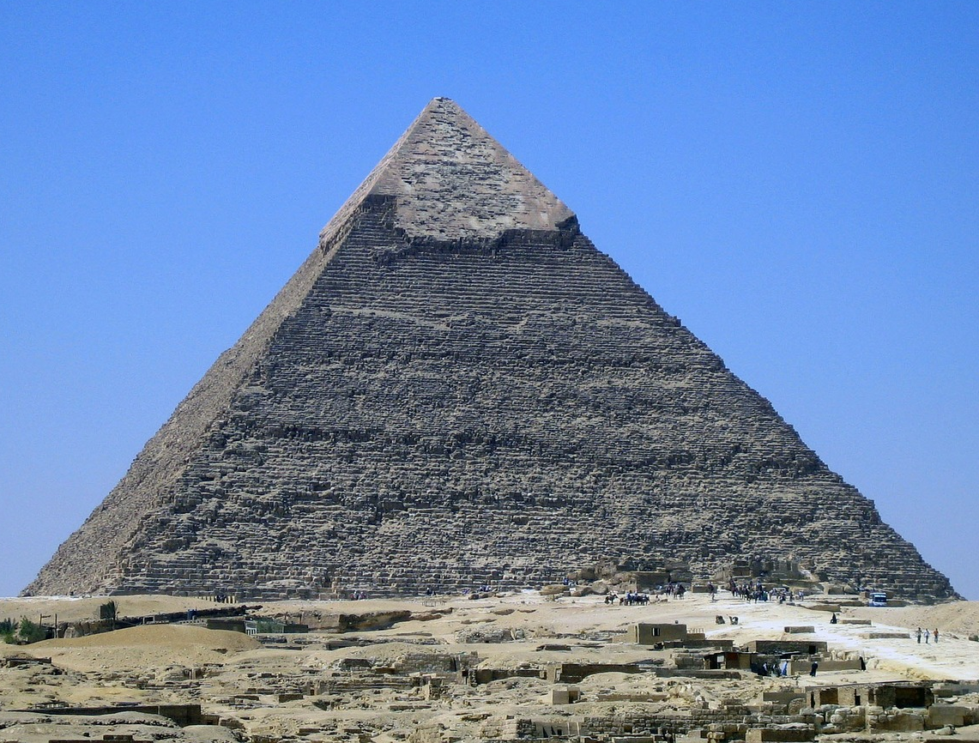
The Pyramid of Khufu
The Pyramid of Khufu, sometimes called the 'Great Pyramid' of Giza,
is the largest of all the Egyptian pyramids.
It is one of the 'Seven Wonders of the Ancient World' and is the only one still standing.
How tall do you think it is?
Built over 4500 years ago, this pyramid was the tallest man made structure in the world until the 1300's.

Slide 16
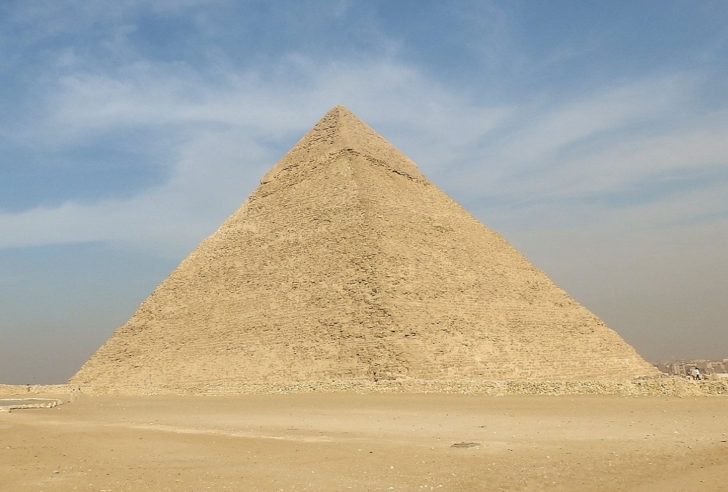
Khufu Pyramid: Facts and Figures
146m high
(original height before removal
of stones and natural erosion)
Number of limestone
blocks used:
2,300,000
Weight of each block:
average 2.5 tons
230m
230m
How long would it take
an Olympic sprinter to run
the same distance as the length of one side of
the pyramid?
What other buildings do you know of today that are over 140m high?
Each side of the pyramid aligns with the points of a compass.
The entrance is usually on the north side.

Slide 17
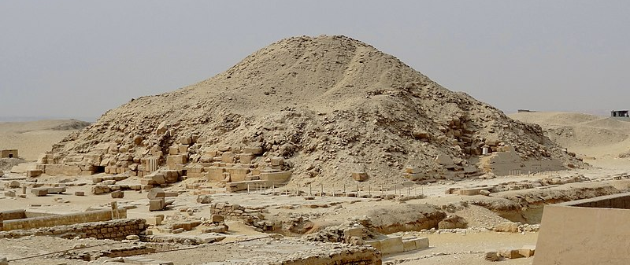
The Pyramid of Unas
This is the Pyramid of Unas at Saqqara.
The photo shows casing similar to that which covered the Khufu
pyramid before the stone was used for buildings in Cairo.
Why do you think they covered the pyramids in this way?

Slide 18
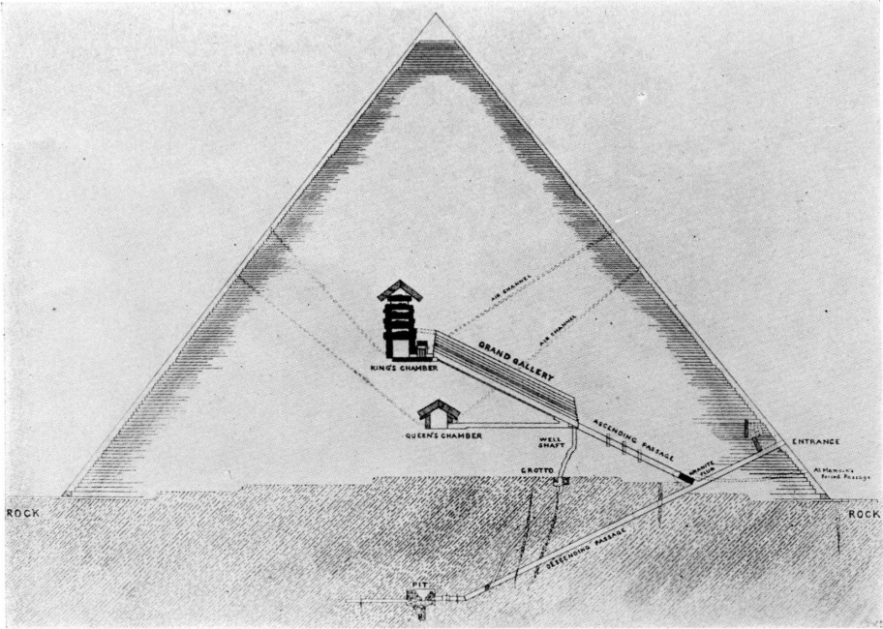
Secret Entrances and Trap Doors
From the outside, the pyramids look quite simple but inside were various passages and chambers, some with secret entrances and trap doors.
Why do you think they used secret entrances and trap doors?
[pyramidtextsonline] is licensed under CC BY 2.0

Slide 19
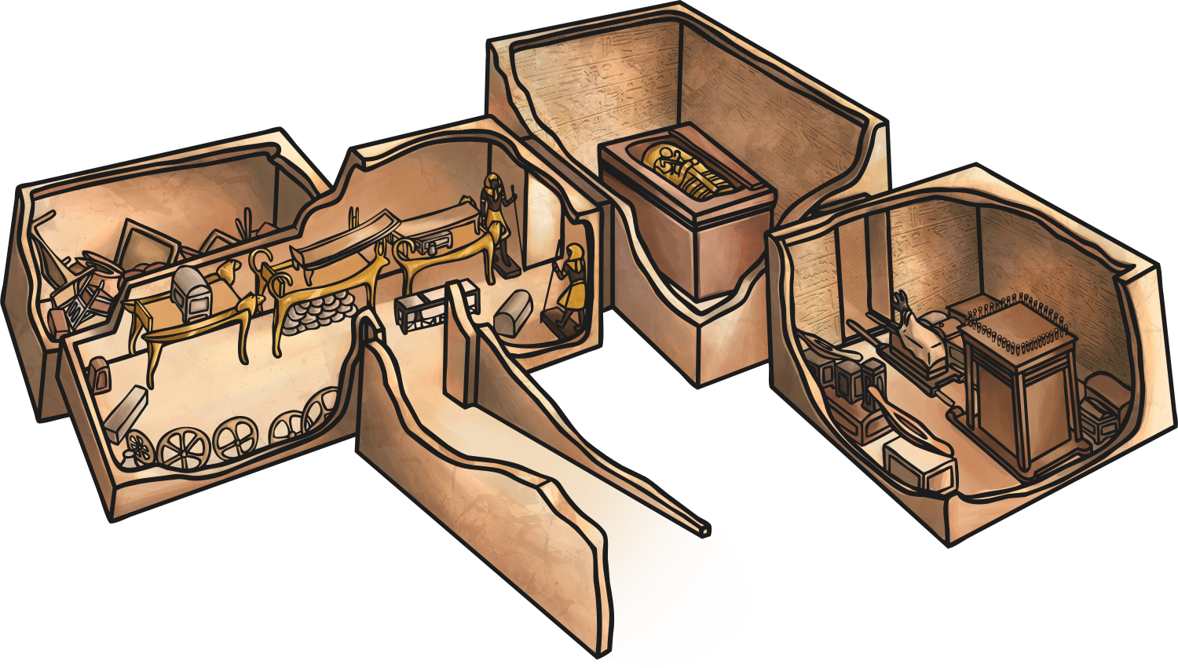
Treasure
Treasure and items for the King to use in the afterlife would be left in the burial chamber.
Other chambers might be used for members of his family.
If you believed you were going to the afterlife, what would you want to take with you?

Slide 20
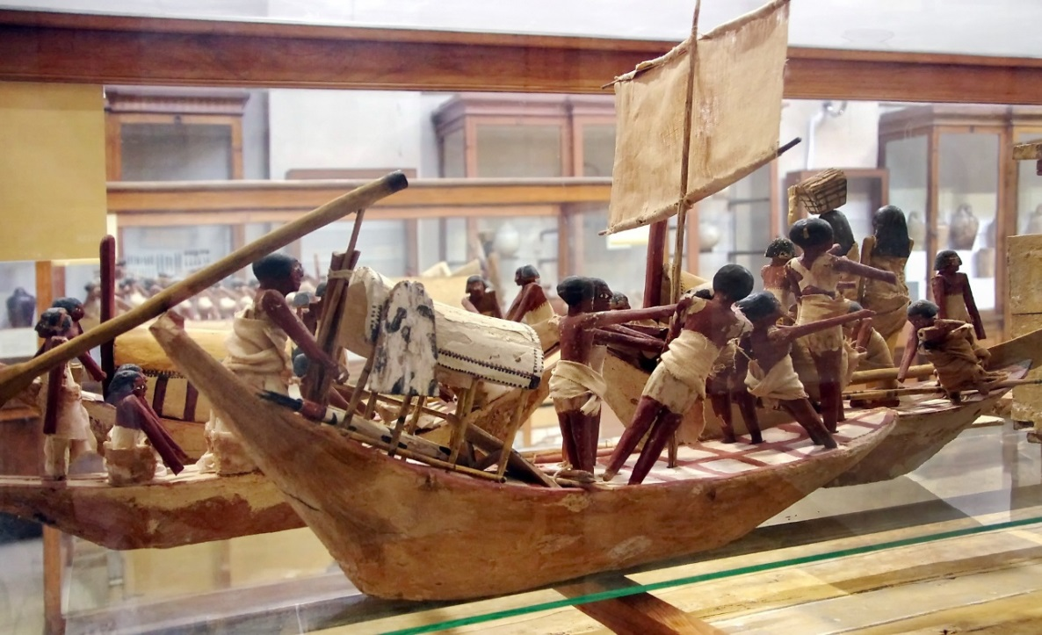
The Khufu pyramid complex included five boat pits, containing ships. One of the ships was restored and is on display. It is not known whether these vessels ever touched water, perhaps to bring the King's body along the Nile to his tomb, or whether they were intended for the King's use in the afterlife.
What do you think was the purpose of the boats?

Slide 21
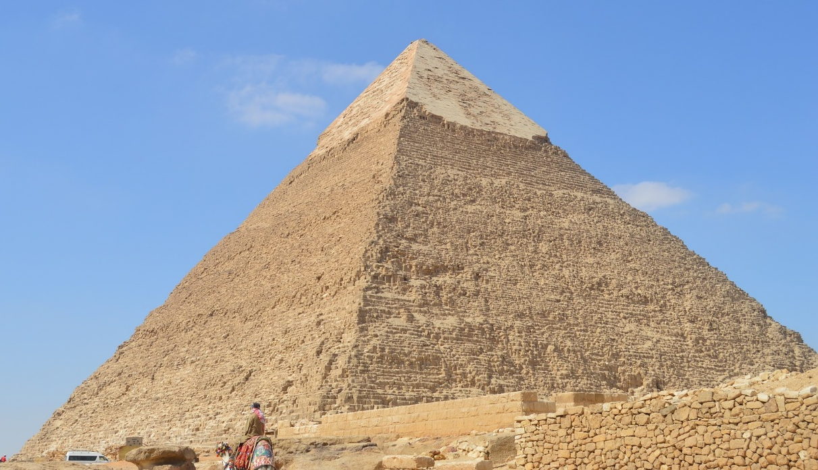
The Khafre Pyramid
Khafre was the son of Khufu and ruled between 2558 and 2532 BC.
His pyramid was slightly smaller than that of his father
but the two entrances have led some to believe that it was
originally intended to be bigger.
This is what is left of the limestone casing that would have covered the whole pyramid.
Why do you
think plans
might change?

Slide 22
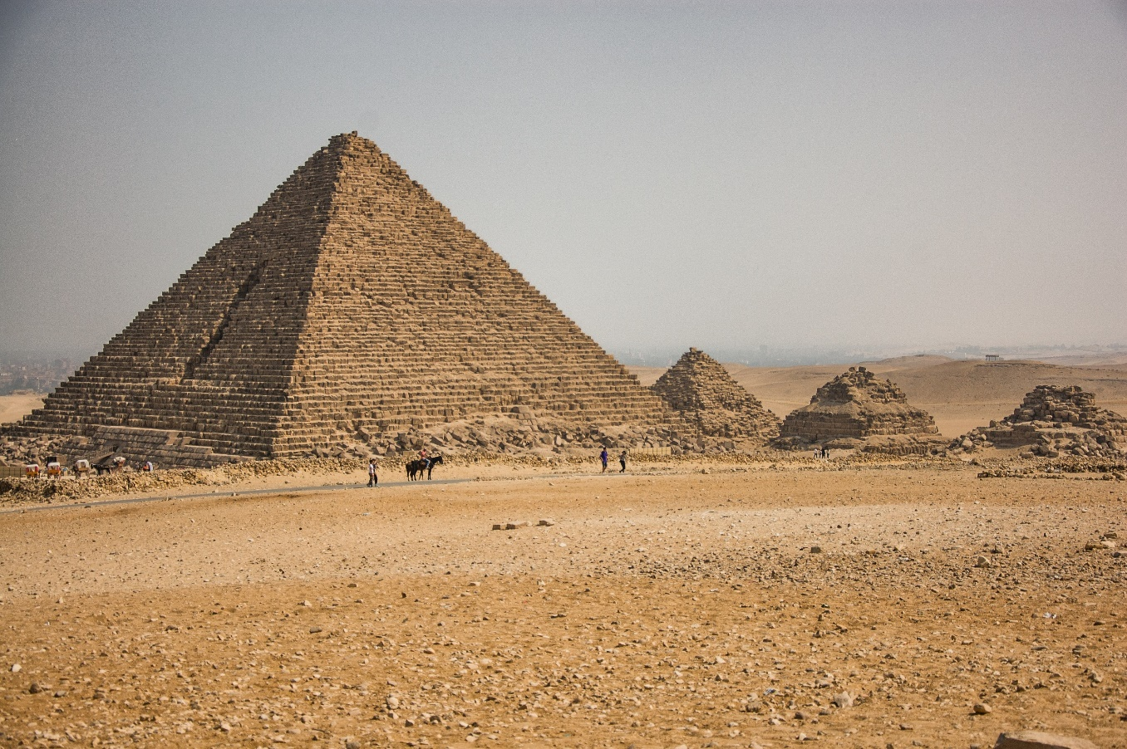
The Menkaure Pyramid
The Menkaure Pyramid is the smallest of the Three Pyramids
of Giza at 65 metres tall.
This is still
pretty big. How
tall are you? Roughly how many times your height is 65 metres?

Slide 23
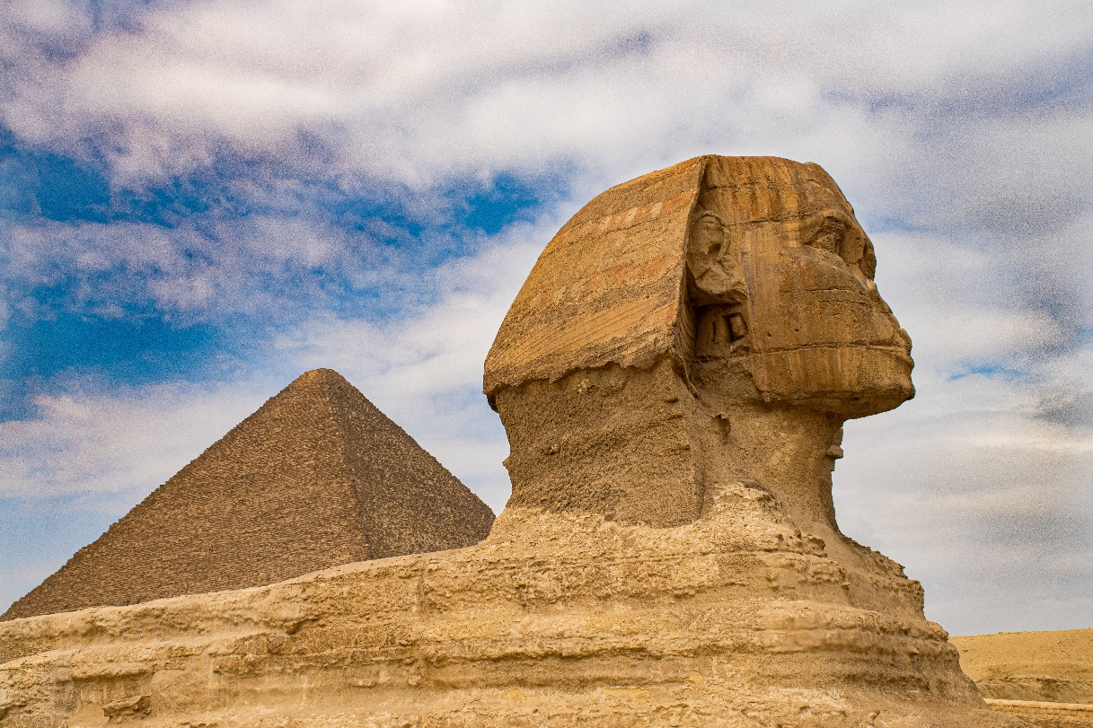
The Sphinx at Giza
The Sphinx is a mythical creature with a human head and the body of a lion. The word means ‘father of dread’ or ‘the terrifying one’.
Made in limestone, it sits near the Pyramids of Giza.
It is the largest stone statue in the world at over 73m long, 19m wide and 20m high.
It was believed to have been built during the reign of Khafra, and the face made in his likeness.
Why do you think the Sphinx was built?

