Slide 1
Area of a triangle

Slide 2
Warm up work out the area and perimeter of this shape
7cm
3cm

Slide 3
Warm up work out the area and perimeter of this shape
7cm
3cm
Perimeter :
7cm+3cm+7cm+3cm= 20cm
Area:
7cm x 3cm= 21cm²

Slide 4
Area of a triangle
The area of a triangle is actually half the area of rectangle.
See! When I put the same two right angled triangles together it makes a rectangle.

Slide 5
See! Triangles are half of rectangles!

Slide 6
How can we work out the area of a dark blue triangle?
5cm
10cm

Slide 7
How can we work out the area of a dark blue triangle?
5cm
10cm
Length x breadth (width) = total area of rectangle. 10cm x 5cm = 50cm²

Slide 8
How can we work out the area of a dark blue triangle?
5cm
10cm
Length x breadth (width) = total area of rectangle. 10cm x 5cm = 50cm²
Then divide by 2 to work out half the area 1 triangle!

Slide 9
How can we work out the area of a dark blue triangle?
5cm
10cm
Length x breadth = total area of rectangle. 10cm x 5cm = 50cm²
Then divide by 2 to work out half the area 1 triangle!
50cm² divide by 2 = 25cm²

Slide 10
Have a go for yourself!
7cm
8cm

Slide 11
How to tackle it!
First step:
Length x breadth = Total rectangle area.
8cm x 7 cm = 56 cm²
Second step:
Divide Total rectangle area by 2 to find out triangle area.
56 divide by 2 = 28cm²
7cm
8cm

Slide 12
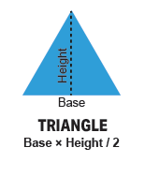
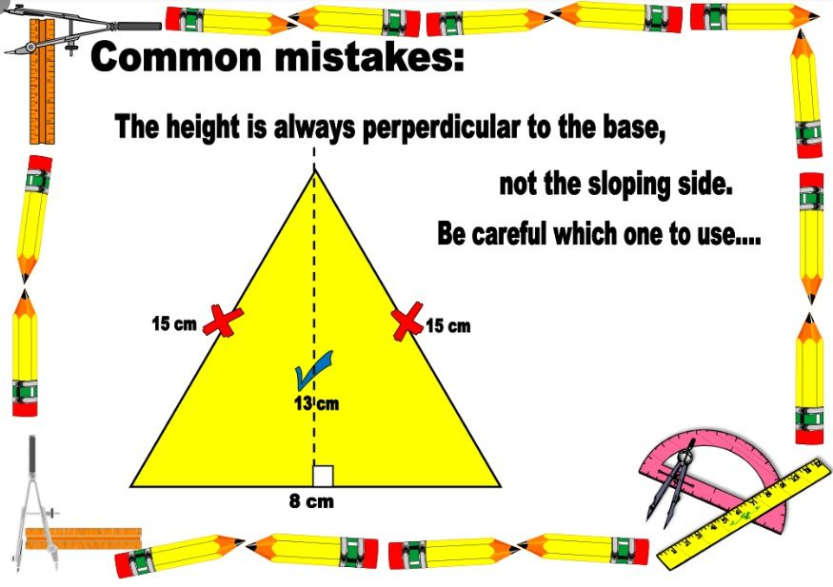
Another way..
Area can also be worked out as..
½ base x height.

Slide 13
Calculate the Area of a Triangle
Area of a triangle = half the area of the rectangle
= half of the base x height
height
base

Slide 14
Try this one for size!
Base = 10 cm
Height = 6cm
Area = ½ base x height
½ base (10 ÷ 2) = 5
5 x 6 = 30
30cm²= Total area of triangle.
6 cm
10cm

Slide 15
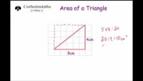
Watch this video
https://youtu.be/jHMH_MLCI38

