Slide 1
3D Shapes
N
- MATHS TOPICS KS2 -

Slide 2
3D shape
Face -the flat parts of the shape;
Edges - lines where two faces meet.
Corner / Vertex - points where two or more edges meet.

Slide 3

Cube
Vertex
Face
Edge

Slide 4
Cube
Faces - 8;
Edges - 12;
Vertices - 8.

Slide 5
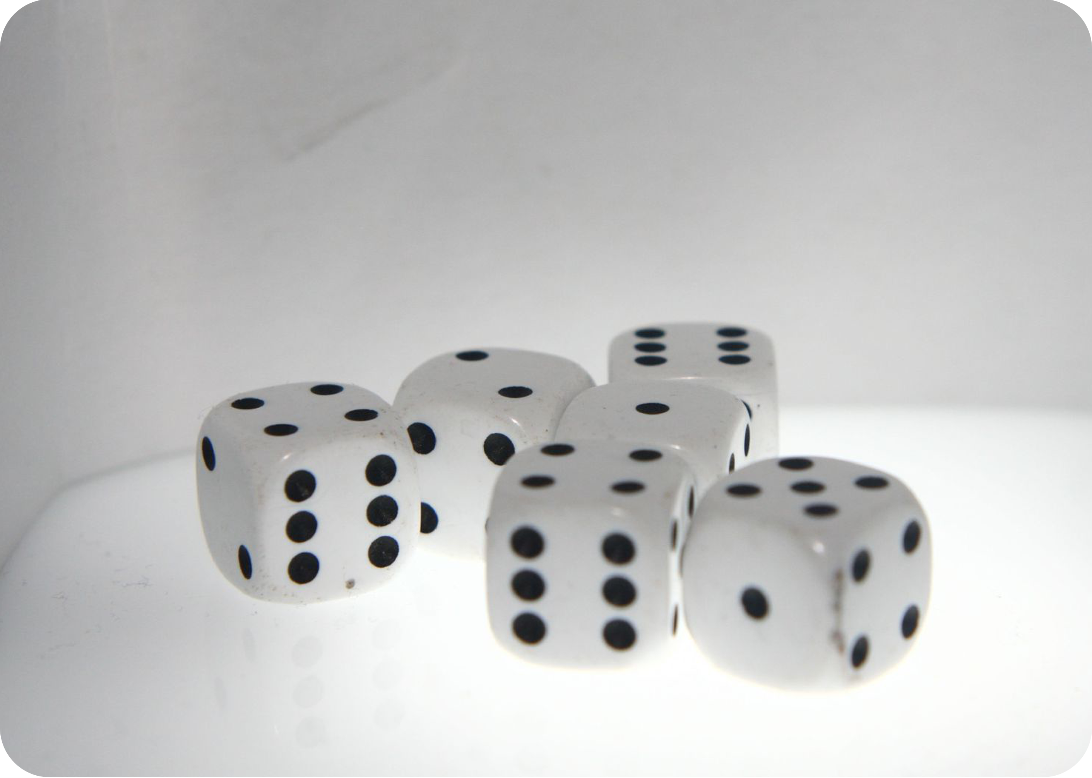

Cube

Slide 6
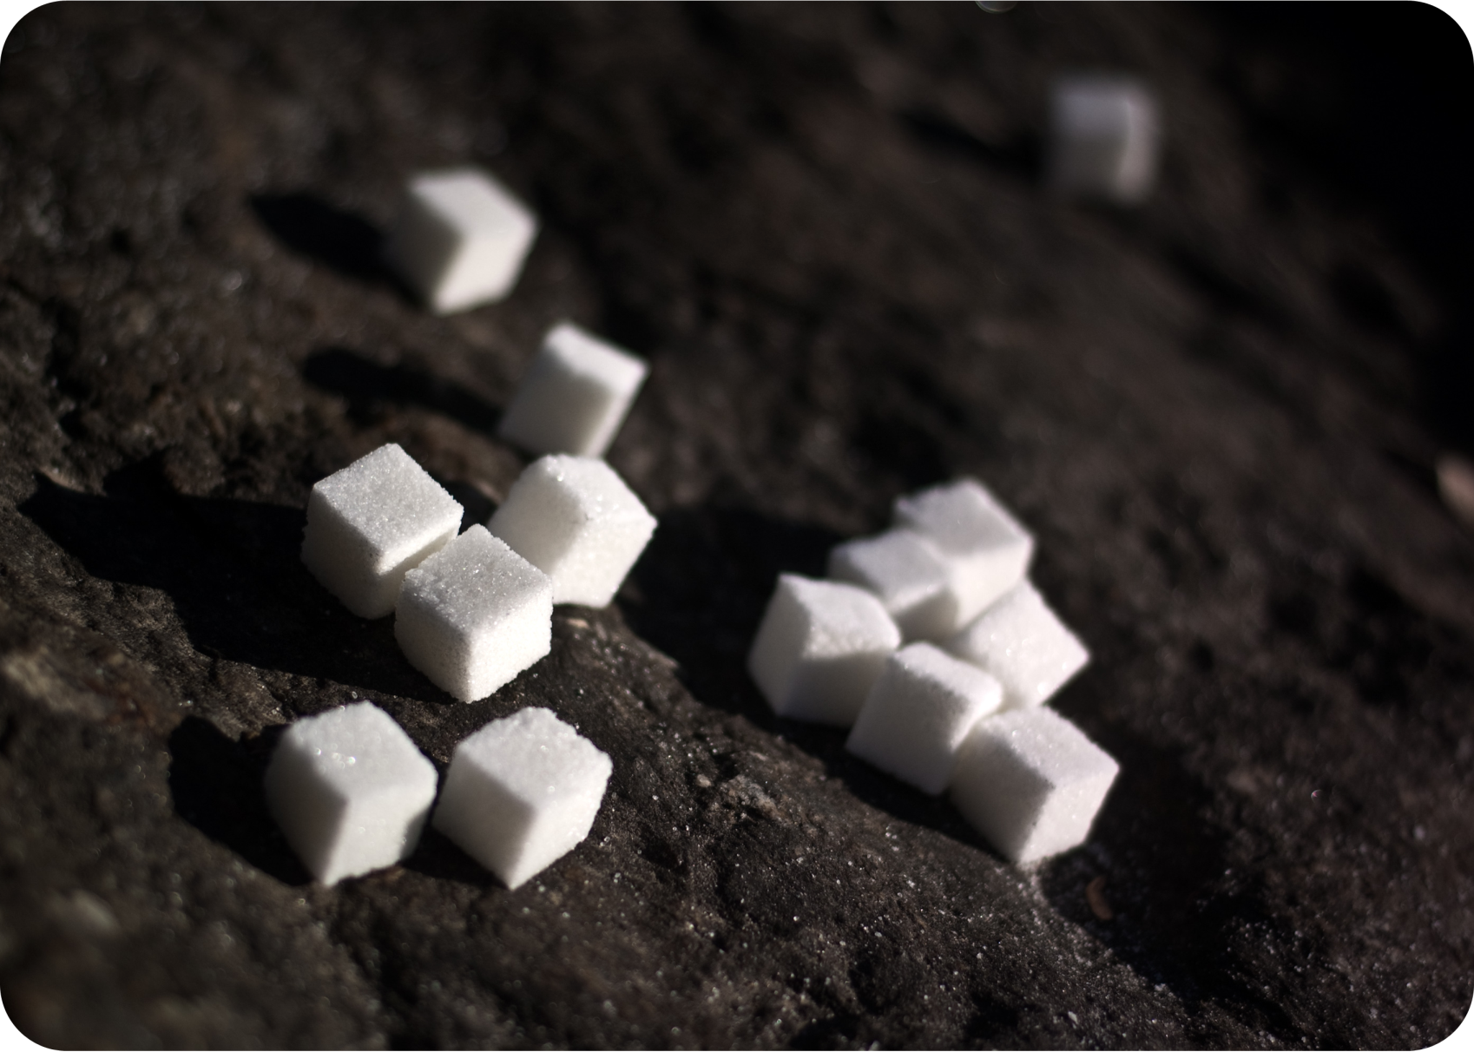
Cube

Slide 7
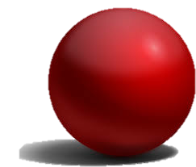
Sphere
Faces - 1;
Edges - 1;
Vertices - 0.

Slide 8
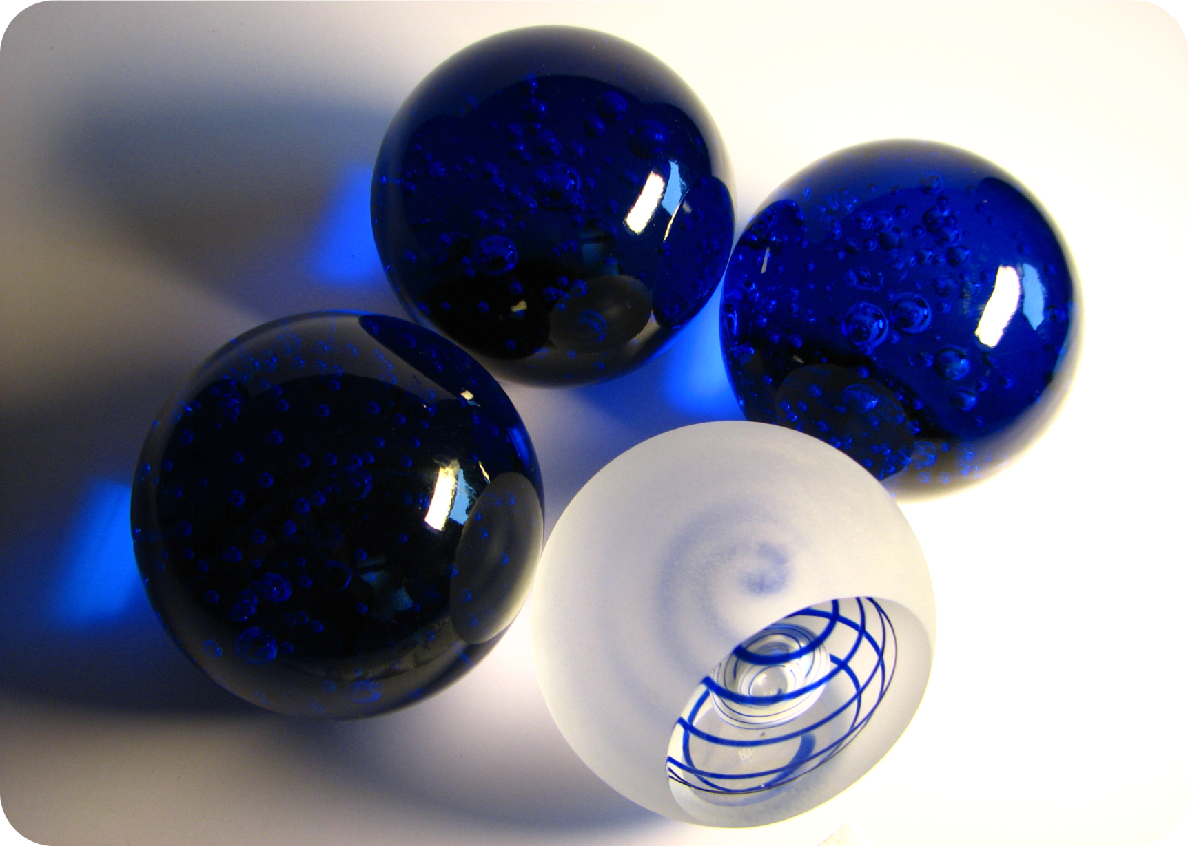
Sphere

Slide 9
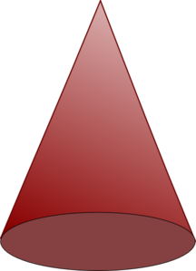
Cone
Faces - 2;
Edges - 1;
Vertices- 1.

Slide 10
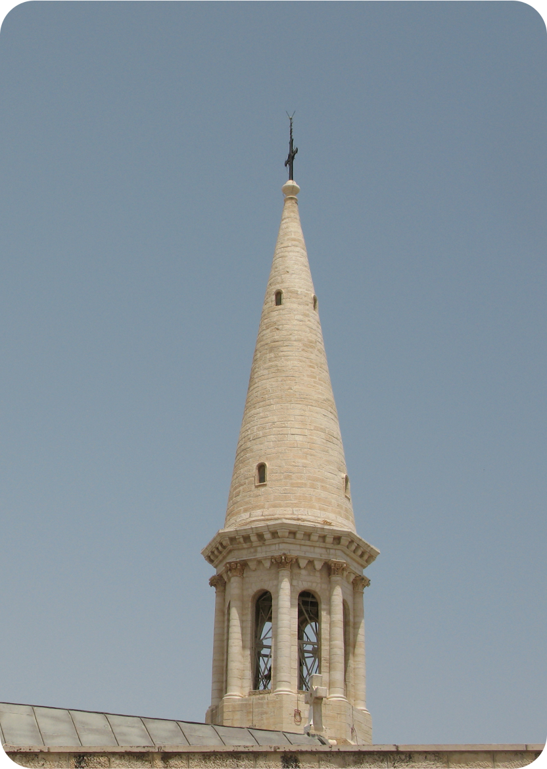
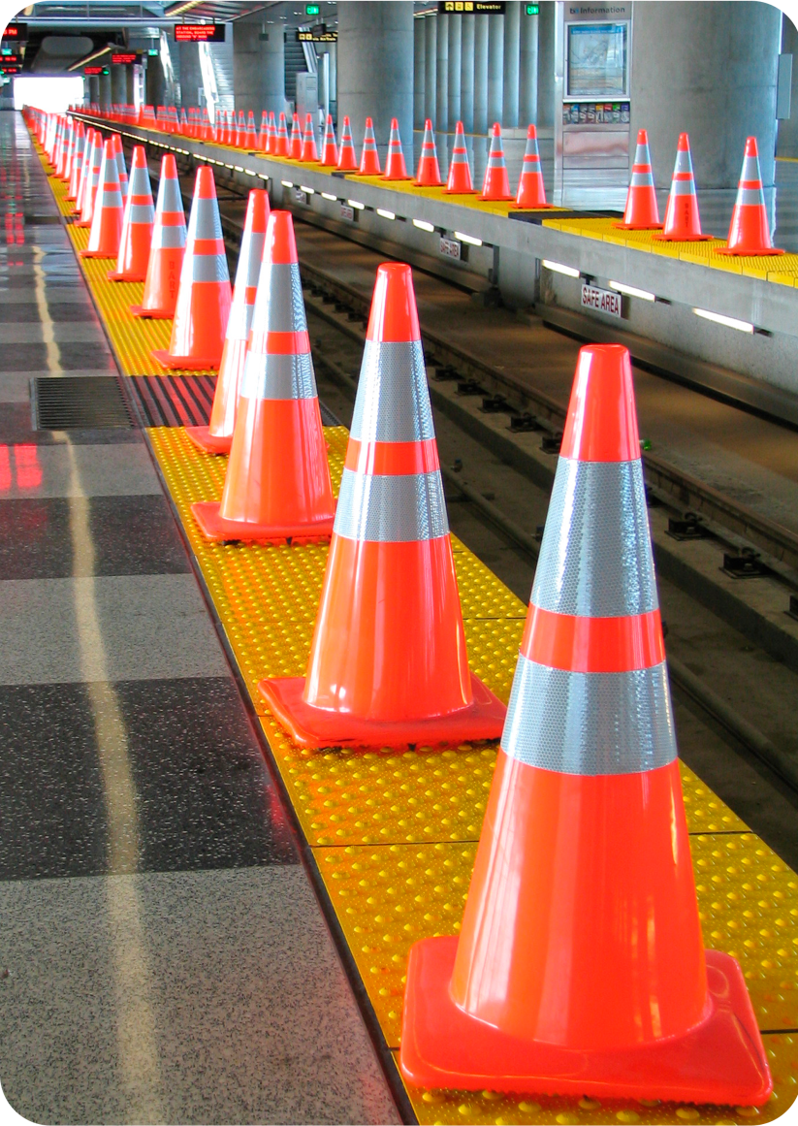
Cone
Photo courtesy of hoyasmeg @flickr.com) - granted under creative commons licence - attribution
Photo courtesy of Peter Kaminski @flickr.com) - granted under creative commons licence - attribution

Slide 11
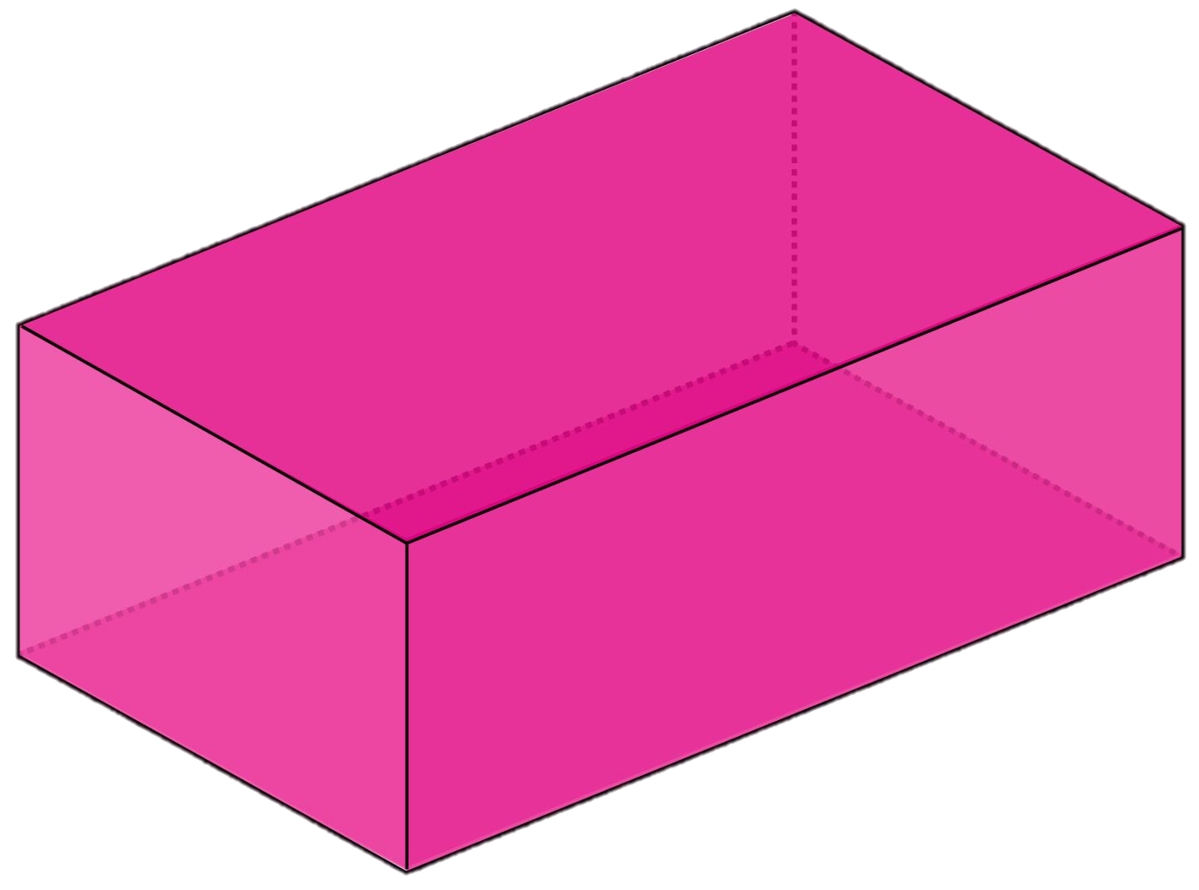
What are the names of these shapes?
Cuboid
Cube
Cone
Sphere

Slide 12
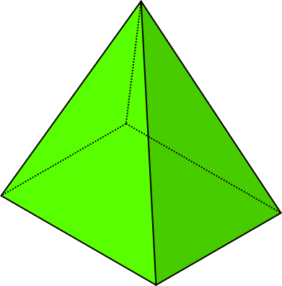
Pyramid
Faces - 5;
Edges - 8;
Vertices - 5.

Slide 13
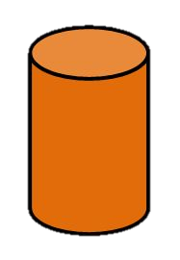
Cylinder
Faces 3;
Edges - 2;
Vertices - 0.

