Slide 1
Co-ordinates
N
- MATHS TOPICS KS2 -
Miss S P5/6

Slide 2
Co-ordinates
To understand co-ordinates, you need to be familiar with a co-ordinates grid.
A co-ordinates grid has two axis; an x axis (across) and a y axis (up).
Y
10
9
8
7
6
You may remember this by saying “Y’s up”, which sounds like the phrase “Wise up!”
5
4
3
2
1
x
0
1
2
3
4
5
6
7
8
9
10

Slide 3
Co-ordinates
Coordinates allow us to pinpoint exactly where a point or shape is on a graph or map.
Coordinates are written in brackets separated by a comma, like this (1, 6).
They are an ‘ordered pair’ of numbers which means the order in which they are written is important.
(
1
6
(
,
(the x coordinate)
The first number shows us how many places to move across the horizontal axis.
(the y coordinate)
The second number shows us how many places to move up the vertical axis.

Slide 4
Co-ordinates
(
1
(
6
,
When reading coordinates
the first number should be read from the horizontal axis.
The second number should be read
off the vertical axis.
You might remember it by thinking that you walk ALONG the corridor, before you go UP the stairs.

Slide 6
Watch the animations on the following slides, which demonstrate how co-ordinate work. Click your mouse to activate the animations.

Slide 7
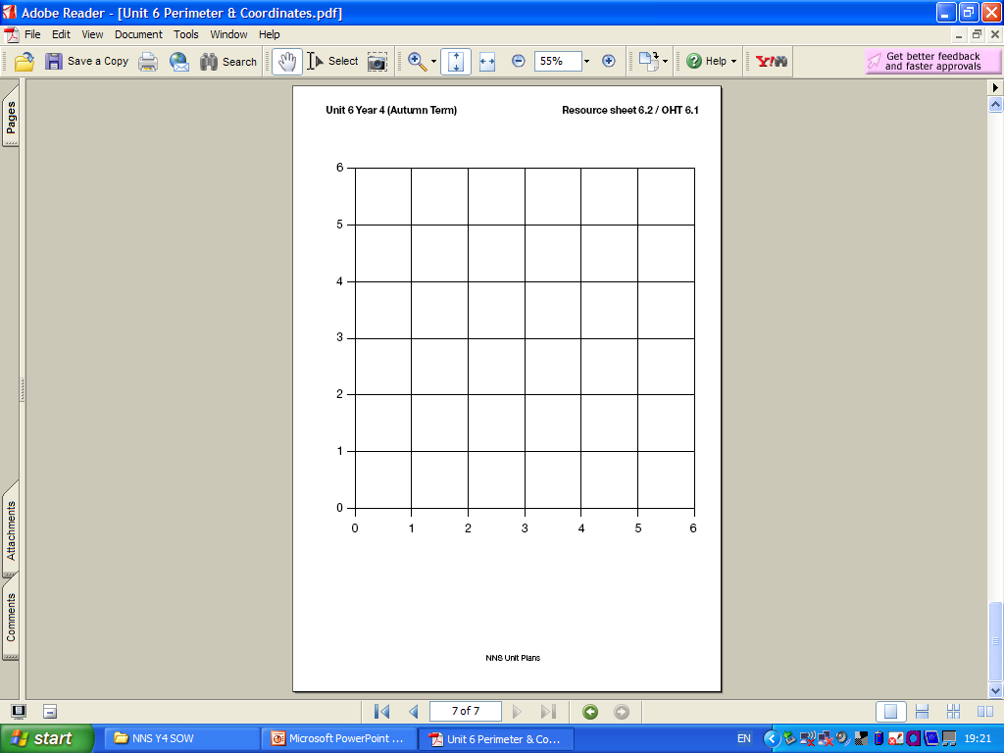
(
1
6
(
,
Remember - across then up.

Slide 8
(3, 5)
Remember - across then up.

Slide 9
(6,2)
Remember - across then up.

Slide 10
Co-ordinates
y
x
(Remember x is a-cross.)
(0,0)

Slide 11
Remember - across then up.
Co-ordinates
Write the co-ordinates for each object.
Also remember the brackets.

