Slide 1
Percentages
N
- MATHS TOPICS KS2 -

Slide 2
Percentages
What does ‘per cent’ actually mean?
Per cent basically means ‘out of 100’.
The prefix ‘cent’ means 100, like in the word ‘century’ which is 100 years.
I’m only 50% of the cucumber I used to be...
N
Percentages

Slide 3
Percentages
A percentage is a fraction out of 100.
10% =
5% =
62% =
99% =
A percentage is a fraction out of 100.
N
Percentages

Slide 4
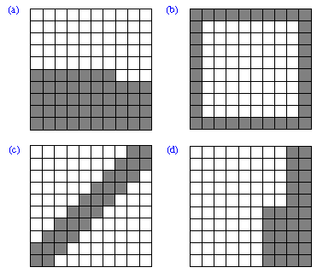
Percentages
What percentage of these shapes are shaded:
47%
36%
28%
30%
Percentage

Slide 5
Percentages
Decimals can also be written a percentages.
0.17
0.35
0.05 (Take Care)
17% =
35% =
5% =
A percentage is a fraction out of 100.
1/100 = 0.01
Percentages

Slide 6


