Slide 1
Bus Stop Division
N
- MATHS TOPICS KS2 -

Slide 2

Warm up questions
10
5
7
6
4
5
4
7
6
4
3
7
7
3
3
8
9
12
9
5
12
9
4
5
12
8
12
12
11
11
30÷3=
25÷5=
42÷6=
18÷3=
24÷6=
15÷3=
28÷7=
49÷7=
36÷6=
16÷4=
24÷8=
21÷3=
14÷2=
12÷4=
36÷12=
56÷7=
81÷9=
72÷6=
90÷10=
40÷8=
48÷4=
63÷7=
32÷8=
20÷4=
60÷5=
64÷8=
108÷9=
144÷12=
121÷11=
110÷10=

Slide 3
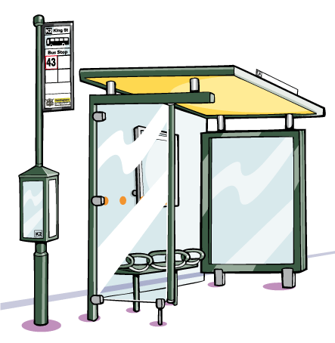
Division- the bus stop method
Today, we are going to be introduced to a new way of writing division problems.
This new method allows us to divide large numbers, beyond our time tables.

Slide 4
Bus Stop Division
You may see a division problem written as follows:
Example 1: Work out 69÷3
We call it the ‘bus stop method’ because it looks like the numbers are waiting at a bus stop!
2
3
3 will go into 6, 2 times so we put the 2 above the line (keeping our columns in line).
3
6 9
3 will go into 9, 3 times so we put the 3 above the line (keeping our columns in line).
We now look at the outside number and see how many times it will go into the following digits.
69÷3 = 23
N
Division

Slide 5
Bus Stop Division
You may see a division problem written as follows:
Example 2: Work out 46÷2
2
3
2
4 6
46÷2 = 23
N
Division

Slide 6
Bus Stop Division
You may see a division problem written as follows:
Example 3: Work out 88÷4
2
2
4
8 8
88÷4 = 22
N
Division

Slide 7
Bus Stop Division
Sometimes, there may be a remainder:
Example: Work out 67 ÷2
3
3 r 1
2
6 7
67÷2 = 33 r 1
N
Division

Slide 8
Bus Stop Division
Sometimes, we need to change the tens:
Example: Work out 42÷3
1
4
3 will go into 4 once with 1 left over, so change 1 ten to 10 units.
3
4 2
1
Now you have 12 units; divide this by 3 and you get 4.
42÷3 = 14
Division

