Slide 1
Position, Movement and Angles
N
- MATHS TOPICS KS2 -
Miss S P5/6

Slide 3
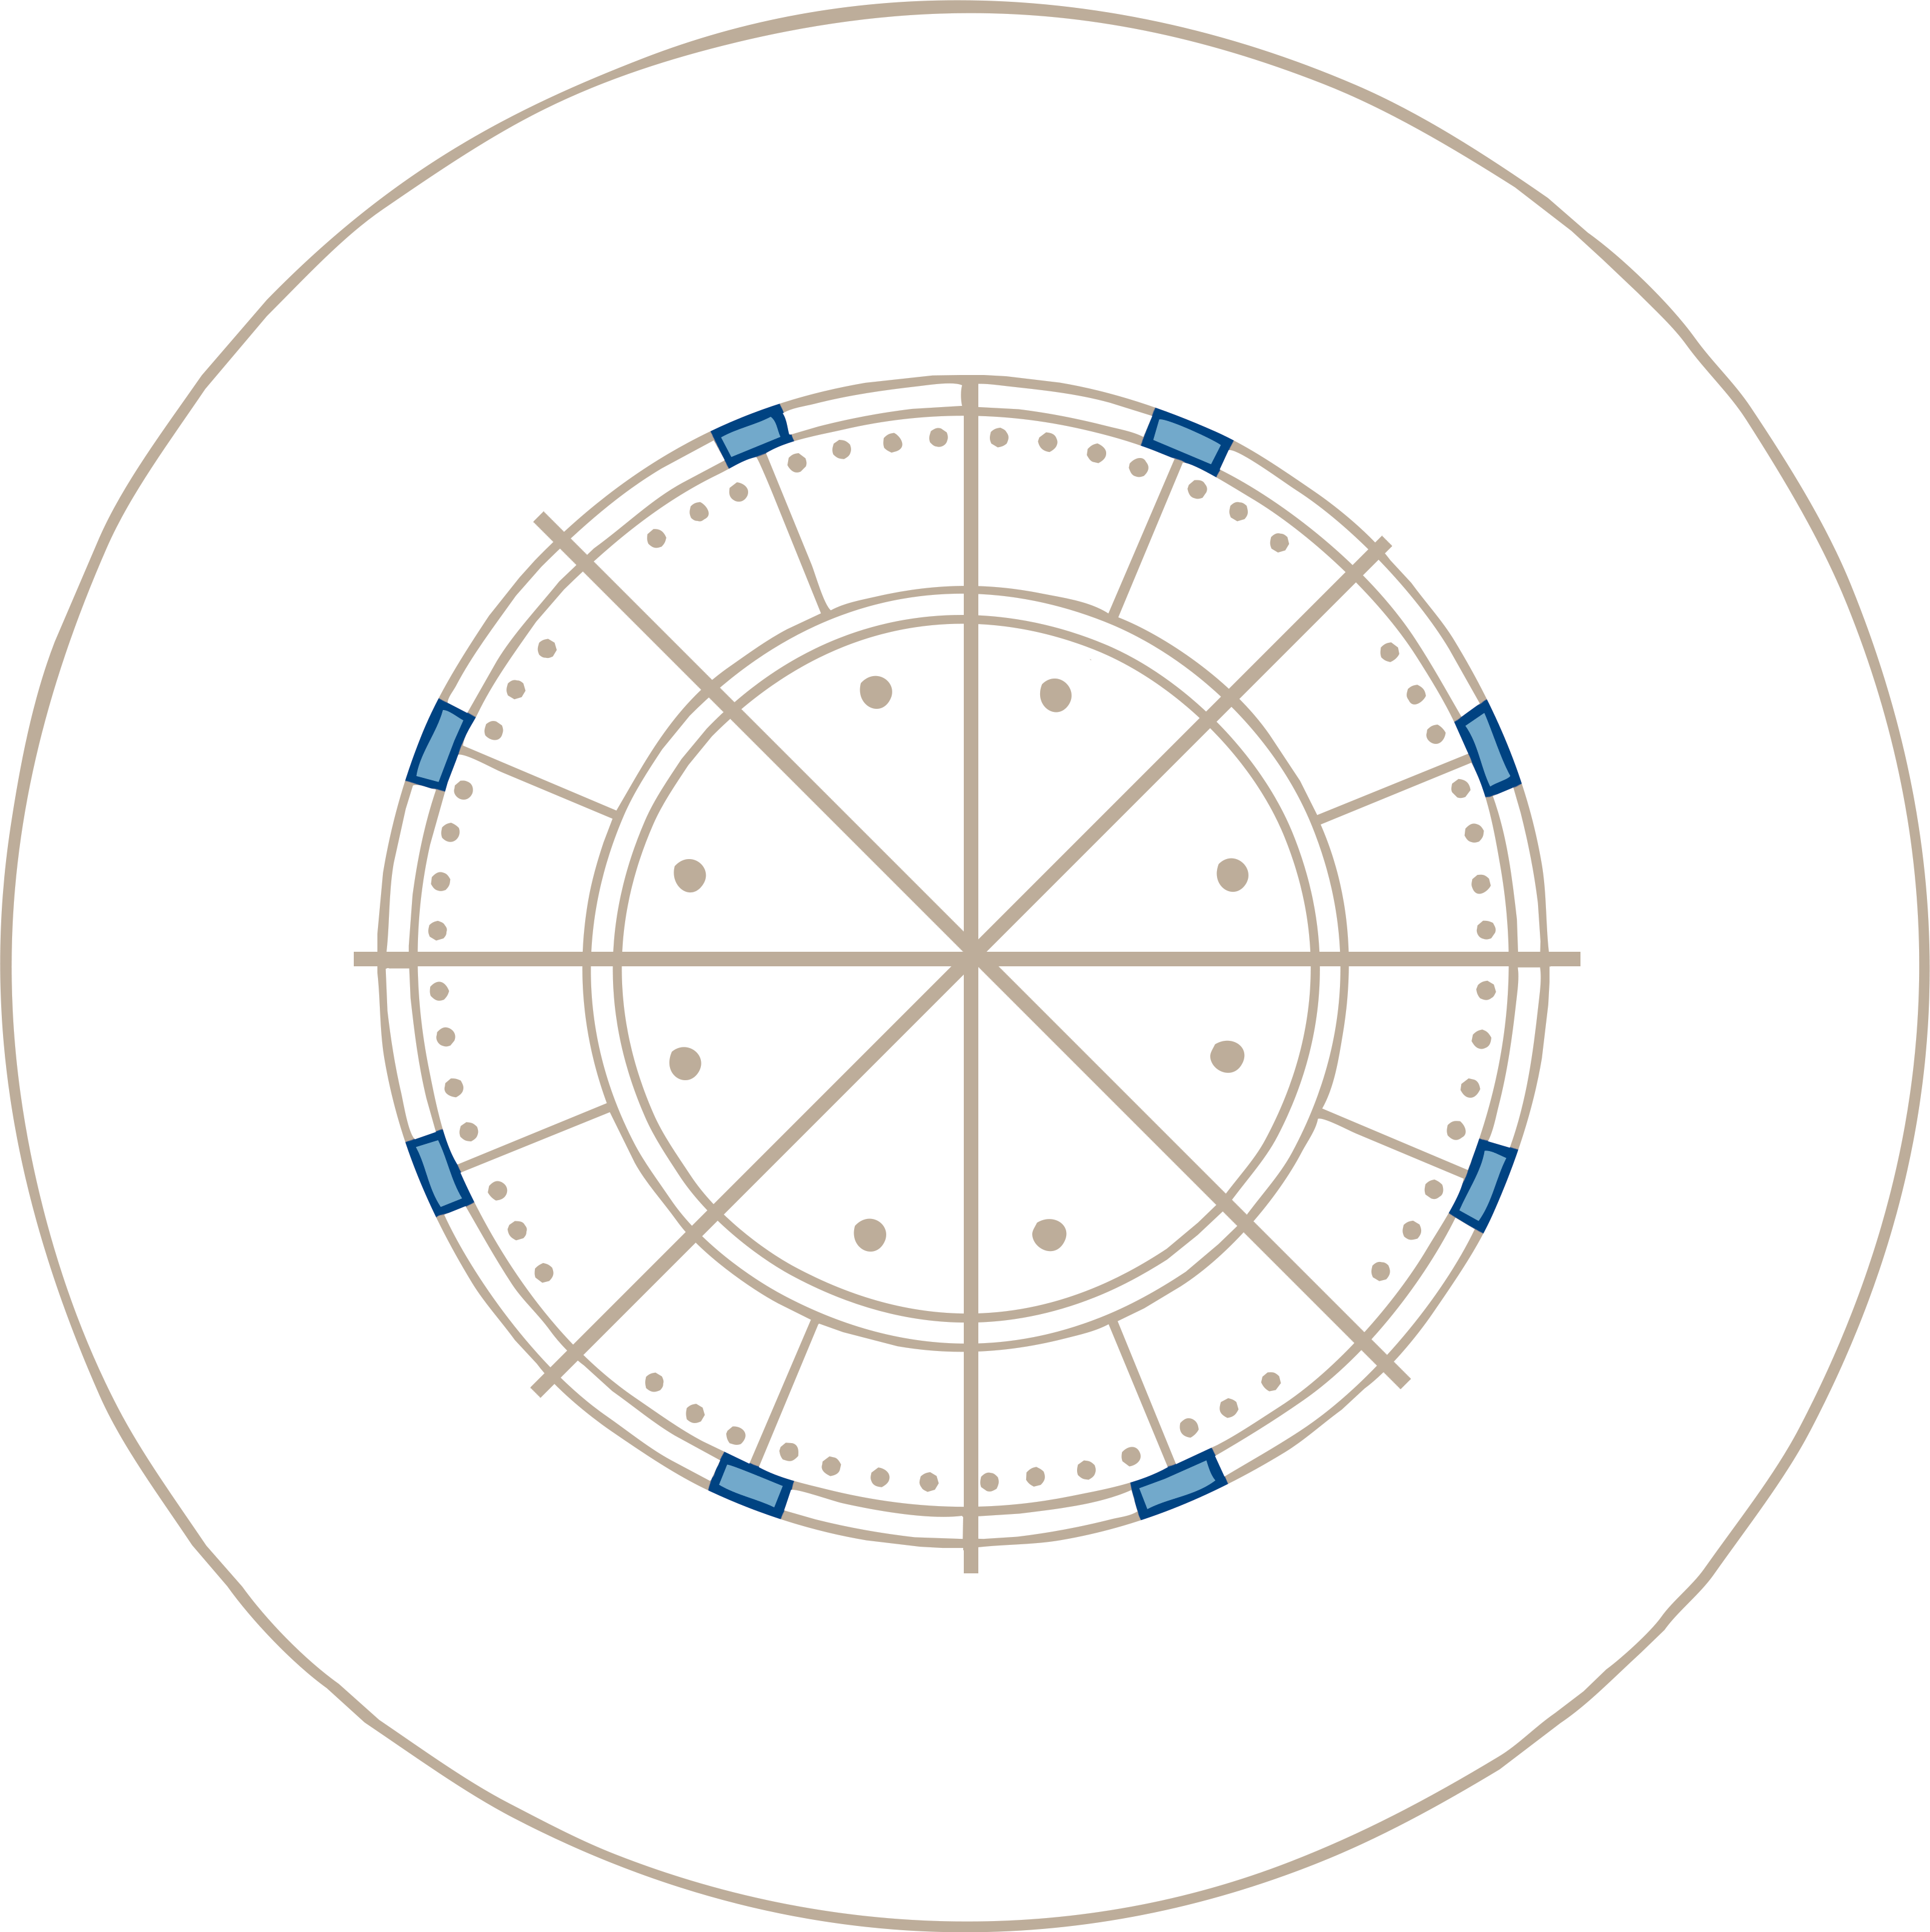
The Four Cardinal Points of a Compass
We use compass points to describe position and direction.
There are four main (cardinal) points of the compass:
N
north,
south,
east
and
west.
W
E
S

Slide 4
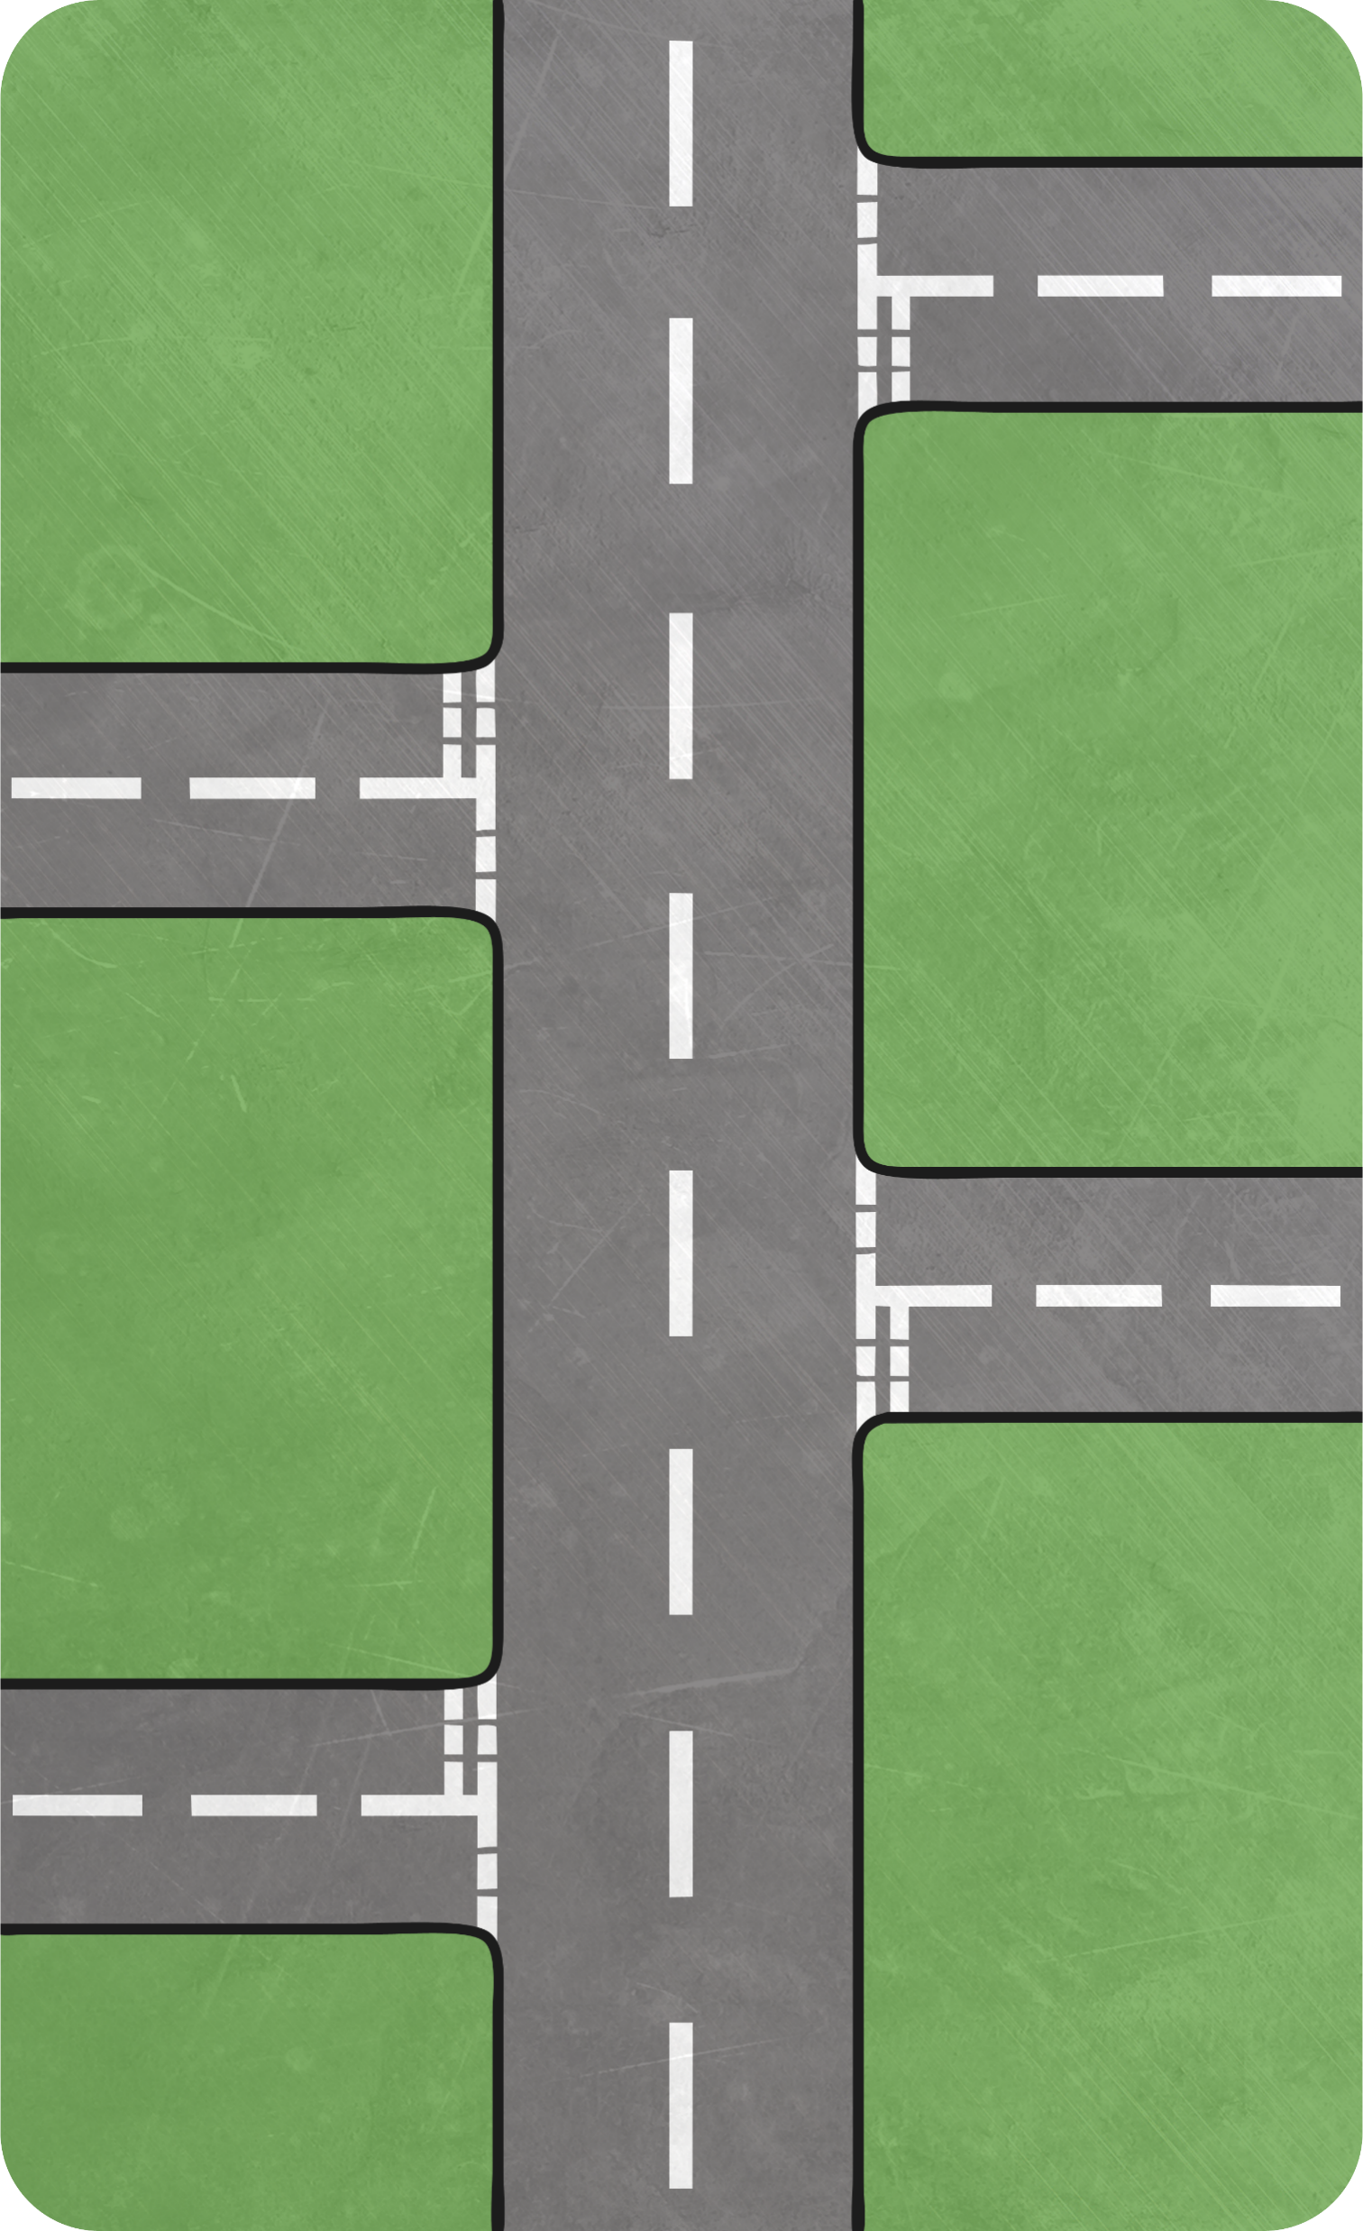

Using the Four Cardinal Points
N
Each quarter turn brings you to a new compass point.
If I am facing north and turn 90° clockwise, I will be facing east.
W
E
S
east

Slide 5

Using the Four Cardinal Points
I am facing south and turn 90° clockwise.
Which direction am I facing now?
N
W
E
S
west

Slide 6

Using the Four Cardinal Points
I am facing west and turn 90° clockwise.
Which direction am I facing now?
N
W
E
S
north

Slide 7
Using the Four Cardinal Points
I am facing north and turn
180° anticlockwise.
Which direction am I facing now?
N
W
E
S
south

Slide 8
Using the Four Cardinal Points
I am facing west and turn
270° clockwise.
Which direction am I facing now?
N
W
E
S
south

Slide 9
Using the Four Cardinal Points
I am facing west and turn
90° clockwise.
Which direction am I facing now?
N
W
E
S
north

Slide 10
Using the Four Cardinal Points
I am facing north and turn
270° anticlockwise.
Which direction am I facing now?
N
W
E
S
east

Slide 11
The Four Intercardinal Points
We can be more specific if we use a further 4 (intercardinal) compass points.
N
NW
NE
These come halfway between the main points and are called:
W
E
north-east (NE),
south-east (SE),
SW
SE
south-west (SW)
S
and north-west (NW).

Slide 12

Using the Four Cardinal Points
Between each of the 8 compass points, there are 45°. This is of a turn.
N
1
8
NW
NE
N
W
E
NE
SW
SE
S
45°
E

