Slide 1
Translations
https://www.bbc.co.uk/bitesize/topics/z2dqrwx/articles/zcjs97h
N
- MATHS TOPICS KS2 -
Miss S P5/6

Slide 2
What Is a Translation?
A translation is one type of transformation. The other two types are reflection and rotation.
A translation moves an object. The shape stays exactly the same size and shape.
You describe a translation by giving the distance moved right or left, then the distance moved up or down.

Slide 3
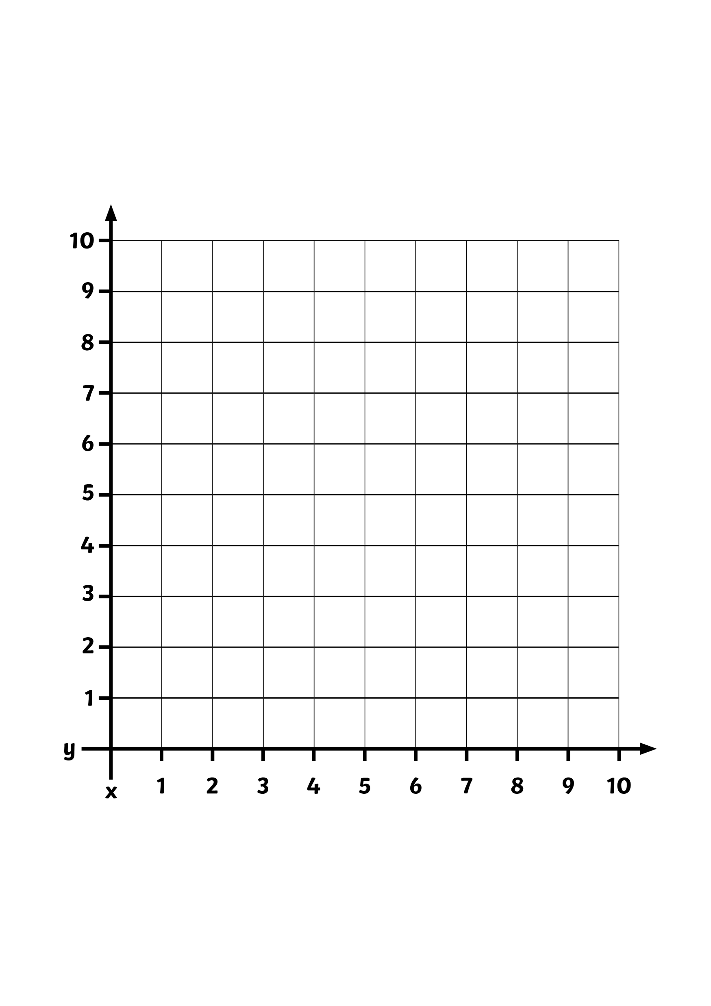
What Is a Translation?
A translation is when a shape moves from one position to another without being rotated or flipped.
On this grid, rectangle A has been moved to position B.
B
A
x
y

Slide 4
What Is a Translation?
This is not a translation because the shape has
been rotated.
B
A
x
y

Slide 5

Translating Shapes
Is this a translation?
B
A
Yes
This is a translation.
x
y

Slide 6

Translating Shapes
Is this a translation?
B
No
This is not a translation because the shape has been rotated.
A
x
y

Slide 7
Translating Shapes
Is this a translation?
B
No
This is not a translation because the shape has been rotated.
A
x
y

Slide 8
Translate the shape 8 units to the right, and 3 units up.

Slide 9
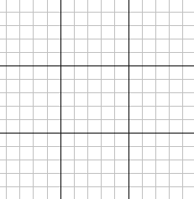
a)
3 right,
4 down
b)
5 right,
2 up
c)
4 left,
3 up

Slide 10
How Do We Describe a Translation?
To describe a translation, you have to say how many squares it has moved to the left or right, and how many squares it has moved up or down.
The shape has been translated 4 squares to the right. Then
3 squares up.
A
B
The coordinates of the black point on shape A are (1,4).
What are the coordinates of the point shown on shape B?
(5,7)
x
y

Slide 11
How Do We Describe a Translation?
The shape has been translated 4 squares to the left.
Then 5 squares up.
The coordinates of the black point on shape A are (5,4).
What are the coordinates of the point shown on shape B?
A
B
(1,9)
x
y

Slide 12
How Has This Shape Been
Translated From A to B?
This shape has been translated 3 squares to the right and
4 squares down.
B
A
A
Can you work out the coordinates of the black point on shape A and shape B?
(1,7) (4,3)
Can you work out all the coordinates of shape B?
(4,3) (8,3) (8,5) (4,5)
B
x
y

Slide 13
How Has This Shape Been
Translated From A to B?
This shape has been translated 2 squares to the left and
5 squares down.
B
A
A
Can you work out the coordinates of the black point on shape A and shape B?
(8,6) (6,1)
Can you work out all the coordinates of shape B?
(6,1) (3,1) (3,4)
B
x
y

Slide 14
How Has This Shape Been
Translated From A to B?
This shape has been translated 3 squares to the left and
3 squares up.
B
Can you work out the coordinates of the black point on shape A and shape B?
(5,5) (2,8)
Can you work out all the coordinates of shape B?
(2,8) (4,8) (3,5) (1,5)
B
A
A
x
y

