Slide 1
Data Handling
Pictograms, Carroll diagram and Venn Diagrams
N
- MATHS TOPICS KS2 -

Slide 2
Pictograms
A Pictogram to Show How the Children in KS2 Travel to School
A pictogram uses pictures or symbols to represent discrete data.
Key:
= 2 children
A key shows the value represented by one picture or symbol.
It is important to identify the value of the whole picture or symbol in a pictogram, as part symbols are often used to show different values.
Walk
Bicycle
Car
Bus
Tram
Train
Other
Types of Transport
A Pictogram to Show How the Children in KS2 Travel to School
Key:
= 4 children
In both of these pictograms, the data is the same but the value of the symbol is different.
Walk
Bicycle
Car
Bus
Tram
Train
Other
Types of Transport

Slide 3
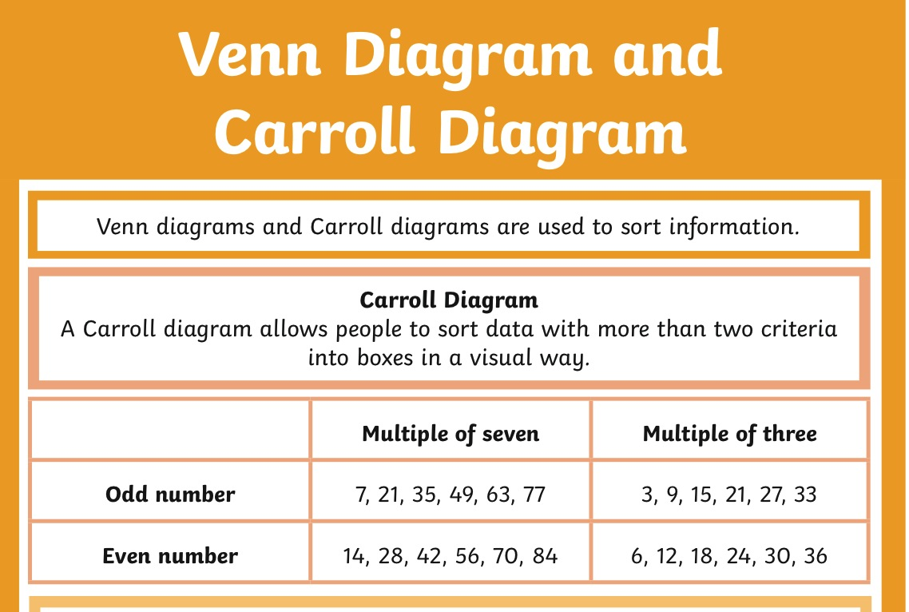

Slide 4


