Slide 1
Weight
N
- MATHS TOPICS KS2 -

Slide 2
Weight
Things to think about:
What sort of things do we weigh?
What do we use to weight things?
What units do we use to write the weight of an object?
N
Weight

Slide 3
Weight
To weigh things, we use:
Grams (g)
The word ‘kilo’ means, ‘1000’.
How many grams do you think there are in a kilogram?
Kilograms (kg)
1000g = 1 kg
N
Weight

Slide 4
Weight
Which is heavier?
Which is heavier – a gram or a kilogram?
kg
g
N
Weight

Slide 6
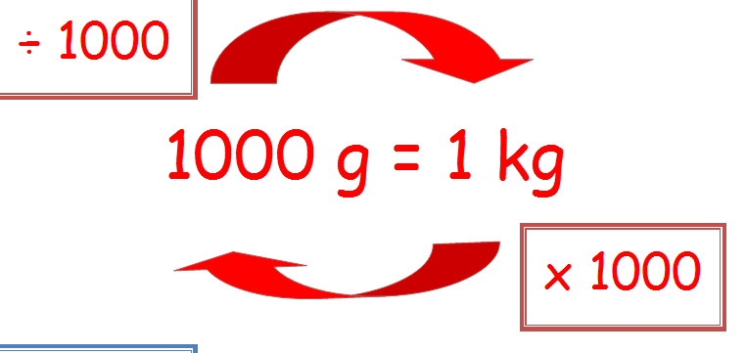
Weight
Units:
To convert from g to kg, we divide by 1000.
To convert from kg to g, we multiply by 1000.
There are 500g in half a kg.
There are 1000g in 1kg.
There are 250g in a quarter of a kg..
N
Weight

Slide 7
Weight
Units:
Watch this video on weight:
https://www.bbc.co.uk/bitesize/clips/zbvgkqt
Now watch this video:
https://www.bbc.co.uk/teach/class-clips-video/maths-ks2-using-grams-and-kilograms/zm7tf4j
N
Weight

Slide 8


How many grams in total?
500g
1kg 500 g
500g
500g
What other way can I write this?
1 kg

Slide 9

What do I have in total?
3 Kg
What other way can I write this?
KG
3kg 500g

Slide 10
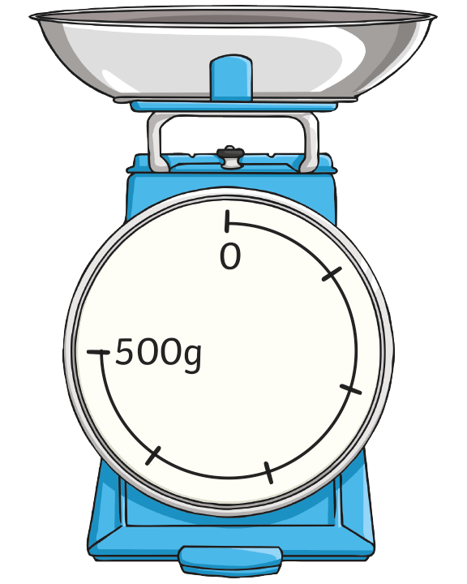
Measure Using Grams or Kilograms
Intervals on Scales
What is each interval worth?
What mass is shown on
these scales?
Show where 200g would be on these scales.

Slide 11
Answers
What is each interval worth?
There are 5 marks between 0 and 500.
500 ÷ 5 = 100.
Each mark is worth 100g.
What weight is shown on these scales?
The pointer is after the fourth mark.
Each mark is 100g. The pointer shows
4 × 100g, or 400g.
Show where 200g would be on
these scales.
Each mark is 100g. 200 ÷ 100 = 2, so 200g would be after the second interval.

Slide 12
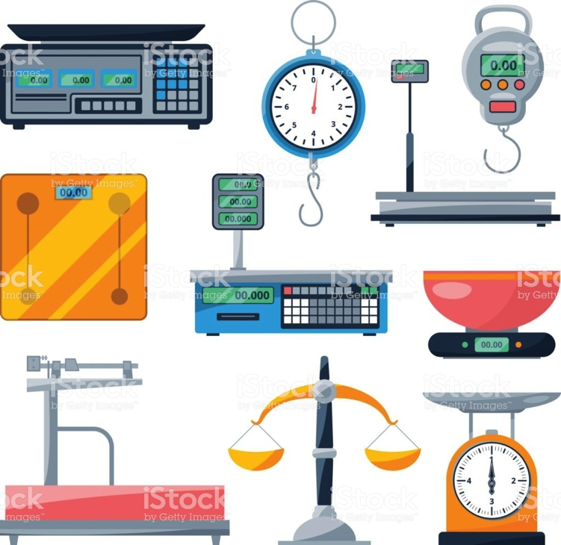
Weight
Scales
There are different types of scales that we can use to measure weight.
Have you seen any of these before?
N
Weight

Slide 13
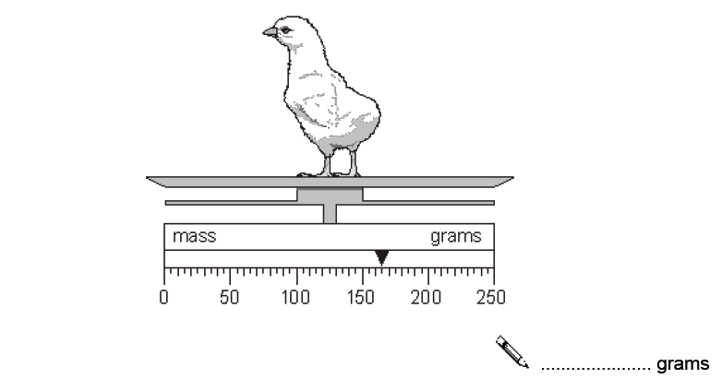
Weight
Example 1:
What weight is this chick?
165g
N
Weight

Slide 14
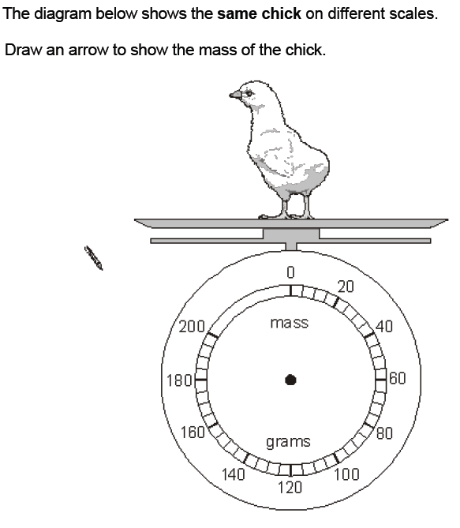
Weight
Example 2:
This is the same chick on different scales. Draw an arrow to show its weight.
N
Weight

Slide 15
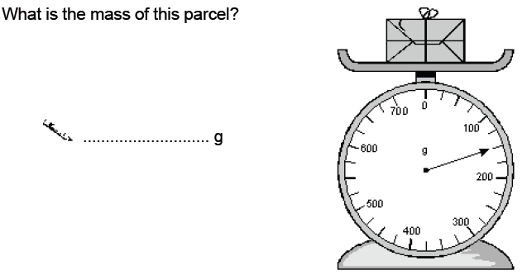
Weight
Example 3:
What weight is this parcel?
150
N
Weight

Slide 16
Weight
Practise reading scales:
Practise reading scales using this game:
https://www.ictgames.com/mobilePage/mostlyPostie/index.htm l
N
Weight

