Slide 1
Measuring Length
N
- MATHS TOPICS KS2 -

Slide 2
Length
Units.
Centimetres (cm)
Units of Length
Millimetres (mm)
Metres (m)
Kilometres (Km)
N
length

Slide 3
Length
Units
How many mm in a cm?
10 mm
100 cm
How many cm in a m?
How many m in a km?
1000 cm
N
Length

Slide 4
Length
Units
50 cm
How many cm in ½ m?
500 m
How many m in ½ km?
250 m
How many m in ¼ km?
N
Length

Slide 5
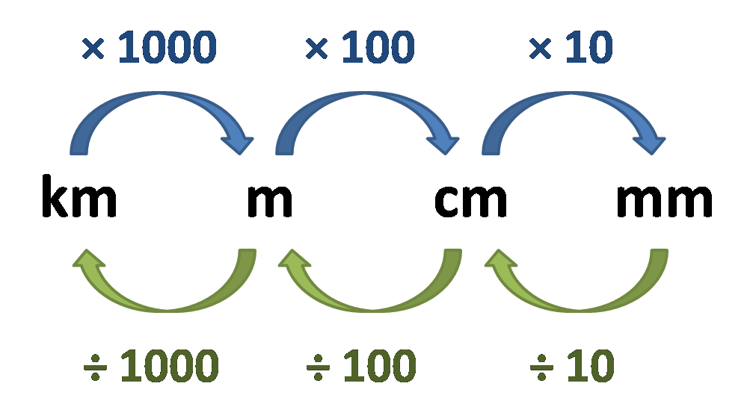
Length
Units:
Examples:
2 km = 2000m
50 mm = 5 cm
7500 m = 7 ½ km
N
Length

Slide 6
Convert: mm to cm
X 10
How many mm in 1 cm?
10
in 2 cm?
20
in 10 cm?
100
in 50cm?
500

Slide 7
Convert: cm to m
X 100
How many cm in 1 m?
100
in 2 m?
200
in 10 m?
1000
in 50 m?
5000

Slide 8
Convert: m to km
X 1000
How many m in 1 km?
1000
in 2 km?
2000
in 10 km?
10,000
in 50 km?
50,000

Slide 9
Convert: cm to mm
÷ 10
How many cm in 10mm?
1
in 20 mm?
2
in 100 mm?
10
in 500 mm?
50

Slide 10
Convert: m to cm
÷ 100
How many m in 100 cm?
1
in 200 cm?
2
in 1000 cm?
10
in 5000 cm?
50

Slide 11
Convert: km to m
÷ 1000
How many km in 1000 m?
1
in 2000m?
2
in 10,000 m?
10
in 50,000 m?
50

Slide 12
Weight
Units:
Watch this video on length:
https://www.bbc.co.uk/bitesize/clips/z8487ty
N
Length

Slide 13
I can measure length and convert lengths
Which is longer?
1m or 200 cm?
2.5 m or 300cm?
50mm or 4 cm?
1km or 1000m?
50,000m or 500 km?
200cm
300cm
50mm
the same!
500km

Slide 14
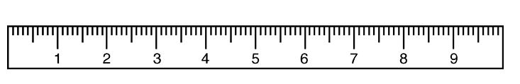
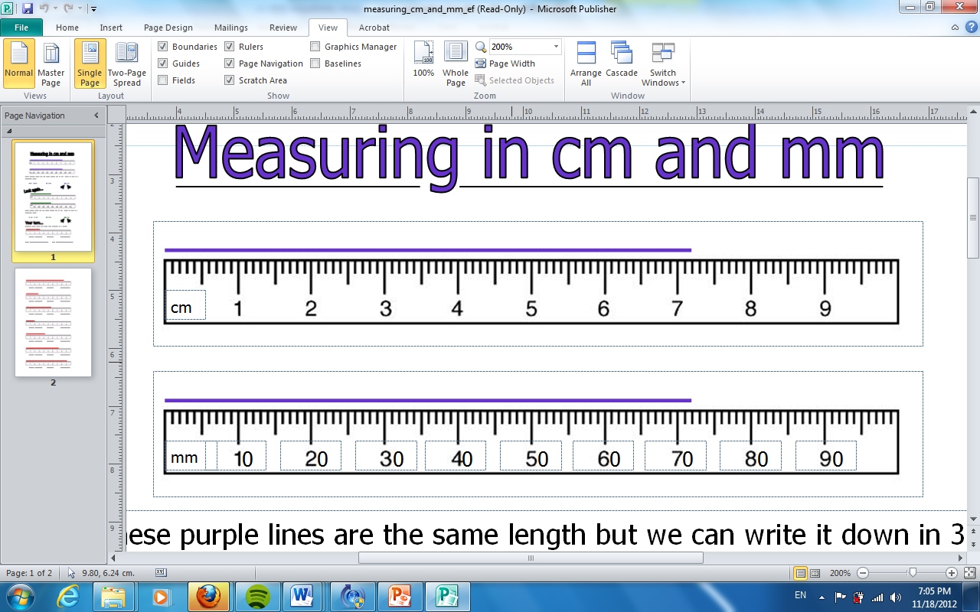
Measuring in centimetres (cm)
cm
Measuring in millimetres (mm)

Slide 15
cm
How long is the line?
___ cm ___mm

Slide 16
How many millimetres?
___ mm
Can you write that in centimetres?

Slide 17
7cm 2mm 72mm
7.2cm
7cm 2mm

Slide 18
cm
How many cm?
5.5cm

Slide 19
How many cm?
8.9cm

Slide 20
cm
How many cm?
3.3cm

Slide 21
Length
Games:
Practise reading a ruler using this game:
https://www.topmarks.co.uk/maths-games/measuring-in-cm
Have fun measuring length and weight:
http://flash.topmarks.co.uk/4769
N
Length

