Slide 1
Measuring Length
N
- MATHS TOPICS KS2 -

Slide 2
Length
Units.
Centimetres (cm)
The prefix ‘cent’ means 100; think of century (100 years!)
Metres (m)
100cm = 1 m
N
length

Slide 3
Length
Things to think about:
What equipment do we use to help us to measure?
What sort of things do we measure?
N
Length

Slide 4
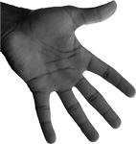

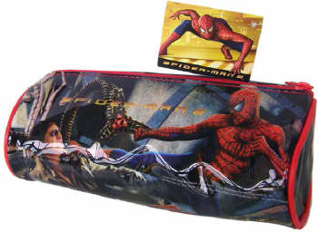
Length
What units would you use to measure these items?
Centimetres
N
Length

Slide 5
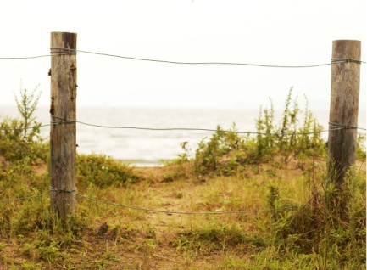
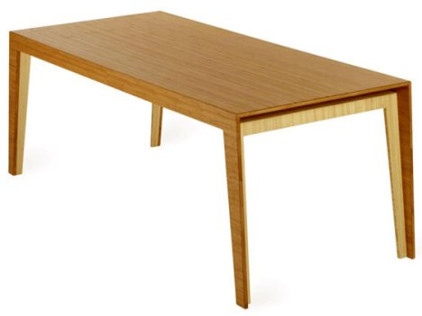
Length
What units would you use to measure these items?
Metres
N
Length

Slide 6
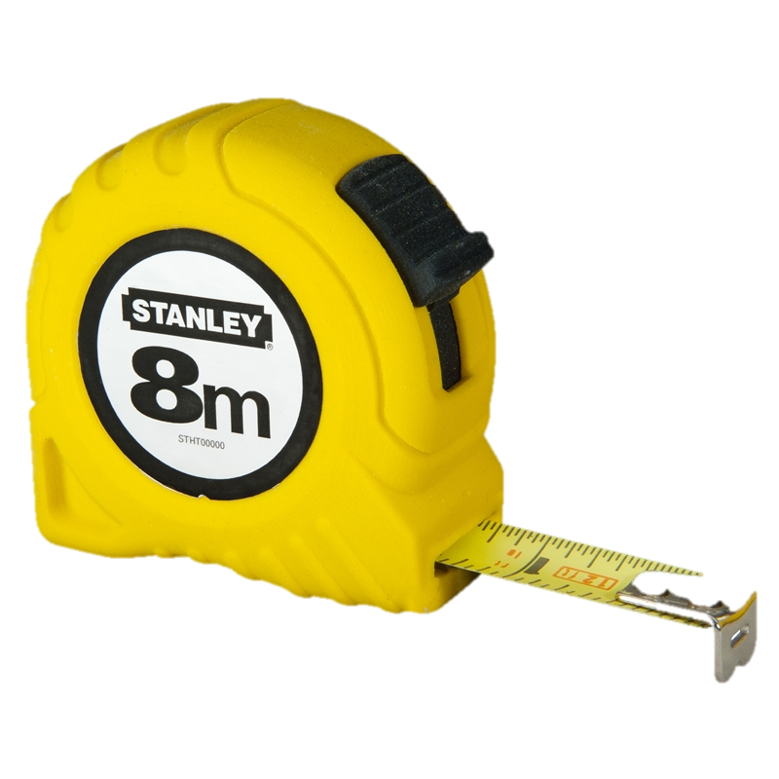
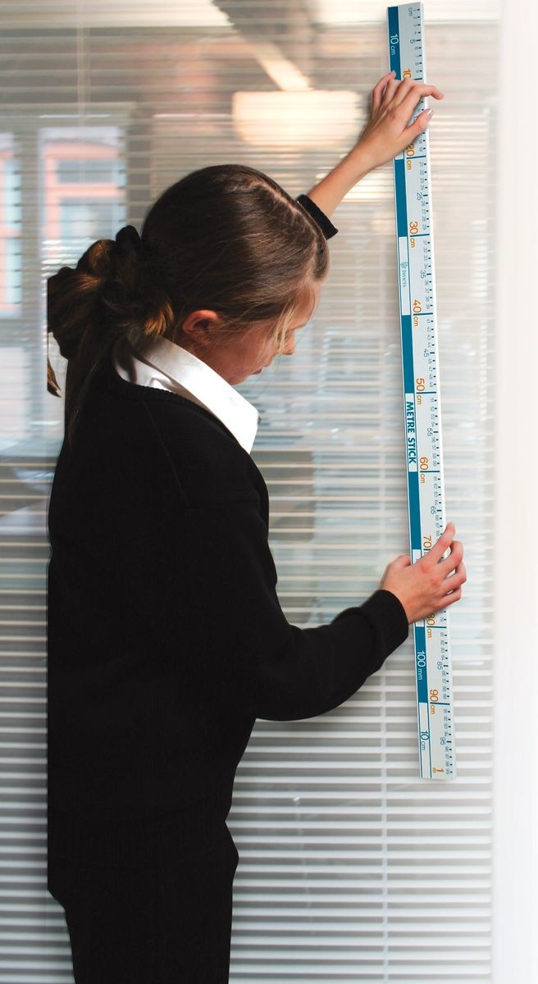
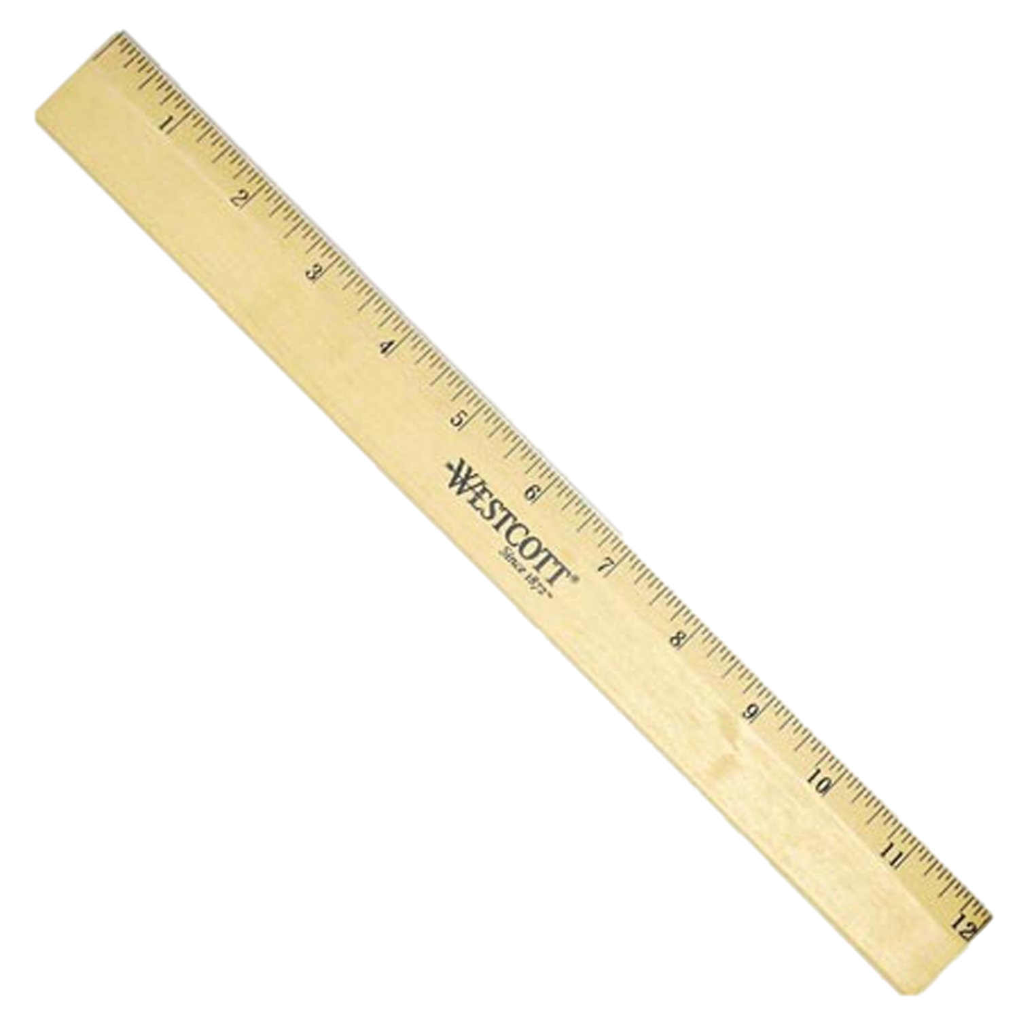
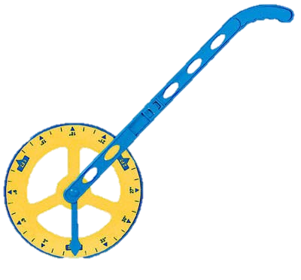
Length
Equipment:
Can you name each piece of measuring equipment and their units?
Ruler
Units = centimetres
Measuring tape
Units= m & cm
Metre stick
Units = metres
Trundle wheel
Units = metres
N
Length

Slide 7
Length
Units
How many centimetres will there be in ½ metre?
50 cm
100 ÷ 2 =
25 cm
How many centimetres will there be in ¼ metre?
100 ÷ 4 =
How many centimetres will there be in ¾ metre?
75 cm
100 ÷ 4 X 3 =
N
Length

Slide 8
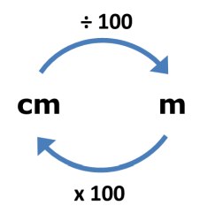
Length
Units:
To convert from cm to m, we divide by 100.
To convert from m to cm, we multiply by 100.
Examples:
400 cm = 4 m
2m = 0.2 cm
N
Length

Slide 9
Length
Units:
Your turn:
How many m in 300 cm?
How many cm in 50m?
How many cm in 2 ½ m?
3 m
5000 cm
250 cm
N
Length

Slide 10
Weight
Units:
Watch this video on length:
https://www.bbc.co.uk/bitesize/clips/z8487ty
N
Length

Slide 11

Length
Estimating Length:
Estimating involves taking an ‘educated guess. When you are asked to ‘estimate’ the length of an object, you should use your knowledge of cm and m to ‘guess’ what length it will be.
Example 1
0m
1m
Estimate the width of this television in centimetres.
There are 100cm in 1m.
N
Length

Slide 12
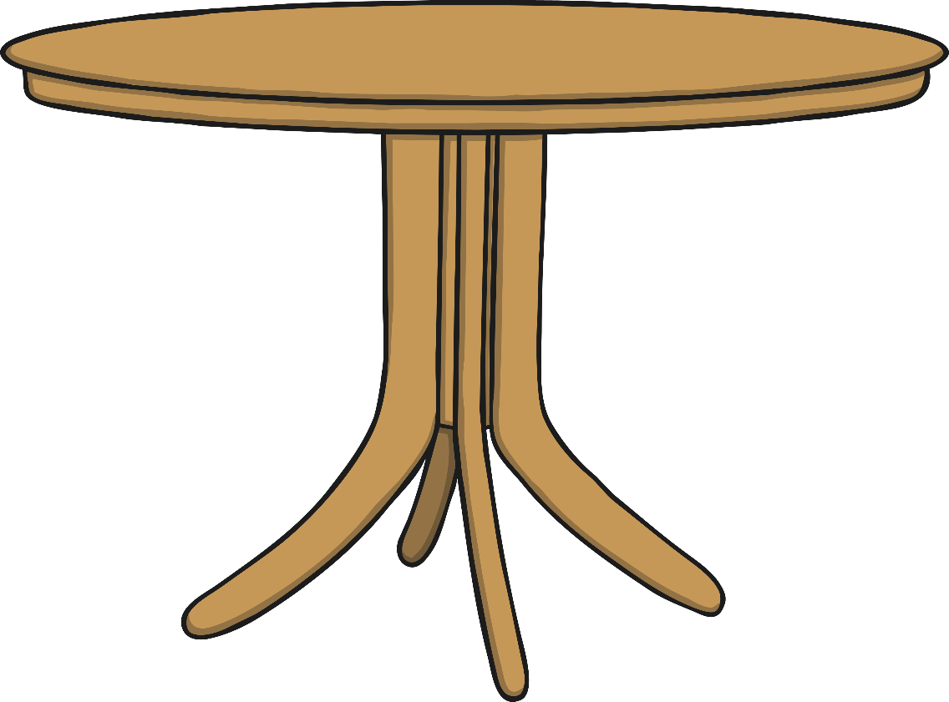
Example 2:
Estimate the length of this table in centimetres.
1m
0m
There is no ‘right’ answer when you estimate but try to get it as close to the actual length as possible.

Slide 13
Length
Games:
Practise reading a ruler using this game:
https://www.topmarks.co.uk/maths-games/measuring-in-cm
Have fun measuring length and weight:
http://flash.topmarks.co.uk/4769
N
Length

